Slide 1
“I Have a Bunch of Data – Now What?”
Data Screening, Exploring and Clean-Up
Melinda K. Higgins, Ph.D.
25 & 26 September 2008

Slide 2
Outline
Descriptive Statistics (univariate & bi-variate)
  Measures of Centrality
  Measures of Variability
  Distributions & Transformations
  Tests of Normality
  Outliers
  Missing Data
  Correlations
Overall Flow Charts
Potential Statistical Analyses (Decision Tree)
Contact Info

Slide 3
A Few Initial Considerations
GROUPS – If data is to be evaluated by group – you will want to evaluate the descriptive statistics BY group (e.g. the data might not be skewed overall, but one group may be by itself) – may or may not want to transform.
LONGITUDINAL DATA – If variables were measured over time, you will need to consider all the time points (e.g. you would NOT want to transform one time point and not the others)
MULTIVARIATE MEASURES – additional screening measures in bi-variate/multivariate combinations (multicollinearity, influential cases, leverage, Mahalonobis distance) – not covered in this lecture.

Slide 4
Measures of Central Tendency
Mean = Σ(Xi)/n
Median = 50% Below ≤ Median ≤ 50% Above
  for odd n, Median=middle value(sorted X)
  For even n, Median = average of 2 middle X’s
Trimmed Mean – mean recalculated after deleting _% or _# off top and bottom of sorted data (usually 5% or so)
Mode – number(s) repeated the most

Slide 5
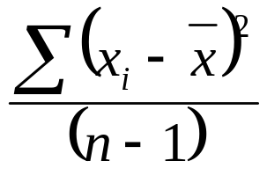
Measures of Variance
(sample) Variance = sums of squares of deviation from mean/(n-1)
(sample) Standard Deviation = sqrt(variance)
Range = max(X) – min(X)
IQR – Interquartile Range = 75th Percentile(X) – 25th Percentile (X)

Slide 6
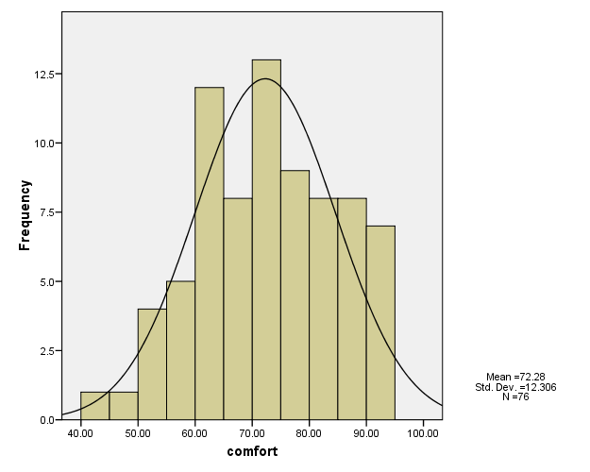
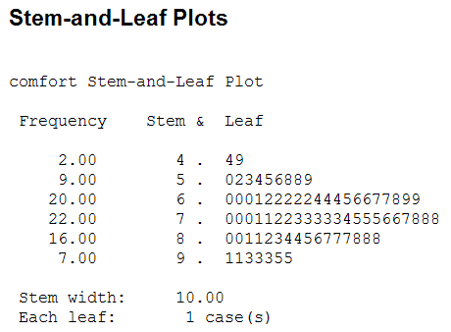
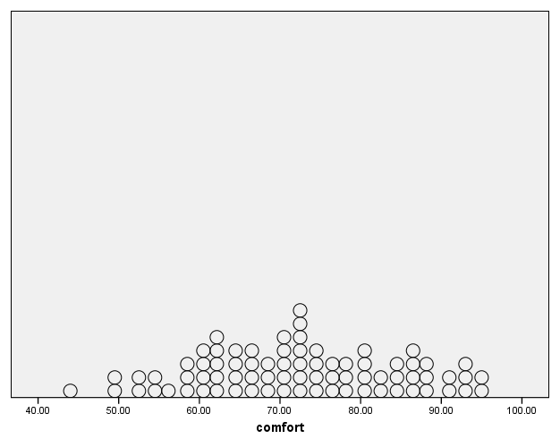
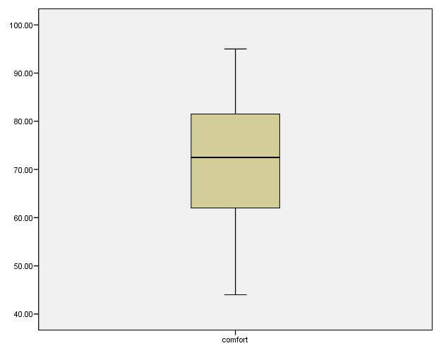
Distributions
Stem and Leaf
Dot plot
Histogram
Box plot

Slide 7
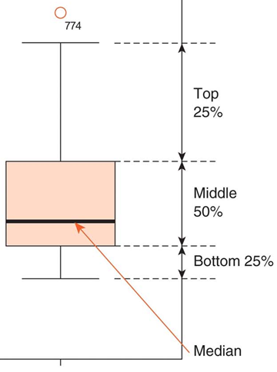
Boxplots (as Defined in SPSS)
A boxplot shows the five statistics (minimum, first quartile, median, third quartile, and maximum). It is useful for displaying the distribution of a scale variable and pinpointing outliers.
The boundaries of the box are “Tukey’s hinges.” The median is identified by a line inside the box. The length of the box is the interquartile range (IQR) computed from Tukey’s hinges [i.e. 25th and 75th percentiles].
Outliers. Cases with values that are between 1.5 and 3 box lengths (box length=IQR) from either end of the box (“o”). Extremes. Cases with values more than 3 box lengths from either end of the box (“*”).
Whiskers at the ends of the box show the distance from the end of the box to the largest and smallest observed values that are less than 1.5 box lengths from either end of the box.

Slide 8
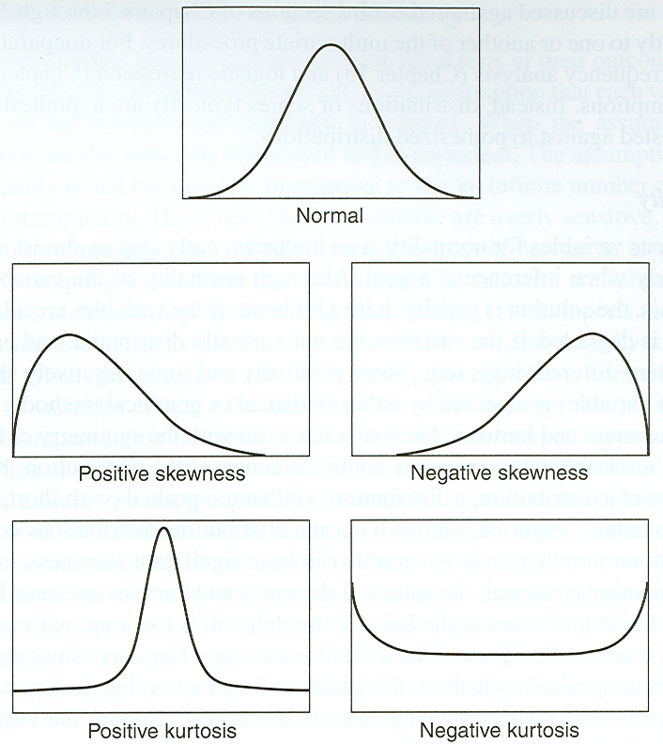
Distributions (cont’d) –
Skewness and Kurtosis
Skewness and Kurtosis are the two most commonly used measures to evaluate deviations from normality.
Skewness measures the extent to which the distribution is not symmetric.
Kurtosis measure the extent to which the distribution is more “pointed/narrow” or “flatter/wider” than the normal distribution.

Slide 9
Statistical Test: Skewness & Kurtosis
Zs = (S_skew-0)/SE_skew
  S_skew = Skewness measure
  SE_skew is the std. error of skewness
Zk = (S_kurt-0)/SE_kurt
  S_kurt = Kurtosis measure
  SE_kurt is the std. error of kurtosis
Zs or Zk values > 1.96 are significant at 0.05 sig. level
Zs or Zk values > 2.58 are significant at 0.01 sig. level
Zs or Zk values > 3.29 are significant at 0.001 sig. level

Slide 10
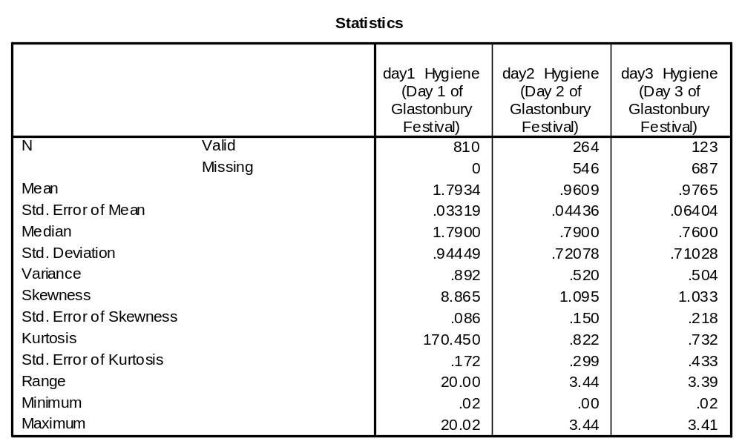
Zs=103.08 Zs=7.3
Zk=990.98 Zk=2.7

Slide 11
Additional Tests of Normality
The following 2 tests compare the scores in the sample to a normally distributed set of scores with the same mean and std. deviation. If the test is non-significant (p<0.05) it says that the sample distribution is not significantly different from a normal population.
  Kolmogorov-Smirov
  Shapiro-Wilk
[NOTE: With larger sample sizes, these tests will be significant for small deviations from normality – use graphics/visual inspection.]

Slide 12
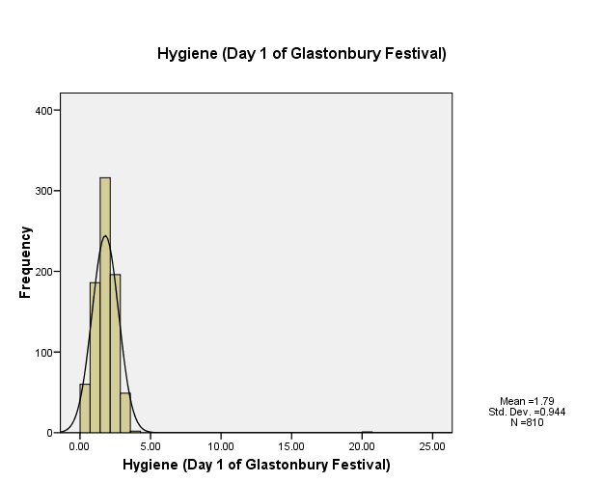
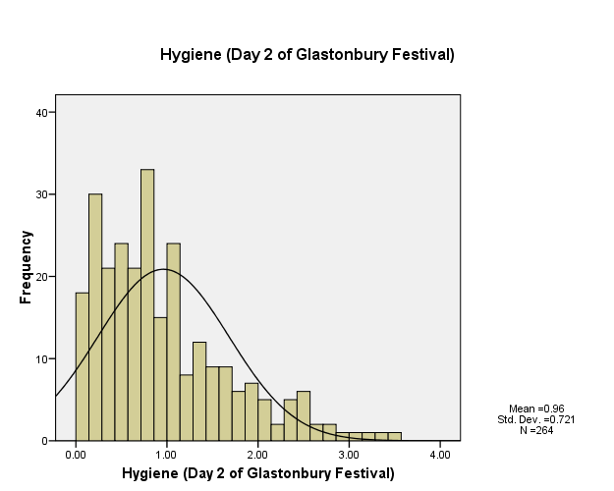
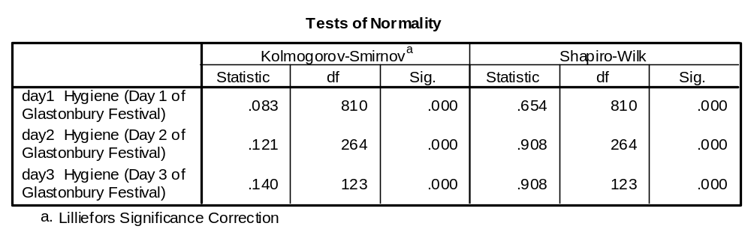
SPSS – Analyze/Explore/Normality Plots with Tests

Slide 13
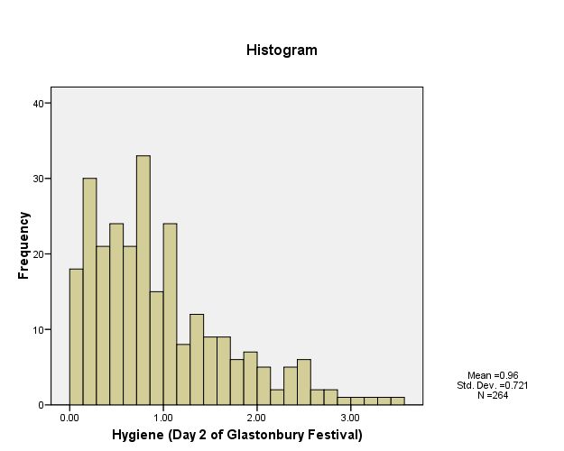
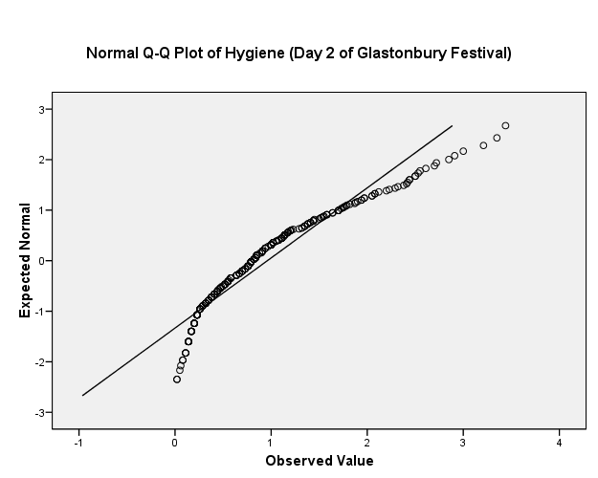
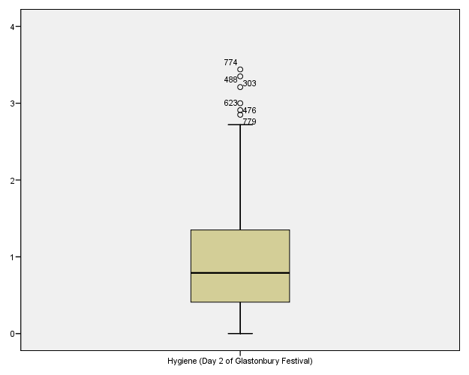
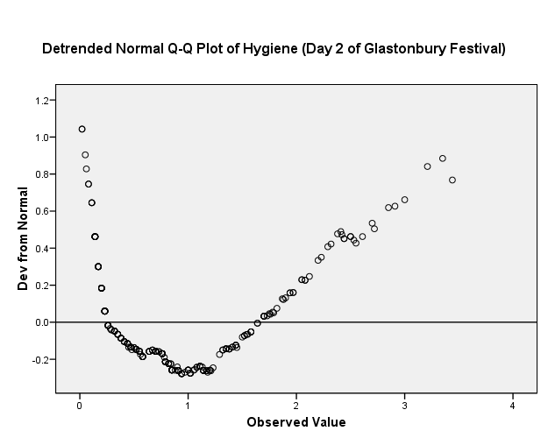
Normal Probability Plots

Slide 14
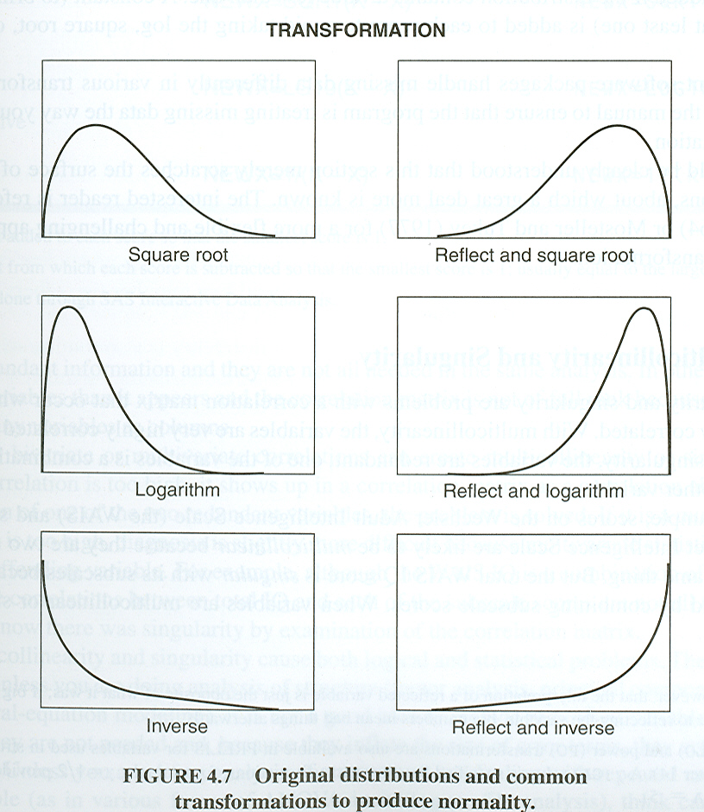
Transformations
SPSS COMPUTE and/or SAS Data Procedure
Moderate – positive skewness
NEWX=SQRT(X)
Substantial positive skewness
NEWX=LG10(X)
(with zero)
NEWX=LG10(X+C)
Severe positive skewness
NEWX=1/X
L-shaped (with zero)
NEWX=1/(X+C)
Moderate negative skewness
NEWX=SQRT(K-X)
Substantial negative skewness
NEWX=LG10(K-X)
Severe negative skewness (J-shaped)
NEWX=1/(K-X)
C = constant added so smallest score is 1
K = constant from which each score is subtracted
so smallest score is 1.

Slide 15
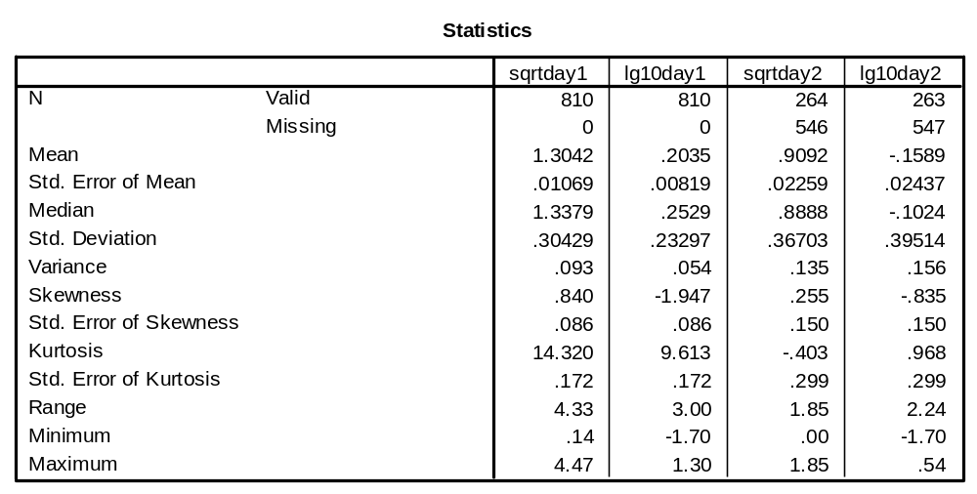
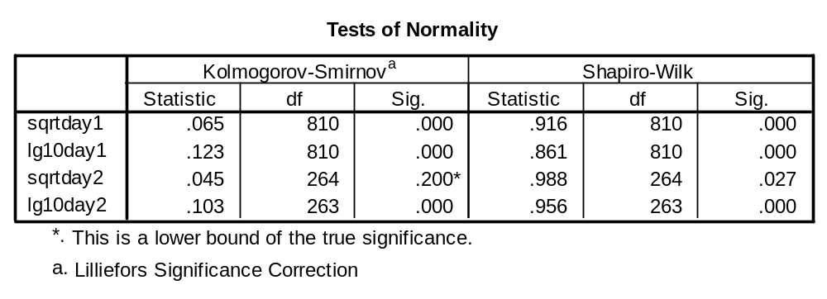

Slide 16
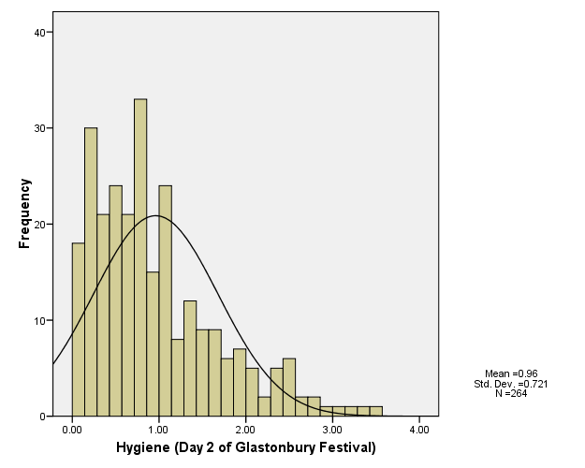
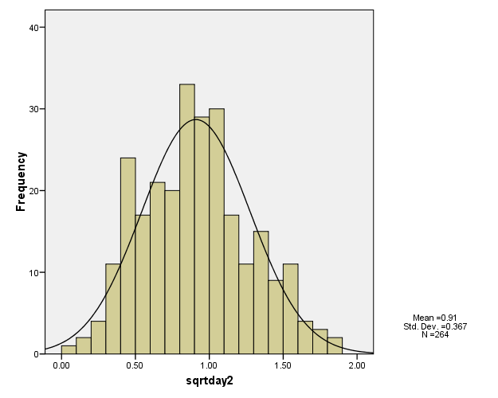
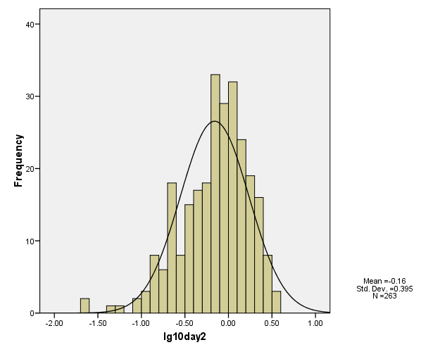
Original
LG10
SQRT

Slide 17
Outliers
Review histograms and boxplots and look for extreme values
Investigate values
  is it “real?”
  can it be corrected?
  Should it be deleted (or left out of analyses)?
  [consider clinical reasons; procedural reasons]
Calculate z-scores (next page) and review amount of outliers
Is there a pattern? (compare outliers to non-outliers)

Slide 18
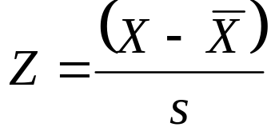
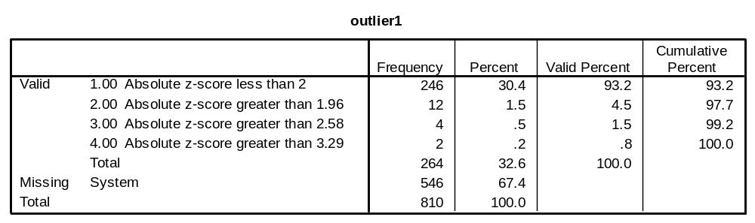
Outliers
DESCRIPTIVES
VARIABLES=day2/SAVE.
COMPUTE outlier1=abs(zday2).
EXECUTE.
RECODE
outlier1 (3.29 thru Highest = 4) (2.58 thru highest = 3) (1.96 thru Highest = 2) (Lowest thru 2 = 1).
EXECUTE.
VALUE LABELS outlier1
1 'Absolute z-score less than 2' 2 'Absolute z-score greater than 1.96' 3 'Absolute z-score greater than 2.58' 4 'Absolute z-score greater than 3.29'.
FREQUENCIES
VARIABLES=outlier1.
/ORDER=ANALYSIS.
/SAVE option creates z-score of “DAY2”

Slide 19
Missing Data
Look for patterns (MVA next slide) and/or reason why missing
Can compare missing data subjects to non-missing data subjects
Can delete/ignore or Impute based on model
Goal is to:
  Minimize Bias
  Maximize utilization of information (data=$$)
  Get good estimates of uncertainty
Censorship (survival analysis – “loss to follow-up”)
[SIDE NOTE: SPSS missing – strings vs. numeric data types]
NOTE: Missing Data Imputation – to be discussed in another lecture

Slide 20
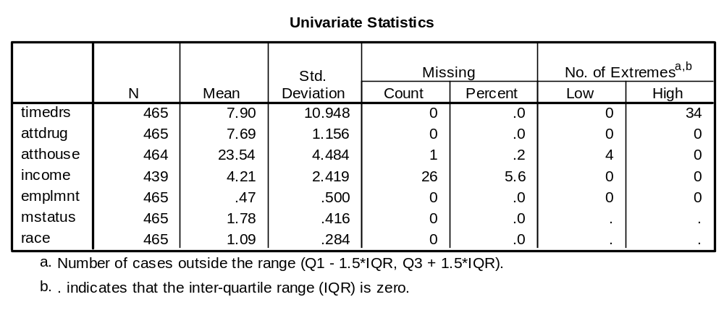
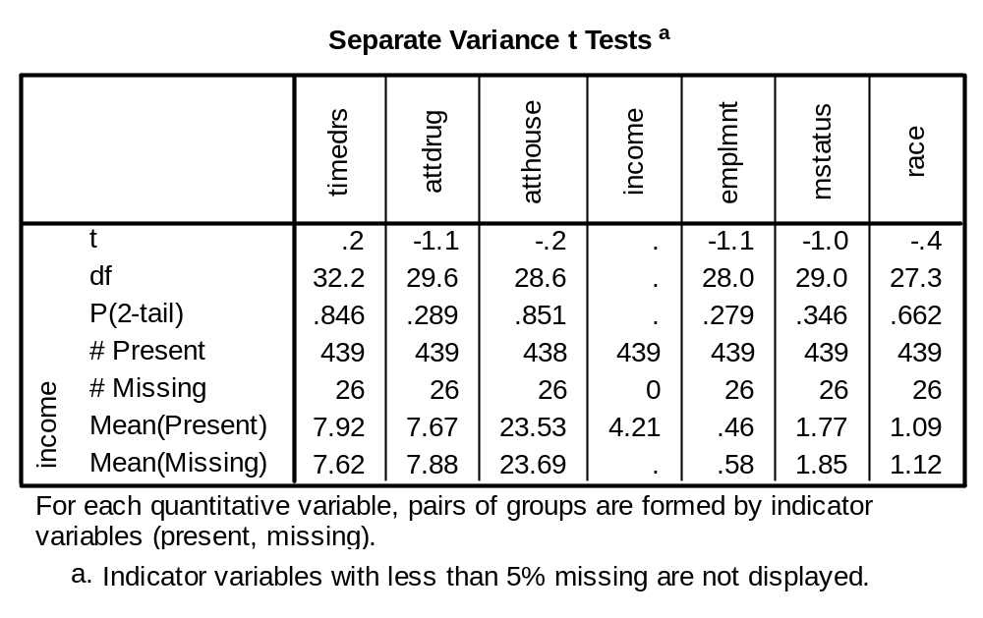
Missing Data
MVA
VARIABLES = timedrs attdrug atthouse income emplmnt mstatus race
/TTEST PROB PERCENT=5
/MPATTERN
/EM.
None are significant (as compared to “INCOME”)

Slide 21
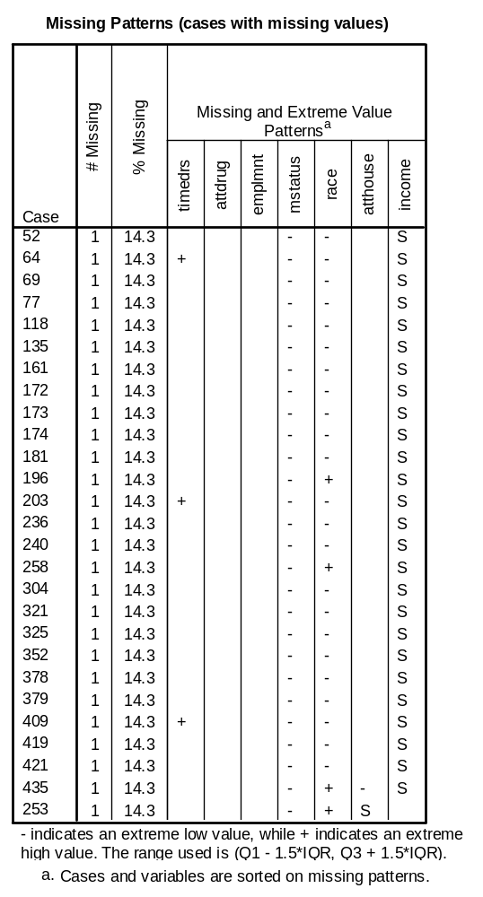

Slide 22
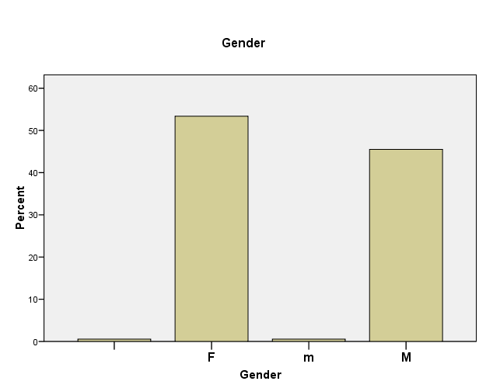
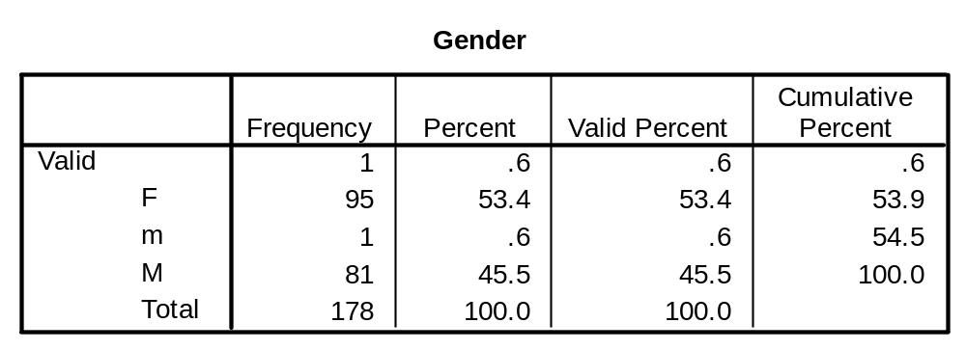
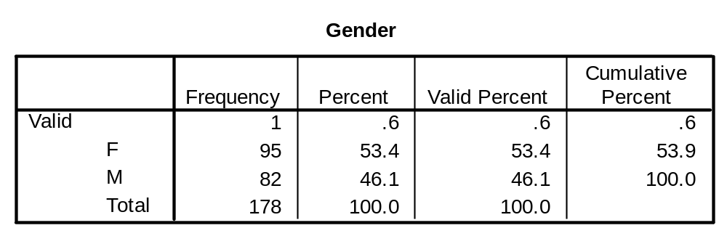
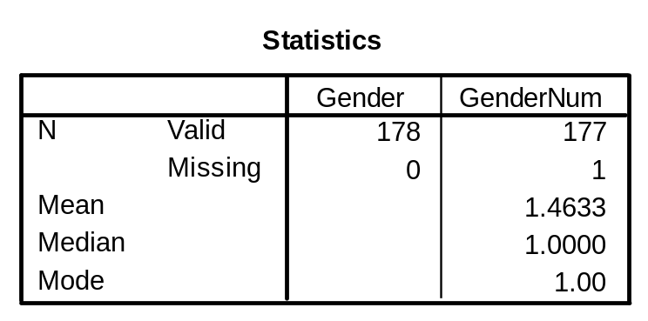
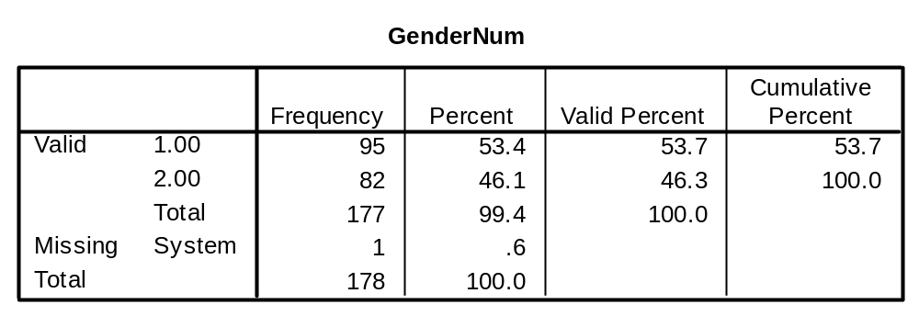
95
81
We fixed “m” but what about the subject with no gender (missing)?
1
1
(string)
(numeric)

Slide 23
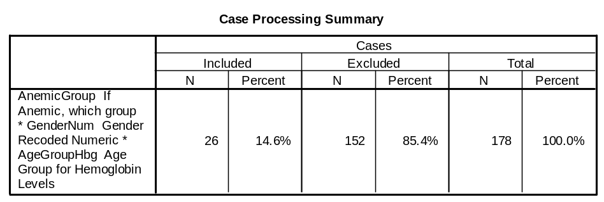
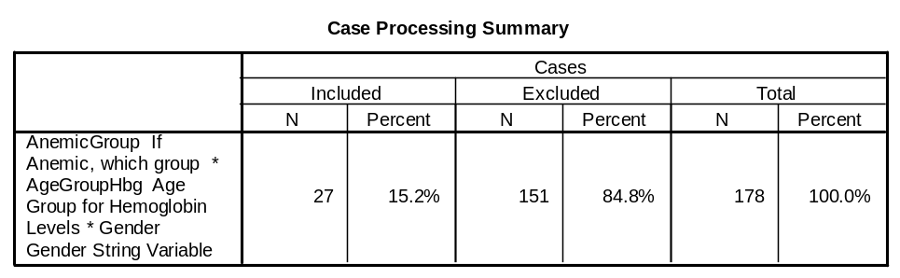
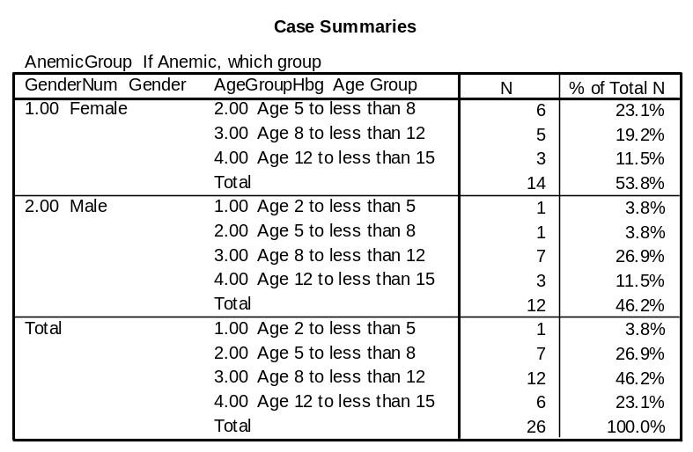
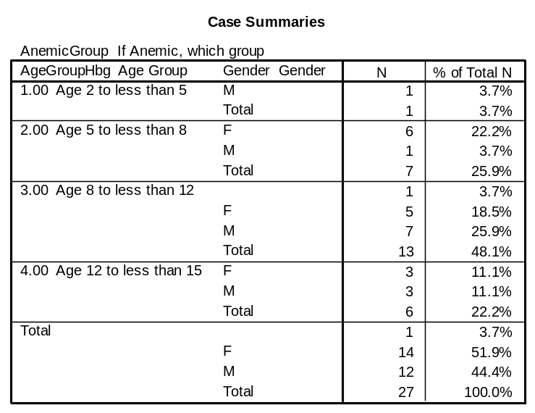
1 case not counted!!
Case correctly counted
This was an interesting case as designation of “anemia” depended only on age (if less than 12), but depends on both age and gender if older than 12. [Our missing gender was 8 yrs old.]

Slide 24
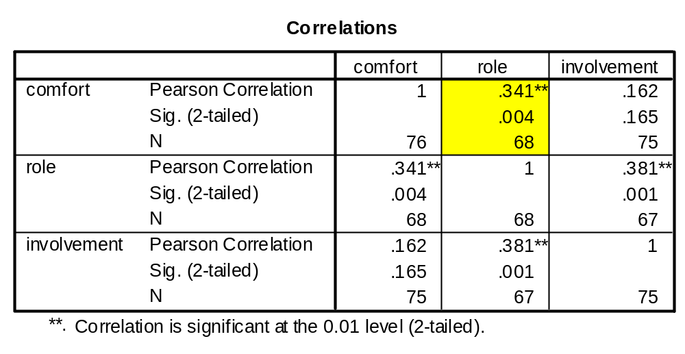
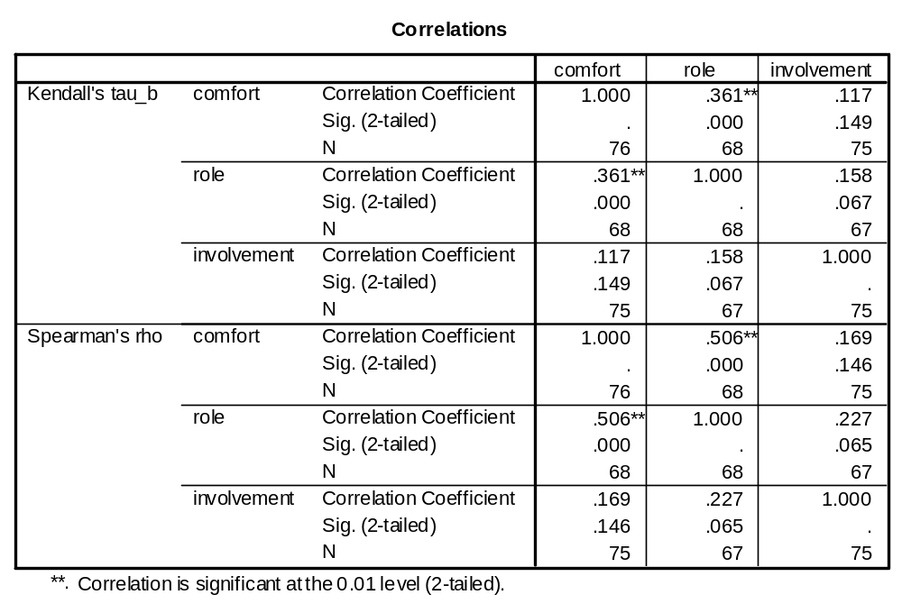
Measures of Correlation
[Parametric] R² and R (X vs Y or X1 vs X2) = Pearson's correlation coefficient
[Non-parametric] Spearman's rho, and Kendall's tau-b – both based on rank (see SPSS Help for further details)

Slide 25
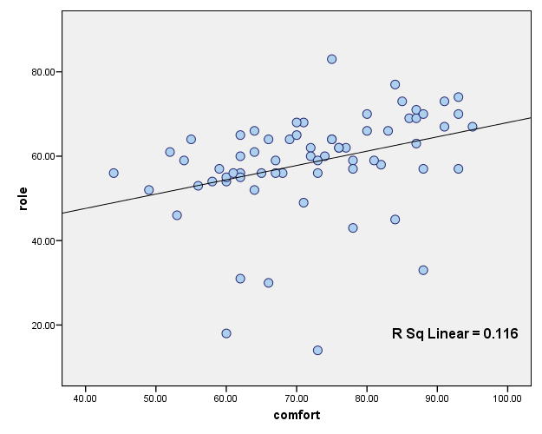
(0.341)² = .116

Slide 26
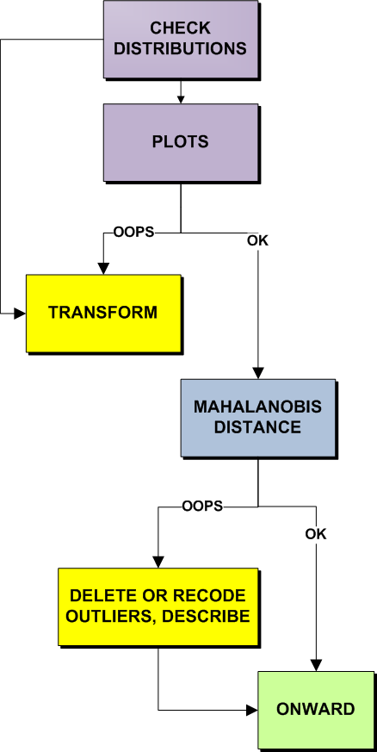
Checklist for Data Screening
Inspect univariate descriptive stats – check for data accuracy/discrepancies
  Out-of-range values
  Plausible means and standard deviations
  Univariate outliers
Evaluate amount and patterns of missing data
Check pairwise plots for nonlinearity and heteroscedasticity [REGRESSION]
Identify and deal with nonnormal variables and univariate outliers
  Check skewness and kurtosis and probability plots
  Perform transforms (if desired)
  Check results of transformation
Identify multivariate outliers [REGRESSION]
Evaluate variables for multicollinearity and singularity [REGRESSION]

Slide 27
What do I do Now? – A Decision Tree for Picking Statistical Methods to Use
Questions to Ask
  Major Research Question?
    Degree of Relationship Among Variables
    Significant Group Difference
    Prediction of Group Membership
    Structure
    Time/Course of Events
  Number & Kind of Dependent Variables
    Single vs Multiple & Discrete vs Continuous
  Number & Kind of Independent Variables
    Single vs Multiple & Discrete vs Continuous
  Covariates? [yes/no]
Decision Tree Yields Analytic Strategy and Goal of Analysis

Slide 28
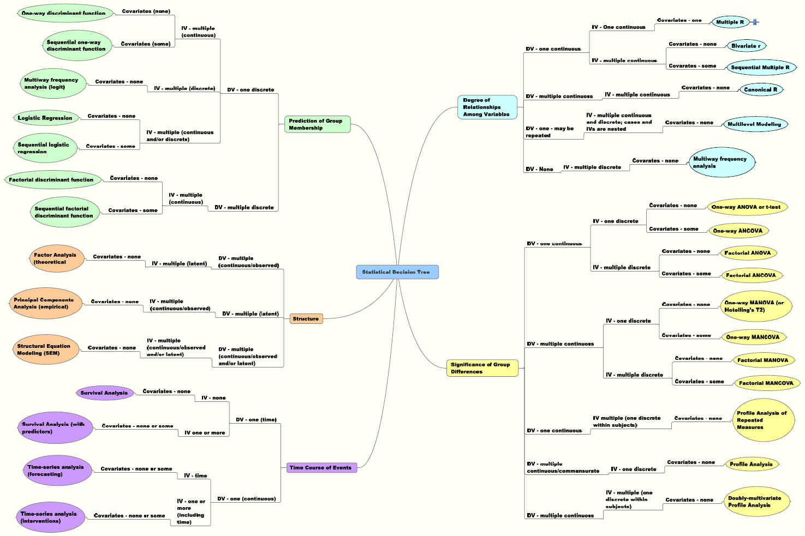
Tabachnick, B.G. and Fidell, L.S. (2007) Using Multivariate Statistics (5th Ed.). New York: Pearson Education, Inc.

Slide 29
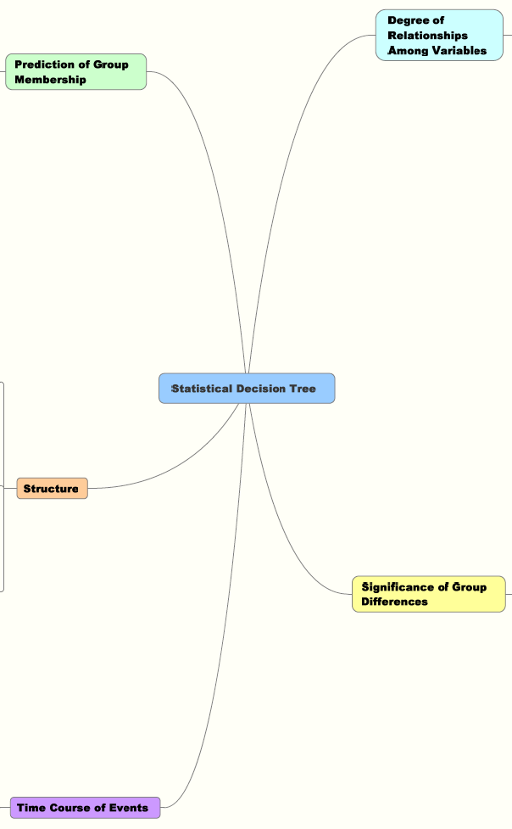

Slide 30
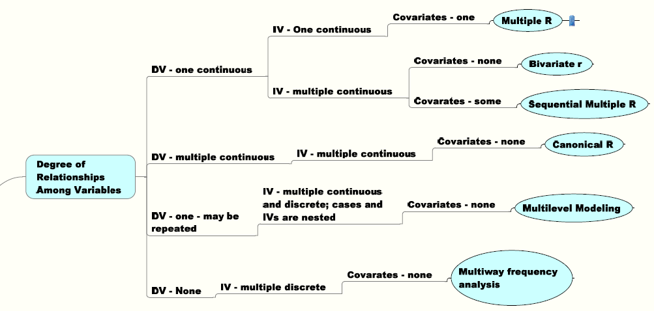

Slide 31
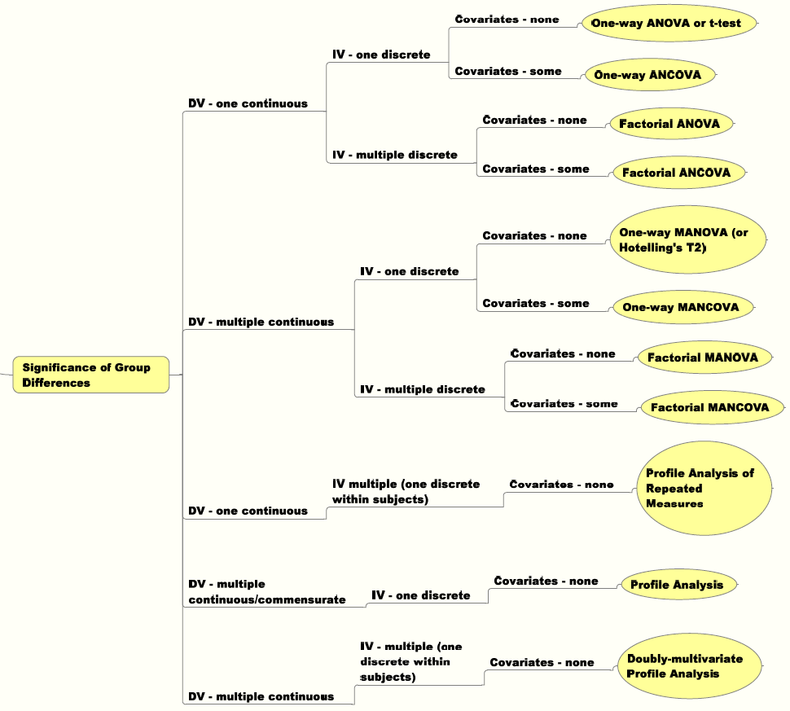

Slide 32
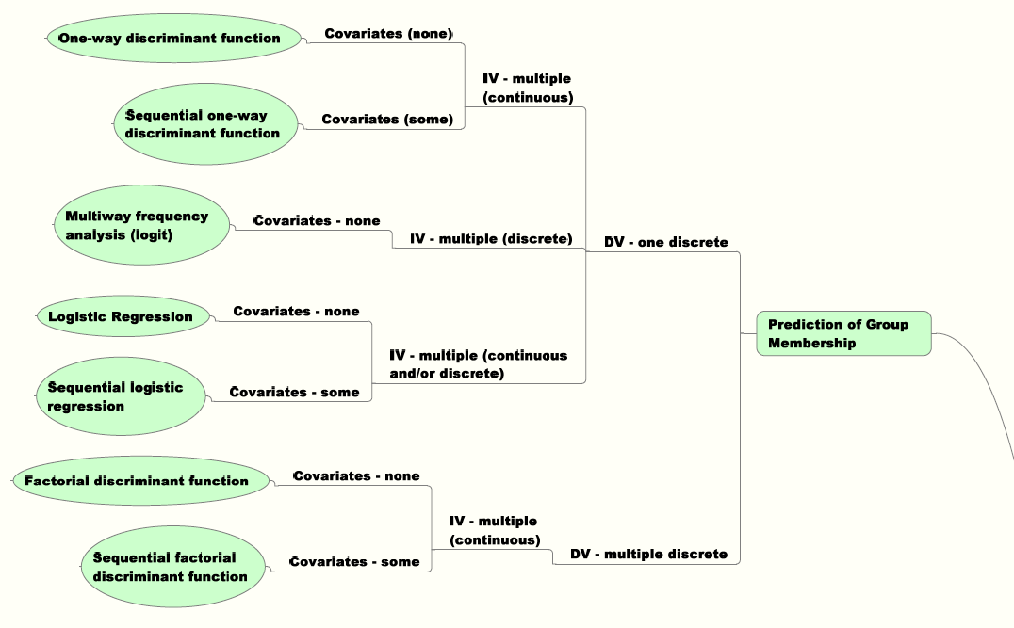

Slide 33
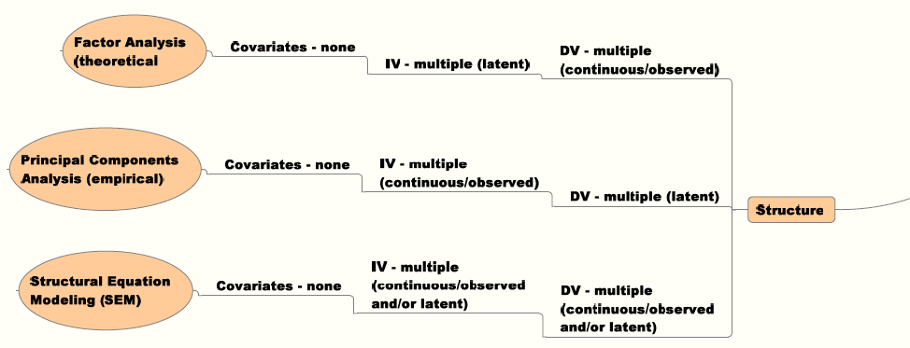

Slide 34
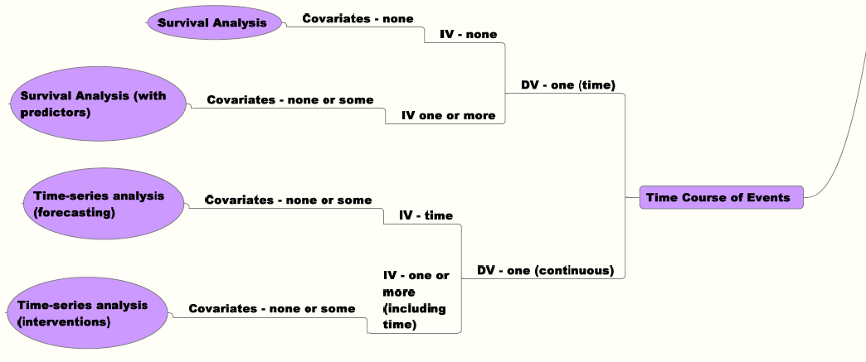

Slide 35
“How to talk to a Statistician”
List of Hypotheses/Aims (end goals)
List of Variables
  Type, Measure (numeric, string, date/time, scales, categorical)
  Independent, covariates, dependent (outcomes)
  Names, Labels and Values [consistency (q1,q2,q3,…, item01,item02,…), length, consider graphics]
Model (hypothesized, general idea – theoretical concerns)
Graphics/figures/tables requested (reports, posters, grants)
POWER – idea on “effect size” (how big a change do you hope to see) – clinical significance, prior results?

Slide 36
VIII. Statistical Resources and Contact Info
SON S:\Shared\Statistics_MKHiggins\website2\index.htm
[updates in process]
  Working to include tip sheets (for SPSS, SAS, and other software), lectures (PPTs and handouts), datasets, other resources and references
  Statistics At Nursing Website: [website being updated] http://www.nursing.emory.edu/pulse/statistics/
  And Blackboard Site (in development) for “Organization: Statistics at School of Nursing”
Contact
    Dr. Melinda Higgins
    Melinda.higgins@emory.edu
    Office: 404-727-5180 / Mobile: 404-434-1785

