Slide 1
Final Project Guidance
2022/12/19
林承賢

Slide 2
Outline
Pass data from command line
Read / Output file
Data structure of Cache
Simulation
Part 2

Slide 3
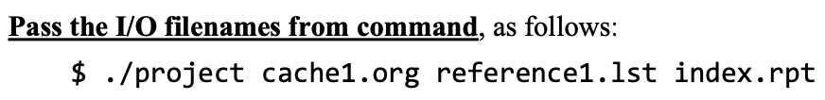
Pass the file name
You can use “argc” and ”argv” to pass the information of command line into your program.

Slide 4
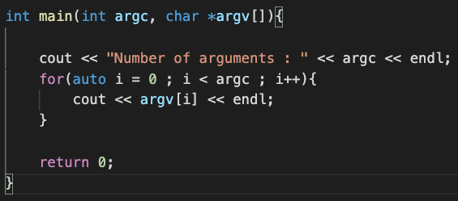
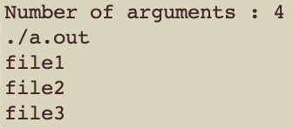
Example : argc , argv
argc : The number of arguments in the command
argv : The array which store all of the arguments
Sample code
Input
Output

Slide 5
Outline
Pass data from command line
Read / Output file
Data structure of Cache
Simulation
Part 2

Slide 6
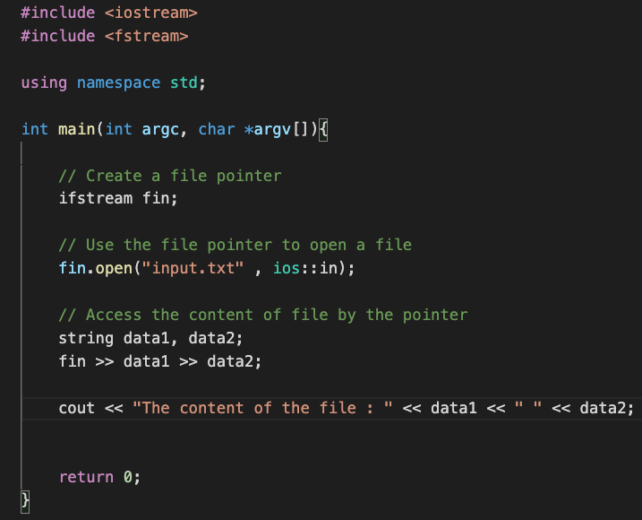

I/O in C++
You can use <fstream> library to read or write a file.
Read example :
input.txt
Output of the program

Slide 7
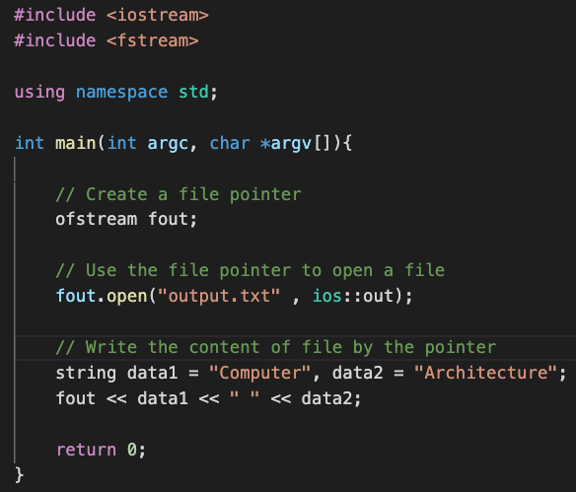
I/O in C++
You can use <fstream> library to read or write a file.
Write example :
output.txt

Slide 8
Outline
Pass data from command line
Read / Output file
Data structure of Cache
Simulation
Part 2

Slide 9
Data structure
You can use
Struct
Class
Array
Vector (STL)
Map / Unorder map (STL)
Queue (STL)

Slide 10
Data structure
Block size : 4 bytes Block size : 8 bytes
1001000
1001001
1001010
1001011
1001100
1001101
1001110
1001111
100100
100101
100110
100111
1001xx
1001xxx

Slide 11
Data structure
Associativity : Number of ways in a set
Cache_sets : Number of sets in a cache
Ways
Cache
Block
Cache
Block
Cache
Block
Set 0
…
Cache
Block
Cache
Block
Cache
Block
Set 1
…
…
…
…
Cache
Block
Cache
Block
…
Cache
Block
Set N

Slide 12
Outline
Pass data from command line
Read / Output file
Data structure of Cache
Simulation
Part 2

Slide 13
Extract the reference
Block size : 8 bytes
Number of set : 16
Indexing policy : LSB
00101010001
Ignore
Indexing bits : Decide which set should this reference visit

Slide 14
Read references
Return hit
Re-reference the block, set the corresponding NRU bit to 0.
Yes
Reference
00000000
00000000
00010000
Return miss.
Check All NRU bits of blocks in set 0 whether there is a block which NRU bit is 1.
10011100
Go to set 0 and check whether “00000000” is in the ways of set 0.
No
00000000
01011000
Yes
No
…
Choose the one which is closest to the head (way 0) as victim.
Reset all NRU bits of set 0 to 1.
Choose the way 0 as the victim.
Put ”00000000” into victim and set the NRU bit of victim to 0.

Slide 15
Outline
Pass data from command line
Read / Output file
Data structure of Cache
Simulation
Part 2

Slide 16
Extract the reference
Block size : 8 bytes
Number of set : 16
Indexing policy : LSB
00101010001
Block size : 8 bytes
Number of set : 16
00101010001
Ignore
Ignore
Indexing bits : 1010
Indexing bits : 0011

Slide 17

How to find proper indexing bits
Exhausted search?
Read the reference paper from p10 to p13?
Attend the 助教課

Slide 18
The method of reference paper
Correlation of two bits : C_{i, j} = min(E_{i,j ,} D_{i,j} ) / max (E_{i,j ,} D_{i,j} )
E_{i,j} : The number of references having the same values at address bits a_{i} and a_{j} .
D_{i,j} : The number of references having different values at address bits a_{i} and a_{j} .
Correlation array
a₇ a₆ a₅ a₄ a₃ a₂ a₁ a₀
C_{2,2} C_{2,3} C_{2,4} C_{2,5} C_{2,6} C_{2,7}
C_{3,2} C_{3,3} C_{3,4} C_{3,5} C_{3,6} C_{3,7}
C_{4,2} C_{4,3} C_{4,4} C_{4,5} C_{4,6} C_{4,7}
C_{5,2} C_{5,3} C_{5,4} C_{5,5} C_{5,6} C_{5,7}
C_{6,2} C_{6,3} C_{6,4} C_{6,5} C_{6,6} C_{6,7}
C_{7,2} C_{7,3} C_{7,4} C_{7,5} C_{7,6} C_{7,7}
0 0 0 0 0 0 0 0
Example : C_{2,3}
E_{2,3} = 4
D_{2,3} = 1
C_{2,3} = 1/4
Example : C_{5,7}
E_{5,7} = 4
D_{5,7} = 1
C_{5,7} = 1/4
0 0 0 1 0 0 0 0
1 0 0 1 1 1 0 0
0 0 0 0 0 0 0 0
0 1 0 1 1 0 0 0
Offset bits

Slide 19
The method of reference paper
Quality measurement : Q_{i} = min(Z_{i ,} O_{i}) / max(Z_{i ,} O_{i})
Z_{i} : The number of references having the value ”0” at address bit a_{i} .
O_{i} : The number of references having the value ”1” at address bit a_{i} .
a₇ a₆ a₅ a₄ a₃ a₂ a₁ a₀
0 0 0 0 0 0 0 0
Example : Q₂
Z₂ = 4
O₂ = 1
Q₂ = 1/4
Example : Q₅
Z₅ = 5
O₅ = 0
Q₅ = 0
0 0 0 1 0 0 0 0
Q₇ | Q₆ | Q₅ | Q₄ | Q₃ | Q₂
1/4 | 1/4 | 0 | 2/3 | 2/3 | 1/4
1 0 0 1 1 1 0 0
0 0 0 0 0 0 0 0
0 1 0 1 1 0 0 0
Offset bits

Slide 20
The method of reference paper
Number of indexing bits : 3
Select the current best quality as indexing bit.
Select a₄ as first indexing bit
Correlation array
Q₇ | Q₆ | Q₅ | Q₄ | Q₃ | Q₂
1/4 | 1/4 | 0 | 2/3 | 2/3 | 1/4
C_{2,2} C_{2,3} C_{2,4} C_{2,5} C_{2,6} C_{2,7}
C_{3,2} C_{3,3} C_{3,4} C_{3,5} C_{3,6} C_{3,7}
C_{4,2} C_{4,3} C_{4,4} C_{4,5} C_{4,6} C_{4,7}
C_{5,2} C_{5,3} C_{5,4} C_{5,5} C_{5,6} C_{5,7}
C_{6,2} C_{6,3} C_{6,4} C_{6,5} C_{6,6} C_{6,7}
C_{7,2} C_{7,3} C_{7,4} C_{7,5} C_{7,6} C_{7,7}
Select a₆ as second indexing bit
x C_{i,4}
Q₇ | Q₆ | Q₅ |  | Q₃ | Q₂
1/4 x C_{7,4} | 1/4 x C_{6,4} | 0 |  | 2/3 x C_{3,4} | 1/4 x C_{2,4}
Select a₃ as third indexing bit
x C_{i,6}
Q₇ |  | Q₅ |  | Q₃ | Q₂
1/4 x C_{7,4} x C_{7,6} |  | 0 |  | 2/3 x C_{3,4} x C_{3,6} | 1/4 x C_{2,4} x C_{2,6}

Slide 21
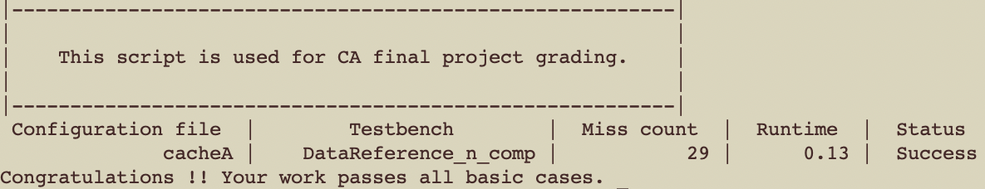
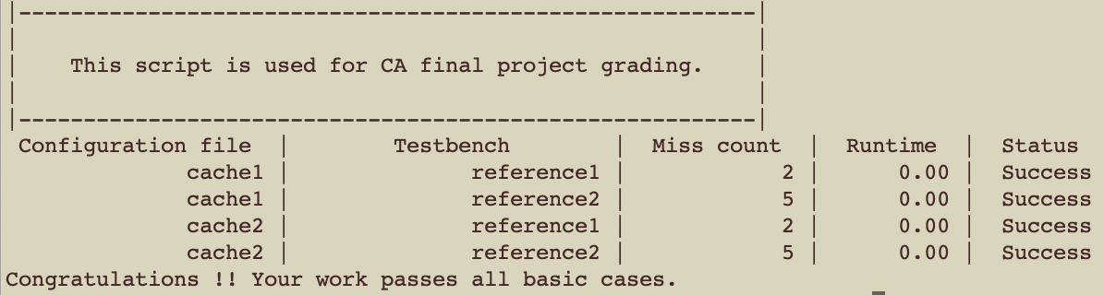
TA’s result of released testcases

