Slide 1
RNE 2024 HW1 Report
許媄香 109000168

Slide 2
Outline
Path Tracking
PID
Pure Pursuit
Stanley
LQR
Path Planning
A Star
RRT Star
Collision Handling

Slide 3
Outline
Path Tracking
PID
Pure Pursuit
Stanley
LQR
Path Planning
A Star
RRT Star
Collision Handling

Slide 4
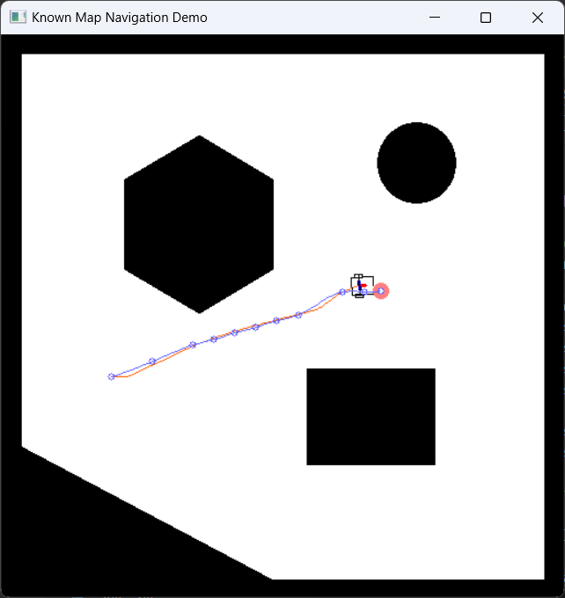
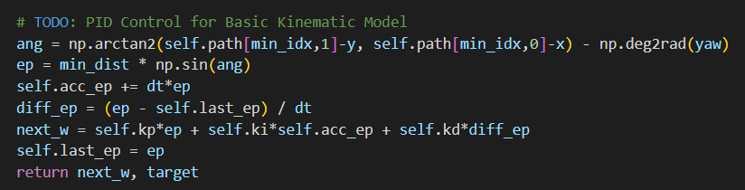
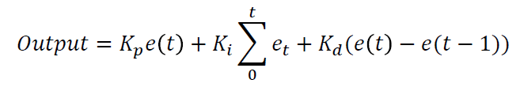
PID – Basic
Here, I simply follow the formula and code given in the slide, but with some modification in ang computation. I subtract the car’s yaw.

Slide 5
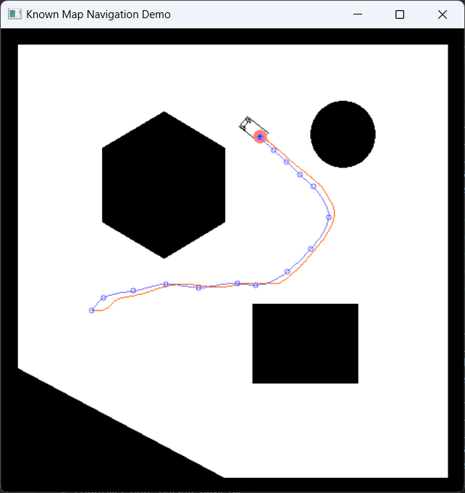
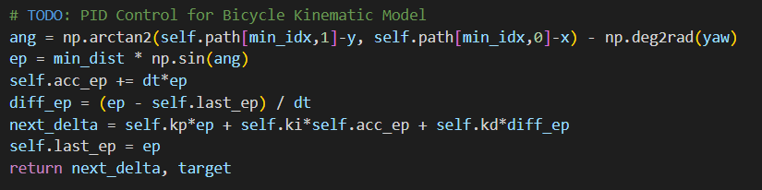
PID – Bicycle
This is exactly the same as basic part.

Slide 6
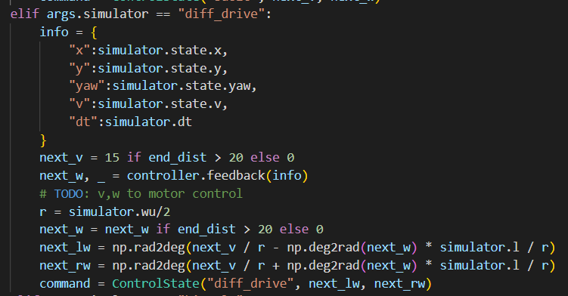
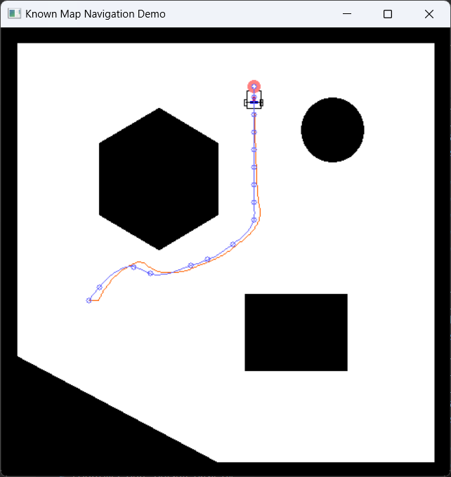
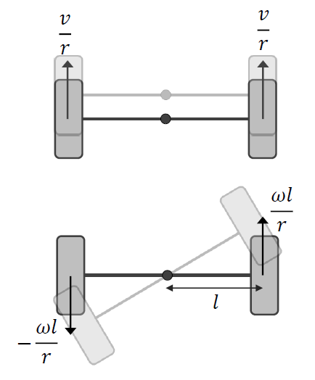
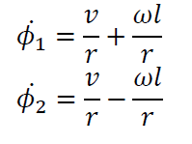
PID – Differential Drive
I converted the formula from the slide into python code where l is the length of the wheel from the center point as shown in the picture below.

Slide 7
Outline
Path Tracking
PID
Pure Pursuit
Stanley
LQR
Path Planning
A Star
RRT Star
Collision Handling

Slide 8
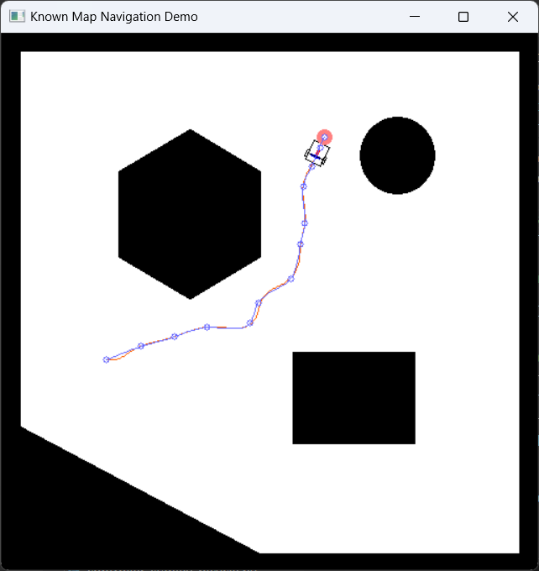
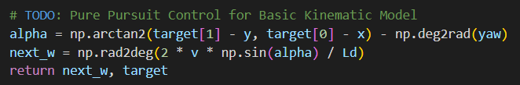
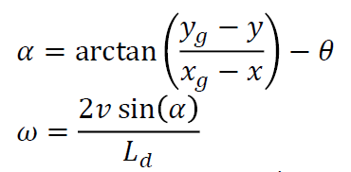
Pure Pursuit – Basic
I converted the formula of alpha and next_w from the slide into python code.

Slide 9
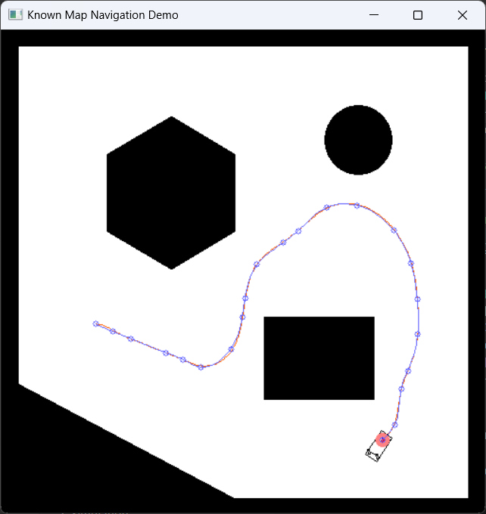
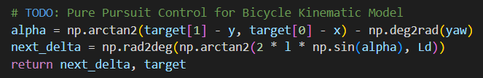
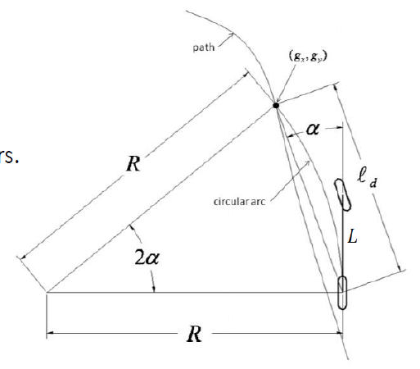
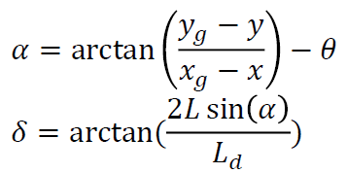
Pure Pursuit – Bicycle
I converted the formula of alpha and next_w from the slide into python code.

Slide 10
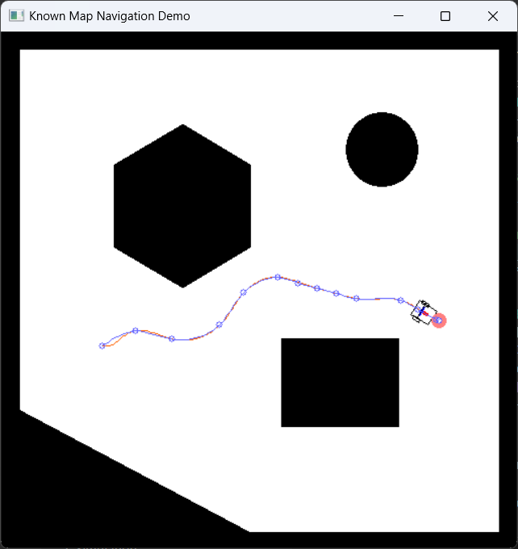
Pure Pursuit – Differential Drive
It uses the same simulator as basic.

Slide 11
Outline
Path Tracking
PID
Pure Pursuit
Stanley
LQR
Path Planning
A Star
RRT Star
Collision Handling

Slide 12
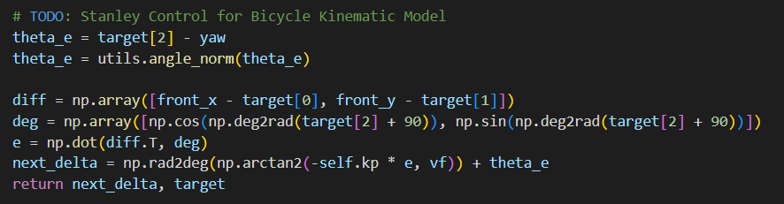
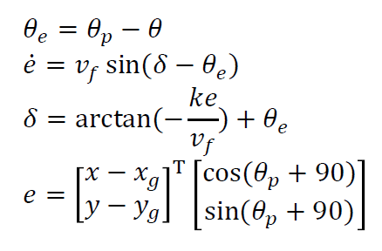
Stanley – Bicycle
I converted the formula of next_delta below from the slide into python code. And normalize the theta_e using the function provided in utils.py.

Slide 13
Outline
Path Tracking
PID
Pure Pursuit
Stanley
LQR
Path Planning
A Star
RRT Star
Collision Handling

Slide 14
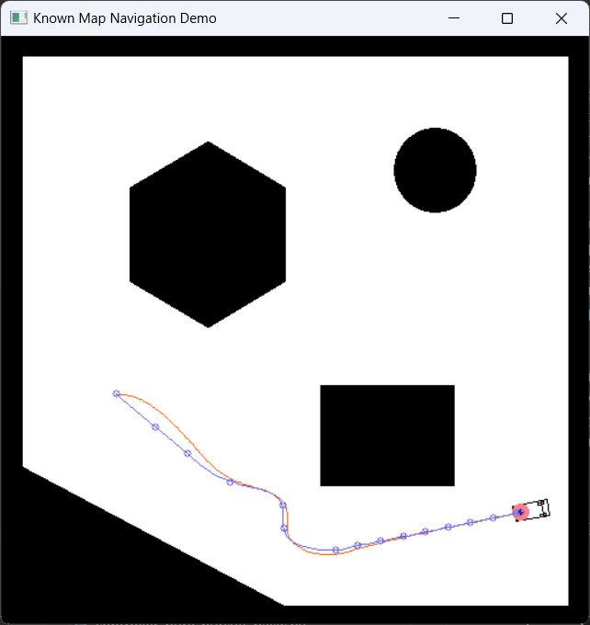
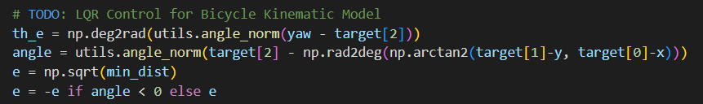
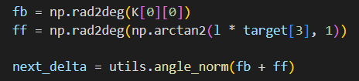
LQR – Bicycle
Since I don’t really understand the explanation in the slide, I refer to a github link to implement it. Basically, I use the formula from the slide and add the code above from the github to get the x matrix. After that, it just worked as we want.

Slide 15
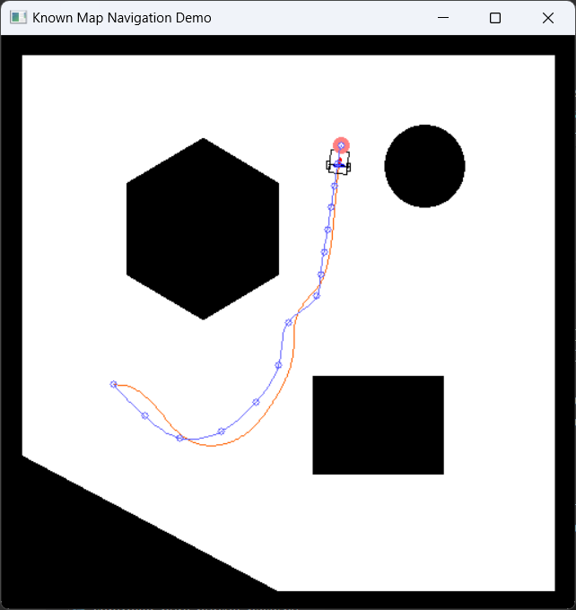
LQR – Basic
It’s similar to the bicycle part, just remove the l (length). And in matrix B we remove the v/l.

Slide 16
Outline
Path Tracking
PID
Pure Pursuit
Stanley
LQR
Path Planning
A Star
RRT Star
Collision Handling

Slide 17
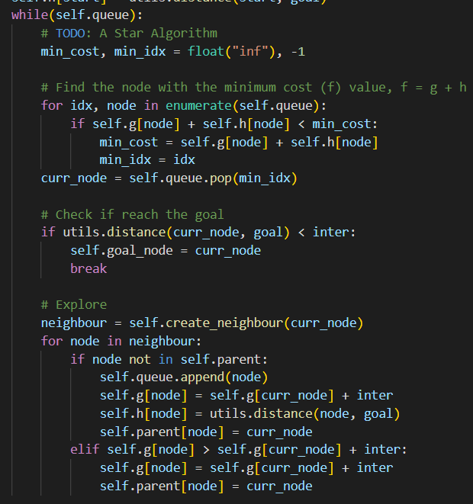
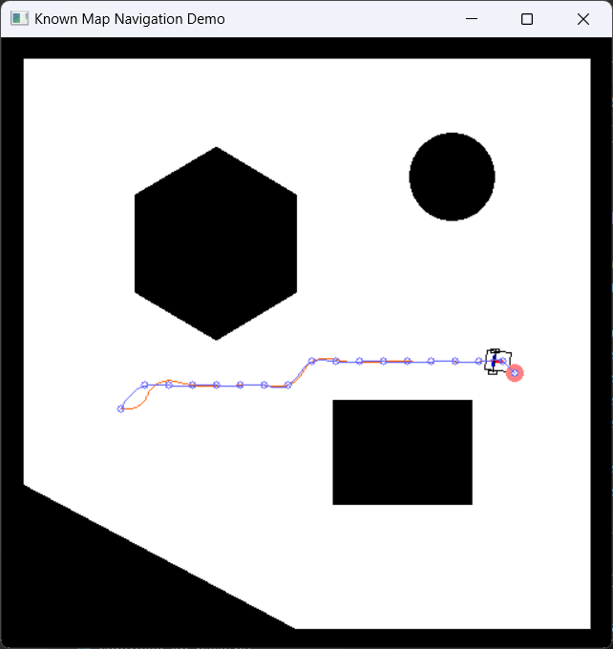
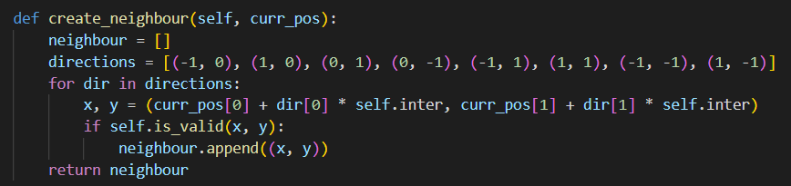
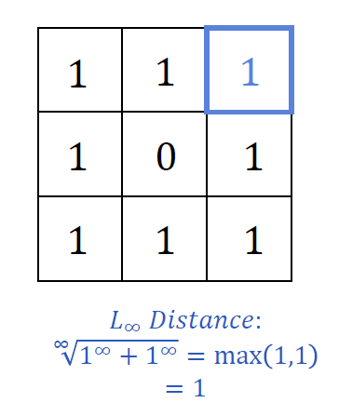

A Star
To implement the A* algorithm, I set the distance between two nodes to 20 pixels and check the validity of 8 directions, left, right, top, bottom, top left, top right, bottom left and bottom right. Valid directions are those not blocked by obstacles. In this case, the map is white color. For the algorithm, I just follow pseudocode.

Slide 18
Outline
Path Tracking
PID
Pure Pursuit
Stanley
LQR
Path Planning
A Star
RRT Star
Collision Handling

Slide 19
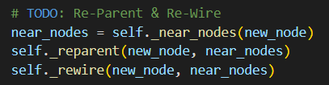
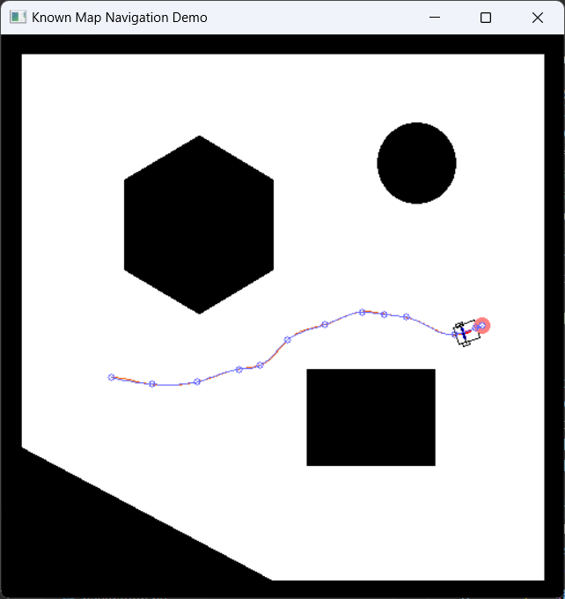
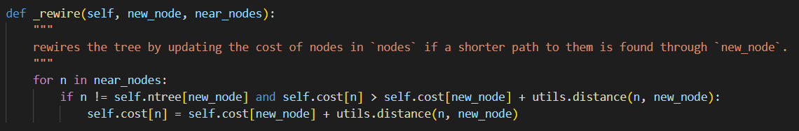
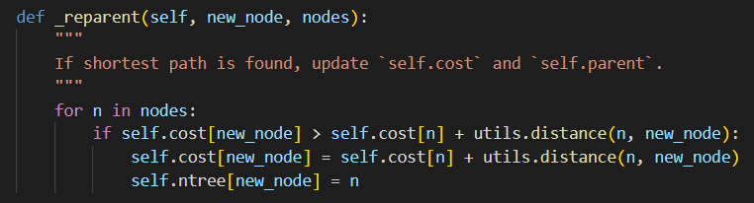
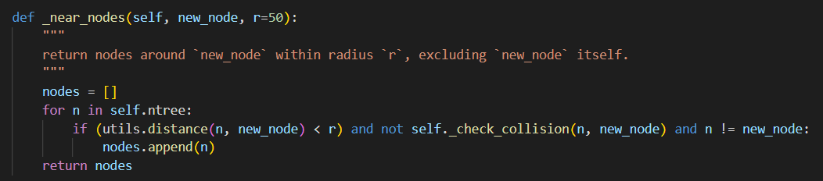
RRT Star
The purpose of each function is explained in the comment under the function intialization.
_node_nodes : searching all of the nodes in self.ntree
_reparent : find out which parent in near_nodes gives the minimum cost
_rewire : after selecting new parent, find out if there is a path that gives the minimum cost

Slide 20
Outline
Path Tracking
PID
Pure Pursuit
Stanley
LQR
Path Planning
A Star
RRT Star
Collision Handling

Slide 21
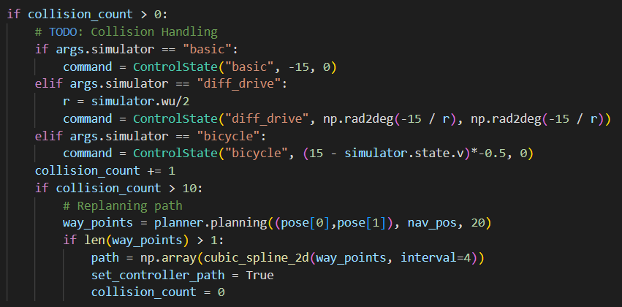
Collision Handling
To handle the collision, I simply move backward 10 times after the first collision occurs. After that, I reuse the replanning code from mouse_click function provided and reset the collision_count to 0 after the new path comes out.

