Slide 1
RNE 2024 HW1 Report
許媄香 109000168

Slide 2
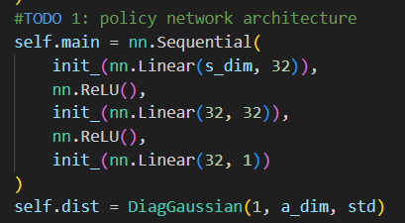
TODO 1
For policy network architecture, I made a rough guess by selecting 32 neurons in hidden layers. Then for the distribution, I saw the hint on the slide and use the implemented DiagGaussian class directly.

Slide 3
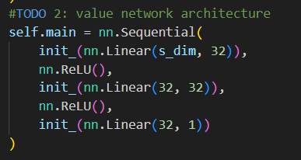
TODO 2
For value network, it is similar to policy network but without the probability distribution.

Slide 4
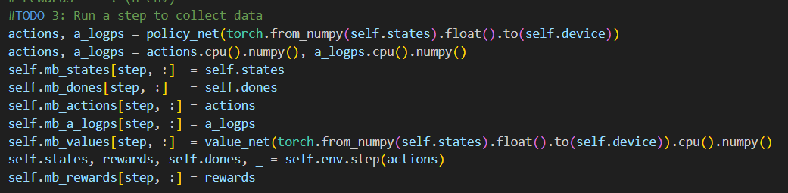
TODO 3
TODO 3 is just simply need to store the information in batch memory. For actions, log probabilities and values, we just need to retrieve them from the networks designed in TODO 1 and 2, the policy and value networks.

Slide 5
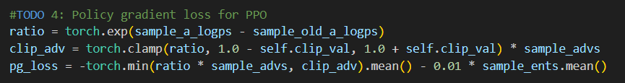
TODO 4
The loss function follows the formula in the slide but with additional entropy to introduce randomness and enhance exploration within the model. To prevent division by zero, computation of ratio is taking the exponential of log probability.

Slide 6
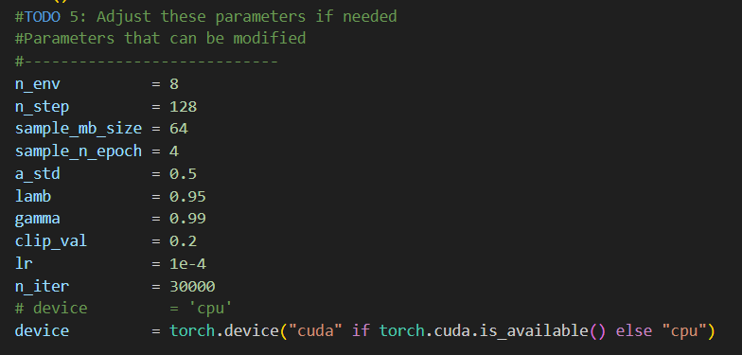
TODO 5
I didn’t change any of the parameters because I obtained pretty okay result in the first trial using the given parameters.

Slide 7
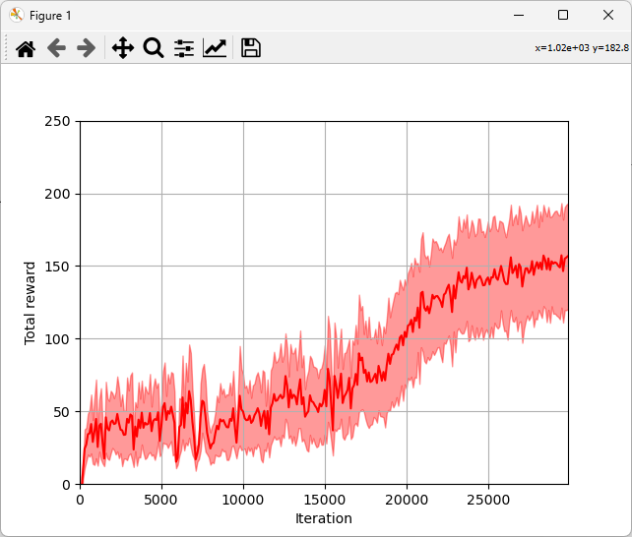
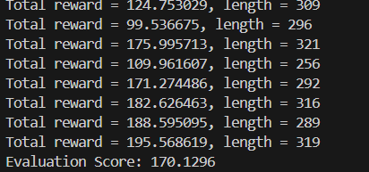
plot.py / eval.py

Slide 8
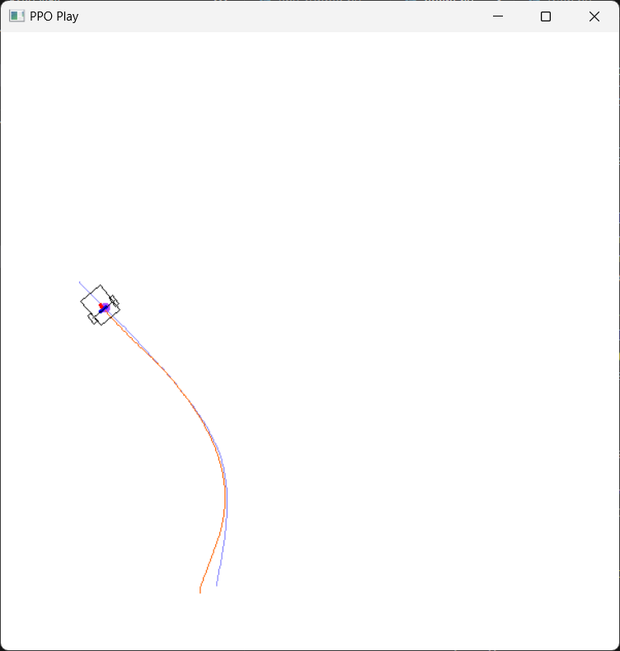
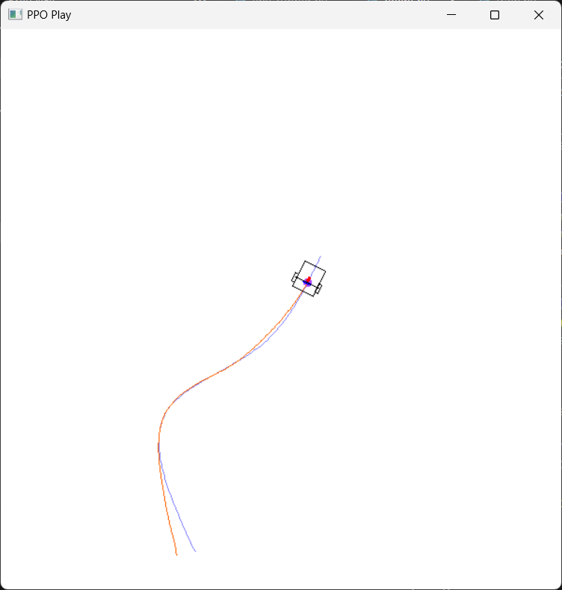
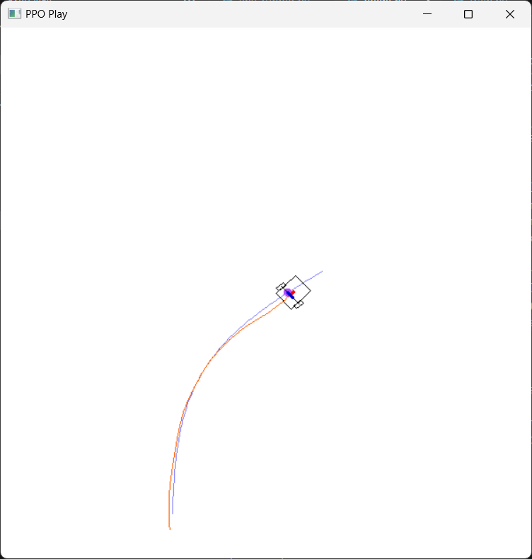
play.py

