Slide 1
CÔBA'S DAUGHTER × GLOSSY · BOARD PROPOSAL V5 · SEPTEMBER 2026
Two Rituals,
One September.
Sep 11 — Glossy Pop NYC gift bags · FIT, Manhattan
Sep 12 — Game Day beauty experience · UT Austin (recommended; Sep 19 open — Glossy to confirm)
Total envelope $4,000 · products from our own Amazon warehouse · zero booth production

Slide 2
01 · THE SEPTEMBER MOMENT
＋ IMAGE — AI MOCK: POP-UP AT DUSK
One weekend, two coasts —
one ships, one shows up
SEP 11 · NYC
SEP 12 · AUSTIN
THE GATE
SEP 15
In the bag
The experience
Sep 12 vs 19
Finale
Glossy Pop at FIT — our products inside a “$500+ value” gift bag next to Fenty-tier brands. No staffing: assembled and delivered ahead.
Glossy proposed a game-day beauty experience with curated UT creators. Our concept answers it: a get-ready ritual with luck at the center.
We recommend Sep 12 (vs Ohio State — GameDay stage, team already stateside). Sep 19 stays open; Dylan returns a formal package once we confirm.
Endless Summer closes 3 days after game day — both events feed its last push and Q4 gifting.

Slide 3
02 · EVENT 1 — GLOSSY POP NYC · GIFT BAG SPONSORSHIP
What goes in: one gate, two plans
PLAN A · PREFERRED
PLAN B · READY NOW
New miniset — mini aloe · mini coffee
scrub · new loofah scrub
Current miniset + full-size Aloe Gel
Both pulled from our Amazon AWD warehouse — zero production, US-only shipping, no lead-time risk.
The refreshed trio as the discovery gift.
GATE: Buyer lead-time answer by Jul 24 — must land in
NYC by Sep 4, or we fall to Plan B.
Default if the gate fails. Same bag, same story.
Every bag also carries a voucher booklet (unique codes → trackable to the bag) and the brand book — packed in a logo-printed canvas drawstring bag (~$3/unit, US supplier). Assembly: a hired NYC helper, photo-briefed; delivery to FIT per Glossy's load-in.

Slide 4
03 · THE BAG — CHEAP TO MAKE, PREMIUM TO OPEN
Canvas drawstring, four things inside
＋ IMAGE — DRAWSTRING BAG
＋ IMAGE — MINISET
＋ IMAGE — ALOE GEL
＋ IMAGE — VOUCHER + BRAND BOOK
~$3
100
$6+
Sep 10
printed canvas drawstring bag — reusable, not landfill packaging
bags planned — confirm final count with Glossy this month
per-bag paper cost stays under — booklet + brand book
assembled bags delivered to FIT, signed receipt + photos

Slide 5
04 · EVENT 2 — THE CONCEPT
Game day is already a ritual.
We own the getting-ready.
THE DAY
THE FORMAT
THE CENTERPIECE
America's most ritual-dense day — lucky jerseys, tailgate traditions, superstitions nobody will break. Fans practice ritual every Saturday; they just don't call it that.
Getting ready is the ritual beauty already owns — GRWM is the defining Gen Z format, and game day has its own genre. Glossy's “get-ready experience” ask is our native language.
Xin xăm — draw your fortune before the big game. Authentic to our heritage, instantly legible to any fan who wants luck tonight, and a built-in story beat for every GRWM video.
THE POINT, FOR THE BOARD
Glossy asked for a “game-day beauty experience.” This is that — but with a centerpiece only we can bring. The intersection isn't a stretch; it's a translation. Full external concept shared with Dylan: /glossy-gameday/concept.html

Slide 6
05 · THE EXPERIENCE — ONE RITUAL, TWO FORMATS
Get ready. Get lucky.
01
02
03
04
COOL
STYLE
DRAW
KEEP
chilled Aloe Gel on wrists and neck — functional beauty in 93°F heat, the hero product doing its actual job
silk-scarf braid bar — game-day hair in terracotta silk that reads burnt orange
the xin xăm moment — shake the cup, draw your stick, receive your lucky ticket
the ticket travels into the stadium; posts tagged @cobasdaughter earn the Aloe Gel gift
FORMAT A · GET-READY SALON
FORMAT B · PUBLIC BOOTH
Curated UT creators, founder-hosted
The same ritual, opened to the crowd
Glossy's model: intimate pre-game get-ready with the creator guest list from their Campus roster — ritual display, braid bar, fortunes as the finale, kits to take home. Sao hosts.
Draw a fortune, keep the ticket, post it, take home aloe. Built for volume and dusk light. The formats stack: salon in the morning, booth through the afternoon.
STYLING RULE — WESTERN POLISH, MODERN TOUCH
Heritage lives in the objects — rattan, silk, amber glass, wooden sticks. Modernity lives in the scene. No temple staging, no costume: a high-end body-care pop-up that happens to tell fortunes.

Slide 7
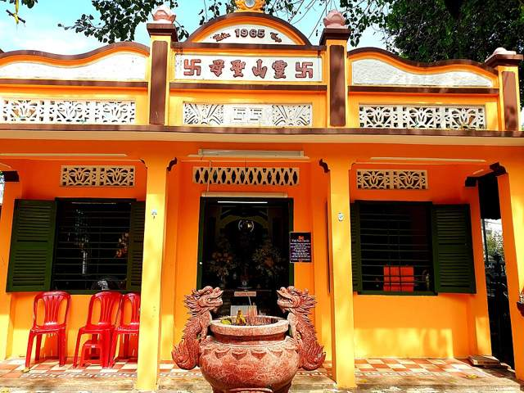
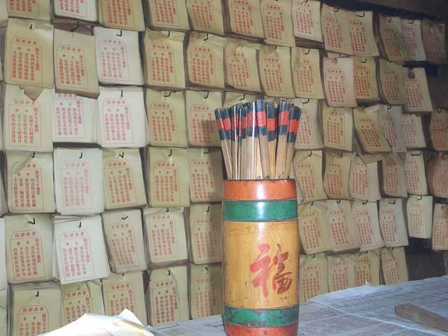
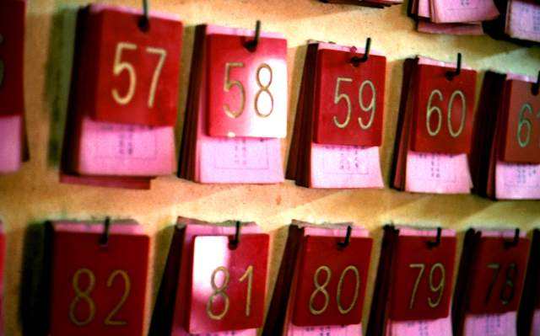
06 · THE FORTUNE, CURATED AMERICAN
Not a temple prop — a lucky ticket
The quẻ styled as a vintage stadium ticket — section, row and seat become lucky numbers, written in our voice, numbered by Vietnamese numerology. All production: one print run + numbered sticks.
CÔ BA'S FORTUNES ADMIT LUCK
CÔ BA'S FORTUNES ADMIT LUCK
CÔ BA'S FORTUNES ADMIT LUCK
Victory favors the rested. The Horns take the fourth quarter — you take the morning after.
Stay cool while 100,000 lose their minds, and fortune will find you in the noise.
Double luck: your team wins the night, your skin wins the weekend.
SEC
ROW
SEAT
SEC
ROW
SEAT
SEC
ROW
SEAT
07
UN
68
39
RE
86
88
CO
79
XIN XĂM SHRINE · CHÙA GIÁC LÂM, SAIGON
THE CUP OF NUMBERED STICKS
NUMBERED FORTUNES, MATCHED TO YOUR STICK
Origin references (the real ritual) — event styling is modern-western per the rule on the previous slide. Photos: Wikimedia Commons, PD / CC BY-SA.

Slide 8
07 · THE DAY, ORGANIZED
Salon in the morning, booth till kickoff
10:00–13:00
13:00–17:00
17:00–18:30
18:30
Get-ready salon
Booth opens
Golden hour
Kickoff
Curated creators in waves · COOL → STYLE → DRAW → KEEP · Sao hosts, kits gifted, content shot in the frame we set
Public fortune draws + aloe station through peak heat · GameDay crowd all afternoon
Pendant lights on, best light of the day · hourly scarf draw holds the crowd · founder reel closes
Last draws + tagged-post aloe gifts · teardown or stay per Dylan's schedule
WHO RUNS WHAT
Sao
Salon host + founder content — the face of the get-ready
Eva
Aloe station + styling support, salon and booth
Emma (Austin)
Fortune table + prep, print pickups, load-in/out, stock counts
Dylan · Glossy
Space/footprint, creator guest list, load-in windows — his package defines Format A's room

Slide 9
08 · ONE LIST RUNS BOTH EVENTS
The master checklist is live, not a slide
LIVE CHECKLIST · EDIT IN BROWSER
WORKBOOK · FOR FINANCE
…/glossy-gameday/checklist.html
glossy-september-ops.xlsx
Every line with qty × cost, owner, vendor, delivery route, due date. Click any cell to edit, add rows, check off, export CSV. Totals track the $4K envelope live.
Same checklist with formulas + budget allocation + prep timeline + salon/booth run-of-show + marketing capture plan. Imports to Google Sheets as-is.
DELIVERY RULES
US delivery only
AWD removals + US print/promo suppliers — no international freight, no customs risk
Handcarry — Sao & Eva
Small premium items only (brand books, silk, notes) in personal luggage
Two helpers, two cities
NYC hire (by Aug 15) assembles + delivers bags · Emma preps and runs Austin

Slide 10
09 · THE $4,000, ALLOCATED
Half product, half execution —
$2.0K cash out of pocket
Product (AWD stock)
$1,975
Labor (NYC + Emma)
$570
Printing
$400
Packaging (bags)
$360
Contingency ~8%
$310
Booth & ops
$235
Logistics (US only)
$150
Coconut station
−$1,000
Paid creator fees
−$500
Total $4,000 · product unit costs are placeholder COGS pending Finance — cash-only view ≈ $2,025. Struck lines = cut to fit. Not included: Glossy's sponsorship package fee — Dylan's formal package (salon space, creator roster, support) arrives after we confirm dates and comes to the board as its own line.

Slide 11
10 · PEOPLE & RUNWAY
Five people, eight weeks, one date to lock
Sao & Eva
Fly to Austin · handcarry small premium items · salon hosting + aloe station on game day
Emma (Austin)
Rehired — print pickups, sticks, kit assembly, fortune table, load-in
NYC helper
New hire by Aug 15 — bag assembly Sep 9–10, FIT delivery, photo proof
Dylan (Glossy)
Formal concept + package after date confirmation · creator guest list · space + load-in
Buyer team
THE gate: new-miniset lead time by Jul 24 · scarf qty by Jul 24
JUL
AUG
SEP 9–11
SEP 12
Confirm Sep 12 with Dylan + share concept · Buyer gate · fortune texts · orders placed
Dylan's package + creator list locked · NYC hire · AWD removals (Aug 17) · all lands by Aug 28
Bags assembled + delivered NYC · Austin prep, salon walkthrough, Emma brief
Salon 10:00 → booth → dusk kickoff

Slide 12
11 · THE RETURN
＋ IMAGE — MAY EVENT / AI MOCK
Two events, one content engine
NYC: 100 beauty-obsessed households open our ritual next to Fenty — coded voucher booklets trace redemptions to the bag. Austin: the salon manufactures creator GRWM content with a story beat no other brand has (the fortune), the booth turns every gifted aloe into a tagged post, and the founder reel format did 150.7K views in June. May precedent: brand mentions 12.5× in a month.
5–8
100+
250–400
40–60
creator GRWM sets from the salon (Glossy roster)
tagged IG posts & stories from the booth
emails via fortune QR · 2 trackable codes to Sep 30
raw clips → ads + organic + Q3 report

Slide 13
12 · DECISIONS & NEXT STEPS
Five answers unlock everything
US → DYLAN
BUYER TEAM
GLOSSY
BRAND TEAM
Confirm Sep 12 + share the concept
New miniset + loofah lead time
NYC bag count + FIT load-in · salon package & fee
Approve $4K split · hire NYC helper · confirm Emma
this week — unlocks his formal package
by Jul 24 — Plan A/B gate
by Jul 31
by Aug 15
Rooted in Heritage. Empowered for Modernity.

