Slide 1
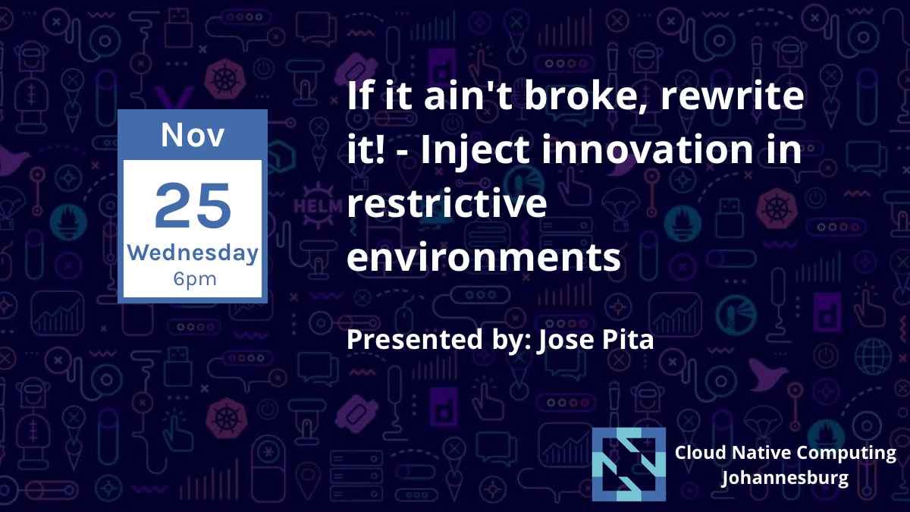

Slide 2
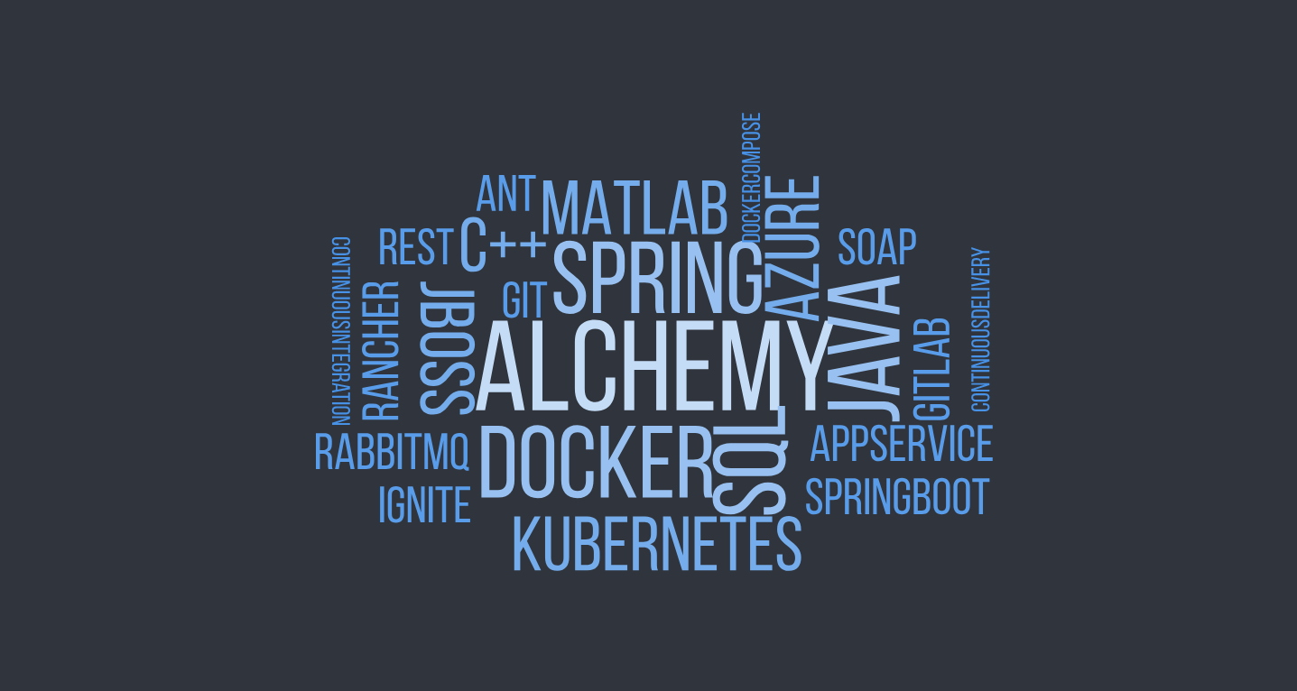

Slide 3



josempita@gmail.com
medium.com/@josempita
@josempita

Slide 4
TRADING
ALCHEMY
REPORTING
SENSITIVITIES

Slide 5
MONOLITHIC
APPLICATION

Slide 6
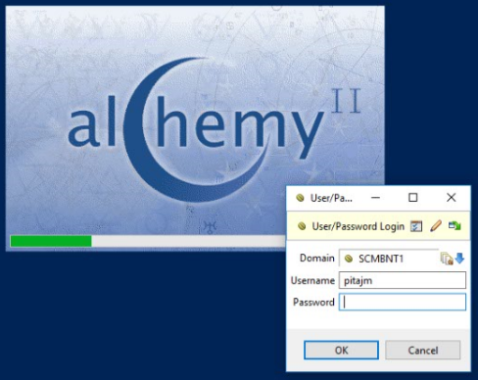


ALCHEMY CLIENTS
JBOSS
(C++, JNI)
Request Queue
Node 1
Command Service Interface (Stateless EJB)
Cluster Service Interface (Stateless EJB)
Matlab
HTTPS
(C++, JNI)
Report Executor (Message Driven Bean)
Node 2
REMOTING
Matlab
Scheduler (Scheduler Service Bean)
(C++, JNI)
Node 3
OLAP
(Mondrian)
NT Login Module
(JAAS Login Module)
Matlab
(C++, JNI)
Node 4
REST
Market Data / Contract
Service
(Web Service)
Data Transformers
Request
Matlab
Node 5
(C++, JNI)
Persistence
(Hibernate)
Risk Results (HDF)
Feeds
(Jasper)
Request
Request
Matlab
Request
Node 6
(C++, JNI)
SOAP
SQL Server 2016 R2
Long term storage - analytics
Request
Matlab
(C++, JNI)
Node 7
SAN
SQL Warehouse
Request
Matlab
(C++, JNI)
Request
Node 8
Matlab

Slide 7
MONOLITHIC
APPLICATION
CONTINUOUS
INTEGRATION

Slide 8


MONOLITHIC
APPLICATION
CONTINUOUS
INTEGRATION

Slide 9

MONOLITHIC
APPLICATION
CONTINUOUS
INTEGRATION
BUSINESS
INNOVATION

Slide 10
ITERATION 1
DEPLOY 1
DEPLOY 2
ITERATION 2
ITERATION 3
2 WEEK SPRINTS
TEST ITERATION 1
TEST ITERATION 2

Slide 11

MONOLITHIC
APPLICATION
CONTINUOUS
INTEGRATION
BUSINESS
INNOVATION

Slide 12

MONOLITHIC
APPLICATION
CONTINUOUS
INTEGRATION
BUSINESS
INNOVATION
MODEL
CONTAINERS
INTEGRATION

Slide 13
MONOLITHIC
APPLICATION
CONTINUOUS
INTEGRATION
BUSINESS
INNOVATION
MODEL
CONTAINERS
INTEGRATION

Slide 14

MONOLITHIC
APPLICATION
CONTINUOUS
INTEGRATION
BUSINESS
INNOVATION
MODEL
CONTAINERS
INTEGRATION
CICD
NAKED
OBJECTS

Slide 15
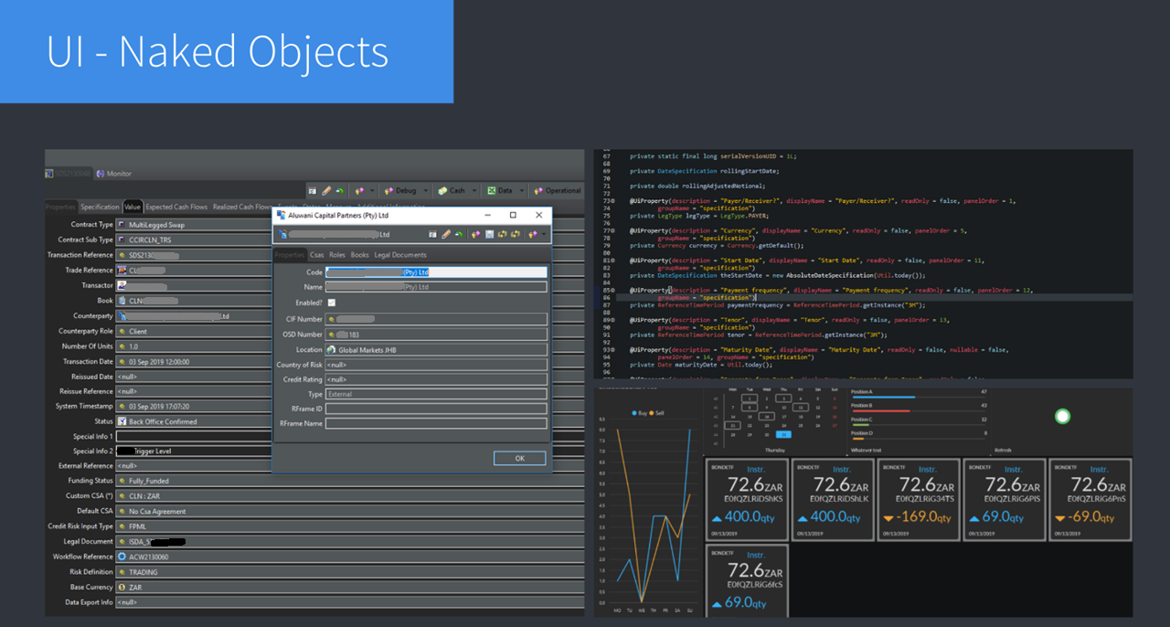

Slide 16
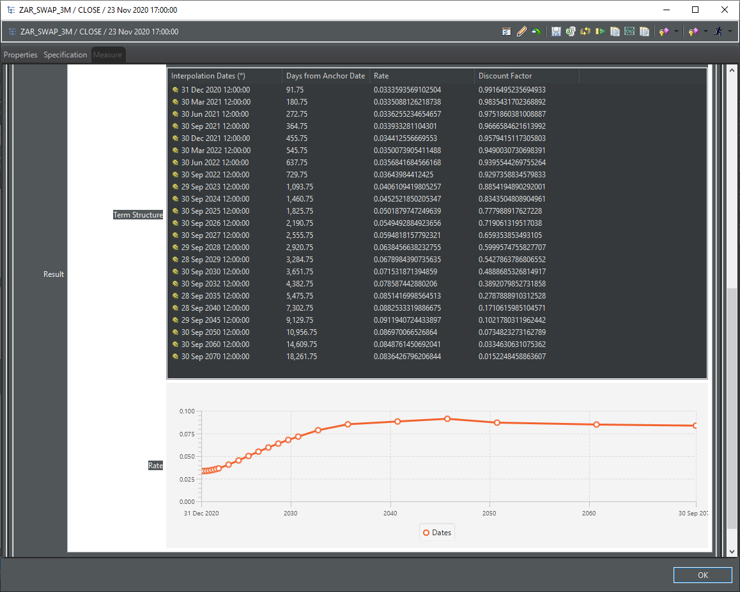

Slide 17
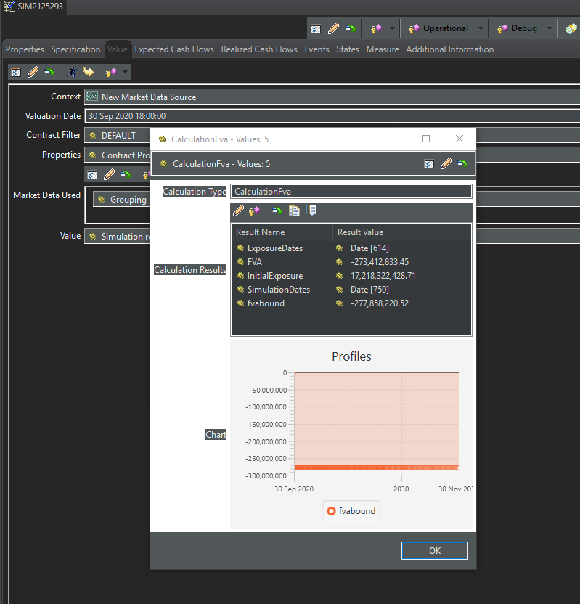

Slide 18

MONOLITHIC
APPLICATION
CONTINUOUS
INTEGRATION
BUSINESS
INNOVATION
MODEL
CONTAINERS
INTEGRATION
CICD
NAKED
OBJECTS
SPRING
JBOSS

Slide 19
MONOLITHIC
APPLICATION
CONTINUOUS
INTEGRATION
BUSINESS
INNOVATION
MODEL
CONTAINERS
INTEGRATION
CICD
NAKED
OBJECTS
SPRING
JBOSS
MICROSERVICES

Slide 20
MONOLITHIC
APPLICATION
CONTINUOUS
INTEGRATION
BUSINESS
INNOVATION
MODEL
CONTAINERS
INTEGRATION
CICD
NAKED
OBJECTS
SPRING
JBOSS
MICROSERVICES

Slide 21
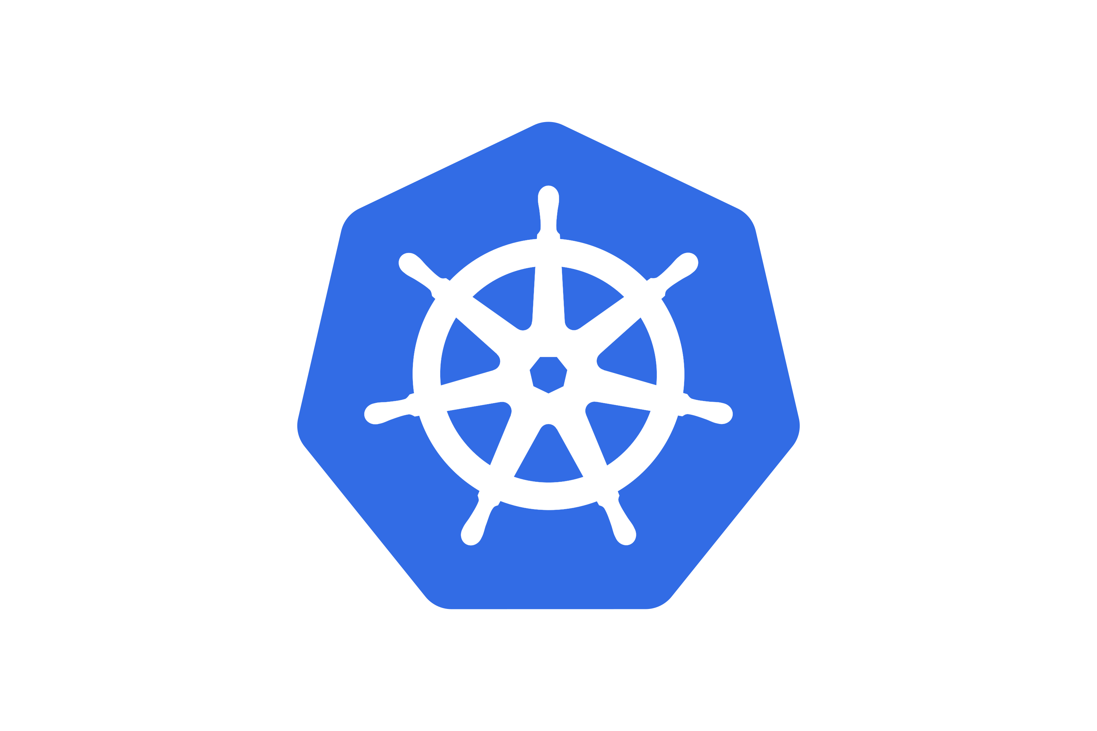
MONOLITHIC
APPLICATION
CONTINUOUS
INTEGRATION
BUSINESS
INNOVATION
MODEL
CONTAINERS
INTEGRATION
CICD
NAKED
OBJECTS
SPRING
JBOSS
MICROSERVICES
ORCHESTRATOR

Slide 22




MONOLITHIC
APPLICATION
CONTINUOUS
INTEGRATION
BUSINESS
INNOVATION
MODEL
CONTAINERS
INTEGRATION
CICD
NAKED
OBJECTS
SPRING
JBOSS
MICROSERVICES
ORCHESTRATOR
BUSINESS
CLOUD
DEPLOYMENT
OCTOPUS

Slide 23

MONOLITHIC
APPLICATION
CONTINUOUS
INTEGRATION
BUSINESS
INNOVATION
MODEL
CONTAINERS
INTEGRATION
CICD
NAKED
OBJECTS
SPRING
JBOSS
MICROSERVICES
ORCHESTRATOR
BUSINESS
CLOUD
DEPLOYMENT
OCTOPUS
SCALE
BARE-METAL
CLUSTER
ALCHEMY COMPUTE

Slide 24
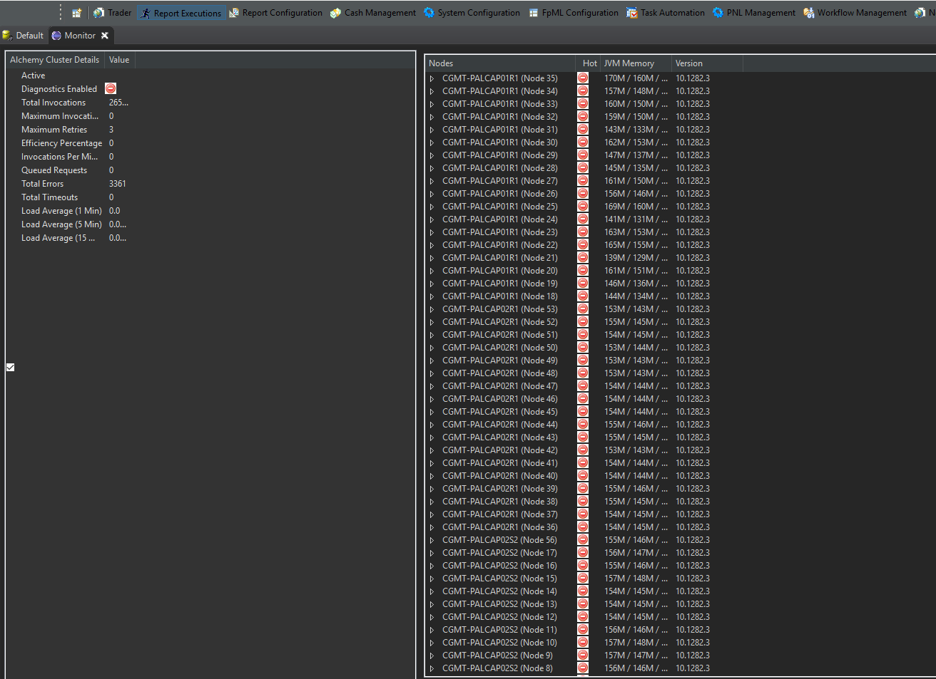

Slide 25





ALCHEMY CLIENTS
HTTPS
RISK ENGINE
RABBITMQ
Node 1
(C++, JNI)
REMOTING
Node 2
(C++, JNI)
Node 3
REST
MATLAB
SOAP
CLOUD

Slide 26
