Slide 1



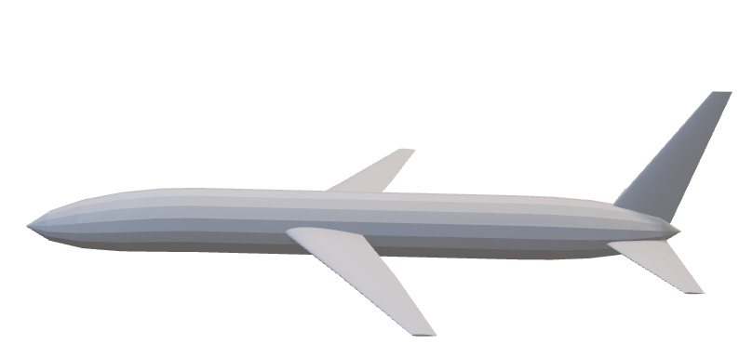
Learn to fly for fun
BuzzerBeaters ConUHacks 2023
Sponsored By:

Slide 2

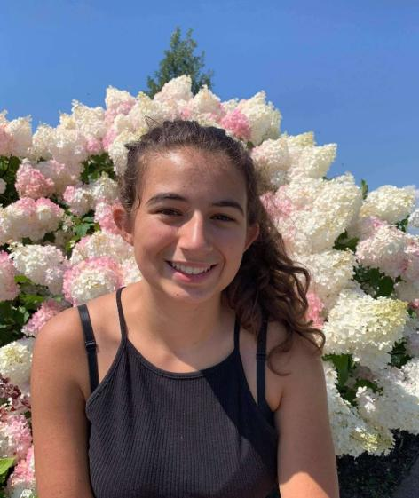
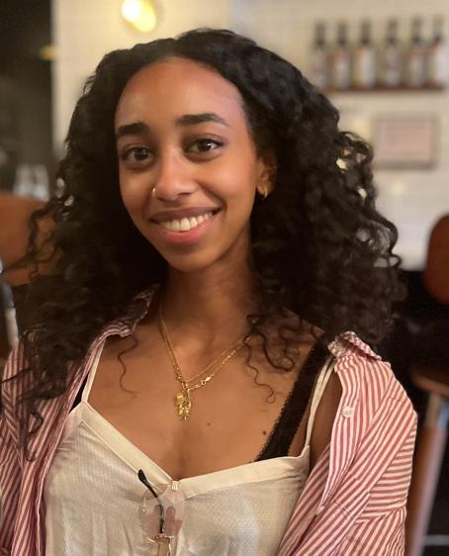

Meet the Team
Christos Karabatsos
3rd Year Software Engineering
Melisa Panaccione
3rd Year Software Engineering
Aida Berhe-Negousse
3rd Year Software Engineering
Emanuelle Ranaldi
4th Year Aerospace Engineering

Slide 3


Our Idea
Beauty of a full flight virtual simulator with added entertainment features
Help adults or children who want to learn how a plane functions
As these added features are purely for entertainment during flight
It is important to note that the additional features are not approved by Transport Canada (TC)
Therefore, this simulator was not built for training pilots rather to educate adults and children on how flying an aircraft works

Slide 4
Additional Features
Voice Recognition
Touch screens
Live pictures to be posted on Instagram
Integrated Spotify and Instagram
Visualization of control system motions
Music integrated in the cockpit

Slide 5
Softwares & Languages Used
Softwares
Languages
Unity
OpenVSP
Blender
Visual Studio Code
Github
C#

Slide 6
Next Steps & The Future of The Simulator
Integrate Spotify and Instagram APIs into the cockpit
Add more educational features
Add more visual aircraft features
Be able to change the aircraft being flown
Users can choose different aircraft to fly
Example: The outside of the aircraft can change from a region jet to a VTOL aircraft

