Slide 1
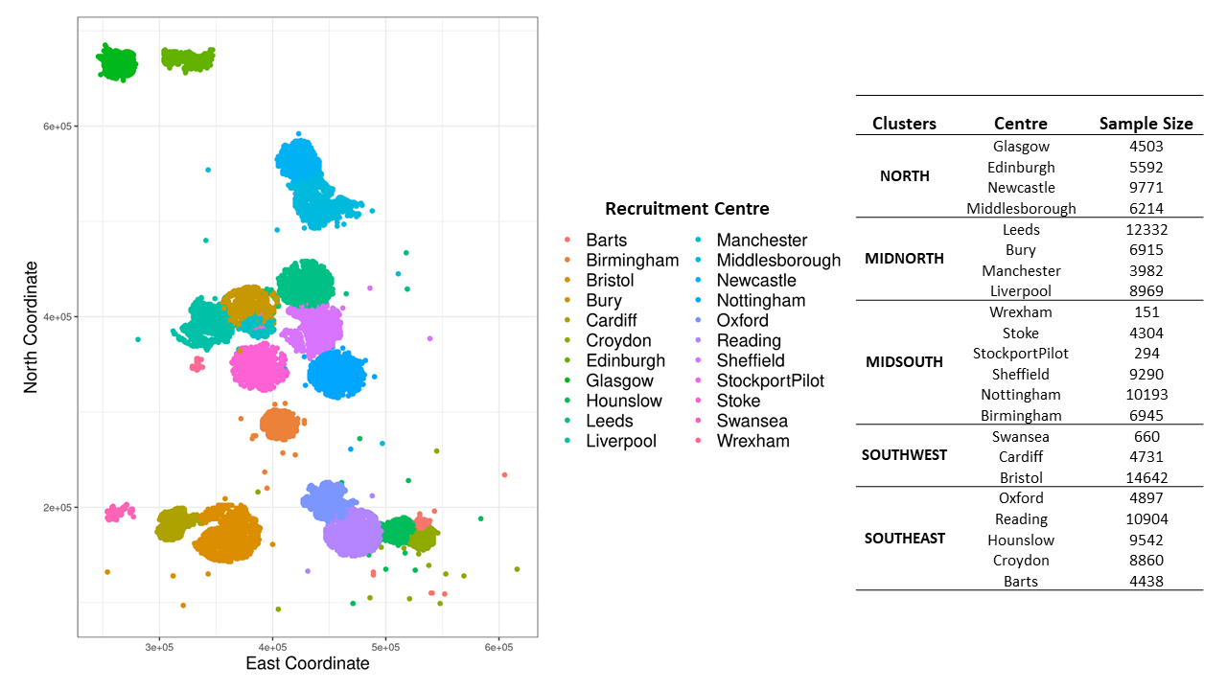

Slide 2
G
E
GxE
G
f.20489.0.0
f.20488.0.0
f.20487.0.0
f.20490.0.0
f.20491.0.0
CHILDHOOOD
C
.
f.20522.0.0
f.20523.0.0
f.20521.0.0
f.20524.0.0
f.20525.0.0
T
PRINCIPAL COMPONENTS
=
ADULT
ALL TRAUMA
A
f.20531.0.0
f.20529.0.0
f.20526.0.0
f.20530.0.0
f.20528.0.0
f.20527.0.0
CATASTROPHIC
G
E
GxE
DEPRESSION / NEUROTICISM TRAIT VARIATION
MIXED LINEAR MODEL | RANDOM EFFECTS | FIXED EFFECTS (COVARIATES)
1. Genetic | G | Age + Sex + Genotyping Array + 1:15 GRM Principal Components
2. Environmental | E
3. Genetic + Environmental | G + E
4. Genetic + Environmental + Interaction | G + E + GxE

Slide 3
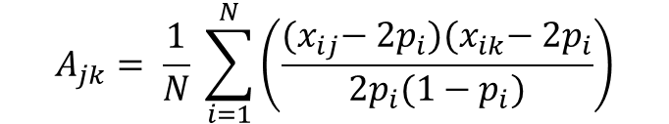
GRM
 | 1 | 2 | 3 | 4
1 | 0.999
2 | 0.001 | 0.993
3 | 0.489 | -0.001 | 0.994
4 | -0.006 | 0.125 | 0.000 | 1.008
$$A_{jk}= \frac{1}{N} \sum_{i=1}^{N}{\left(\frac{{(x}_{ij}− {2p}_{i}){(x}_{ik}− {2p}_{i}}{{2p}_{i}(1−p_{i})}\right)}$$

Slide 4
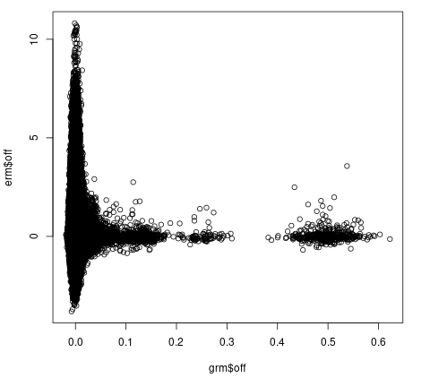
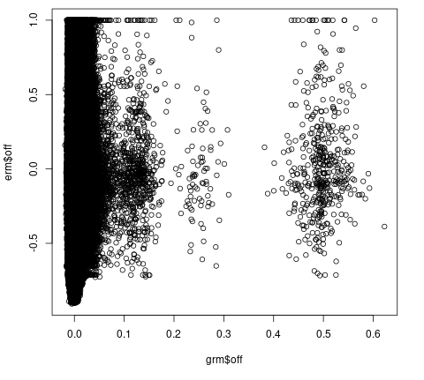
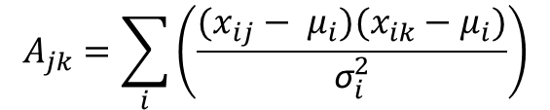
ERM
ALGORITHM 1
ERM v GRM (Offdiagonals)
 | 1 | 2 | 3 | 4…
1 | 1.100
2 | 0.032 | 0.900
3 | 0.086 | 0.002 | 1.200
4 | -0.006 | 0.025 | 0.000 | 0.981
$$A_{jk}=\sum_{i}{\left(\frac{(x_{ij}− μ_{i})(x_{ik}−μ_{i})}{{\text{σ}}_{i}^{2}}\right)}$$
ALGORITHM 3
 | 1 | 2 | 3 | 4…
1 | 1.000
2 | 0.002 | 1.000
3 | 0.060 | 0.302 | 1.000
4 | -0.300 | 0.027 | 0.050 | 1.000
(OSCA Zhang et al., 2019)
Notes:
I ran a MLM with the ERMs fitted as random effects – results seemed to be very similar, so instead used the GRMvERM graphs to help visualise how the alogrithms impact our data, algorithm 1 outputted smoother and more expected graphs
In the algorithm we are interested in; Xij unstandardized probe i in individual j,

Slide 5
GRMxERM
Genomic Relationship Matrix for Genotyped SNPs
Environmental Relationship Matrix using Trauma PCs
Interaction Matrix (Hadamard Product of GRM & ERM)
 | 1 | 2 | 3 | 4…
1 | 0.999
2 | 0.001 | 0.993
3 | 0.489 | -0.00131 | 0.994
4 | -0.006 | 0.125 | 0.000 | 1.008
 | 1 | 2 | 3 | 4…
1 | 1.100
2 | 0.032 | 0.900
3 | 0.086 | 0.002 | 1.200
4 | -0.006 | 0.025 | 0.000 | 0.980
 | 1 | 2 | 3 | 4…
1 | 1.190
2 | 0.000 | 0.894
3 | 0.042 | -0.000 | 1.193
4 | 0.000 | 0.003 | 0.000 | 0.988
x
=

