Slide 1
Phenotype | Sample | Min | Mean | Max | Total
Psychological Distress | Offspring | 2.00 | 15.51 | 52.00 | 2315.00
 | Maternal | 3.00 | 15.63 | 51.00
 | Paternal | 1.00 | 13.87 | 47.00
Depression | Offspring | 0.00 | 0.66 | 10.00 | 2280.00
 | Maternal | 0.00 | 0.58 | 10.00
 | Paternal | 0.00 | 0.66 | 10.00
Educational Attainment | Offspring | 0.00 | 5.29 | 10.00 | 2361.00
 | Maternal | 1.00 | 4.31 | 10.00
 | Paternal | 0.00 | 4.32 | 10.00
Height | Offspring | 145.00 | 171.22 | 200.00 | 2648.00
 | Maternal | 144.20 | 161.23 | 180.50
 | Paternal | 152.80 | 174.68 | 195.60
Age | Offspring | 18.00 | 31.45 | 61.00 | 2680.00
 | Maternal | 38.00 | 58.56 | 85.00
 | Paternal | 38.00 | 60.47 | 88.00
Phenotype | Sample | Female | Male |  | Total
Sex | Offspring | 1517 | 1163 |  | 2680

Slide 2
Polygenic Score (PGS) | GWAS | GWAS N | PGS SNP N | GS PGS Accounted Variance (R2)
Trait |  |  |  | Trait | R2
Depression | (Howard et al, 2019) | 807,533 | 18,333 | Psychological Distress | 0.009
 |  |  |  | Depression | 0.004
Educational Attainment | (Lee et al, 2018) | 750,403 | 23,756 | Educational Attainment | 0.051
Height | (Yengo et al, 2018) | 693,529 | 34,402 | Height | 0.278

Slide 9
Phenotype | Model | AIC | BIC | logLik | Accounted Variance R2 | P-Value | FDR
Psychological | I | 6442.251 | 6591.677 | -3195.126 | 0.018
Distress | II | 6445.204 | 6606.124 | -3194.602 | 0.019 | 0.592 | 1.00
Depression | I | 6120.125 | 6269.155 | -3034.063 | 0.017
 | II | 6116.865 | 6277.359 | -3030.433 | 0.020 | 0.027 | 0.070
Educational | I | 5899.643 | 6049.581 | -2923.821 | 0.056
Attainment | II | 5873.629 | 6035.100 | -2908.814 | 0.075 | 0.000 | 0.000
Height | I | 4194.411 | 4347.332 | -2071.205 | 0.672
 | II | 4193.926 | 4358.610 | -2068.963 | 0.674 | 0.106 | 0.255

Slide 10
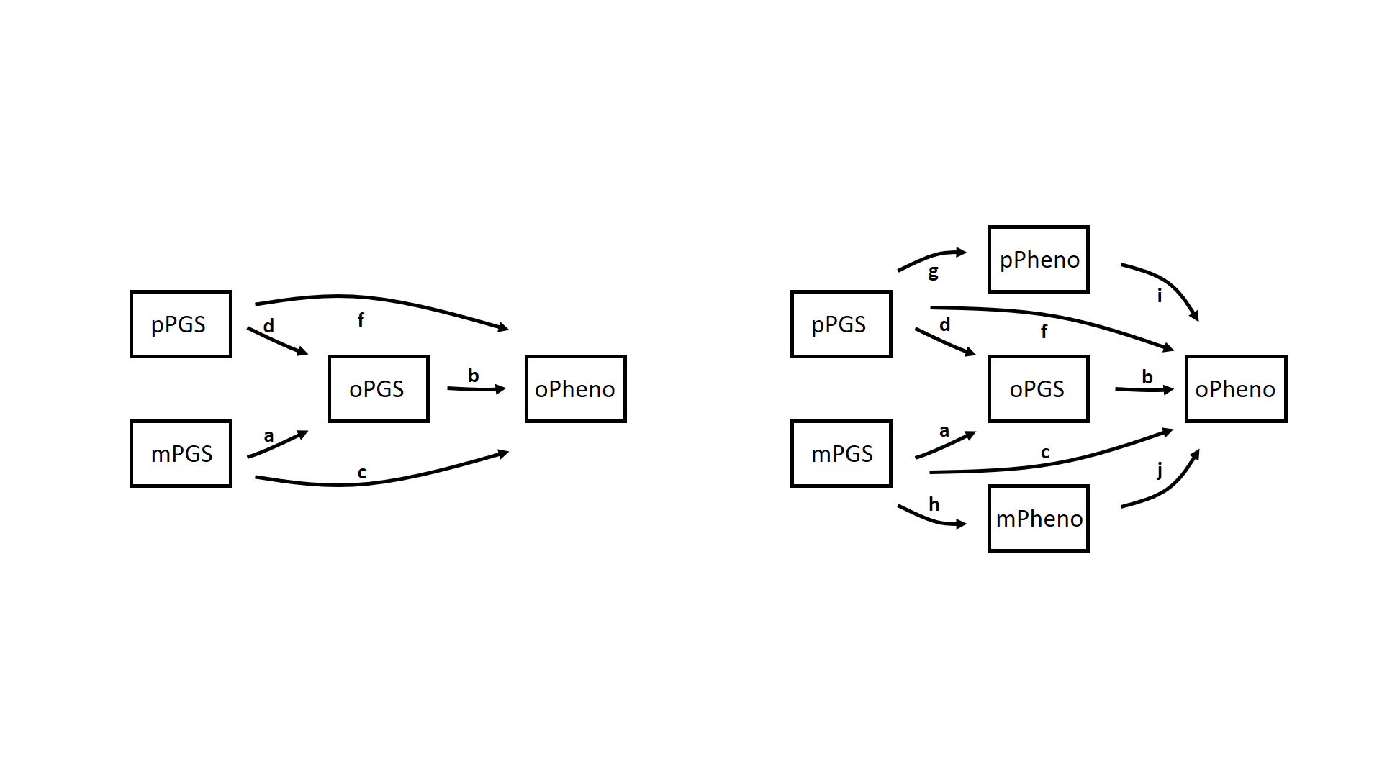
Phenotype | Dependent Variable | Predictor | Label | Simple Model |  |  | Extended Model
 |  |  |  | Estimate | SE | P | Estimate | SE | P
Psychological Distress | Offspring | OffspringPGS | b | 0.637 | 0.224 | 0.005 | 0.655 | 0.223 | 0.003
 | Offspring | Maternal PGS | c | 0.048 | 0.199 | 0.809 | -0.090 | 0.198 | 0.650
 | Offspring | Paternal PGS | f | -0.155 | 0.194 | 0.423 | -0.225 | 0.193 | 0.244
 | Paternal | Paternal PGS | g |  |  |  | 0.323 | 0.138 | 0.020
 | Maternal | Maternal PGS | h |  |  |  | 0.824 | 0.155 | 0.000
 | Offspring | Paternal Pheno | i |  |  |  | 0.074 | 0.024 | 0.002
 | Offspring | Maternal Pheno | j |  |  |  | 0.113 | 0.022 | 0.000
Depression | Offspring | OffspringPGS | b | 0.073 | 0.046 | 0.113 | 0.074 | 0.046 | 0.106
 | Offspring | Maternal PGS | c | 0.033 | 0.041 | 0.423 | 0.023 | 0.041 | 0.576
 | Offspring | Paternal PGS | f | -0.079 | 0.040 | 0.048 | -0.083 | 0.040 | 0.037
 | Paternal | Paternal PGS | g |  |  |  | 0.069 | 0.028 | 0.014
 | Maternal | Maternal PGS | h |  |  |  | 0.119 | 0.030 | 0.000
 | Offspring | Paternal Pheno | i |  |  |  | 0.060 | 0.024 | 0.013
 | Offspring | Maternal Pheno | j |  |  |  | 0.048 | 0.024 | 0.044
Educational Attainment | Offspring | OffspringPGS | b | 0.174 | 0.041 | 0.000 | 0.172 | 0.040 | 0.000
 | Offspring | Maternal PGS | c | 0.085 | 0.036 | 0.018 | 0.000 | 0.036 | 0.991
 | Offspring | Paternal PGS | f | 0.163 | 0.036 | 0.000 | 0.106 | 0.035 | 0.003
 | Paternal | Paternal PGS | g |  |  |  | 0.270 | 0.032 | 0.000
 | Maternal | Maternal PGS | h |  |  |  | 0.302 | 0.028 | 0.000
 | Offspring | Paternal Pheno | i |  |  |  | 0.110 | 0.018 | 0.000
 | Offspring | Maternal Pheno | j |  |  |  | 0.155 | 0.021 | 0.000
Height | Offspring | OffspringPGS | b | 3.285 | 0.152 | 0.000 | 3.288 | 0.125 | 0.000
 | Offspring | Maternal PGS | c | 0.319 | 0.132 | 0.016 | -1.180 | 0.120 | 0.000
 | Offspring | Paternal PGS | f | 0.171 | 0.130 | 0.187 | -1.193 | 0.117 | 0.000
 | Paternal | Paternal PGS | g |  |  |  | 3.068 | 0.104 | 0.000
 | Maternal | Maternal PGS | h |  |  |  | 3.030 | 0.098 | 0.000
 | Offspring | Paternal Pheno | i |  |  |  | 0.368 | 0.016 | 0.000
 | Offspring | Maternal Pheno | j |  |  |  | 0.392 | 0.017 | 0.000

Slide 11
g
pPheno
i
pPGS
d
f
pPGS
d
f
oPGS
b
oPheno
oPGS
b
oPheno
a
a
mPGS
mPGS
c
c
j
h
mPheno

