Slide 1
Volte overview

Slide 2
agenda
Introduction to VoLTE.
VoLTE Radio Bearer Setup.
VoLTE Architecture.
IMS/SIP signaling.
VoLTE Call Flows.
SIP Registration/Authentication.

Slide 3
Introduction to VOLTE
LTE is a packet only architecture designed to improve data performance. It does not support CS voice or video call.
In order to accommodate voice on LTE, two approaches were taken i.e CSFB(Circuit Switch Fall Back) and VoLTE.
GSMA – Voice over LTE has evolved as the preferred standard for telephony solution in LTE that has been accepted by the operator community.
GSMA has defined Voice over LTE (VoLTE) in PRD IR.92; describing minimum set of requirements for delivering voice in an all IP environment based on existing 3GPP IMS based multimedia telephony solution.

Slide 4
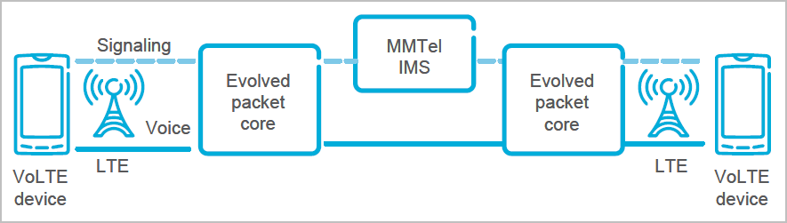
VoLTE end-to-end (simplified view)
A simplified version of the VoLTE communication architecture.

Slide 5
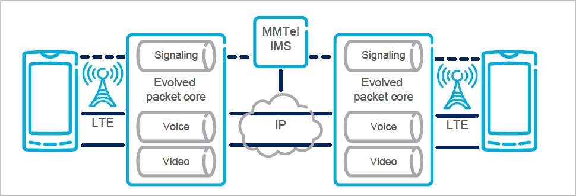
Volte radio bearer setup
Three bearers – for signaling, voice and video.

Slide 6
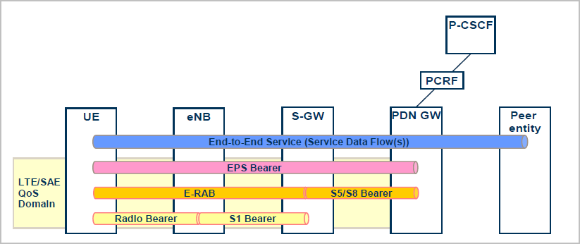
EPS Bearer Service Architecture

Slide 7
Bearer management for qos
As per GSMA IR.92 recommendations:
  Voice media should always be mapped to a separate EPS bearer as it has GBR (Guaranteed Bit Rate).
  SIP signaling should also be protected against congestion by being mapped to a separate EPS bearer.
Each QCI(QOS Class Identifier) is related to certain transport characteristics.
Out of 256 possible QCI values, 9 of them have been standardized. These have been specified in 3GPP TS 23.203.

Slide 8
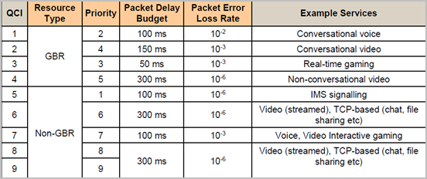
Table of standardizes qci’s
Notes:
Voice is carried over RTP (Real time transport protocol) and IMS signaling using SIP. There are 256 different QCI values possible. The QCI1 to QCI9 are fully
defined (Please see Figure 28). Each of theses QCIs is related to a specific
set of standardized QCI Characteristics; Resource Type (GBR or Non-GBR),
Priority, Packet Delay Budget and Packet Error Loss Rate, which are defined
for the EPS bearer and used to pre-configure the network nodes, for the
standardized QCIs.

Slide 9
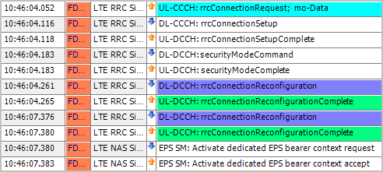
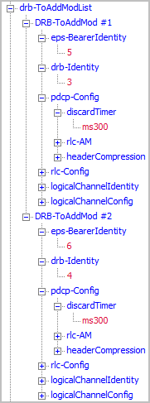
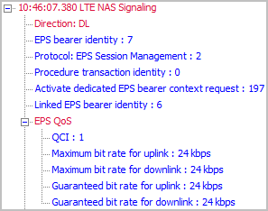
Layer 3 messaging from TD for bearer setup

Slide 10
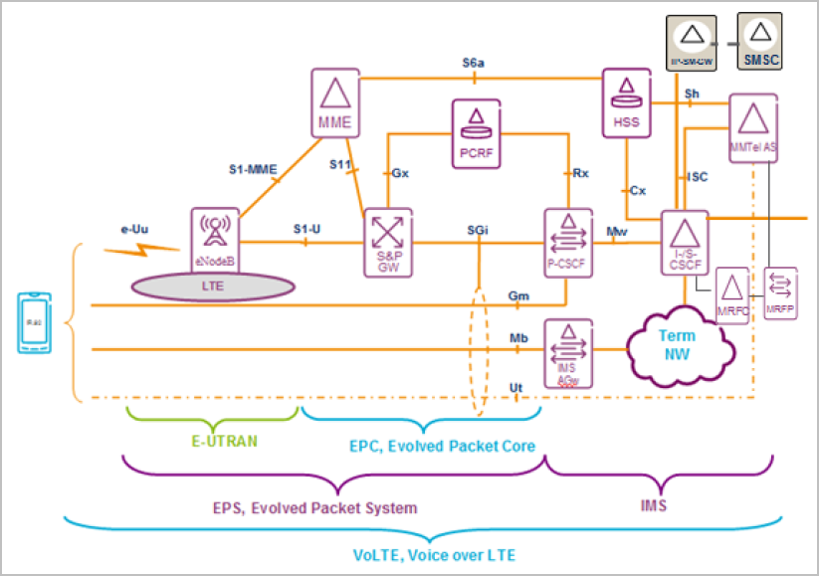
Volte architecture

Slide 11
Sip signaling
SIP – Session Initiation Protocol, is an application layer signaling protocol.
It runs on TCP, UDP and SCTP.
It has been developed and defined by IETF (Internet Engineering Task Force).
It is used for IMS signaling.

Slide 12
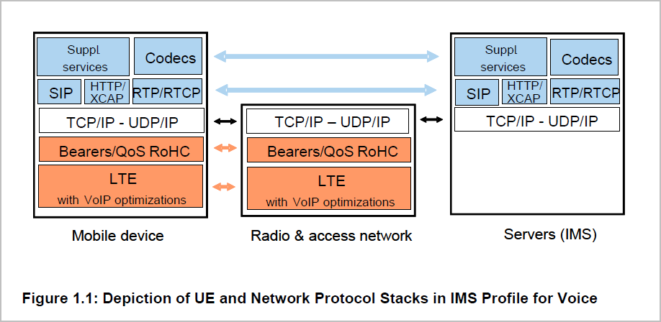
Protocol stack
Notes:
Talk abt l1 l2 and l3

Slide 13
SIP Request messages
REGISTER: Used by a UA to indicate its current IP address and the URLs for which it would like to receive calls.
INVITE: Used to establish a media session between user agents.
ACK: Confirms reliable message exchanges.
CANCEL: Terminates a pending request.
BYE: Terminates a session between two users in a conference.
PRACK (Provisional Response Acknowledgement): PRACK improves network reliability by adding an acknowledgement system to the provisional Responses (1xx).

Slide 14
CALL FLOWS

Slide 15
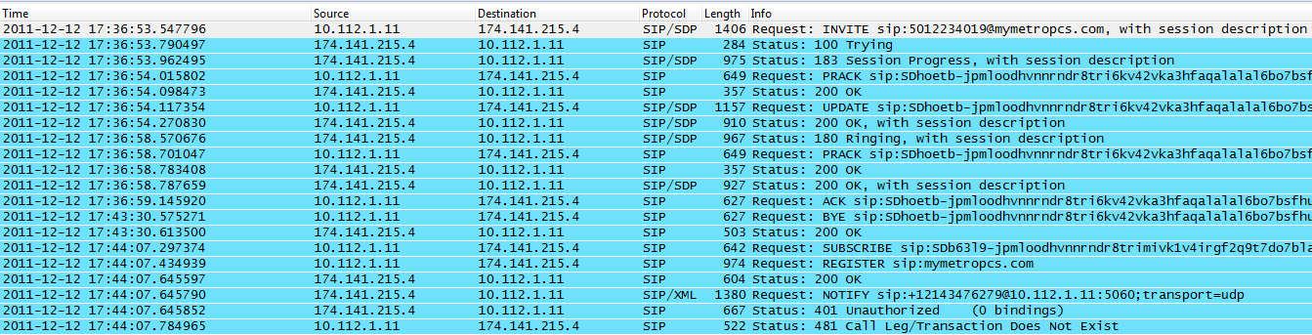

Long call
Shown in layer 3 messages. Please see next slide.
LC
The session setup time is the time between the SIP Invite message to the SIP 180 Ringing message.

Slide 16
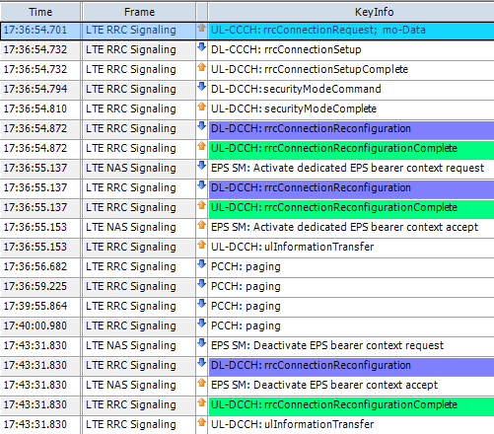

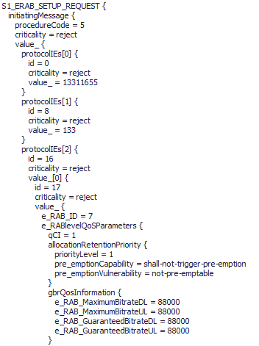
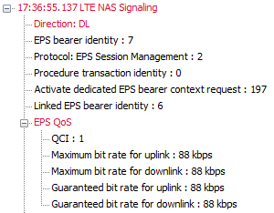
Long call, contd.
Layer 3 msgs from UE Trace
Layer 3 messages from TEMS Discovery

Slide 17
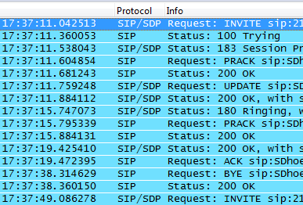

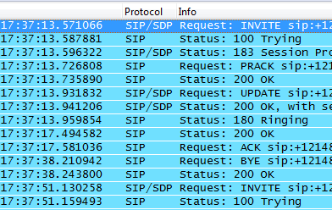

Short call (MO & MT)
MO
MT
MO Session setup time is ~ 4.705 s
MT Session setup time is ~ 389 ms

Slide 18
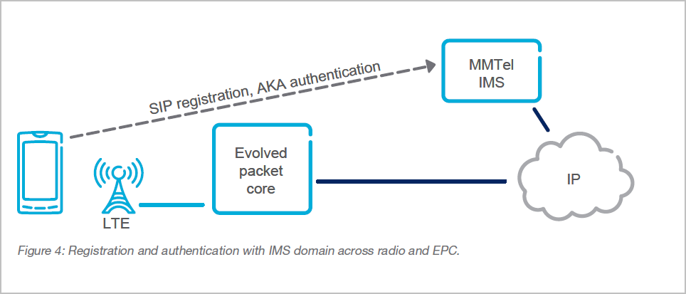
Registration

Slide 19
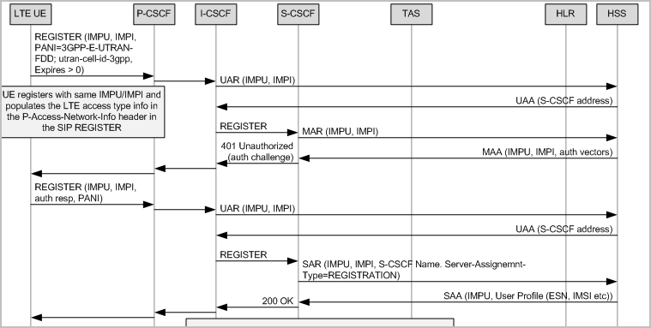
Registration flow

Slide 20
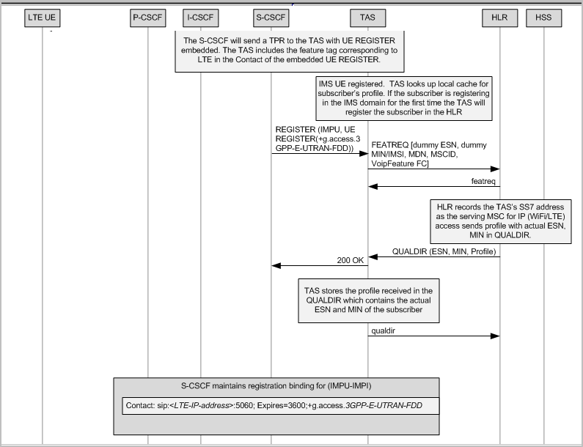
Notify
Notify

Slide 21
ApPendix

Slide 22
Ims architecture
The IMS System has a layered architecture, which separates functionality into three layers - an application layer, a control layer and a connectivity layer.
The application layer comprises: applications, content servers with the purpose to execute value added services to the end user.
The control layer comprises network control servers, which are in charge of call or session setup, modification and release. The control servers may also handle functions like security, charging and inter-working towards external networks on a control plane level.
The connectivity layer comprises routers, switches, media gateways and other user plane elements. The routers and switches provide transport capabilities for both control plane and user plane traffic. The media gateways provide different kinds of inter-working on a user plane level, including inter-working between different transmission technologies and inter-working between different media formats

Slide 23
P-CSCF
The P-CSCF address is discovered by the UE using a P-CSCF discovery mechanism.
The P-CSCF forwards the SIP messages received from the UE to an ICSCF or S-CSCF (and vice versa).
P-CSCF keeps track of UE registration information (like UE contact information and S-CSCF address) and active call sessions.

Slide 24
I-/s - CSCF
These logical entities are designed to execute traffic in either co-located or standalone mode, based on network configuration.
I-CSCF (Interrogating Call Session Control Function) is the contact point inside an operator’s network for all SIP requests destined to a user of that network operator. It locates the S-CSCF that was assigned to the user at registration through interaction with HSS.
S-CSCF (Serving Call Session Control Function) performs session control services for the endpoint. This includes routing of originating requests to the terminating network and routing of terminating requests tothe P-CSCF (SBG). The S-CSCF supports establishment, modification and releaseof IP multimedia sessions using the SIP/SDP protocol suite.
Notes:
The CSCF (Call Session Control Function) is an essential product in IMS for
processing signaling, using SIP as the signaling protocol. Multiple I-CSCFs can exist
concurrently in an operator’s network.
Multiple I-CSCFs can exist
concurrently in an operator’s network.

Slide 25
HSS
The functions provided by HSS are:
Identification – i.e maintaining relations between the public user identities used for call establishment and private user identities identifying the subsciption.
Authentication support of user access
Access authorization
Location of the S-CSCF that is assigned to the user.
Service information support - providing support for storage of initial filter criteria with description of trigger points and application server identities. Initial filter criteria are part of the user profile.
Charging information support – Each user is provisioned with the address of the offline (CDF) and online (OCS) charging systems. This ensures that all charging data for a particular user is delivered to the same charging system.
Barring – A Private User Identity can be barred to prevent registration of a user.
One or several Public User Identities can be barred to prevent that SIP s

Slide 26
Multimedia Telephony Application Server
(MMTel AS )
The MTAS MMTel AS is an application server which provides real time peer-to-peer communication services.
Multi-Media Telephony (MMTel), enables the usage of different media components such as audio, video and text in a single or combined way.
It also includes supplementary and multimedia services.
The operation of the supplementary services is controlled by XML documents that are stored as transparent data in the HSS.
Regulatory Services such as Carrier select/Carrier Pre-Select and Legal Intercept are also supported.

Slide 27
MRF
The Media Resource Function (MRF) contains functionality to allow manipulation of multimedia streams. It supports various service capabilities such as conferencing, multimedia message playing and media conversion services.
The MRF is decomposed into a Media Resource Function Controller (MRFC) and a Media Resource Processor (MRFP).
The MRFC controls the activities of the MRFP using H.248. The MRFC in IMS System is integrated with MTAS.
MRFC is focused on high volume multimedia tasks such as putting media streams on hold, playing of voice/video announcements and controlling multi-party voice/video conferences.
MRFP provides all the necessary functionality for processing payload in conversational multimedia services in an IP network. It provides a set of codecs, transcoders and mixing functions to realize audio and video manipulations.

Slide 28


