Slide 1

G2M Insight For Cab Investment Firm
Melisa GOZET
9, August 2021

Slide 2
Outline
Problem Statement
Datasets Information
History of the Datasets
EDA
Conclusion

Slide 3

Problem Statement –G2M Cab Industry Case Study
XYZ is a private equity firm in US. Due to remarkable growth in the Cab Industry in last few years and multiple key players in the market, it is planning for an investment in Cab industry.
Provide actionable insights to help XYZ firm in identifying the right company for making investment.
Cab Companies
Yellow Cab
Pink Cab

Slide 4
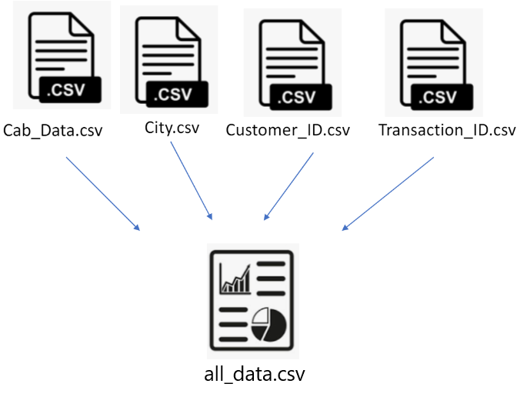
Datasets Information
There are 4 datasets:
Cab_Data.csv - This file includes details of transaction for 2 cab companies.
City.csv - This file contains list of US cities, their population and number of cab users.
Customer_ID.csv - This is a mapping table that contains a unique identifier which links the customer’s demographic details.
Transaction_ID.csv - This is a mapping table that contains transaction to customer mapping and payment mode.
Timeframe of the data: 2016/01/02 to 2018/12/31.
Total data points : 356,392

Slide 5

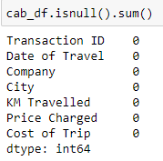
Profit Analysis
History of the Dataset - Cab Data.csv
As you see, there are 359392 data points.
There is no NA value.

Slide 6
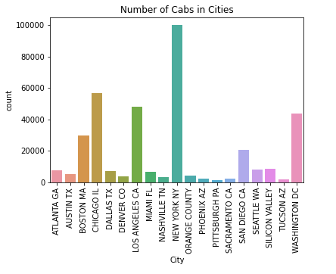
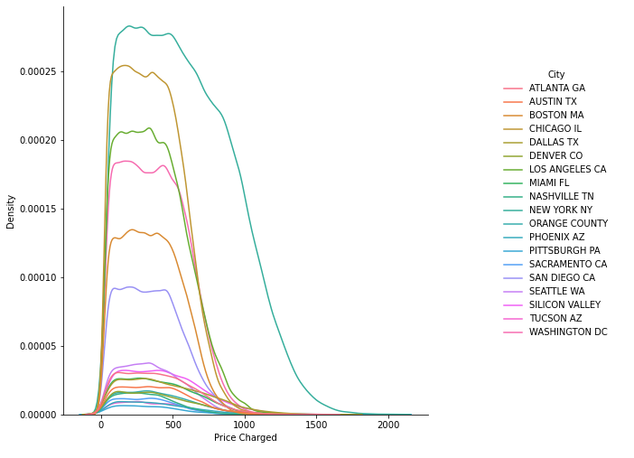
Profit Analysis
History of the Dataset - Cab Data.csv
Price Charged Density by City

Slide 7
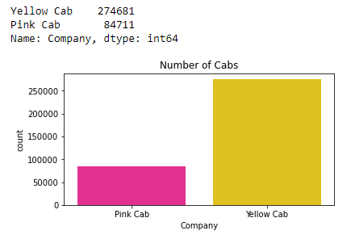
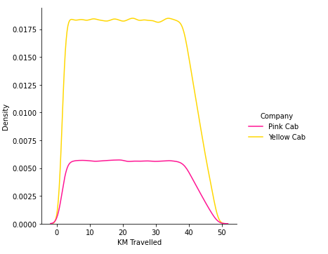
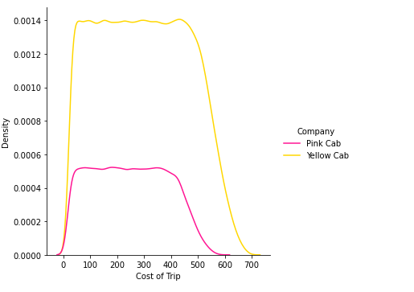
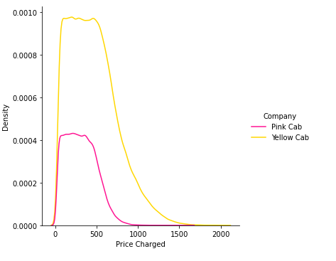
History of the Dataset - Cab Data.csv
The number of Yellow Cab is considerably higher than the Pink Cab.
Due to the number of Yellow Cab it is seen that the number of kilometers traveled is more.

Slide 8
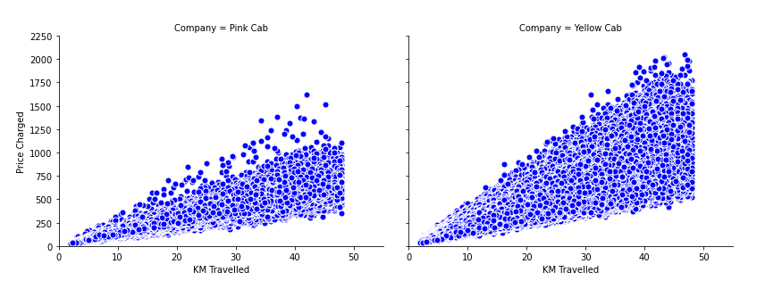
History of the Dataset - Cab Data.csv
In terms of the KM Travelled and Price Charged, it is seen that the yellow taxi travels more.

Slide 9

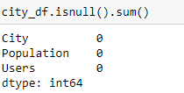
History of the Dataset - City Data.csv
As you see, there are 20 data points.
There is no NA value.

Slide 10
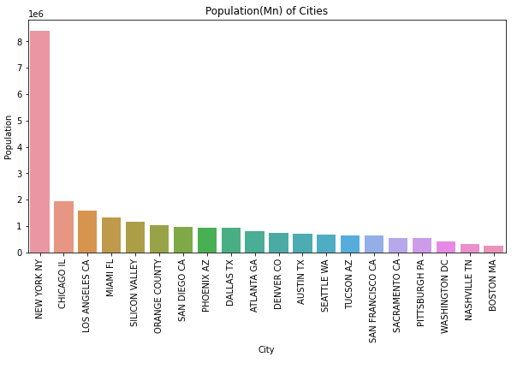
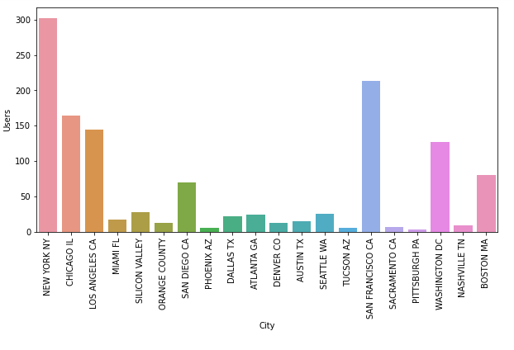
Profit Analysis
History of the Dataset - City Data.csv
Cab Users (K) of Cities

Slide 11
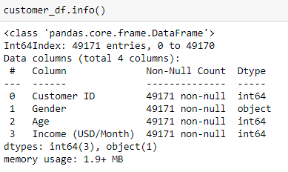
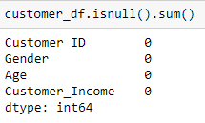
Profit Analysis
History of the Dataset - Customer_ID.csv
As you see, there are 49171 data points.
There is no NA value.

Slide 12
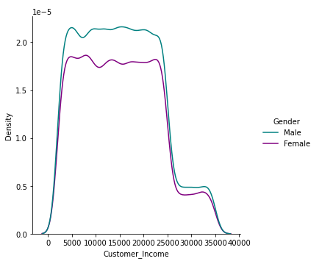
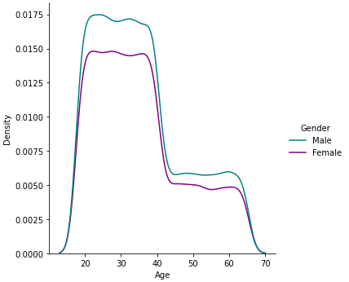
Profit Analysis
History of the Dataset - Customer_ID.csv
Income of customers using cabs is between 4K and 27K.
In general, it is seen that male users are more.
Age of customers using cabs is approximately between 20 and 42.
In general, it is seen that male users are more.

Slide 13

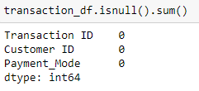
Profit Analysis
History of the Dataset - Transaction_ID.csv
As you see, there are 440098 data points.
There is no NA value.

Slide 14
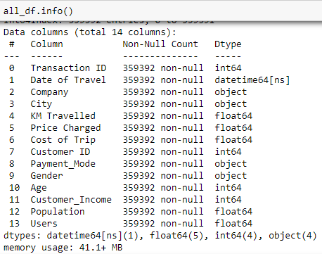
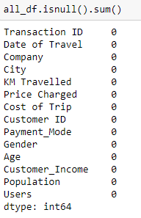
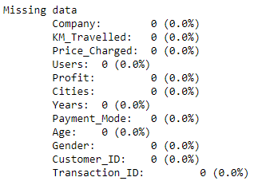
Profit Analysis
History of the Dataset – all_data.csv
As you see, there are 359392 data points.
There is no NA value.
4 datasets are combined in this file.

Slide 15
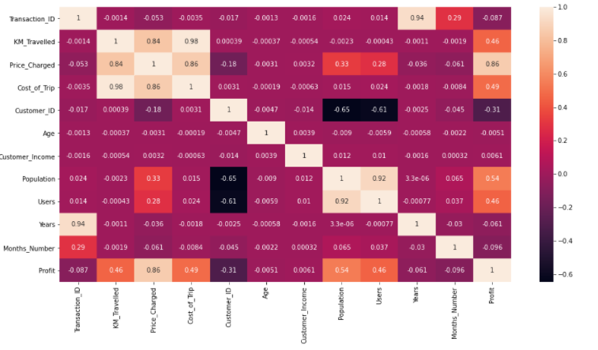
Correlation of numeric variables in all_data

Slide 16
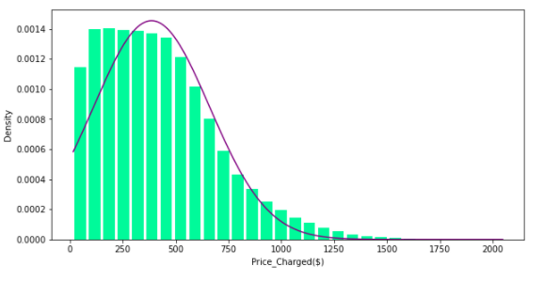
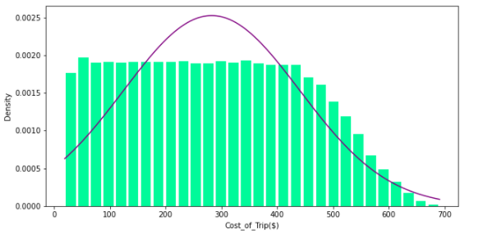
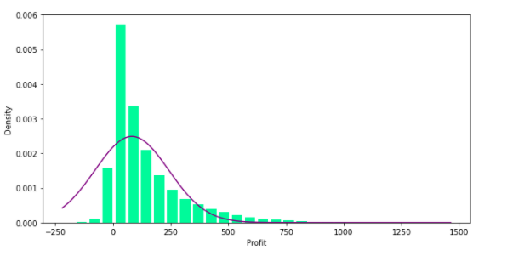
Distributions

Slide 17
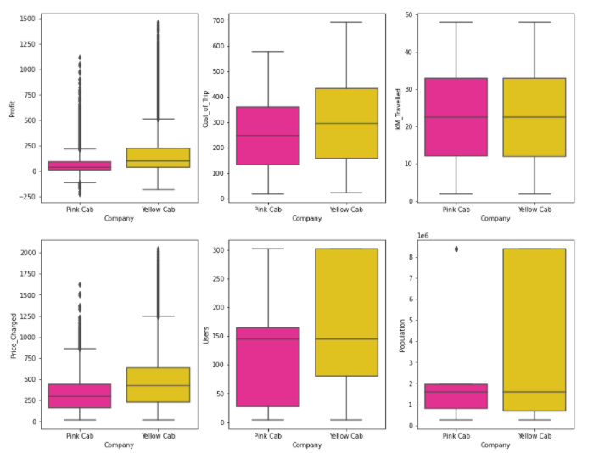
Box Plot Analysis
The appearance of outliers explains some of the deviations.
Due to the high number of yellow taxis, its dominance can be seen in all values.
The negative profit could not be explained by the available data.

Slide 18
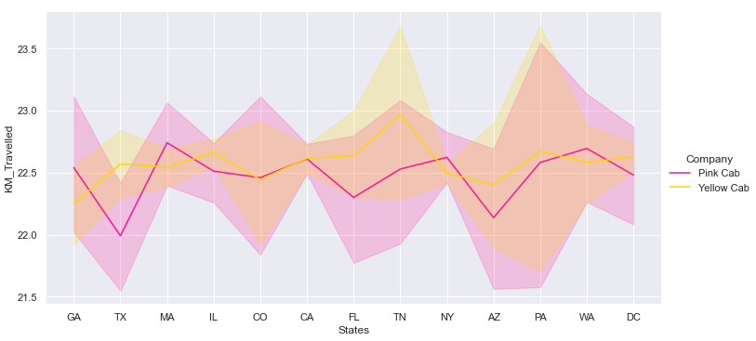
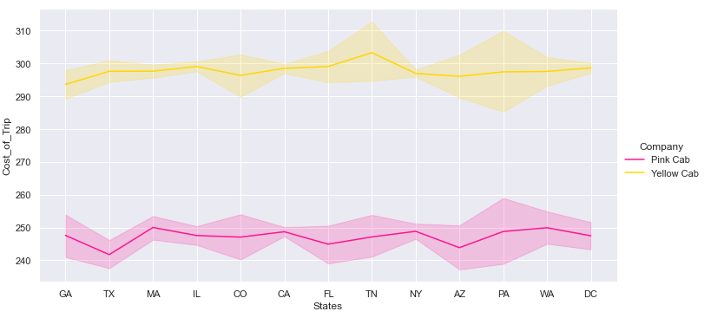
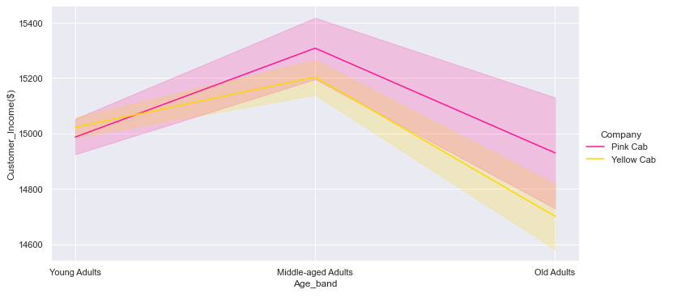
Profit Analysis
Profit Analysis
The Pink Cab has done more KM_ Travelled in some States (GA, MA, NY, WA). As can be seen the Cost_of_Trip is low.
In addition most people who use the Pink Cab seem to have a very high income.

Slide 19
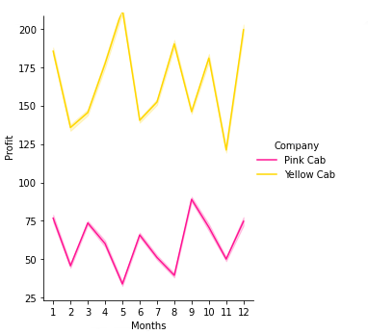
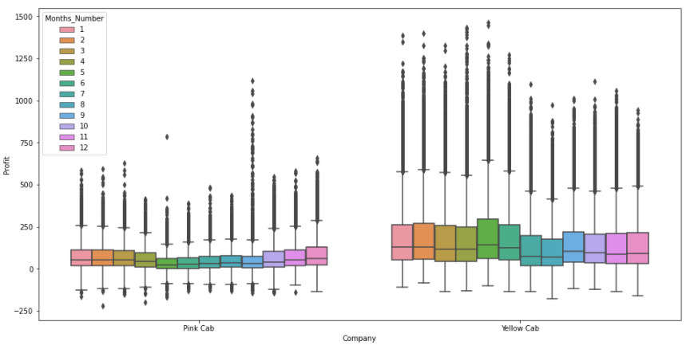
Profit Analysis
Profit Analysis
Both companies made a profit.
It is seen that the highest profit of the Yellow Cab is at the 5th month and the highest profit of the Pink Cab is at the 9th month.
Although it seems that both companies make a profit according to the months, in fact there are losses.
The reason for this could not be found with the available data.

Slide 20
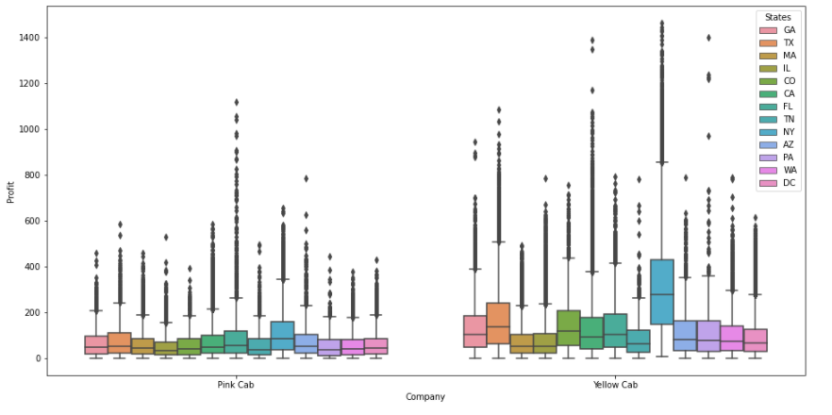
Profit Analysis
Profit Analysis
Yellow Cab earned its highest income from NY.
On the other hand, Pink Cab earned its highest income from FL.

Slide 21
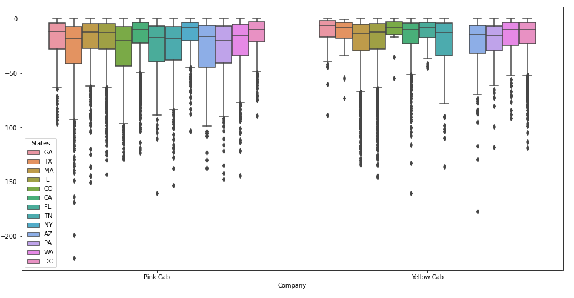
Profit Analysis
The graph shows the losses of both companies by States. But it noteworthy that the Yellow Cab did not lose in NewYork (NY).

Slide 22
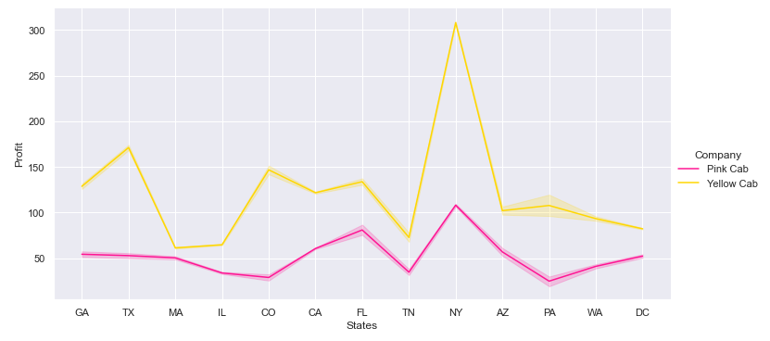
Profit Analysis
Profit graph by States
The 3 most profitable States in the Yellow Cab are NY, TX and CO.
In a Pink Cab is NY, FL and AZ.

Slide 23
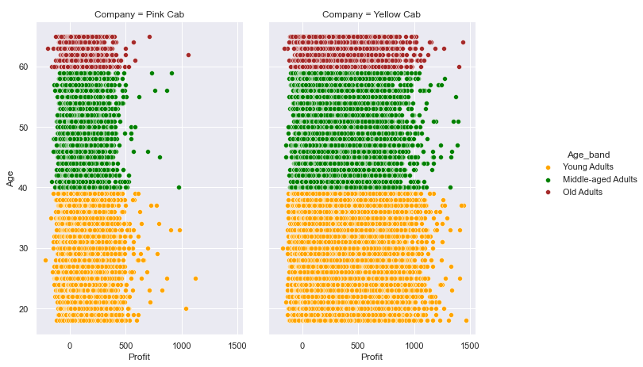
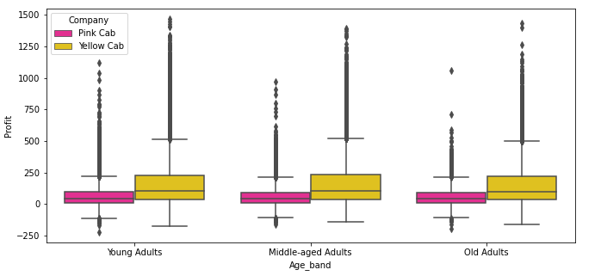
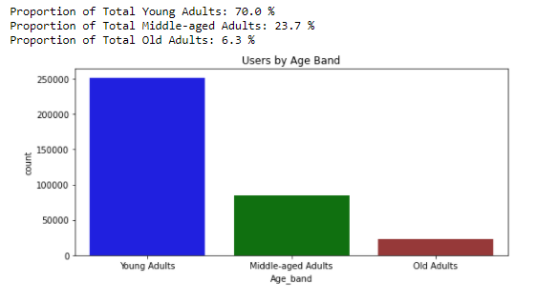
Profit Analysis
Seventy percent of cabs users are Young_Adults.
Yellow Cab with the highest profits also by Age_band.

Slide 24
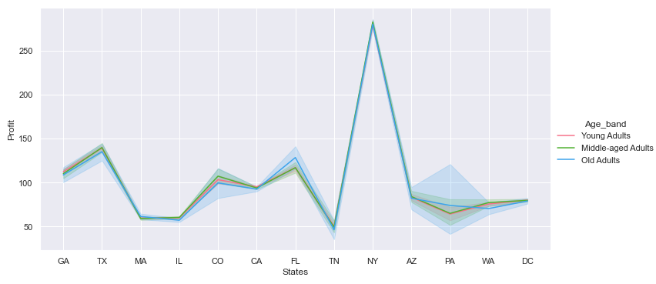
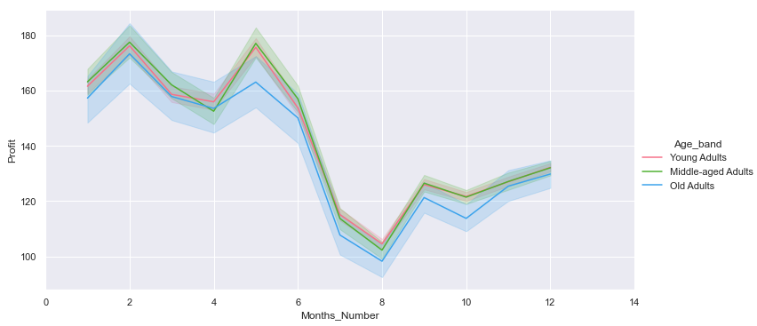
Profit Analysis
When the profit is analyzed by months, the highest income Middle_aged_Adults in 2 and 5 months.
When looked at by state, the highest profit comes from Older_Adults in NY.

Slide 25
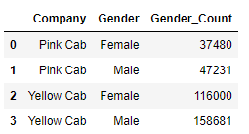
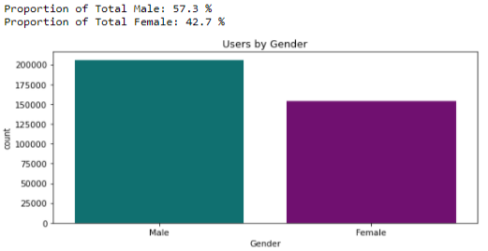
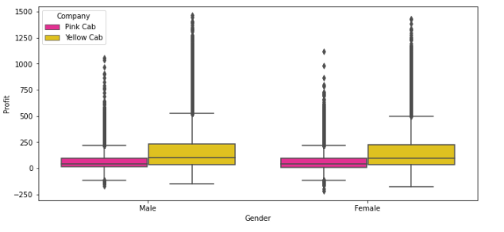
Profit Analysis
Profit Analysis
In both cabs have more male users.

Slide 26
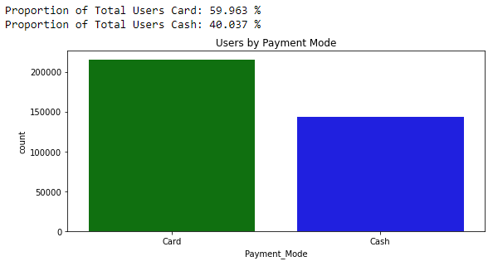
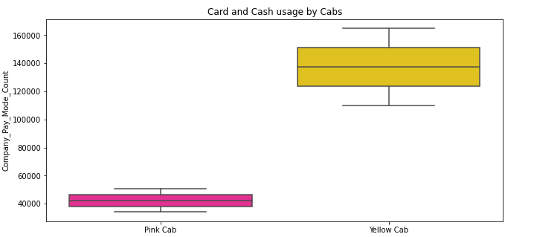
Profit Analysis
In both cabs have more Card users.

Slide 27
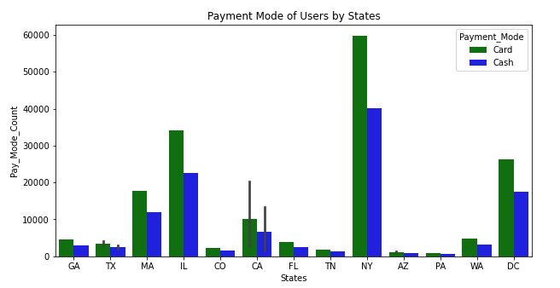
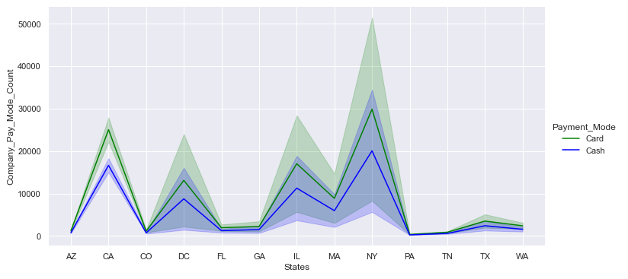
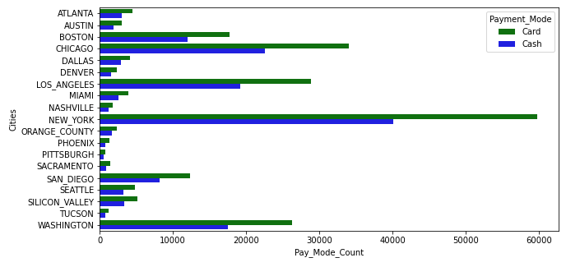
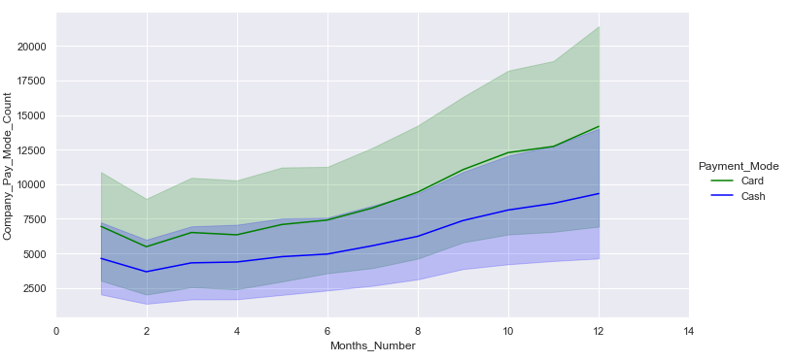
Profit Analysis
Payment is generally made by card.

Slide 28
Conclusion
When the datasets of 3 years were examined, it was seen that the most profitable company was the Yellow Cab compared to the Pink Cab.
Yellow cab’s average profit per KM is almost three times the average profit per KM of the Pink cab.
In general, the Payment_Mode is card.
According to the detailed analysis, XYZ firm should invest in Yellow Cab. Given the losses, XYZ firm should invest more to Yellow Cab in the New York.

Slide 29
THANK YOU !

