Slide 1
HEAP SORT
As mentioned earlier, priority queues can be used to sort in O(N log N) time.
  buildHeap: takes O(N) time
  N deleteMins: take O(N log N) time

Slide 2
HEAP SORT
As mentioned earlier, priority queues can be used to sort in O(N log N) time.
  buildHeap: takes O(N) time
  N deleteMins: take O(N log N) time
Minor problem: The sorted numbers have to be stored in a separate array, so memory requirement is doubled!

Slide 3
HEAP SORT
After buildHeap, each deleteMin/deleteMax shrinks the array by 1.

Slide 4
HEAP SORT
After buildHeap, each deleteMin/deleteMax shrinks the array by 1.
We can use this observation to actually avoid using the second array

Slide 5
HEAP SORT
After buildHeap
97
53
59
26
41
58
31
1
2
3
4
5
6
7
After swap
31
53
59
26
41
58
97
1
2
3
4
5
6
7
After deleteMax is
completed
59
53
58
26
41
31
97
1
2
3
4
5
6
7
One deleteMax Step

Slide 6
HEAP SORT
After swap
31
53
58
26
41
59
97
1
2
3
4
5
6
7
After deleteMax is
completed
58
53
31
26
41
59
97
1
2
3
4
5
6
7

Slide 7
HEAP SORT
After swap
41
53
31
26
58
59
97
1
2
3
4
5
6
7
After deleteMax is
completed
53
41
31
26
58
59
97
1
2
3
4
5
6
7

Slide 8
HEAP SORT
After swap
26
41
31
53
58
59
97
1
2
3
4
5
6
7
After deleteMax is
completed
41
26
31
53
58
59
97
1
2
3
4
5
6
7

Slide 9
HEAP SORT
After swap
31
26
41
53
58
59
97
1
2
3
4
5
6
7
After deleteMax is
completed
31
26
41
53
58
59
97
1
2
3
4
5
6
7

Slide 10
HEAP SORT
After swap
26
31
41
53
58
59
97
1
2
3
4
5
6
7
After deleteMax is
completed
26
31
41
53
58
59
97
1
2
3
4
5
6
7

Slide 11
HEAP SORT
inline int leftChild( int i )
{
return 2*i + 1;
}

Slide 12
HEAP SORT
template <class Comparable>
void heapsort(vector<Comparable> & a)
{
// buildHeap
for(int i = a.size()/2; i >= 0; i––)
percDown(a, i, a.size());
// sort
for(int j = a.size() –1; j > 0; j––)
{
swap(a[0], a[j]); // swap max to the last pos.
percDown(a, 0, j); // re-form the heap
}
}

Slide 13
HEAP SORT
template <class Comparable> // for deleteMax
// a is the array, i is the position to percolate down from
// n is the logical size of the array
void percDown( vector<Comparable> &a, int i, int n )
{
int child;
Comparable tmp;
for(tmp=a[i] ; leftChild(i) < n; i = child )
{
child = leftChild(i);
if( child != n-1 && a[ child ] < a[ child+1 ] )
child++;
if( a[child ] > tmp )
a[i] = a[ child ];
else
break;
}
a[ i ] = tmp;
}

Slide 14
ANALYSIS OF HEAP SORT
buildHeap uses at most O(N) comparisons.
We have sequence of (N-1) deleteMax operations with heaps of sizes 2,3,... N; each takes time at most O(log N)
Total time is O(N log N)

Slide 15
MERGESORT
Mergesort is an example of a recursive sorting algorithm.

Slide 16
MERGESORT
Mergesort is an example of a recursive sorting algorithm.
It is based on the divide-and-conquer paradigm

Slide 17
MERGESORT
Mergesort is an example of a recursive sorting algorithm.
It is based on the divide-and-conquer paradigm
It uses the merge operation as its fundamental component

Slide 18
THE MERGE OPERATION
Merge takes in two sorted sequences
and produces a single sorted sequence

Slide 19
THE MERGE OPERATION
Initially
1
5
12
23
3
4
11
34
Actr
Bctr
Cctr

Slide 20
THE MERGE OPERATION
Initially
1
5
12
23
3
4
11
34
Actr
Bctr
Cctr
Compare 1 and 3, 1 is smaller, move that to C and increment Actr and Cctr
1
5
12
23
3
4
11
34
1
Actr
Bctr
Cctr

Slide 21
THE MERGE OPERATION
Compare 5 and 3, 3 is smaller, move that to C and increment Bctr and Cctr
1
5
12
23
3
4
11
34
1
3
Actr
Bctr
Cctr

Slide 22
THE MERGE OPERATION
Compare 5 and 3, 3 is smaller, move that to C and increment Bctr and Cctr
1
5
12
23
3
4
11
34
1
3
Actr
Bctr
Cctr
Compare 5 and 4, 4 is smaller, move that to C and increment Bctr and Cctr
1
5
12
23
3
4
11
34
1
3
4
Actr
Bctr
Cctr

Slide 23
THE MERGE OPERATION
Compare 5 and 11, 5 is smaller, move that to C and increment Actr and Cctr
1
5
12
23
3
4
11
34
1
3
4
5
Actr
Bctr
Cctr

Slide 24
THE MERGE OPERATION
Compare 5 and 11, 5 is smaller, move that to C and increment Actr and Cctr
1
5
12
23
3
4
11
34
1
3
4
5
Actr
Bctr
Cctr
Compare 12 and 11, 11 is smaller, move that to C and increment Bctr and Cctr
1
5
12
23
3
4
11
34
1
3
4
5
11
Actr
Bctr
Cctr

Slide 25
THE MERGE OPERATION
Compare 12 and 34, 12 is smaller, move that to C and increment Actr and Cctr
1
5
12
23
3
4
11
34
1
3
4
5
11
12
Actr
Bctr
Cctr

Slide 26
THE MERGE OPERATION
Compare 12 and 34, 12 is smaller, move that to C and increment Actr and Cctr
1
5
12
23
3
4
11
34
1
3
4
5
11
12
Actr
Bctr
Cctr
Compare 23 and 34, 23 is smaller, move that to C and increment Actr and Cctr
1
5
12
23
3
4
11
34
1
3
4
5
11
12
23
Actr
Bctr
Cctr

Slide 27
THE MERGE OPERATION
Move 34 to C
1
5
12
23
3
4
11
34
1
3
4
5
11
12
23
34
Actr
Bctr
Cctr

Slide 28
ANALYSIS OF MERGE
From two lists of total N elements, we create a single list of N elements.

Slide 29
ANALYSIS OF MERGE
From two lists of total N elements, we create a single list of N elements.
Every comparison (except the last) adds one element to the result list.

Slide 30
ANALYSIS OF MERGE
From two lists of total N elements, we create a single list of N elements.
Every comparison (except the last) adds one element to the result list.
The last comparison adds at least 2 elements.

Slide 31
ANALYSIS OF MERGE
From two lists of total N elements, we create a single list of N elements.
Every comparison (except the last) adds one element to the result list.
The last comparison adds at least 2 elements.
Thus, we need at most N-1 comparisons.

Slide 32
(back to) MERGESORT
Let us assume we are sorting a list of N items.

Slide 33
(back to) MERGESORT
Let us assume we are sorting a list of N items.
  If N = 1, then no sort is needed, just return the list.

Slide 34
(back to) MERGESORT
Let us assume we are sorting a list of N items.
  If N = 1, then no sort is needed, just return the list
  Otherwise, divide and conquer

Slide 35
(back to) MERGESORT
Let us assume we are sorting a list of N items.
  If N = 1, then no sort is needed, just return the list
  Otherwise, divide and conquer
    divide the list into 2 (almost equal lists)

Slide 36
(back to) MERGESORT
Let us assume we are sorting a list of N items.
  If N = 1, then no sort is needed, just return the list
  Otherwise, divide and conquer
    divide the list into 2 (almost equal lists)
    sort each part recursively

Slide 37
(back to) MERGESORT
Let us assume we are sorting a list of N items.
  If N = 1, then no sort is needed, just return the list
  Otherwise, divide and conquer
    divide the list into 2 (almost equal lists)
    sort each part recursively
    merge the two sorted lists to create a single sorted list

Slide 38
(back to) MERGESORT
Let us assume we are sorting a list of N items.
  If N = 1, then no sort is needed, just return the list.
  Otherwise, divide and conquer
    divide the list into 2 (we get 2 smaller problems)
    sort each part recursively (solve the smaller problems)
    merge the two sorted lists to create a single sorted list. (combine the smaller solutions into a large solution)

Slide 39
mergeSort
/**
* Mergesort algorithm (driver).
*/
template <class Comparable>
void mergeSort( vector<Comparable> & a )
{
vector<Comparable> tmpArray( a.size( ) );
mergeSort( a, tmpArray, 0, a.size( ) - 1 );
}

Slide 40
mergeSort
/**
* Internal method that makes recursive calls.
* a is an array of Comparable items.
* tmpArray is an array to place the merged result.
* left is the left-most index of the subarray.
* right is the right-most index of the subarray.
*/
template <class Comparable>
void mergeSort( vector<Comparable> & a,
vector<Comparable> & tmpArray, int left, int right )
{
if( left < right )
{
int center = ( left + right ) / 2;
mergeSort( a, tmpArray, left, center );
mergeSort( a, tmpArray, center + 1, right );
merge( a, tmpArray, left, center + 1, right );
}
}

Slide 41
merge
/**
* Internal method that merges two sorted halves of a subarray.
* a is an array of Comparable items.
* tmpArray is an array to place the merged result.
* leftPos is the left-most index of the subarray.
* rightPos is the index of the start of the second half.
* rightEnd is the right-most index of the subarray.
*/
template <class Comparable>
void merge( vector<Comparable> & a, vector<Comparable> & tmpArray,
int leftPos, int rightPos, int rightEnd )
{
int leftEnd = rightPos - 1;
int tmpPos = leftPos;
int numElements = rightEnd - leftPos + 1;

Slide 42
merge
// Main loop
while( leftPos <= leftEnd && rightPos <= rightEnd )
if( a[ leftPos ] <= a[ rightPos ] )
tmpArray[ tmpPos++ ] = a[ leftPos++ ];
else
tmpArray[ tmpPos++ ] = a[ rightPos++ ];
while( leftPos <= leftEnd ) // Copy rest of first half
tmpArray[ tmpPos++ ] = a[ leftPos++ ];
while( rightPos <= rightEnd ) // Copy rest of right half
tmpArray[ tmpPos++ ] = a[ rightPos++ ];
// Copy tmpArray back
for( int i = 0; i < numElements; i++, rightEnd-- )
a[ rightEnd ] = tmpArray[ rightEnd ];
}

Slide 43
merge
// Main loop
while( leftPos <= leftEnd && rightPos <= rightEnd )
if( a[ leftPos ] <= a[ rightPos ] )
tmpArray[ tmpPos++ ] = a[ leftPos++ ];
else
tmpArray[ tmpPos++ ] = a[ rightPos++ ];
while( leftPos <= leftEnd ) // Copy rest of first half
tmpArray[ tmpPos++ ] = a[ leftPos++ ];
while( rightPos <= rightEnd ) // Copy rest of right half
tmpArray[ tmpPos++ ] = a[ rightPos++ ];
// Copy tmpArray back
for( int i = 0; i < numElements; i++, rightEnd-- )
a[ rightEnd ] = tmpArray[ rightEnd ];
}

Slide 44
merge
// Main loop
while( leftPos <= leftEnd && rightPos <= rightEnd )
if( a[ leftPos ] <= a[ rightPos ] )
tmpArray[ tmpPos++ ] = a[ leftPos++ ];
else
tmpArray[ tmpPos++ ] = a[ rightPos++ ];
while( leftPos <= leftEnd ) // Copy rest of first half
tmpArray[ tmpPos++ ] = a[ leftPos++ ];
while( rightPos <= rightEnd ) // Copy rest of right half
tmpArray[ tmpPos++ ] = a[ rightPos++ ];
// Copy tmpArray back
for( int i = 0; i < numElements; i++, rightEnd-- )
a[ rightEnd ] = tmpArray[ rightEnd ];
}
Note that exactly one of these loops is actually executed!

Slide 45
merge
// Main loop
while( leftPos <= leftEnd && rightPos <= rightEnd )
if( a[ leftPos ] <= a[ rightPos ] )
tmpArray[ tmpPos++ ] = a[ leftPos++ ];
else
tmpArray[ tmpPos++ ] = a[ rightPos++ ];
while( leftPos <= leftEnd ) // Copy rest of first half
tmpArray[ tmpPos++ ] = a[ leftPos++ ];
while( rightPos <= rightEnd ) // Copy rest of right half
tmpArray[ tmpPos++ ] = a[ rightPos++ ];
// Copy tmpArray back
for( int i = 0; i < numElements; i++, rightEnd-- )
a[ rightEnd ] = tmpArray[ rightEnd ];
}

Slide 46
MERGESORT
Simulation of Mergesort

Slide 47
ANALYSIS OF MERGESORT
Let us assume N = 2^{k} for some k, so that everytime we divide by 2, we get even halves.

Slide 48
ANALYSIS OF MERGESORT
Let us assume N = 2^{k} for some k, so that everytime we divide by 2, we get even halves.
When N = 1, the number of comparisons is 0

Slide 49
ANALYSIS OF MERGESORT
Let us assume N = 2^{k} for some positive integer k, so that everytime we divide by 2, we get even halves.
When N = 1, the number of comparisons is 0
Otherwise, we do two mergesorts of size N/2 and we do a merge of N elements.

Slide 50
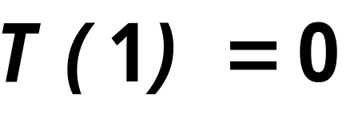
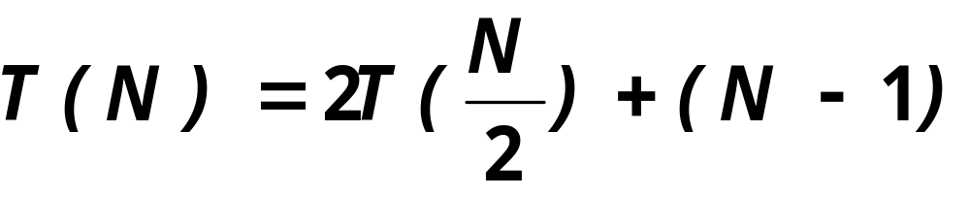
ANALYSIS OF MERGESORT
So, the recurrence looks like this

Slide 51
ANALYSIS OF MERGESORT
So, the recurrence looks like this
Cost of the merge
Costs of the subproblems

Slide 52
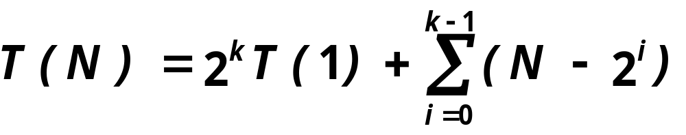
ANALYSIS OF MERGESORT
This recurrence can be solved by (repeated)
expansion into

Slide 53
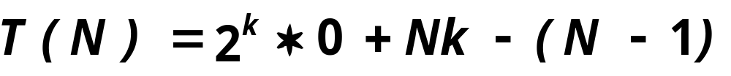
ANALYSIS OF MERGESORT
This recurrence can be solved by (repeated)
expansion into

Slide 54
ANALYSIS OF MERGESORT
This recurrence can be solved by (repeated)
expansion into
Since k = log₂ N

Slide 55
MERGESORT
Although Mergesort is quite fast and asymptotically optimal, there are two important problems:

Slide 56
MERGESORT
Although Mergesort is quite fast and asymptotically optimal, there are two important problems:
  It uses extra memory (another array of same size)
  Copying between two arrays slows down the sort considerably

Slide 57
MERGESORT
Although Mergesort is quite fast and asymptotically optimal, there are two important problems:
  It uses extra memory (another array of same size)
  Copying between two arrays slows down the sort considerably
It is possible to implement some minor optimizations for these but no really significant improvements.

Slide 58
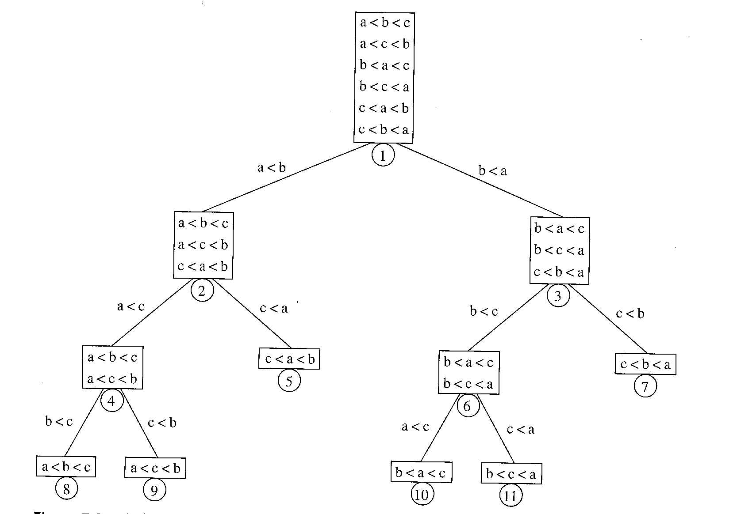
Comparison-based sorting
A Decision Tree to sort 3 numbers

Slide 59
Comparison-based sorting
Let T be a binary tree of height d, then T has at most 2^{d} leaves.

Slide 60
Comparison-based sorting
Let T be a binary tree of height d, then T has at most 2^{d} leaves.
A binary tree of L leaves must have a height of at least ⎡log L⎤.

Slide 61
Comparison-based sorting
Any sorting algorithm that uses only comparisons between elements requires at least ⎡log (N!)⎤ comparisons in the worst case.
  Decision tree to sort has N! leaves

Slide 62
Comparison-based sorting
Any sorting algorithm that uses only comparisons between elements requires Ω(N log N) comparisons.
  log (N!) = log N + log N-1+ … log 2 + log 1
  ≥ log N + log N-1 + … + log (N/2)
  ≥ (N/2) * log (N/2)
  ≥ (N/2) log N – N/2
  = Ω(N log N)

Slide 63
QUICKSORT
Fastest known sorting algorithm with an average running time of O(N log N), (but O(N²) worst case performance)

Slide 64
QUICKSORT
Fastest known sorting algorithm with an average running time of O(N log N), (but O(N²) worst case performance)
Like Mergesort, it is a divide and conquer algorithm.

Slide 65
QUICKSORT
Basic Quicksort sorting an array S works as follows:
  If the number of elements in S is 0 or 1, then return.
  Pick any element v in S. Call this pivot.
  Partition the set S-{v} into two disjoint groups:
    S₁ = {x ε S-{v} | x ≤ v}
    S₂ = {x ε S-{v} | x ≥ v}

Slide 66
QUICKSORT
Basic Quicksort sorting an array S works as follows:
  If the number of elements in S is 0 or 1, then return.
  Pick any element v in S. Call this pivot.
  Partition the set S-{v} into two disjoint groups:
    S₁ = {x ε S-{v} | x ≤ v}
    S₂ = {x ε S-{v} | x ≥ v}
Intentional ambiguity

Slide 67
QUICKSORT
Basic Quicksort sorting an array S works as follows:
  If the number of elements in S is 0 or 1, then return.
  Pick any element v in S. Call this pivot.
  Partition the set S-{v} into two disjoint groups:
    S₁ = {x ε S-{v} | x ≤ v}
    S₂ = {x ε S-{v} | x ≥ v}
  Return quicksort(S₁) followed by v followed by quicksort(S₂)

Slide 68
QUICKSORT
13
45
14
56
34
32
31
21
78
Select Pivot
13
45
14
56
34
32
31
21
78

Slide 69
QUICKSORT
13
45
14
56
34
32
31
21
78
Partition around Pivot
13
31
21
56
34
45
14
32
78

Slide 70
QUICKSORT
13
31
21
56
34
45
14
32
78
Quicksort recursively
13
14
21
31
32
34
45
56
78
13
14
21
31
32
34
45
56
78

Slide 71
QUICKSORT-DETAILS
Picking the pivot value:
  Pick the first element

Slide 72
QUICKSORT-DETAILS
Picking the pivot value:
  Pick the first element
  Pick some element randomly

Slide 73
QUICKSORT-DETAILS
Picking the pivot value:
  Pick the first element
  Pick some element randomly
  Pick an element slightly cleverly

Slide 74
PICKING THE PIVOT
Picking the first element as the pivot
  Works OK if the input is random

Slide 75
PICKING THE PIVOT
Picking the first element as the pivot
  Works OK if the input is random
  Works quite bad if the input is already (almost) sorted (or reverse sorted, or has large sorted subsections)
    All elements go to S1 or S2
    This happens consistently in the recursive steps
    Takes quadratic time to do essentially nothing!

Slide 76
PICKING THE PIVOT
Picking the first element as the pivot
  Works OK if the input is random
  Works quite bad if the input is already (almost) sorted (or reverse sorted, or has large sorted subsections)
    All elements go to S1 or S2
    This happens consistently in the recursive steps
    Takes quadratic time to do essentially nothing!
  Do not use this pivoting strategy at all!

Slide 77
PICKING THE PIVOT
Pick a random element as the pivot
  Generally a safe technique ...

Slide 78
PICKING THE PIVOT
Pick a random element as the pivot
  Generally a safe technique ...
  unless the random number generator has a flaw

Slide 79
PICKING THE PIVOT
Pick a random element as the pivot
  Generally a safe technique ...
  unless the random number generator has a flaw
  It is very unlikely that a random pivot would consistently provide a poor partition

Slide 80
PICKING THE PIVOT
Pick a random element as the pivot
  Generally a safe technique ...
  unless the random number generator has a flaw
  It is very unlikely that a random pivot would consistently provide a poor partition
  use it if you do not want to do anything complicated

Slide 81
PICKING THE PIVOT
Median-of-Three Partitioning

Slide 82
PICKING THE PIVOT
Median-of-Three Partitioning
The median of N numbers is the number located at position ⎡N/2⎤ when they are sorted.

Slide 83
PICKING THE PIVOT
Median-of-Three Partitioning
The median of N numbers is the number located at position ⎡N/2⎤ when they are sorted.
But, computing the median is NOT easy
Possible approximations
  Pick three elements randomly and then pick the middle element as the (approximate) median.

Slide 84
PICKING THE PIVOT
Median-of-Three Partitioning
Possible approximations
  Pick three elements randomly and then pick the middle element as the (approximate) median.
  Pick the median of the 1st, last and the center element.
    8,1,4,9,6,3,5,2,7,0

Slide 85
PICKING THE PIVOT
Median-of-Three Partitioning
Possible approximations
  Pick three elements randomly and then pick the middle element as the (approximate) median.
  Pick the median of the 1st, last and the center element.
    8,1,4,9,6,3,5,2,7,0

Slide 86
PICKING THE PIVOT
Median-of-Three Partitioning
Possible approximations
  Pick three elements randomly and then pick the middle element as the (approximate) median.
  Pick the median of the 1st, last and the center element.
    8,1,4,9,6,3,5,2,7,0
    Choose 6
  Eliminates the problem with (almost) sorted input.

