Slide 1
QUICKSORT
Fastest known sorting algorithm with an average running time of O(N log N), (but O(N²) worst case performance)

Slide 2
QUICKSORT
Fastest known sorting algorithm with an average running time of O(N log N), (but O(N²) worst case performance)
Like Mergesort, it is a divide and conquer algorithm.

Slide 3
QUICKSORT
Basic Quicksort sorting an array S works as follows:
  If the number of elements in S is 0 or 1, then return.
  Pick any element v in S. Call this pivot.
  Partition the set S-{v} into two disjoint groups:
    S₁ = {x ε S-{v} | x ≤ v}
    S₂ = {x ε S-{v} | x ≥ v}

Slide 4
QUICKSORT
Basic Quicksort sorting an array S works as follows:
  If the number of elements in S is 0 or 1, then return.
  Pick any element v in S. Call this pivot.
  Partition the set S-{v} into two disjoint groups:
    S₁ = {x ε S-{v} | x ≤ v}
    S₂ = {x ε S-{v} | x ≥ v}
Intentional ambiguity

Slide 5
QUICKSORT
Basic Quicksort sorting an array S works as follows:
  If the number of elements in S is 0 or 1, then return.
  Pick any element v in S. Call this pivot.
  Partition the set S-{v} into two disjoint groups:
    S₁ = {x ε S-{v} | x ≤ v}
    S₂ = {x ε S-{v} | x ≥ v}
  Return quicksort(S₁) followed by v followed by quicksort(S₂)

Slide 6
QUICKSORT-DETAILS
Picking the pivot value:
  Pick the first element
  Pick some element randomly
  Pick an element slightly cleverly (Median of First, Last and Middle elements)

Slide 7
PARTITIONING STRATEGY
Once a pivot is picked we need to quickly partition the array around this pivot.
  Swap the pivot with the rightmost element

Slide 8
PARTITIONING STRATEGY
Once a pivot is picked we need to quickly partition the array around this pivot.
  Swap the pivot with the rightmost element
  Scan from both ends swapping out of place elements (until no swaps are possible)
  Put pivot back into place

Slide 9
PARTITIONING
13, 32, 45, 34, 21,31, 56, 78
Select Pivot

Slide 10
PARTITIONING
13, 32, 45, 34, 21,31, 56, 78
Select Pivot
13, 32, 45, 78, 21,31, 56, 34
Swap Pivot
and last element

Slide 11
PARTITIONING
13, 32, 45, 34, 21,31, 56, 78
Select Pivot
13, 32, 45, 78, 21,31, 56, 34
Swap Pivot
and last element
i
j

Slide 12
PARTITIONING
Move i right until an element larger than the pivot is found
13, 32, 45, 78, 21,31, 56, 34
i
j

Slide 13
PARTITIONING
Move i right until an element larger than the pivot is found
13, 32, 45, 78, 21,31, 56, 34
i
Move j left until an element smaller than the pivot is found
13, 32, 45, 78, 21,31, 56, 34
i
j

Slide 14
PARTITIONING
Move i right until an element larger than the pivot is found
13, 32, 45, 78, 21,31, 56, 34
Move j left until an element smaller than the pivot is found
13, 32, 45, 78, 21,31, 56, 34
i is smaller than j, so swap the elements
13, 32, 31, 78, 21,45, 56, 34
i
j

Slide 15
PARTITIONING
Move i right until an element larger than the pivot is found
13, 32, 31, 78, 21,45, 56, 34
i
j

Slide 16
PARTITIONING
Move i right until an element larger than the pivot is found
13, 32, 31, 78, 21,45, 56, 34
i
j
Move j left until an element smaller than the pivot is found
13, 32, 31, 78, 21,45, 56, 34
i
j

Slide 17
PARTITIONING
Move i right until an element larger than the pivot is found
13, 32, 31, 78, 21,45, 56, 34
Move j left until an element smaller than the pivot is found
13, 32, 31, 78, 21,45, 56, 34
i is smaller than j, so swap the elements
13, 32, 31, 21, 78,45, 56, 34
i
j

Slide 18
PARTITIONING
Move i right until an element larger than the pivot is found
13, 32, 31, 21, 78,45, 56, 34
i,j

Slide 19
PARTITIONING
Move i right until an element larger than the pivot is found
13, 32, 31, 21, 78,45, 56, 34
i,j
Move j left until an element smaller than the pivot is found
13, 32, 31, 21, 78,45, 56, 34
j
i

Slide 20
PARTITIONING
Move i right until an element larger than the pivot is found
13, 32, 31, 21, 78,45, 56, 34
Move j left until an element smaller than the pivot is found
13, 32, 31, 21, 78,45, 56, 34
i and j have crossed, swap
pivot with element at i
13, 32, 31, 21, 34,45, 56, 78

Slide 21
PARTITIONING
13, 32, 31, 21, 34, 45, 56, 78
At this stage we know
Every element at position p < i is less than the pivot
Every element at position p > i is greater than the pivot

Slide 22
PARTITIONING
What should we do about elements equal to the pivot?

Slide 23
PARTITIONING
What should we do about elements equal to the pivot?
Should i and j stop when they see elements equal to the pivot?

Slide 24
PARTITIONING
What should we do about elements equal to the pivot?
Should i and j stop when they see elements equal to the pivot?
Intuitively
  They should do the same thing, otherwise they will cause an imbalance.

Slide 25
PARTITIONING
What should we do about elements equal to the pivot?
Should i and j stop when they see elements equal to the pivot?
Intuitively
  They should do the same thing, otherwise they will cause an imbalance.
  For instance if i stops and j does not stop all elements equal to the pivot end up in S₂

Slide 26
PARTITIONING
If i and j both stop when they see elements equal to the pivot, there will be many swaps between identical elements.

Slide 27
PARTITIONING
Consider the case where all items are equal:
a, a, a, a, a, a
i
i
i
i
j
i

Slide 28
PARTITIONING
Consider the case where all items are equal:
a, a, a, a, a, a
i
j
j
i
i
j

Slide 29
PARTITIONING
Consider the case where all items are equal:
  If i and j both stop, there will be many swaps between identical elements.

Slide 30
PARTITIONING
Consider the case where all items are equal:
  If i and j both stop, there will be many swaps between identical elements.
  Although this seems useless, the positive effect is that i and j will cross in the middle, so the partition creates (nearly) equal sized partitions.

Slide 31
PARTITIONING
Consider the case where all items are equal:
  If i and j both stop, there will be many swaps between identical elements.
  Although this seems useless, the positive effect is that i and j will cross in the middle, so the partition creates (nearly) equal sized partitions.
  Consequently, if i and j do NOT stop, this would create very uneven partitions. (similar to choosing the first element!)

Slide 32
SMALL ARRAYS
Some O(N²) sorting algorithms (e.g., Insertion sort) actually perform better (than Quicksort) when N is small (5 ≤ N ≤ 20).
So one can use these methods in place of the recursive call to Quicksort when the array size is small.

Slide 33
quicksort
/**
* Quicksort algorithm (driver).
*/
template <class Comparable>
void quicksort( vector<Comparable> & a )
{
quicksort( a, 0, a.size( ) - 1 );
}

Slide 34
swap
/**
* Standard swap
*/
template <class Comparable>
inline void swap( Comparable & obj1, Comparable & obj2 )
{
Comparable tmp = obj1;
obj1 = obj2;
obj2 = tmp;
}

Slide 35
median3
/**
* Return median of left, center, and right.
* Order these and hide the pivot.
*/
template <class Comparable>
const Comparable & median3( vector<Comparable> & a, int left, int right )
{
int center = ( left + right ) / 2;
if( a[ center ] < a[ left ] )
swap( a[ left ], a[ center ] );
if( a[ right ] < a[ left ] )
swap( a[ left ], a[ right ] );
if( a[ right ] < a[ center ] )
swap( a[ center ], a[ right ] );
// Place pivot at position right - 1
swap( a[ center ], a[ right - 1 ] );
return a[ right - 1 ];
}

Slide 36
median3
/**
* Return median of left, center, and right.
* Order these and hide the pivot.
*/
template <class Comparable>
const Comparable & median3( vector<Comparable> & a,
int left, int right )
{
int center = ( left + right ) / 2;
if( a[ center ] < a[ left ] )
swap( a[ left ], a[ center ] );
if( a[ right ] < a[ left ] )
swap( a[ left ], a[ right ] );
if( a[ right ] < a[ center ] )
swap( a[ center ], a[ right ] );
// Place pivot at position right - 1
swap( a[ center ], a[ right - 1 ] );
return a[ right - 1 ];
}
Sort the numbers at left,right
and center
Smallest ends up at left,
largest ends up at right

Slide 37
median3
What are we supposed to do beside finding the median?

Slide 38
median3
What are we supposed to do beside finding the median?
  swap median with the element on the right

Slide 39
median3
What are we supposed to do beside finding the median?
  swap median with the element on the right
  initialize i and j

Slide 40
median3
What are we supposed to do beside finding the median?
  swap median with the element on the right
  initialize i and j
s
.........
C
.........
L
After sort
Left
Center
Right

Slide 41
median3
What are we supposed to do beside finding the median?
  swap median with the element on the right
  initialize i and j
s
.........
C
.........
L
After sort
Left
Center
Right
s
.........
L
.........
C
After swap
Left
Center
Right

Slide 42
median3
What are we supposed to do beside finding the median?
  swap median with the element on the right
  initialize i and j
s
.........
C
.........
L
After sort
Left
Center
Right
s
.........
L
.........
C
After swap
Left
Center
Right
s
.........
L
.........
C
After initialization
of i and j
Left
Center
Right
i
j

Slide 43
median3
What are we supposed to do beside finding the median?
  swap median with the element on the right
  initialize i and j
What is the problem here?
s
.........
C
.........
L
After sort
Left
Center
Right
s
.........
L
.........
C
After swap
Left
Center
Right
s
.........
L
.........
C
After initialization
of i and j
Left
Center
Right
i
j

Slide 44
median3
s
.........
C
.........
X
L
After sort
Left
Center
Right

Slide 45
median3
s
.........
C
.........
X
L
After sort
Left
Center
Right
After the partitioning, we know that L will be to the right
of C, so why put it to the left first and then fix?
s
.........
X
.........
C
L
After swap
Left
Center
Right
Right-1

Slide 46
median3
s
.........
C
.........
X
L
After sort
Left
Center
Right
After the partitioning, we know that L will be to the right
of C, so why put it to the right first and then fix?
s
.........
X
.........
C
L
After swap
Left
Center
Right
Right-1
We can initalize j to Right – 2, and i to Left+1
s
.........
X
.........
C
L
After swap
Left
Center
Right
i
j

Slide 47
median3
/**
* Return median of left, center, and right.
* Order these and hide the pivot.
*/
template <class Comparable>
const Comparable & median3( vector<Comparable> & a,
int left, int right )
{
int center = ( left + right ) / 2;
if( a[ center ] < a[ left ] )
swap( a[ left ], a[ center ] );
if( a[ right ] < a[ left ] )
swap( a[ left ], a[ right ] );
if( a[ right ] < a[ center ] )
swap( a[ center ], a[ right ] );
// Place pivot at position right - 1
swap( a[ center ], a[ right - 1 ] );
return a[ right - 1 ];
}
Place median at
right - 1

Slide 48
(internal) quicksort
/**
* Internal quicksort method that makes recursive calls.
* Uses median-of-three partitioning and a cutoff of 10.
* a is an array of Comparable items.
* left is the left-most index of the subarray.
* right is the right-most index of the subarray.
*/
template <class Comparable>
void quicksort( vector<Comparable> & a, int left, int right )
{
if( left + 10 <= right ) // more than 10 elements
{
Comparable pivot = median3( a, left, right );

Slide 49
(internal) quicksort
// Begin partitioning
int i = left, j = right - 1;
for( ; ; )
{
while( a[ ++i ] < pivot ) { }
while( pivot < a[ --j ] ) { }
if( i < j )
swap( a[ i ], a[ j ] );
else
break;
}

Slide 50
(internal) quicksort
swap( a[ i ], a[ right - 1 ] ); // Restore pivot
quicksort( a, left, i - 1 ); // Sort small elements
quicksort( a, i + 1, right ); // Sort large elements
}
else // Do an insertion sort on the subarray
insertionSort( a, left, right );
}

Slide 51
(internal) insertionsort
/**
* Internal insertion sort routine for subarrays
* that is used by quicksort.
* a is an array of Comparable items.
* left is the left-most index of the subarray.
* right is the right-most index of the subarray.
*/
template <class Comparable>
void insertionSort( vector<Comparable> & a, int left, int right )
{
for( int p = left + 1; p <= right; p++ )
{
Comparable tmp = a[ p ];
int j;
for( j = p; j > left && tmp < a[ j - 1 ]; j-- )
a[ j ] = a[ j - 1 ];
a[ j ] = tmp;
}
}

Slide 52
QUICKSORT IN ACTION
Quicksort Simulation
  http://math.hws.edu/TMCM/java/xSortLab/index.html
Another Sort Simulation Page
  http://www.csc.depauw.edu/~bhoward/courses/0203Fall/csc222/sort/

Slide 53
ANALYSIS OF QUICKSORT

Slide 54
ANALYSIS OF QUICKSORT
Time to solve the subproblems
Time to partition

Slide 55

ANALYSIS OF QUICKSORT
Worst Case
The pivot is the smallest element always
i = 0 (assuming T(0) =T(1) = 0)

Slide 56
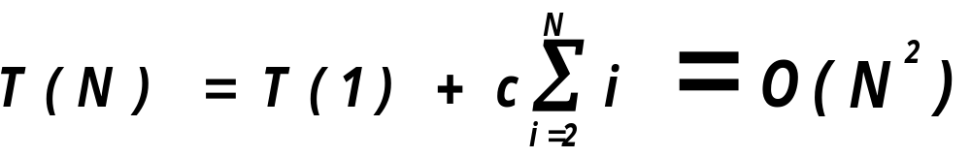
ANALYSIS OF QUICKSORT
Worst Case
The pivot is the smallest element always
i = 0 (assuming T(0) =T(1) = 0)

Slide 57
ANALYSIS OF QUICKSORT
Best Case
The pivot is always in the middle
We assume T(0) =T(1) = 0
We assume two subparts are equal!

Slide 58
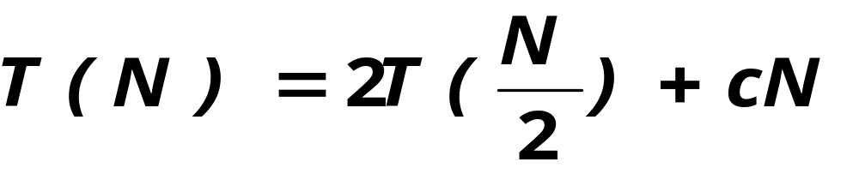
ANALYSIS OF QUICKSORT
Best Case
The pivot is always in the middle
We assume T(0) =T(1) = 0
We assume two subparts are equal!

Slide 59
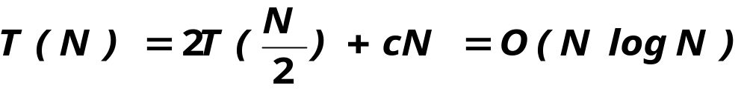
ANALYSIS OF QUICKSORT
Best Case
The pivot is always in the middle
We assume T(0) =T(1) = 0
We assume two subparts are equal!

Slide 60
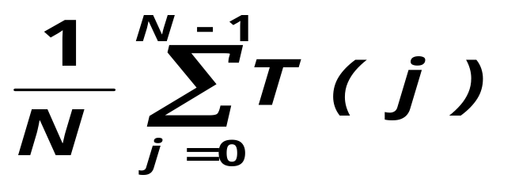
ANALYSIS OF QUICKSORT
Average Case:
We assume each of the sizes of S₁ is
equally likely (with probability 1/N)
Average value of T(i) (and also T(N-i-1)) is

Slide 61
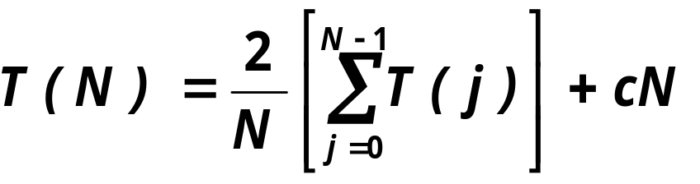
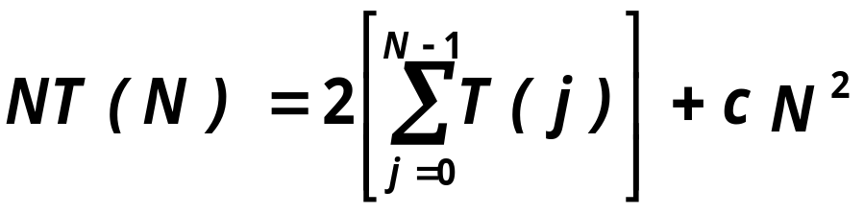
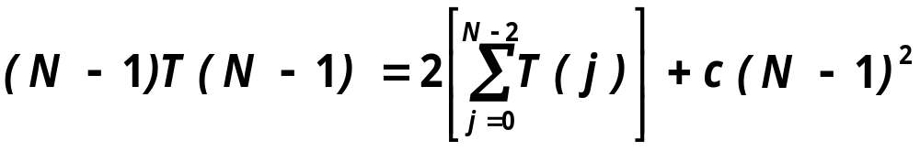
ANALYSIS OF QUICKSORT
Thus the equation becomes
which when multiplied by N becomes
which we can telescope with one more equation

Slide 62
ANALYSIS OF QUICKSORT
Subtracting
gives

Slide 63
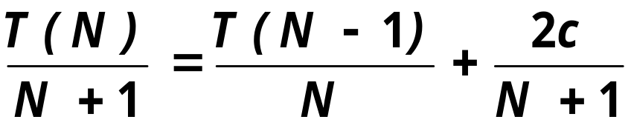
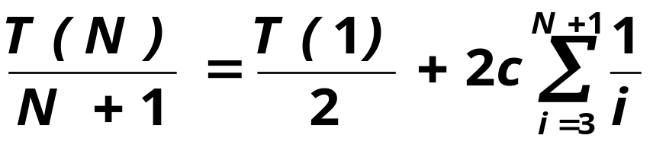
ANALYSIS OF QUICKSORT
Rearranging and dropping c gives
Dividing by N(N+1)
Now telescoping all the way down to T(2) we get

Slide 64
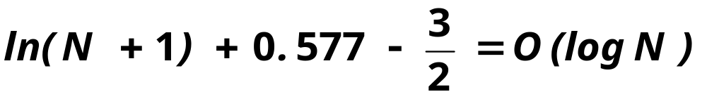
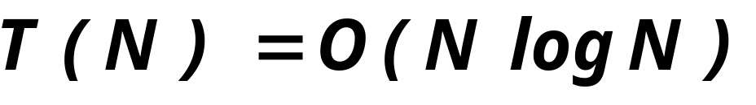
ANALYSIS OF QUICKSORT
Now T(1) is 0 and the sum is
Thus

Slide 65
SELECTION PROBLEM
Find the k^{th} largest (or smallest) element.

Slide 66
SELECTION PROBLEM
Find the k^{th} largest (or smallest) element.
We saw algorithms using a heap (best was O(N log k))

Slide 67
SELECTION PROBLEM
Find the k^{th} largest (or smallest) element.
We saw algorithms using a heap (best was O(N log k))
We can change Quicksort a bit to obtain a linear expected time algorithm for selection.

Slide 68
QUICK SELECT
Given a set S and k, the quick select operates as follows:
  If ⏐S⏐= 1, then k=1 and return the element in S as the result.
    If a cutoff for small arrays is used, and ⏐S⏐≤ CUTOFF, the sort S and return the k^{th} element.

Slide 69
QUICK SELECT
Given a set S and a k, the quick select operates as follows:
  Otherwise pick a pivot element v,
  Partition S – {v}, just as we did for quicksort.
  If k ≤ ⏐S₁⏐, then the k^{th} smallest element is in S₁. Return quickselect(S₁, k)
  If k = ⏐S₁⏐+1, then return v as the answer.
  If k > ⏐S₁⏐+1, then return quickselect(S₂, k -⏐S₁⏐-1)

Slide 70
QUICK SELECT
Quick select makes one recursive call instead of two of quicksort.

Slide 71
QUICK SELECT
Quick select makes one recursive call instead of two of quicksort.
  Worst case is O(N²)

Slide 72
QUICK SELECT
Quick select makes one recursive call instead of two of quicksort.
  Worst case is O(N²)
  Average case is O(N)

