Slide 1
TRAVERSING A BINARY TREE
To put the nodes of a binary tree into a linear order we use the notion of a traversal.

Slide 2
TRAVERSING A BINARY TREE
To put the nodes of a binary tree into a linear order we use the notion of a traversal.
  Pre-order traversal
  Post-order traversal
  In-order traversal

Slide 3
PRE-ORDER TRAVERSAL
Do something with the root
Process the left-tree (if any)
Process the right-tree (if any)

Slide 4
PRE-ORDER TRAVERSAL
Do something with the root
Process the left-tree (if any)
Process the right-tree (if any)
14
14, 3, 1, 0, 2, 5, 4, 7, 17, 19, 18, 22
3
1
5
17
0
2
4
7
19
18
22

Slide 5
POST-ORDER TRAVERSAL
Process the left-tree (if any)
Process the right-tree (if any)
Do something with the root

Slide 6
POST-ORDER TRAVERSAL
Process the left-tree (if any)
Process the right-tree (if any)
Do something with the root
0, 2, 1, 4, 7, 5, 3, 18, 22, 19, 17, 14
14
14
3
3
1
1
5
5
17
17
19
0
19
0
2
2
4
4
7
7
18
22
18
22

Slide 7
IN-ORDER TRAVERSAL
Process the left-tree (if any)
Do something with the root
Process the right-tree (if any)

Slide 8
IN-ORDER TRAVERSAL
Process the left-tree (if any)
Do something with the root
Process the right-tree (if any)
14
14
0,1,2,3,4,5,7,14,17,18,19,22
3
3
1
1
5
5
17
17
19
0
19
0
2
2
4
4
7
7
18
22
18
22

Slide 9
IN-ORDER TRAVERSAL
Process the left-tree (if any)
Do something with the root
Process the right-tree (if any)
14
14
0,1,2,3,4,5,7,14,17,18,19,22
3
3
Note that in-order traversal of a
binary search tree orders nodes in an
ascending order.
1
1
5
5
17
17
19
0
19
0
2
2
4
4
7
7
18
22
18
22

Slide 10
(private) printTree
/**
* Internal method to print a subtree rooted at t in sorted order.
*/
template <class Comparable>
void BinarySearchTree<Comparable>::
printTree( BinaryNode<Comparable> *t ) const
{
if( t != NULL )
{
printTree( t->left );
cout << t->element << endl;
printTree( t->right );
}
}

Slide 11
(private) printTree
/**
* Internal method to print a subtree rooted at t in sorted order.
*/
template <class Comparable>
void BinarySearchTree<Comparable>::
printTree( BinaryNode<Comparable> *t ) const
{
if( t != NULL )
{
printTree( t->left );
cout << t->element << endl;
printTree( t->right );
}
}
Inorder traversal of the nodes of a tree

Slide 12
(private) clone
/**
* Internal method to clone subtree.
*/
template <class Comparable>
BinaryNode<Comparable> *
BinarySearchTree<Comparable>::
clone( BinaryNode<Comparable> * t ) const
{
if( t == NULL )
return NULL;
else
return new
BinaryNode<Comparable>( t->element, clone( t->left ), clone( t->right ) );
}

Slide 13
SIMPLE BST APPLICATION
#include <iostream.h>
#include <stdlib.h>
#include "BinarySearchTree.h"
// Test program
int main( )
{
const int ITEM_NOT_FOUND = -9999;
BinarySearchTree<int> t( ITEM_NOT_FOUND );
int i;
for (i=0; i < 10 ; i++)
t.insert(rand());
t.printTree();
cout << "Minimum Value " << t.findMin() << endl;
cout << "Maximum Value " << t.findMax() << endl;

Slide 14
SIMPLE BST APPLICATION
if (t.find(41) == ITEM_NOT_FOUND)
cout << " Value " << 41 << " Not Found "<<endl;
else
cout << " Value " << 41 << " Found "<<endl;
if (t.find(49) == ITEM_NOT_FOUND)
cout << " Value " << 49 << " Not Found "<<endl;
else
cout << " Value " << 49 << " Found "<<endl;
t.remove(41);
if (t.find(41) == ITEM_NOT_FOUND)
cout << " Value " << 41 << " Not Found "<<endl;
else
cout << " Value " << 41 << " Found "<<endl;
return 0;
}

Slide 15
SIMPLE BST APPLICATION
41
6334
11478
15724
18467
19169
24464
26500
26962
29358
Minimum Value 41
Maximum Value 29358
Value 41 Found
Value 49 Not Found
Value 41 Not Found

Slide 16
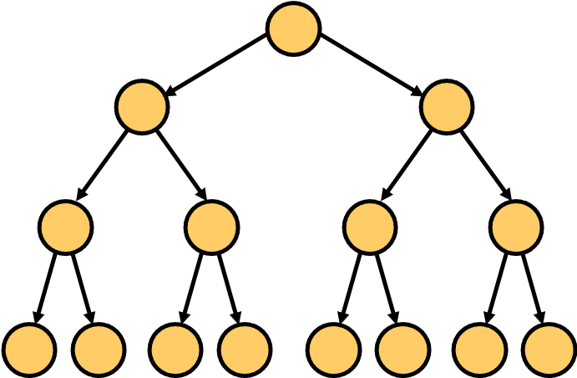
AVERAGE-CASE ANALYSIS
Intuitively all operations (except makeEmpty, operator= and printTree) on binary search trees (seem to) take O(log N) time.
  In constant time we descend a level in the tree, and
  Work on a tree roughly half the size

Slide 17
AVERAGE-CASE ANALYSIS
Intuitively all operations (except makeEmpty, operator= and printTree) on binary search trees (seem to) take O(log N) time.
  In constant time we descend a level in the tree, and
  Work on a tree roughly half the size
Indeed, the running time of almost all the operations on a binary tree is O(d) where d is the depth of the item accessed.

Slide 18
AVERAGE-CASE ANALYSIS
Assuming all insertion sequences are equally likely
We can prove the average depth of all nodes is O(log N)

Slide 19
INTERNAL PATH LENGTH
The sum of the depths of all the nodes in a tree is called the internal path length
14
14
3
3
1
1
5
5
17
17
19
0
19
0
2
2
4
4
7
7
18
22
18
22

Slide 20
INTERNAL PATH LENGTH
The sum of the depths of all the nodes in a tree is called the internal path length
14
0
14
3
1
3
1
1
5
5
2
17
1
2
17
19
0
19
0
2
2
4
4
7
7
2
3
3
3
3
3
18
22
3
18
22

Slide 21
INTERNAL PATH LENGTH
The sum of the depths of all the nodes in a tree is called the internal path length
the internal path length =
0 + 1 + 2 + 2 + 3 + 3 + 3 + 3 +
1 + 2 + 3 + 3 = 26
Average Depth = 26 / 12 = 2.16
14
0
14
3
1
3
1
1
5
5
2
17
1
2
17
19
0
19
0
2
2
4
4
7
7
2
3
3
3
3
3
18
22
3
18
22

Slide 22
INTERNAL PATH LENGTH
The sum of the depths of all the nodes in a tree is called the internal path length
IPL = 10
14
14
3
0
3
IPL = 5
1
1
5
5
1
17
0
1
17
19
0
19
0
2
2
4
4
7
7
1
2
2
2
2
2
18
22
2
18
22

Slide 23
INTERNAL PATH LENGTH
The sum of the depths of all the nodes in a tree is called the internal path length
IPL = 10 + 5 + 7 + 4
14
14
3
0
3
1
1
5
5
1
17
0
1
17
19
0
19
0
2
2
4
4
7
7
1
2
2
2
2
2
18
22
2
18
22

Slide 24
INTERNAL PATH LENGTH
The sum of the depths of all the nodes in a tree is called the internal path length
IPL = 10 + 5 + 7 + 4
14
14
3
0
3
1
1
5
5
1
17
0
1
17
19
0
19
0
2
2
4
4
7
7
1
2
2
2
2
2
18
22
2
18
22

Slide 25
INTERNAL PATH LENGTH
The sum of the depths of all the nodes in a tree is called the internal path length
IPL = 10 + 5 + 7 + 4
14
14
3
0
3
1
1
5
5
1
17
0
1
17
19
0
19
0
2
2
4
4
7
7
1
2
2
2
2
2
18
22
2
18
22

Slide 26
INTERNAL PATH LENGTH
The sum of the depths of all the nodes in a tree is called the internal path length
IPL = 10 + 5 + 7 + 4
14
14
3
0
3
1
1
5
5
1
17
0
1
17
19
0
19
0
2
2
4
4
7
7
1
+1 for each node on the
left subtree
2
2
2
2
2
18
22
2
18
22

Slide 27
INTERNAL PATH LENGTH
The sum of the depths of all the nodes in a tree is called the internal path length
IPL = 10 + 5 + 7 + 4
14
14
3
0
3
+1 for each
node on the
right subtree
1
1
5
5
1
17
0
1
17
19
0
19
0
2
2
4
4
7
7
1
+1 for each node on the
left subtree
2
2
2
2
2
18
22
2
18
22

Slide 28
COMPUTING IPL
Let D(N) be the IPL of a tree with N nodes.
  D(1) = 0

Slide 29
COMPUTING IPL
Let D(N) be the IPL of a tree with N nodes.
  D(1) = 0
An N-node tree consists of a root (1) a left subtree of i nodes and a right subtree of N – i – 1 nodes. So:

Slide 30
COMPUTING IPL
Let D(N) be the IPL of a tree with N nodes.
  D(1) = 0
An N-node tree consists of a root (1) a left subtree of i nodes and a right subtree of N – i – 1 nodes. So:
  D(N) = D(i) + D(N-i–1) + N-1

Slide 31
COMPUTING IPL
Let D(N) be the IPL of a tree with N nodes.
  D(1) = 0
An N-node tree consists of a root (1) a left subtree of i nodes and a right subtree of N – i – 1 nodes. So:
  D(N) = D(i) + D(N-i–1) + N-1
    These are with respect to their own roots!
    This is the additional 1 for each of the nodes in the subtrees since they now are 1 level deeper.

Slide 32
COMPUTING AVERAGE IPL
If all subtree sizes are equally likely, then the average values of D(i) and D(N-i-1) are
    (1/N) D(j)
i | D(i)
0 | D(0)
1 | D(1)
2 | D(2)
... | ...
N-2 | D(N-2)
N-1 | D(N-1)
N-i-1 | D(N-i-1)
N-1 | D(N-1)
N-2 | D(N-2)
... | ...
2 | D(2)
1 | D(1)
0 | D(0)
N -1
Σ
j=0

Slide 33
COMPUTING AVERAGE IPL
  IPL
    D(1) = 0
    D(N) = D(i) + D(N-i–1) + N-1
Thus average D(N) is
    D(N) = (2 / N) D(j) + N - 1
N -1
Σ
j=0

Slide 34
COMPUTING AVERAGE IPL
Thus average D(N) is
    D(N) = (2 / N) D(j) + N - 1
N -1
Σ
j=0

Slide 35
COMPUTING AVERAGE IPL
Thus average D(N) is
    D(N) = (2 / N) D(j) + N – 1
    N D(N) = 2 D(j) + N² – N
Similarly
    (N-1) D(N-1) = 2 D(j) + (N-1)² – (N-1)
N -1
Σ
j=0
N -1
Σ
j=0
N -2
Σ
j=0

Slide 36
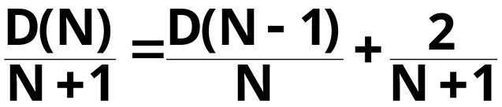
COMPUTING AVERAGE IPL
Subtracting we get
Ignoring the 2, we get
Dividing by N(N+1), we get

Slide 37
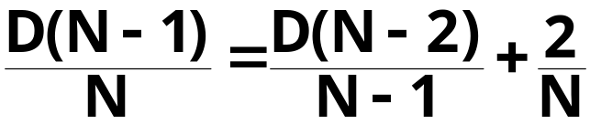
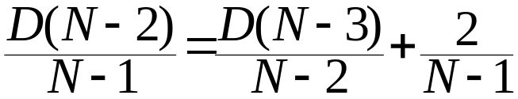
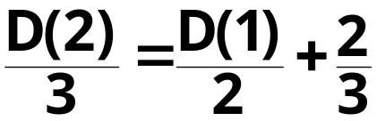
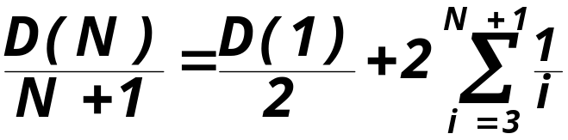
COMPUTING AVERAGE IPL
We use telescoping
....
Adding up we get

Slide 38
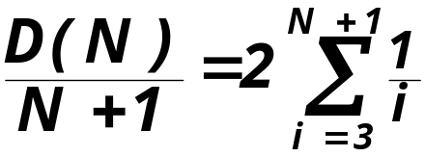
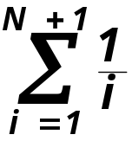
COMPUTING AVERAGE IPL
D(1) = 0, so we get
Now is known as the (N+1)^{st} Harmonic Number (H_{N+1}) ≅ log_{e}(N+1) + 0.577
So, D(N)/(N+1) = O(log N)
D(N)=O(N log N)
Average Depth O(log N)

Slide 39
AVERAGE RUNNING TIME
This however does not necessarily imply that the average time of all the operations is O(log N).

Slide 40
AVERAGE RUNNING TIME
This however does not necessarily imply that the average time of all the operations is O(log N).
Because of deletions, it is not clear all binary search trees are equally likely.
Our deletion makes the left subtree deeper than the right subtree.

Slide 41
AVERAGE RUNNING TIME
Let’s insert the following numbers into an initially empty binary search tree in the order they are given: 10, 27, 33, 45
10
27
33
35

Slide 42
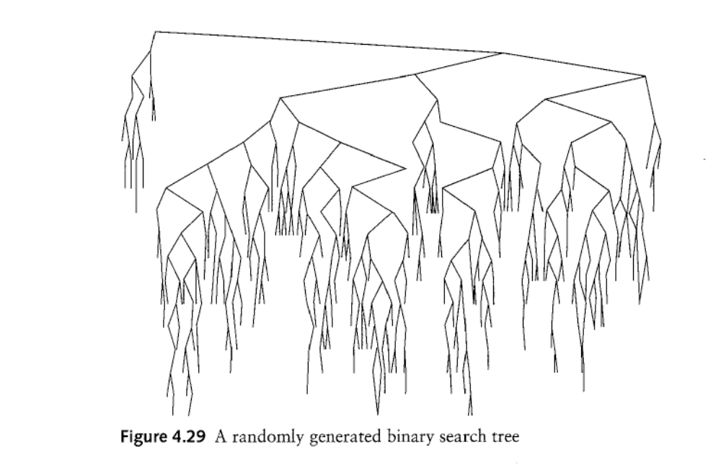
UNBALANCED BSTs

Slide 43
BALANCED BST
Basic binary search trees have this unwanted property that after many insertions and deletions, the tree may become unbalanced, that is, it may be heavy on one side.

Slide 44
BALANCED BST
Basic binary search trees have this unwanted property that after many insertions and deletions, the tree may become unbalanced, that is, it may be heavy on one side.
Solution: Balanced binary search trees

Slide 45
BALANCED BST
Basic binary search trees have this unwanted property that after many insertions and deletions, the tree may become unbalanced, that is, it may be heavy on one side.
Solution: Balanced binary search trees
  AVL (Adelson-Velskii and Landis) trees
  Splay Trees

Slide 46
BALANCED BST
AVL (Adelson-Velskii and Landis) trees
  Any insert or remove operation takes O(log N) time and ensures that the depth of the tree is O(log N)

Slide 47
BALANCED BST
AVL (Adelson-Velskii and Landis) trees
  Any insert or remove operation takes O(log N) time and ensures that the depth of the tree is O(log N)
Splay Trees
  Any consecutive M tree operations (insert, remove, find) take total O(M log N) time, but some individual operations may actually take O(N) time. So, on the average, each operation takes O(log N) time.

Slide 48
AVL TREES
An AVL tree is a binary search tree with the additional property that
  for every node in the tree the height of its left and right subtrees can not differ by more than 1.
  (height of an empty tree is –1)

Slide 49
AVL TREES
5
5
2
8
1
4
7
3

Slide 50
AVL TREES
3
5
2
1
Height of the tree.
5
2
8
0
1
For each node, the height of its left
and right subtrees differ by at most
1, so this is an AVL tree.
1
4
7
0
3
0
Height of a node.

Slide 51
AVL TREES
6
5
2
8
1
4
3
5

Slide 52
AVL TREES
6
2
0
5
2
8
1
4
These nodes have heights
that differ by more than 1
hence this is not an AVL tree.
3
5

Slide 53
AVL TREES
5
Minimum sized AVL Trees
5
2
8
5
Minimum sized AVL Tree of height 0
Minimum sized AVL Tree of height 2
1
5
5
5
2
8
5
8
Minimum sized AVL Tree of height 1
1
4
10
Minimum sized AVL Tree of height 3
3

Slide 54


MIN. SIZED AVL TREES
Let S(h) be the number of nodes in a minimum sized AVL tree of height h
S(h) is computed as follows:

Slide 55
MIN. SIZED AVL TREES
The number of nodes in a mimimum sized AVL tree of height h is computed as follows:

Slide 56
MIN. SIZE AVL TREES
The number of nodes in a mimimum sized AVL tree of height h is computed as follows:
Root Node
Minimum sized right AVL
tree of height h-2
Minimum sized left AVL tree of height h-1

Slide 57

MIN. SIZE AVL TREES
(Fibonacci strikes again!)

Slide 58

MIN. SIZE AVL TREES
(Fibonacci strikes again!)
Proof by induction
Basis:

Slide 59



MIN. SIZE AVL TREES
(Fibonacci strikes again!)
Proof by induction
Basis:
Assume
for

Slide 60
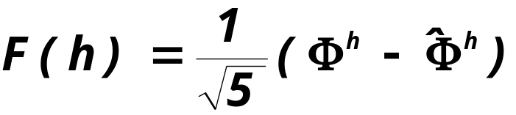
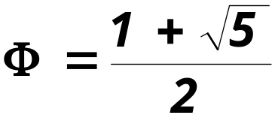
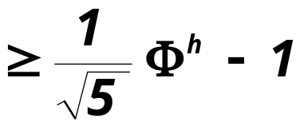
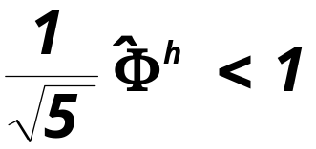
MIN. SIZE AVL TREES
Now
where
since

Slide 61
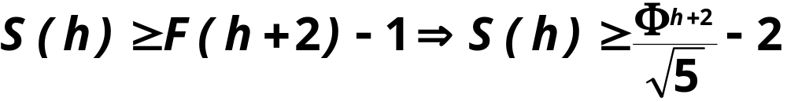

MIN. SIZE AVL TREES
So

Slide 62
MAX HEIGHT OF AN AVL TREE
So the max height of an AVL tree with N nodes is logarithmic function of N.

