Slide 1
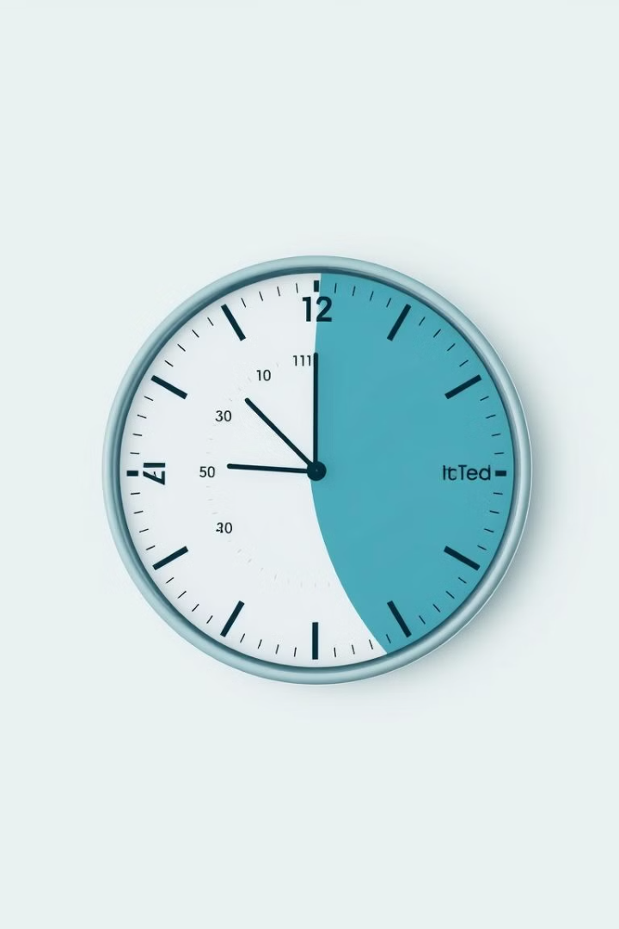
Melisnur Dönerler (31145)
TikTok Insights: A Personal Journey
This project explores my TikTok usage and how it reflects my daily habits, preferences, and time management.

Slide 2
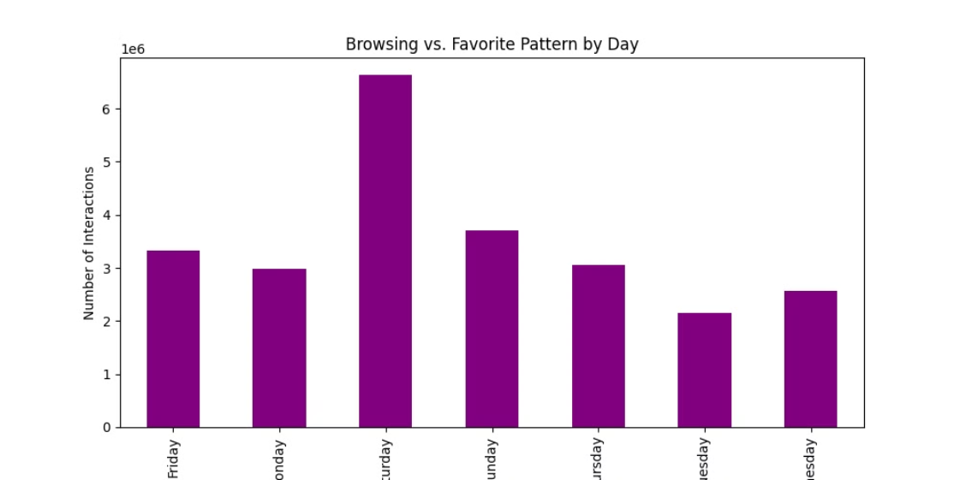
Browsing vs. Favorite Pattern by Day
Weekend Peak
Weekday Dip
Saturdays are my most active day, with significantly higher interactions than any other day.
Weekdays, particularly Tuesday and Wednesday, show the least activity, likely reflecting my busier schedule.

Slide 3

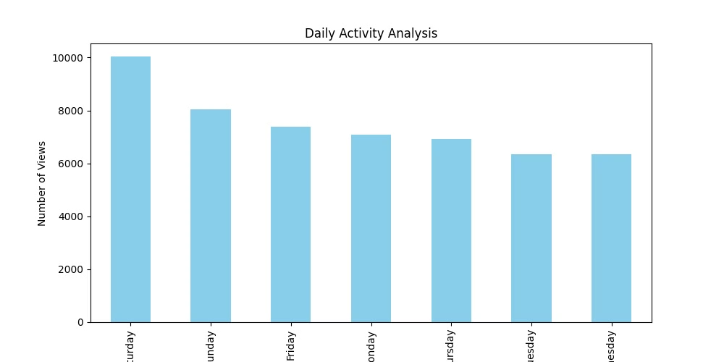
Daily Activity Analysis
1
Saturday Binge
Saturdays dominate, showing that this is when I’m most likely to binge-watch videos.
2
Weekday Moderation
I maintain a moderate level of usage throughout the week, suggesting that TikTok remains a consistent part of my daily routine.

Slide 4
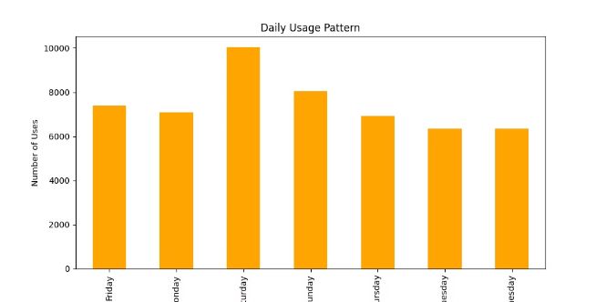
Daily Usage Pattern
Weekend Relaxation
Weekends are my time to relax and engage with TikTok without the time constraints of work or studies.
Mid-Week Dip
The mid-week dip, particularly on Tuesday and Wednesday, is more pronounced here.

Slide 5

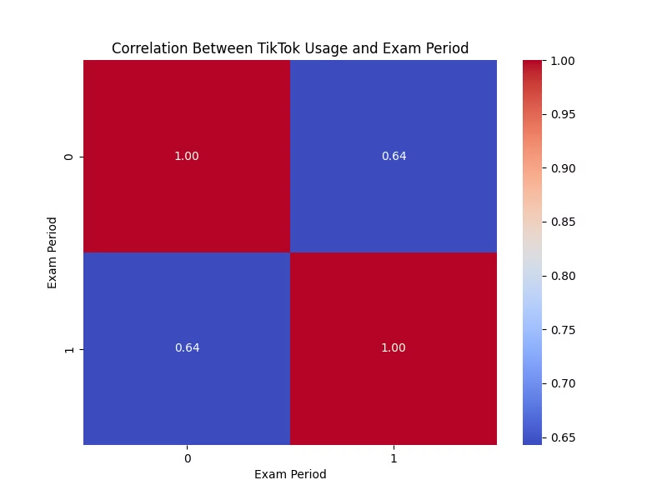

Correlation Between TikTok Usage and Exam Period
Moderate Correlation
My TikTok usage decreases slightly during exams, but it doesn’t disappear entirely.

Slide 6
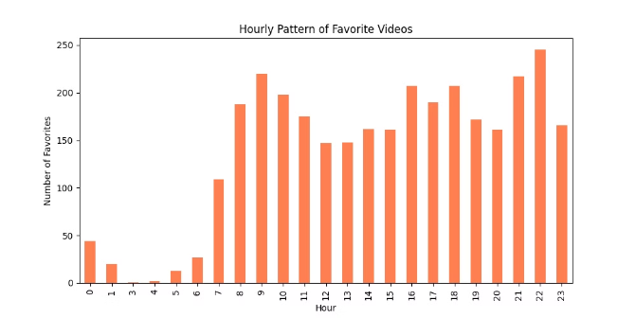
Hourly Pattern of Favorite Videos
Evening Relaxation
Late evenings, especially between 9 PM and 11 PM, are my peak hours for engaging with content. This likely reflects a period of relaxation after work or studies, where I dedicate more time to leisurely browsing and saving videos for later viewing.
Midday Lull
Pre-Sleep Scroll
The period between noon and 4 PM shows a significant dip in my favorite video activity. This aligns with my typical workday, where I focus on my tasks and minimize distractions.
Before bed, there's another small increase around 11 PM - 1 AM. This could be a wind-down activity before sleep, a quick last scroll through saved content, or a way to relax before sleep.
1
2
3
4
5
Morning Browsing
Afternoon Pick-up
There’s also a small spike around 6 AM, which might indicate that I occasionally scroll TikTok in the morning. This suggests a brief moment of engagement before starting the day, possibly during my morning routine.
There is a slight increase in favorited videos in the late afternoon around 5 PM to 6 PM, before I start dinner preparations and evening activities. It seems that after work I catch up on my favorite videos before focusing on other aspects of my day.

Slide 7

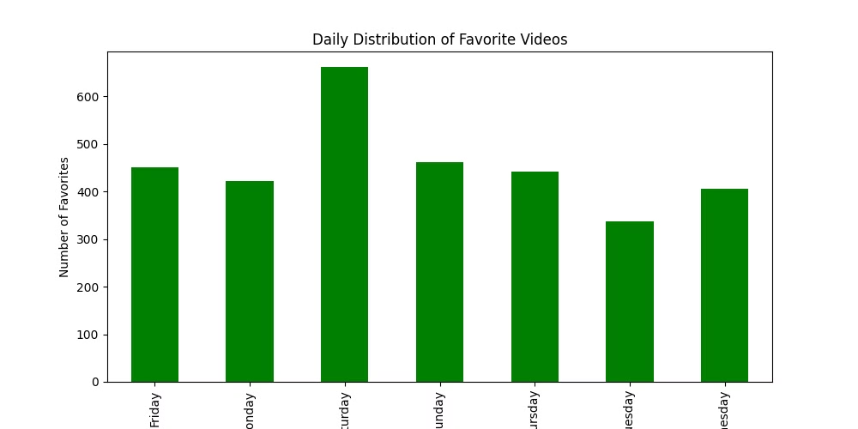


Daily Distribution of Favorite Videos
Saturday Peak
Saturday is my most active day not only for watching but also for liking content.
Weekday Drop
On weekdays, however, favoriting activity drops significantly, especially on Tuesday and Wednesday.

Slide 8

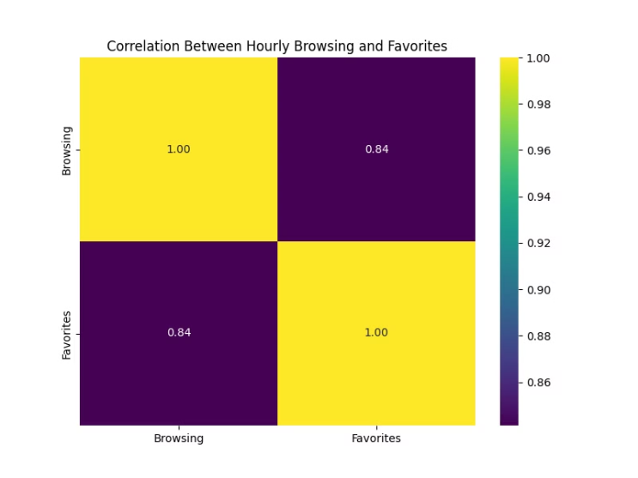

Correlation Between Hourly Browsing and Favorites
1
2
3
1
Active Engagement
2
Browsing Leads to Favorites
3
Strong Correlation (0.84)

Slide 9

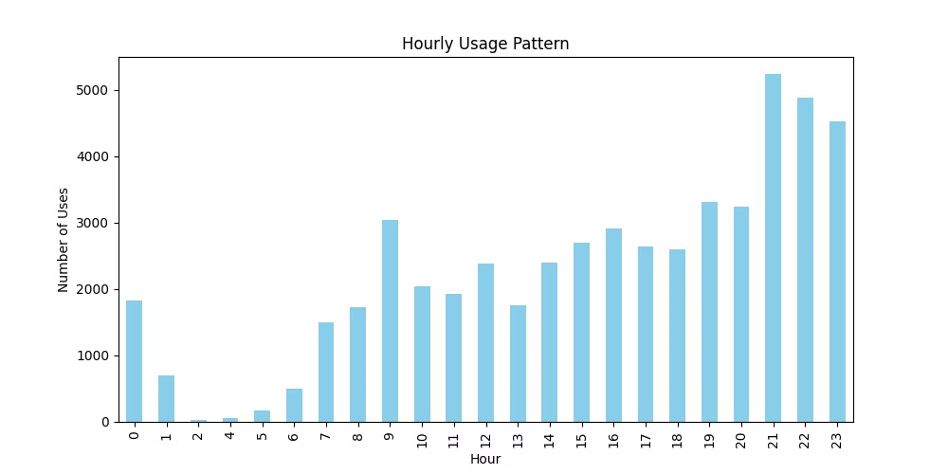
Hourly Usage Pattern
Evening Unwind
1
The peak hours are between 9 PM and 11 PM, which is likely when I’m relaxing after a long day.
Late-Night Scrolling
There’s also a smaller spike around midnight, reflecting those nights when I end up scrolling right before bed.
2

