Slide 1

Web Browser
-> Firefox, Internet Explorer
Internet
Database Server
-> MySQL, SQLite, PostgreSQL
Table Data, Relationships, etc.
Web Server
-> Apache, Microsoft IIS
HTTP, HTTPS
-> with embedded Programming Language;
PHP, Perl, Java Server Pages, ASP – Active Server Pages, etc.

Slide 2
Web Browser
-> Firefox, Internet Explorer
Internet
Database Server
-> MySQL, SQLite, PostgreSQL
Table Data, Relationships, etc.
Web Server
-> Apache, Microsoft IIS
HTTP, HTTPS
-> with embedded Programming Language;
PHP, Perl, Java Server Pages, ASP – Active Server Pages, etc.
Local Host
http://localhost/
http://hostname/ -> http://Bitt_Designs/
http://127.0.0.1/
The default port for Web Server pages is 80, so
http://www.google.com/
...is typically equal to ...
http://www.google.com:80/
... which is equal to ...
http://74.125.95.104/
http://74.125.95.104:80/
C:\> hostname
Bitt_Designs
C:\> ping www.google.com
Pinging www.l.google.com [74.125.95.104] with 32 bytes of data:
Reply from 74.125.95.104: bytes=32 time=29ms TTL=240
Reply from 74.125.95.104: bytes=32 time=27ms TTL=240

Slide 3
Web Browser
-> Firefox, Internet Explorer
Internet
Database Server
-> MySQL, SQLite, PostgreSQL
Table Data, Relationships, etc.
Web Server
-> Apache, Microsoft IIS
HTTP, HTTPS
-> with embedded Programming Language;
PHP, Perl, Java Server Pages, ASP – Active Server Pages, etc.
Web Server Default Port
http://localhost:80/
Local ND Web Server
http://studentweb.ndpma.org/
.. which is equal to ...
http://172.31.1.21/
Tomcat default port is 8080, so
http://172.31.1.21:8080/
... displays the Tomcat Default Page
Apache Tomcat is an implementation of the Java Servlet and Java Server Pages (JSP) technologies which enables HTTP Web Pages to be integrated with the Java programming language.

Slide 4
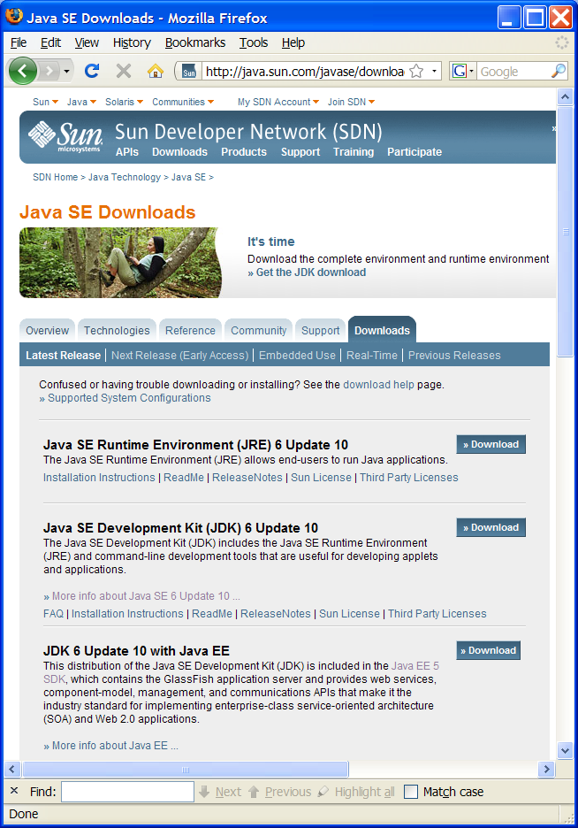
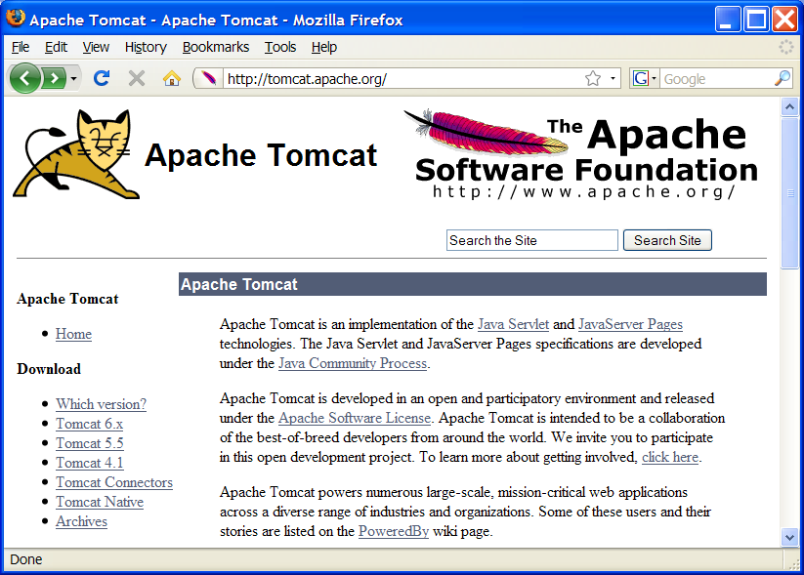
Download Sun Java JDK/JRE
Download Apache Tomcat
... Install and Configure ...

Slide 5
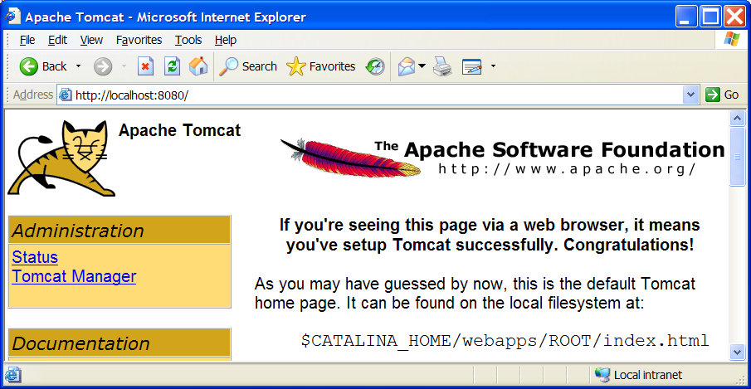
Install Successful

Slide 6
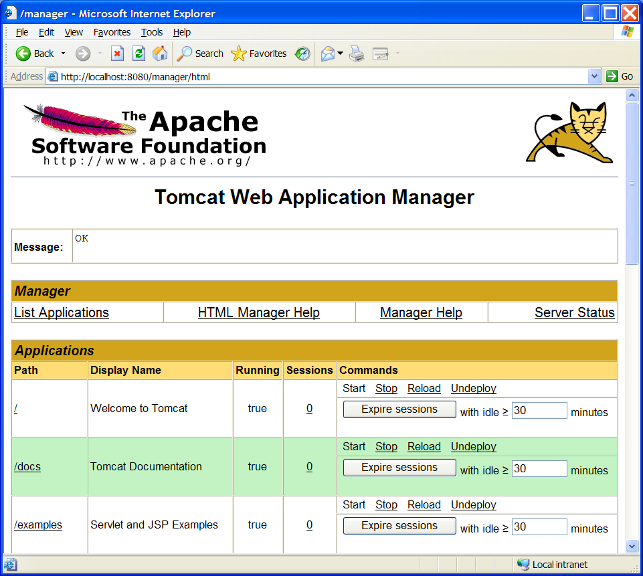
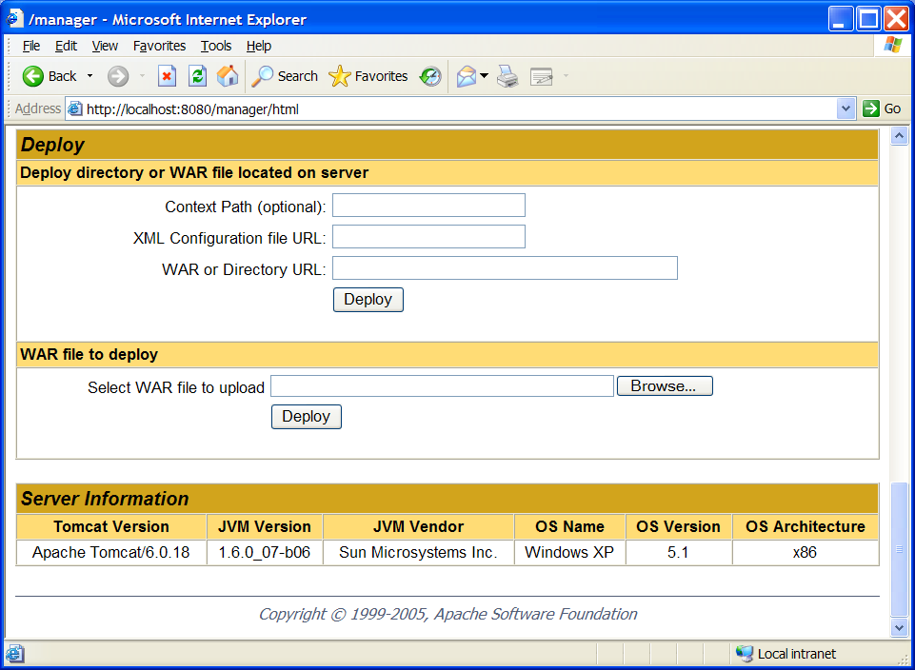
Tomcat Manager

Slide 7
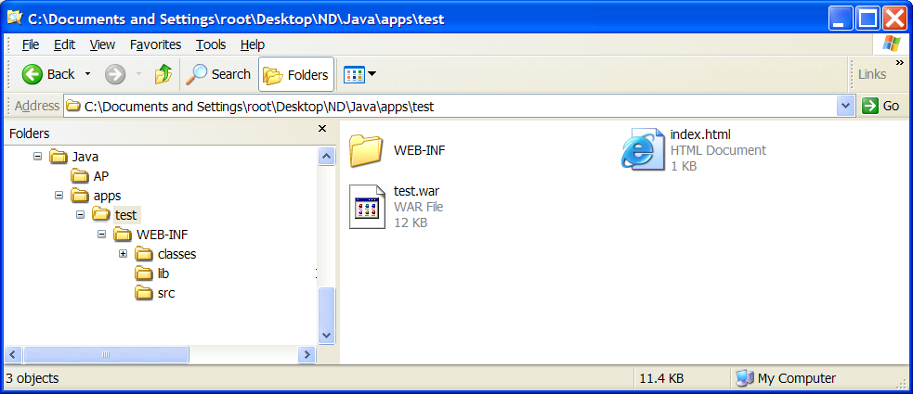
How to Build a WAR File ...
Highlight all files within the “application name” folder
and create a zip file with the naming convention of
application_name.war
Note: WAR, JAR, EAR and other Java related file
extensions are just zip files containing an specific
folder structure for the respective types.
Create the basic WAR folder/directory structure
under the designated application folder, i.e.
[app_name]
+ WEB-INF
+ classes
+ lib
+ src
where the compiled java classes must reside
within the classes folder.

Slide 8
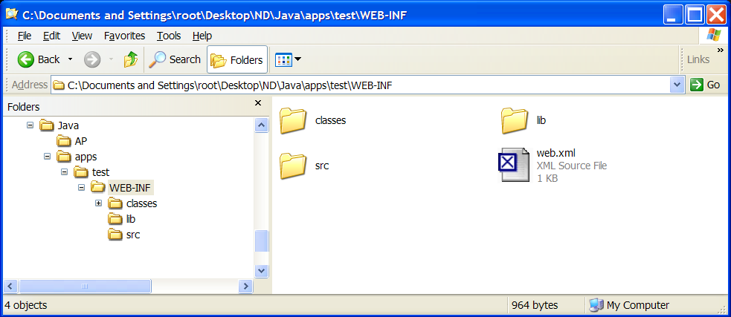
How to Build a WAR File ...
web.xml
<?xml version="1.0" encoding="ISO-8859-1"?>
<web-app>
<servlet>
<servlet-class>Hello</servlet-class>
<servlet-name>HelloServlet</servlet-name>
</servlet>
<servlet-mapping>
<servlet-name>HelloServlet</servlet-name>
<url-pattern>/hello</url-pattern>
</servlet-mapping>
</web-app>
Hello.class
Hello.java
Object Relationship
http://localhost:8080/test/hello

