Slide 1
INTRODUCCIÓN AL APRENDIZAJE AUTOMÁTICO
AGO – DIC 2020

Slide 2
Examen

Slide 3
Instrucciones
Revisar el escenario asignado y el data set disponible
Analizar el dataset y elegir un algoritmo para predecir el valor indicado
Elabora un reporte que incluya:
Descripción de dataset
Explicación de procedimiento: qué atributos eligieron y qué tomaron en cuenta para elegir el algoritmo
Screenshot de la implementación del modelo, ya sea en python o azure studio
Resultados obtenidos
Conclusión – posibles modificaciones futuras para mejorar resultados, etc.

Slide 4

Escenario 1 cpu_small
Este dataset contiene algunas medidas de actividades de sistemas de computadoras.
Nos interesa conocer el tiempo de cpu en user mode.
File name: cpu_small

Slide 5
Escenario 1 cpu_small
System measures used:
lread - Reads (transfers per second ) between system memory and user memory.
lwrite - writes (transfers per second) between system memory and user memory.
scall - Number of system calls of all types per second.
sread - Number of system read calls per second.
swrite - Number of system write calls per second .
fork - Number of system fork calls per second.
exec - Number of system exec calls per second.
rchar - Number of characters transferred per second by system read calls.
wchar - Number of characters transfreed per second by system write calls.
pgout - Number of page out requests per second.

Slide 6
Escenario 1 cpu_small
ppgout - Number of pages, paged out per second
pgfree - Number of pages per second placed on the free list
pgscan - Number of pages checked if they can be freed per second.
atch - Number of page attaches (satisfying a page fault by reclaiming a page in memory) per second.
pgin - Number of page-in requests per second.
ppgin - Number of pages paged in per second.
pflt - Number of page faults caused by protection errors (copy-on-writes.
vflt - Number of page faults caused by address translation.
runqsz - Process run queue size..
freemem - Number of memory pages available to user processes.
freeswap - Number of disk blocks available for page swapping..
usr - Portion of time (%) that cpus run in user mode.
sys - Portion of time (%) that cpus run in system mode..
wio - Portion of time (%) that cpus are idle waiting for block IO
idle - Portion of time (%) that cpus are otherwise idle.

Slide 7
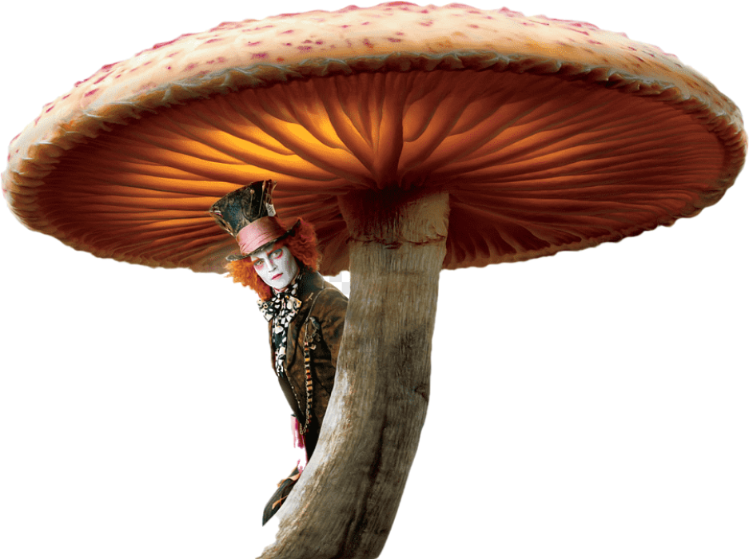
Escenario 2 mushroom
Este data set contiene información sobre muestras de hongos recolectados
Se categorizan para saber si son o no nocivos para el consumo.
File name: mushroom

Slide 8
Escenario 2 mushroom
1. cap-shape: bell,conical,convex,flat, knobbed,sunken
2. cap-surface: fibrous,grooves,scaly,smooth
3. cap-color: brown,buff,cinnamon,gray,green, pink,purple,red,white,yellow
4. bruises?: bruises,no
5. odor: almond,anise,creosote,fishy,foul, musty,none,pungent,spicy
6. gill-attachment: attached,descending,free,notched
7. gill-spacing: close,crowded,distant
8. gill-size: broad,narrow
9. gill-color: black,brown,buff,chocolate,gray, green,orange,pink,purple,red, white,yellow
10. stalk-shape: enlarging,tapering

Slide 9
Escenario 2 mushroom
11. stalk-root: bulbous,club,cup,equal, rhizomorphs,rooted,missing
12. stalk-surface-above-ring: fibrous,scaly,silky,smooth
13. stalk-surface-below-ring: fibrous,scaly,silky,smooth
14. stalk-color-above-ring: brown,buff,cinnamon,gray,orange, pink,red,white,yellow
15. stalk-color-below-ring: brown,buff,cinnamon,gray,orange, pink,red,white,yellow
16. veil-type: partial,universal
17. veil-color: brown,orange,white,yellow
18. ring-number: none,one,two
19. ring-type: cobwebby,evanescent,flaring,large, none,pendant,sheathing,zone
20. spore-print-color: black,brown,buff,chocolate,green, orange,purple,white,yellow
21. population: abundant,clustered,numerous, scattered,several,solitary
22. habitat: grasses,leaves,meadows,paths, urban,waste,woods
23. class: edible, poisonous

Slide 10
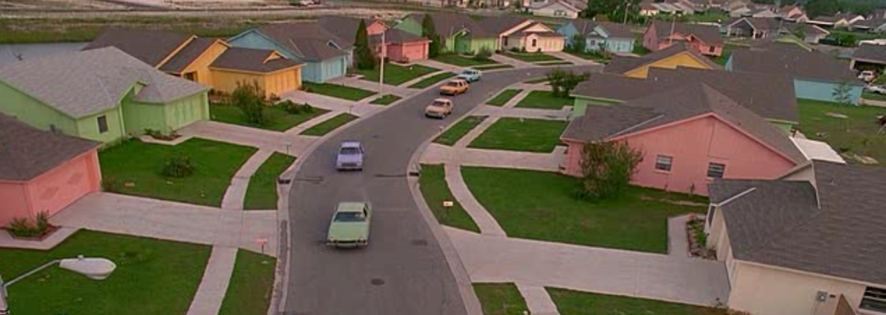
Escenario 3 house _sales
Este dataset contiene información sobre casas en King County
Nos interesa predecir el precio de las casas

Slide 11
Escenario 3 house _sales
id
date
price
bedrooms
bathrooms
sqft_living
sqft_lot
floors
waterfront
view
condition
grade
sqft_above
sqft_basement
yr_built
yr_renovated
zipcode
lat
long
sqft_living15
sqft_lot15

Slide 12

Escenario 4 loan_approval
Este dataset contiene información sobre clientes que aplicaron para un crédito
Nos interesa predecir si el crédito es aprobado o rechazado
File name: loan_approval

Slide 13
Escenario 4 loan_approval
Variable | Description
Loan_ID | Unique Loan ID
Gender | Male/ Female
Married | Applicant married (Y/N)
Dependents | Number of dependents
Education | Applicant Education (Graduate/ Under Graduate)
Self_Employed | Self employed (Y/N)
ApplicantIncome | Applicant income
CoapplicantIncome | Coapplicant income
LoanAmount | Loan amount in thousands
Loan_Amount_Term | Term of loan in months
Credit_History | credit history meets guidelines
Property_Area | Urban/ Semi Urban/ Rural
Loan_Status | Loan approved (Y/N)

