Slide 1






Presentation (ICT)
Exploring Information and Communication Technology (ICT) and Key Tools
settar lina
section A
groupe 26

Slide 2

Information and Communication Technology: Empowering Connectivity
Information and Communication Technology (ICT) encompasses a wide range of technologies used to manage, process, communicate, and exchange information. It's a comprehensive term that includes various hardware, software, networking, and communication technologies.

Slide 3

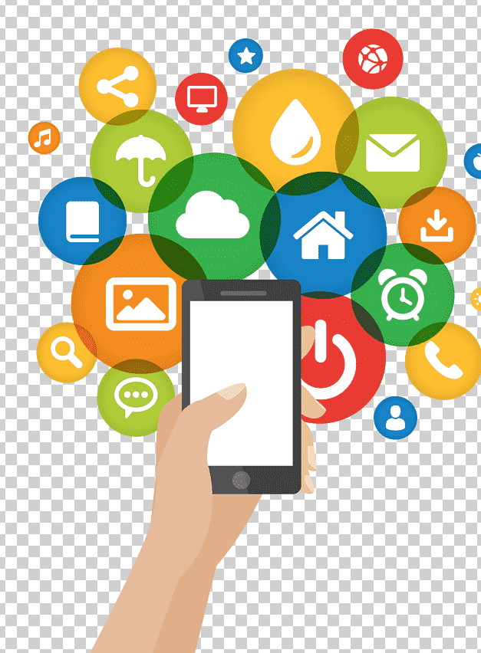





Information and Communication Technology key components:
Information Technology (IT):
software applications:
Refers to the use of computers, storage, networking, and other devices to create, process, store, secure, and exchange electronic data and information.
Encompasses various software programs and applications used for different purposes such as productivity (Microsoft Office, Google Workspace), design (Adobe Suite), development (IDEs like Visual Studio Code), and more.
Communication Technology:
Networking Infrastructure:
Encompasses technologies used for transmitting, receiving, and sharing data and information. This includes telecommunication networks, internet services, wireless communication, etc.
Refers to the hardware and software components that allow devices to connect and communicate with each other, including routers, switches, cables, protocols, and cloud-based infrastructure.
Digital Devices and Tools:
Internet and Online Services:
Includes computers, smartphones, tablets, servers, and other devices used for data processing, communication, and storage.
Covers the vast array of services and platforms available on the internet, including social media, cloud storage, e-commerce, online collaboration tools, and more.

Slide 4
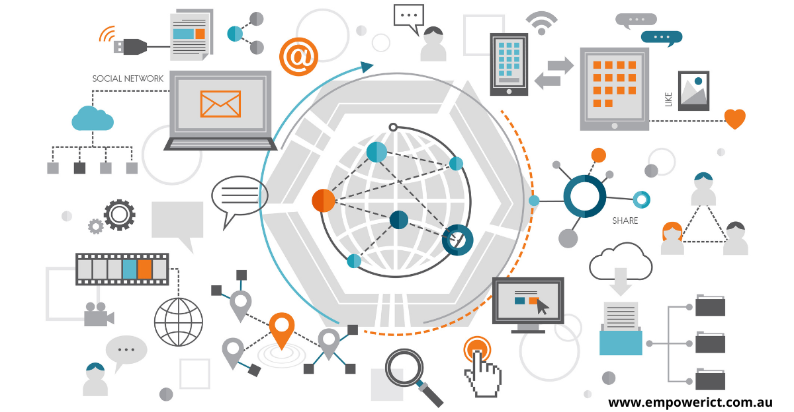
Understanding ICT
Definition of Information and Communication Technology (ICT):
Information and Communication Technology (ICT) refers to the diverse set of technologies, systems, tools, and resources used to manage, store, transmit, and manipulate information. It encompasses both the hardware and software technologies that facilitate the processing, distribution, and utilization of data in various forms, including text, images, sound, and video.
ICT integrates the realms of information technology (IT) with telecommunications, networking, and other communication technologies to enable the exchange of information and interaction among individuals, organizations, and systems across different platforms and devices. It involves the seamless integration of computing devices, networks, applications, and services to support communication, collaboration, and data management.

Slide 5

Google Services
Google offers a suite of services that have
become integral to personal and professional
digital workflows. Here's an overview of some
key Google services:
1. Gmail.
2. Google Drive.
3. Google Docs.
4. Google Sheets.
5. Google Slides.
6. Google Calendar.
7. Google Meet.
8. Google Photo.
9. Google Forms.
10. Google Workspace (formerly G Suite).

Slide 6






Microsoft Tools
1. Microsoft Office 365:
4. OneDrive:
Productivity Suite: Office 365 encompasses a range of applications:
Word,Excel,PowerPoint,Outlook,OneNote,Access and Publisher.
Cloud Storage: OneDrive is Microsoft's cloud storage service for files and documents. It allows for easy access, sharing, and synchronization across devices. Integrated with Office apps for seamless editing and collaboration.
2. Microsoft Teams:
7. Microsoft Power Platform:
Collaboration Platform: Teams is a hub for teamwork, offering features like:
Chat,Meetings,Channels,Integration
Low-code Development Platform: Power Platform comprises Power BI (for data visualization), Power Apps (for app development), Power Automate (for workflow automation), and Power Virtual Agents (for creating chatbots).
3. Microsoft Outlook:
8. Microsoft Edge:
Email and Calendar: Outlook is a comprehensive email client that includes email organization, calendaring, task management, and contact management features.
Web Browser: Microsoft Edge is a web browser designed for speed, security, and compatibility. It integrates with Microsoft services and offers features like Collections and vertical tabs.

Slide 7
Introduction to Git and GitHub
Git and GitHub are fundamental tools in the realm of software development, offering version control and collaborative functionalities.
Git:
Git is an open-source distributed version control system designed to track changes in source code during software development.
GitHub:
GitHub is a web-based hosting service for Git repositories, adding a social and collaborative layer to Git.

Slide 8
Benefits of Git and GitHub
1
Version Control:
Track changes, collaborate, and revert to previous versions easily, ensuring code integrity.
2
Collaboration
Enable multiple developers to work on the same project simultaneously and manage contributions effectively.
3
Community and Open Source:
GitHub fosters a vibrant community around open-source projects, facilitating contribution and collaboration among developers worldwide.
4
Project Management:
GitHub's features help in organizing tasks, managing workflows, and maintaining project transparency.

Slide 9
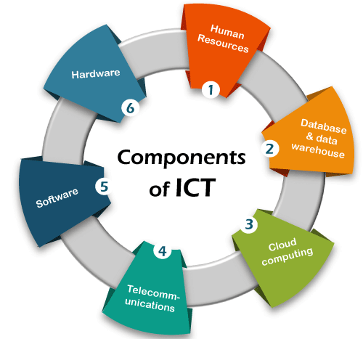
▪Importance of TIC
Information and Communication Technologies (TIC) continue to reshape our world by playing a pivotal role in fostering global connectivity. Technologies such as the internet, mobile networks, and social media have transformed the way individuals and businesses communicate and share information. In addition to that fostering connectivity, innovation by emerging technologies like artificial intelligence, blockchain, and the Internet of Things (IoT) are driving advancements across industries, leading to improved efficiency and new possibilities.

Slide 10
THANKS

