Slide 1
Saferide shuttle simulation
Aim: Simulate a point-to-point shuttle service, and find a better algorithm for scheduling passengers.

Slide 2
Map data structure
Read in input from file
Node[ # EW streets ][ # NS streets ]
  Address
  Neighbors: north, south, east, west
Considerations:
  Which nodes aren’t reachable?

Slide 3
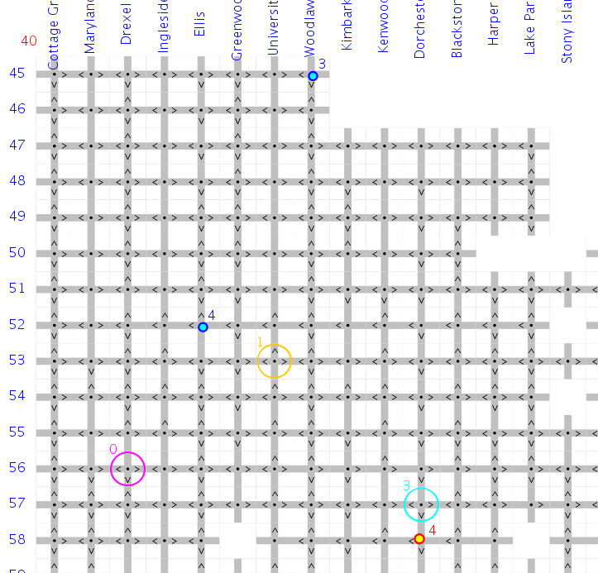
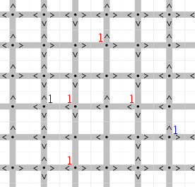
Time
Animated Graph
Addresses:
street names
dropoff
Frequency count
no. of pickups
no. of dropoffs
directions
van
not reachable
pickup

Slide 4
Passenger Sample Generation
Read in parameters from another file
  how long the service is in operation
  number of passengers
  number of calls
  randomly generate passenger(s) calling at time t, with random addresses
Van parameters
  number of vans, capacity, start location

Slide 5
In one unit of time…
Vans move one block towards their destination
Vans pick up or drop off people, if they happen to reach their destination then
New passengers call in to the Operator, who assigns them each to a van
Update van’s schedule, if necessary

Slide 6
Two scheduling algorithms
Schedule: a linked list of passengers
Simple algorithm:
  Pickup is at index where van happens to be closest to his location. Dropoff is automatically placed at tail of schedule.
Alternate algorithm:
  Calculate pickup and dropoff indices to minimize total cost of insertion

Slide 7
Calculating cost
distance * weight
  distance:
    Alternate: A* search algorithm, Manhattan distance
      Returns shortest distance & recommended route
    Simple: Manhattan distance
  weight: how long the passengers in the van had already waited to get home
    Parcels can wait but people don’t like waiting

Slide 8
Statistics
Indicators of efficiency:
  Average total time taken (from call to drop-off)
  Average time spent sitting in van
Data collection from simulation:
  Observation manager, for one trial
  Trial manager, for many trials
Does our alternate algorithm produce better results?

Slide 9
Results
1000 trials: Alternate Simple | Mean average total time | SD of average total time | Mean average in-van time | SD of average in-van time
Hyde Park (21x20) | 27.1384 30.1413 | 0.1399 0.04967 | 13.4254 18.8528 | 0.0993 0.1354
21x20, without unreachable nodes | 29.9487 45.3336 | 2.2776 2.4738 | 19.4440 28.6734 | 2.2200 0.5299
5x5 without unreachable nodes | 9.3622 9.3444 | 1.0808 1.4439 | 4.7901 4.8695 | 0.1531 1.4666
Alternate:
Lower mean,
SD ?
Alternate:
Lower mean,
SD ?
Alternate:
Mean about
the same,
SD higher

Slide 10
Conclusion
Disparity between alternate and simple algorithms seems to get more pronounced as size of map increases
More testing is needed

