Slide 1
Company Profile
Jewel’s First Maternity and Lying-in Clinic

Slide 2
Company Profile
Located at 136, Block 8, Zone 2, Barangay Fort Bonifacio, Taguig City
Founded by Mrs. Remedios Saludes, RM. On February, 2011
It provides top-tier services in Maternity and Pediatric Field. This includes Family Planning, Pre and Post-Natal Check up, Maternity Delivery
Prescriptions for the Pregnant Patient, Provides Pediatric services from New-born to 4 years old child

Slide 3
Description of Present System
Jewel’s First Maternity and Lying-in Clinic

Slide 4
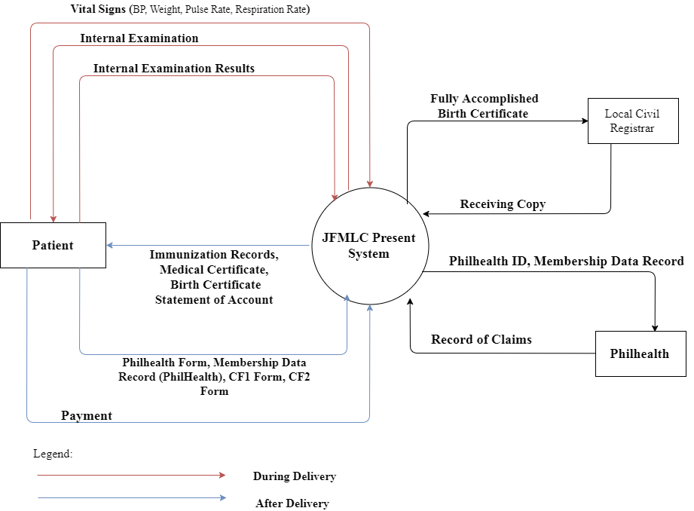
Maternal Delivery

Slide 5
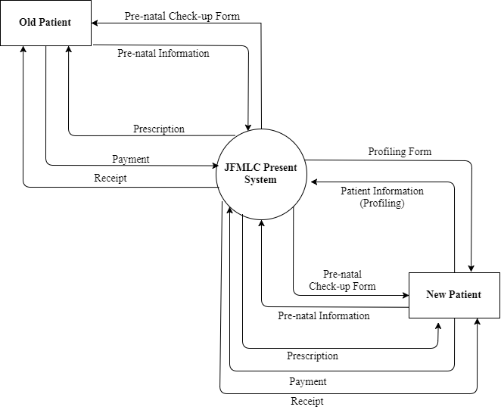
Prenatal Check-up

Slide 6
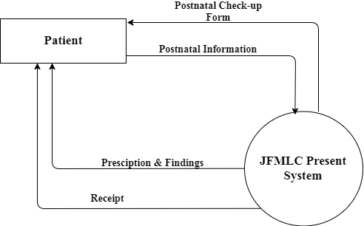
Postnatal Check-up

Slide 7
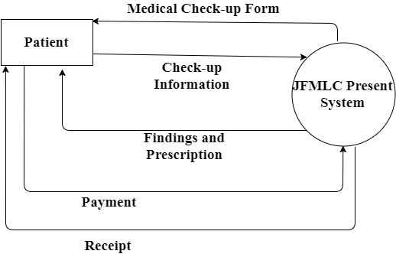
Consultation

Slide 8
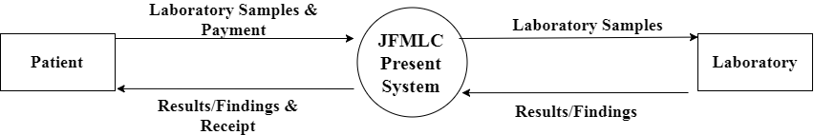
Laboratory

Slide 9
Problems
Jewel’s First Maternity and Lying-in Clinic

Slide 10
Problems
Slow and sometimes inaccurate retrieval of patient’s information when requested
Patient’s Records are not centralized
Billing process is not centralized
Delayed or missed appointments at the clinic due to lack of reminders
Inconsistent process of issuing Statement of Account, Medical Records, and Medical Certificates.
Decision making becomes slower due to slow retrieval of data
Delayed and inaccurate audit of income
Medical supplies and items are not properly monitored

Slide 11
Solutions
Jewel’s First Maternity and Lying-in Clinic

Slide 12
Capabilities
“One stop source of Information”
- The database is now centralized for the Clinic’s Services
Patient Record Management System
- Accurate and instant in inserting, retrieving, organizing and generating the Patient’s Records
SMS Notification
SMS Notification for the patients to avoid delayed or missed appointments
Scheduling System
Organized scheduling for the appointments of the patients
Billing System - Every transaction is now monitored for every patient and a faster process of issuing Statement of Accounts

Slide 13
Capabilities
Clinic Item Monitoring
- Monitor and updates every local clinic supplies
Faster Decision support Making
- Monitors every patient’s records and reports data that need immediate medical action.
Report Generator
- Generates accurate and complete report when requested. The reports include Medical Records, Statement of Account

Slide 14
Title
“M.C.I.S”
(Development of Maternity Clinic Information System)

