Slide 1

RBE-550 Assignment 1
Turtle Graphics & Obstacle Fields
Victor Sierra Search Pattern and f(ρ) Obstacle Fields
Mohamed Eljahmi

Slide 2
Overview
• Part 1: Draw Victor Sierra search pattern with turtle graphics
• Part 2: Generate obstacle fields with tetrominoes
• Verify outputs against assignment requirements
• Submit code, images, and report

Slide 3

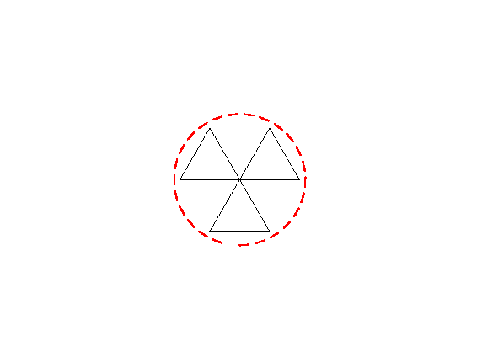

Victor Sierra Search Patterns
Three layouts implemented with turtle graphics:
• Zigzag
• Radial
• Linear

Slide 4
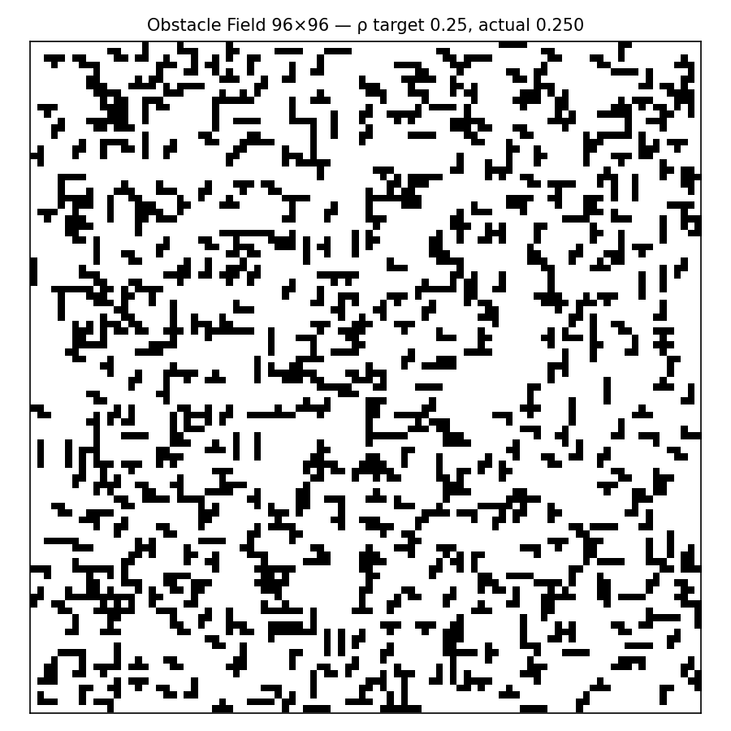
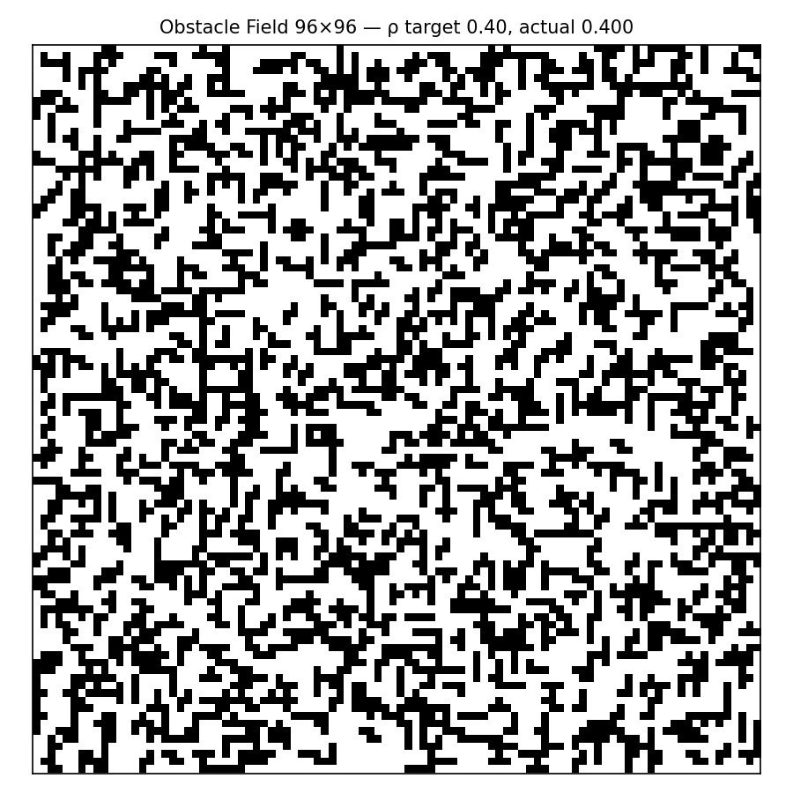
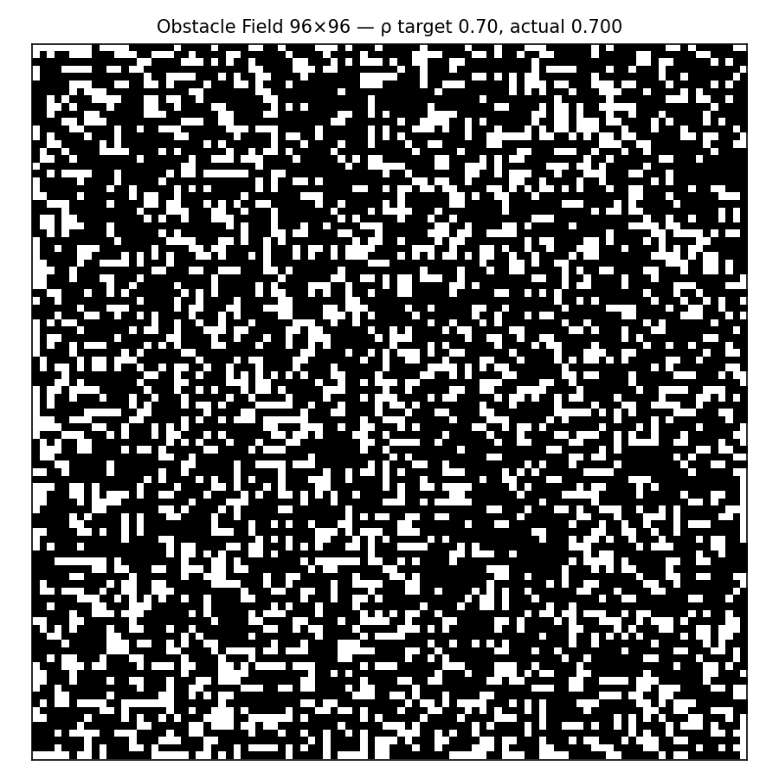
Obstacle Fields (f(ρ))
Generated black/white obstacle fields at different coverage:
• ρ = 0.25
• ρ = 0.40
• ρ = 0.70

Slide 5
Environment & Reproducibility
• Python 3.10.12
• Ubuntu 22.04, kernel 6.8.0-78-generic
• Libraries: turtle, numpy, matplotlib
• requirements.txt and environment.txt included

Slide 6
Conclusion
• Implemented Victor Sierra patterns (zigzag, radial, linear)
• Generated obstacle fields at target ρ levels
• Verified actual coverage matches targets
• Submission includes source code, EPS/PNG outputs, README, and report

