Slide 1

Benchmarking Classical Grid-Based Planners in ROS 2
Name: Mohamed Eljahmi Course: RBE 550 – Motion Planning Professor: Dan Flickinger Date: October 7, 2025

Slide 2
Motivation
Motion planning algorithms trade off between speed, optimality, and memory.
Benchmarking these planners fairly is difficult without consistent environments.
This project creates an automated, reproducible ROS 2 benchmarking framework.

Slide 3
Objectives
Implement multiple search algorithms:
BFS, Dijkstra, Greedy Best-First, A*.
Generate both random and structured (maze) environments.
Record metrics: path length, runtime, nodes expanded.
Package the system using Docker for full reproducibility.

Slide 4
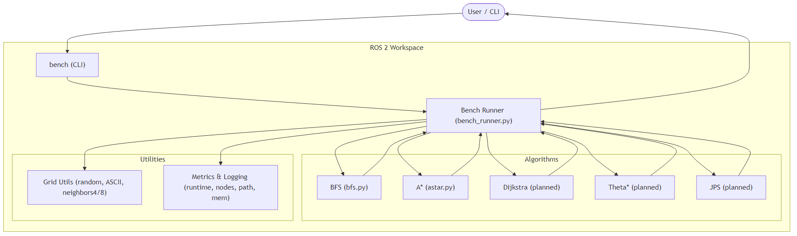
System Architecture

Slide 5
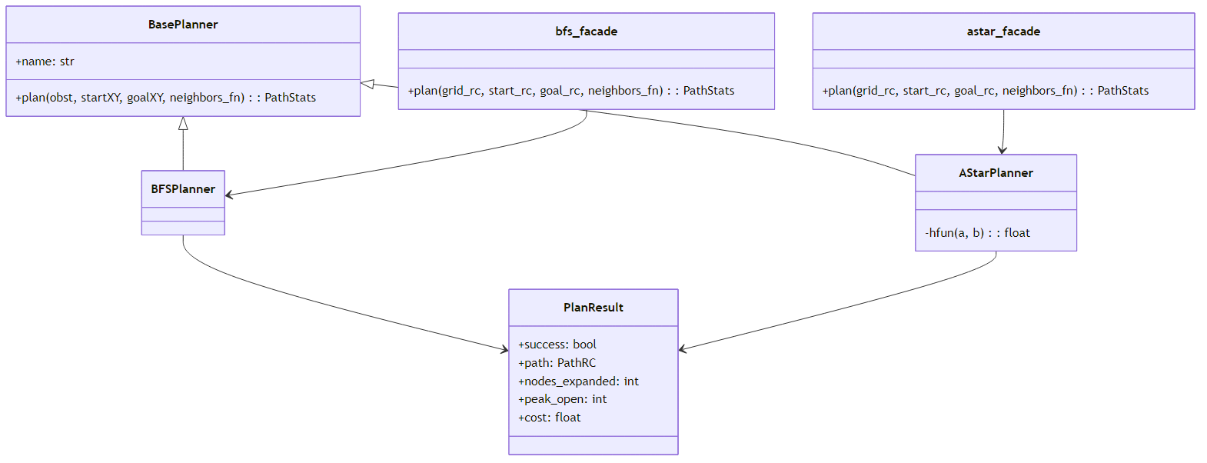
Class Structure (Algorithms)

Slide 6
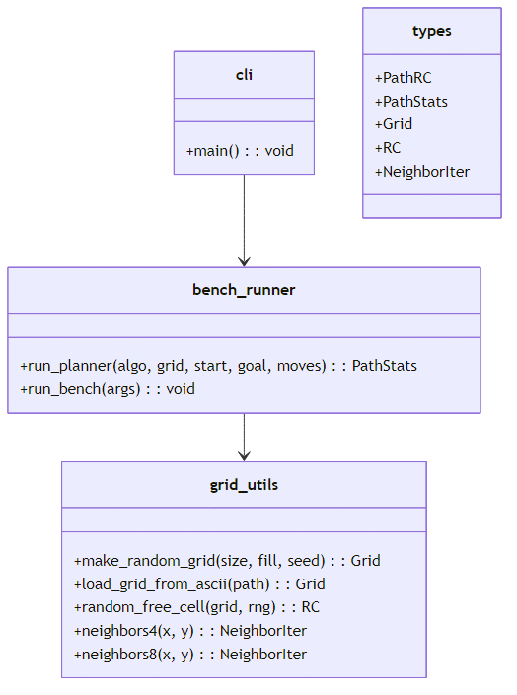
Class Structure (Core & Environment)

Slide 7
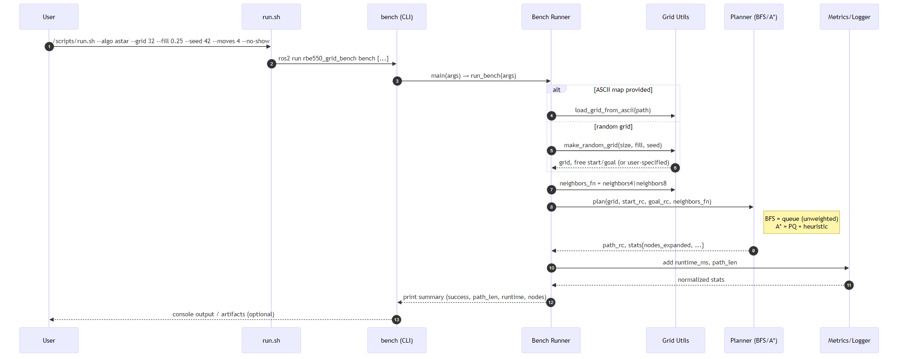
Sequence Diagram

Slide 8
Packaging & Reproducibility
Entire benchmark is containerized for consistent runs across machines.
A single command builds and executes all experiments.
Docker image rbe550-bench includes:
ROS 2 Humble base
Workspace source (src/) and maps (maps/)
Automated build and execution via entrypoint
Results are automatically stored in outputs/.
Guarantees deterministic and fully reproducible benchmarking.

Slide 9
Preliminary Results
Algorithm | Connectivity | Heuristic | Path Length | Nodes Expanded | Runtime (ms)
BFS | 4 | - | 64 | 2155 | 2.39
A* | 4 | Manhattan | 64 | 910 | 1.93
A* | 8 | Euclidean | 45 | 455 | 1.81
A* expands fewer nodes
Heuristics reduce exploration
8-connected + Euclidean shortens path

Slide 10
Validation
Deterministic seeding for reproducible random maps.
Maze and random environments tested repeatedly.
Results are identical across different systems using Docker.

Slide 11
Challenges & Next Steps
Challenges:
Fixing COLCON_TRACE build issue.
Ensuring maps/ inclusion inside Docker.
Balancing parameters for fair comparisons.
Next Steps:
Add weighted heuristics and cost variants.
Integrate visualization (RViz / Matplotlib).
Extend to probabilistic planners later in the semester.

