Slide 1
Multiple Instance Learning via Successive Linear Programming
Olvi Mangasarian
Edward Wild
University of Wisconsin-Madison

Slide 2
Standard Binary Classification
Points: feature vectors in n-space
Labels: +1/-1 for each point
Example: results of one medical test, sick/healthy
(point = symptoms of one person)
An unseen point is positive if it is on the positive side of the decision surface
An unseen point is negative if it is not on the positive side of the decision surface
Notes:
If one test for disease is positive, then classify as sick
If no test for disease is positive, then classify as healthy

Slide 3
Example: Standard Classification
Positive:
Negative:

Slide 4
Multiple Instance Classification
Bags of points
Labels: +1/-1 for each bag
Example: results of repeated medical test generate
sick/healthy bag (bag = person)
An unseen bag is positive if at least one point in the bag is on the positive side of the decision surface
An unseen bag is negative if all points in the bag are on the negative side of the decision surface

Slide 5
Example: Multiple Instance Classification
Positive:
Negative:

Slide 6
Multiple Instance Classification
Given
  Bags represented by matrices, each row a point
  Positive bags B^{i}, i = 1, …, k
  Negative bags C^{i}, i = k + 1, …, m
Place some convex combination of points x^{i} in each positive bag in the positive halfspace:
  ∑v_{i} = 1, v_{i} ¸ 0, i = 1, …, m^{i} ⇒ ∑v_{i}x^{i} is in positive halfspace
Place all points in each negative bag in the negative halfspace
Above procedure ensures linear separation of positive and negative bags

Slide 7
Multiple Instance Classification
Decision surface
  x⁰w - γ = 0 (prime ⁰ denotes transpose)
For each positive bag (i = 1, …, k)
  v^{i0}B^{i}w ¸ γ+1
  e⁰v^{i} = 1, v^{i} ¸ 0, (e a vector of ones)
  v^{i0}B^{i} is some convex combination of the rows of B
For each negative bag (i = k + 1, …, m)
  C^{i}w · (γ-1)e

Slide 8
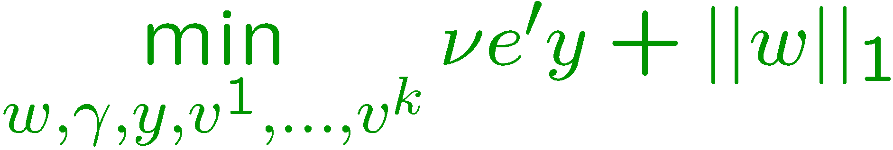
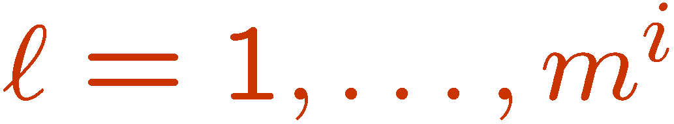

Multiple Instance Classification
Minimize misclassification and maximize margin
y’s are slack variables that are nonzero if points/bags are on the wrong side of the classifying surface

Slide 9
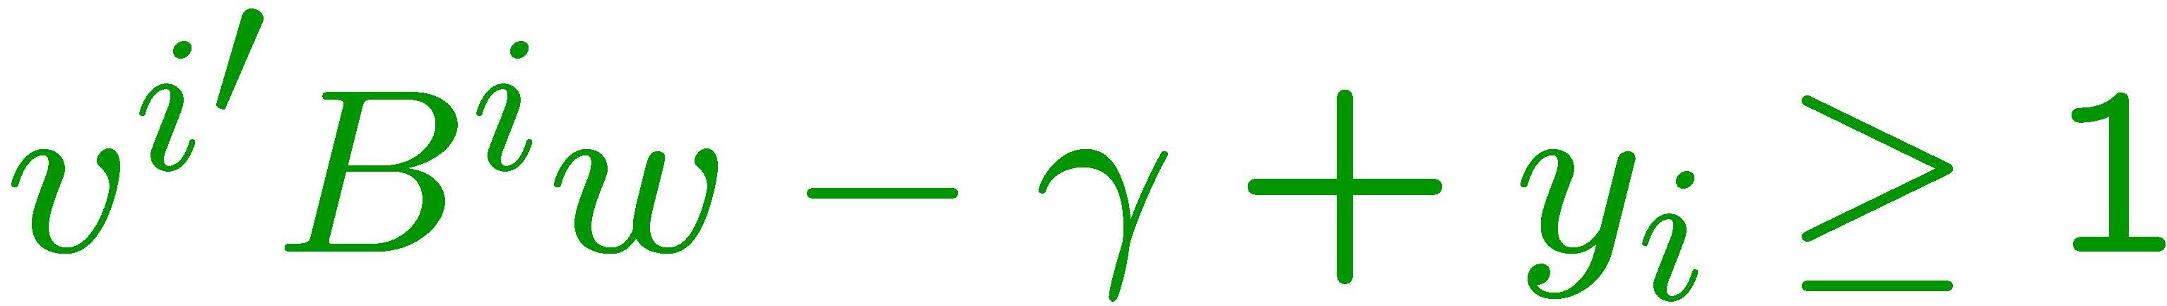
Successive Linearization
The first k constraints are bilinear
For fixed v^{i}, i = 1, …, k
  is linear in w, γ, and y_{i}, i = 1, …, k
For fixed w
  is linear in v^{i}, γ, and y_{i}, i = 1, …, k
Alternate between solving linear programs for (w,γ, y) and (v^{i},γ,y).

Slide 10
Multiple Instance Classification Algorithm: MICA
Start with v^{i0} = e/m^{i}, i = 1, …, k
  (v^{i0})⁰B^{i} will result in the mean of bag B^{i}
r = iteration number
For fixed v^{ir}, i = 1, …, k, solve for (w^{r}, γ^{r}, y^{r})
For fixed w^{r}, solve for (γ, y, v^{i(r+1)}), i = 1, …, k
Stop if difference in v variables is very small
Notes:
First step: initialize with mean

Slide 11

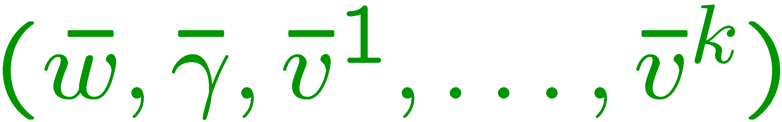
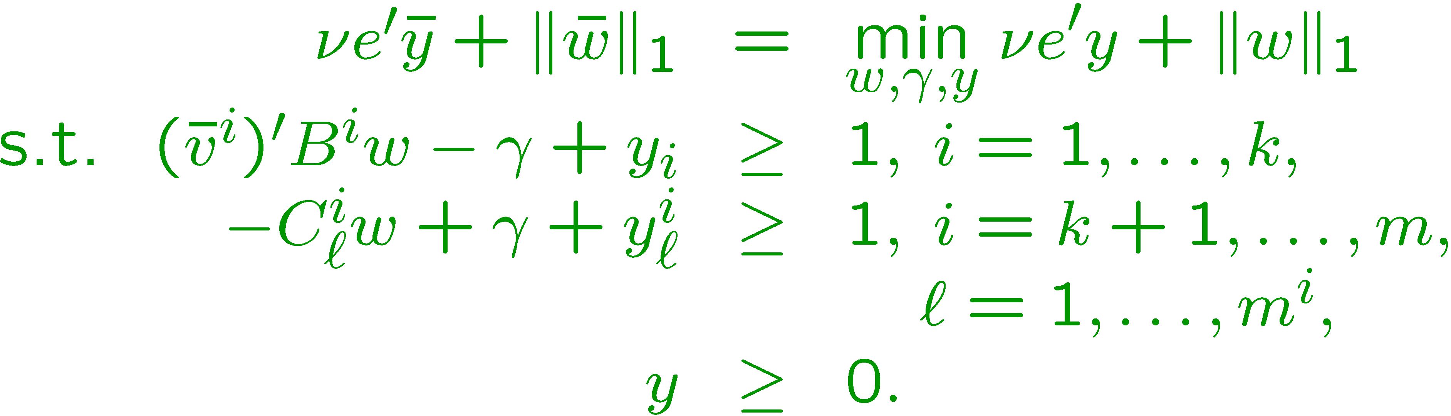
Convergence
Objective is bounded below and nonincreasing, hence it converges to
for any accumulation point
local minimum property of objective function

Slide 12
Sample Iteration 1: Two Bags Misclassified by Algorithm
Positive:
Convex combination for positive bag:
Misclassified bags
Negative:

Slide 13
Sample Iteration 2: No Misclassified Bags
Positive:
Convex combination for positive bag:
Negative:

Slide 14
Numerical Experience: Linear Kernel MICA
Compared linear MICA with 3 previously published algorithms
  mi-SVM (Andrews et al., 2003)
  MI-SVM (Andrews et al., 2003)
  EM-DD (Zhang and Goldman, 2001)
Compared on 3 image datasets from (Andrews et al., 2003)
  Determine if an image contains a specific animal
  MICA best on 2 of 3 datasets

Slide 15
Results: Linear Kernel MICA
10 fold cross validation correctness (%)
(Best in Bold)
Data Set | MICA | mi-SVM | MI-SVM | EM-DD
Elephant | 82.5 | 82.2 | 81.4 | 78.3
Fox | 62.0 | 58.2 | 57.8 | 56.1
Tiger | 82.0 | 78.4 | 84.0 | 72.1
Data Set | + Bags | + Points | - Bags | - Points | Features
Elephant | 100 | 762 | 100 | 629 | 230
Fox | 100 | 647 | 100 | 673 | 230
Tiger | 100 | 544 | 100 | 676 | 230

Slide 16


Nonlinear Kernel Classifier
Here x2 R^{n}, u2 R^{m} is a dual variable and H is
the m£ n matrix defined as:
and
is an arbitrary kernel map from
R^{n}£ R^{n£ m} into R^{m}.

Slide 17
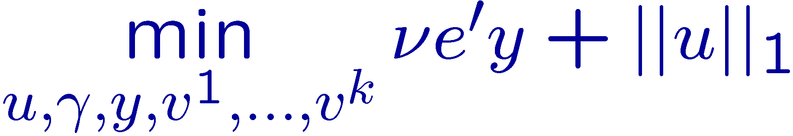
Nonlinear Kernel Classification Problem

Slide 18
Numerical Experience: Nonlinear Kernel MICA
Compared nonlinear MICA with 7 previously published algorithms
  mi-SVM, MI-SVM, and EM-DD
  DD (Maron and Ratan, 1998)
  MI-NN (Maron and De Raedt, 2000)
  Multiple instance kernel approaches (Gartner et al., 2002)
  IAPR (Dietterich et al., 1997)
Musk-1 and Musk-2 datasets (UCI repository)
  Determine whether a molecule smells “musky”
  Related to drug activity prediction
  Each bag contains conformations of a single molecule
  MICA best on 1 of 2 datasets

Slide 19
Results: Nonlinear Kernel MICA
10 fold cross validation correctness (%)
Data Set | MICA | mi-SVM | MI-SVM | EM-DD | DD | MI-NN | IAPR | MIK
Musk-1 | 84.4 | 87.4 | 77.9 | 84.8 | 88.0 | 88.9 | 92.4 | 91.6
Musk-2 | 90.5 | 83.6 | 84.3 | 84.9 | 84.0 | 82.5 | 89.2 | 88.0
Data Set | + Bags | + Points | - Bags | - Points | Features
Musk-1 | 47 | 207 | 45 | 269 | 166
Musk-2 | 39 | 1017 | 63 | 5581 | 166
Notes:
IAPR is Dietterich’s best axis parallel rectangle algorithm
MIK is Gartner et al.’s best multiple instance kernel algorithm

Slide 20
More Information
http://www.cs.wisc.edu/~olvi/
http://www.cs.wisc.edu/~wildt/

