Slide 2




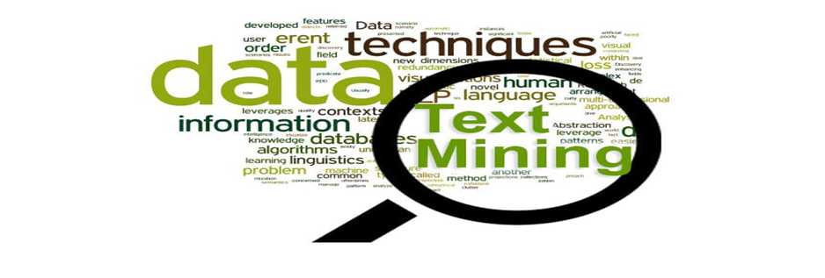
Analyzing Amazon’s Customer Reviews using SAS Test Miner for Devising Product Launch Strategies
Manideep Mellachervu Anvesh Reddy Minukuri
Oklahoma State University Comcast Corporation
Abstract
Abstract
Introduction
The digital economy is showing tremendous growth in the 21st century, and it is having a massive impact on the current society. E-commerce is one element of the Internet of Things (IoT), and its worldwide retail sales amounted to 2.3 trillion US dollars. This amount shows the popularity of online shopping, and it indicates an evolution of retailers in this industry. A recent study conducted by GE Capital Retail Bank found that 81% of consumers perform online research before buying products. This indicates that consumers rely heavily on others' opinions and experiences in order to buy a product. Businesses need to understand customers' views of their products and of competitors' products for strategic marketing. E-commerce businesses provide a platform to generate user-experience content through customer reviews, which are vital for a buyer to choose the best product out of numerous similar products available in the market. Companies need to analyze the customers' perspectives through reviews for better business, evaluate customer engagement, and devise strategies for the launch of their products. This paper focuses on analyzing customer reviews primarily on Amazon using Python and SAS® Text Miner. This project determined which product features are given high-ratings or low-ratings, and how the high-rating features of a best-selling product perform compared to a similar product that is sold by a different vendor.
Methods
Manideep Mellachervu
Results 1
Results 2
Conclusion

Slide 3
Analyzing Amazon’s Customer Reviews using SAS Test Miner for Devising Product Launch Strategies
Manideep Mellachervu
Manideep Mellachervu Anvesh Reddy Minukuri
Oklahoma State University Comcast Corporation
Oklahoma State University
Introduction
The rapid evolution of online market sale helps customers to find the good product, based on online reviews in e-commerce websites like Amazon. These reviews suggest to determine high and low rating features of any individual product and thereby provide access to compare high rating features of a bestselling product with that of other similar products available in the market. It is often important for any business to understand the customer opinion about a product. The reviews from e-commerce websites help companies to determine the customer engagement and plan strategies for future products to gain better business value. Textual data in the form of reviews from Amazon have been gathered to extract the features of a product.
Abstract
Introduction
Methods
Results 1
Results 2
Conclusion
Objective
Methodology
Understand customer opinion about a product
Help companies to determine the customer engagement
Plan strategies for future products to gain better business value
Help customers to find best product out of numerous products
Data
Decomposition
Data Collection
Feature Extraction
Features

Slide 4
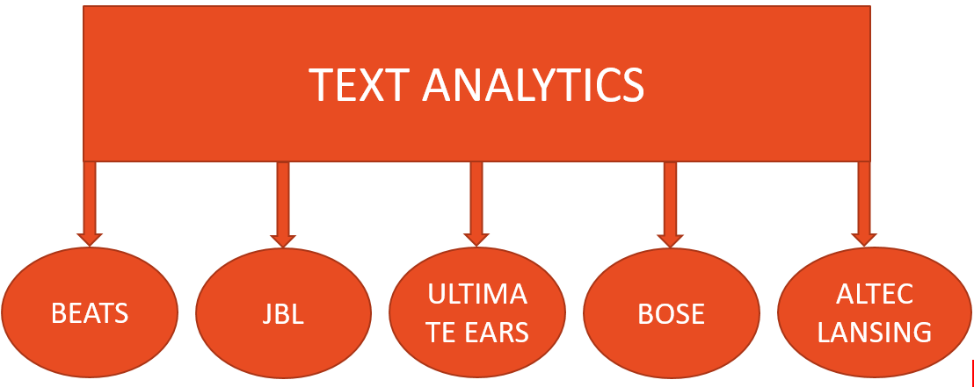
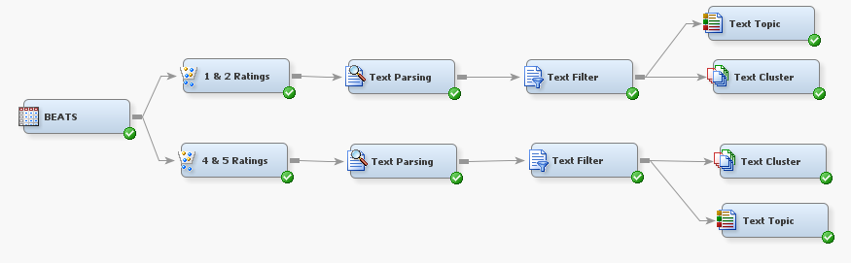
Analyzing Amazon’s Customer Reviews using SAS Test Miner for Devising Product Launch Strategies
Manideep Mellachervu
Manideep Mellachervu Anvesh Reddy Minukuri
Oklahoma State University Comcast Corporation
Oklahoma State University
Data Collection
ASIN code is used for extracting reviews from Amazon
Data Dictionary has Author, Header, Posted Date, User Rating, Comment
Filter Node helps to separate the comments
Abstract
Introduction
Methods
Results 1
Results 2
Conclusion

Slide 5
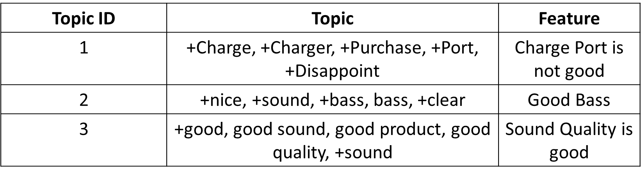
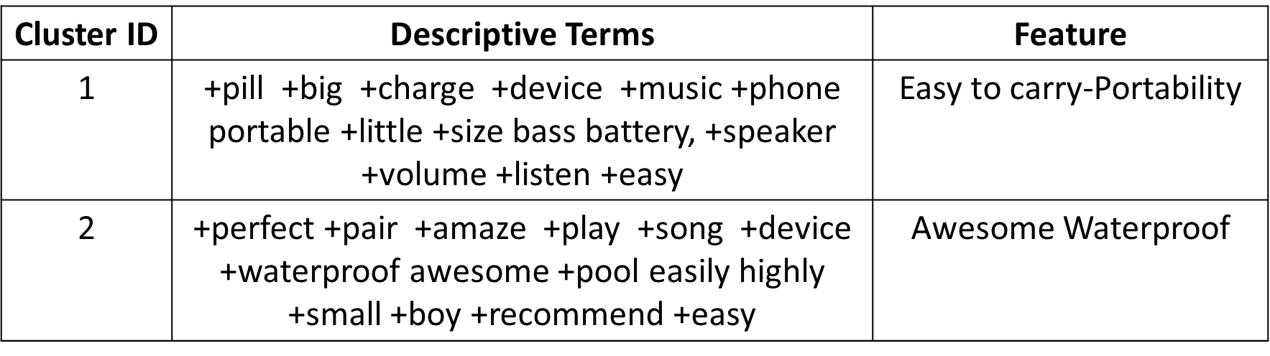
Analyzing Amazon’s Customer Reviews using SAS Test Miner for Devising Product Launch Strategies
Manideep Mellachervu
Manideep Mellachervu Anvesh Reddy Minukuri
Oklahoma State University Comcast Corporation
Oklahoma State University
Text Parsing
Text Filter
Text Topic/Cluster
Text Parsing
‘Abbr’, ‘Aux’, ‘Conj’, ‘Det’, ‘Interj’, ‘Num’, ‘Part’, ‘Prep’, ‘Pron’, ‘Prop’ parts of speech have been ignored.
‘Num’, ‘Punct’ types of attributes have been ignored.
Abstract
Introduction
Methods
Results 1
Text Filter
Results 2
‘Abbr’, ‘Aux’, ‘Conj’, ‘Det’, ‘Interj’, ‘Num’, ‘Part’, ‘Prep’, ‘Pron’, ‘Prop’ parts of speech have been ignored.
‘Num’, ‘Punct’ types of attributes have been ignored.
Conclusion
Text Cluster
Text Topic
40 as the maximum number of clusters and 15 as the number of descriptive terms to describe clusters using Expectation-Maximization Cluster Algorithm
Number of Multi-Term Topics has been set to 20

Slide 6
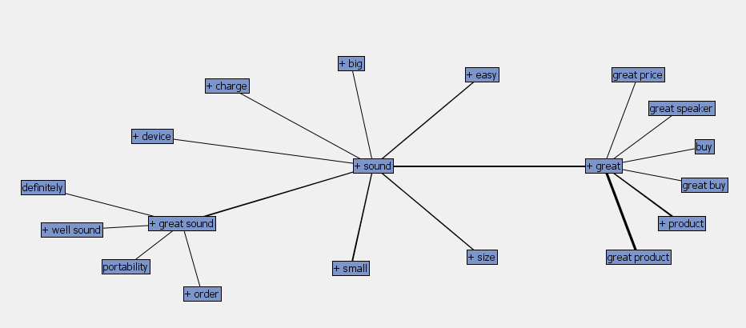
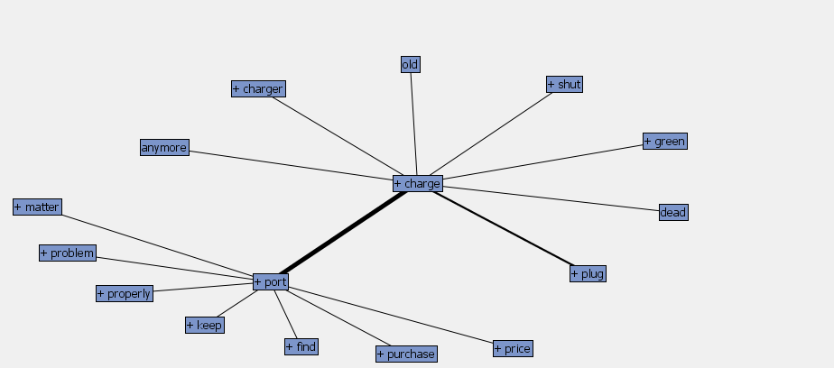
Analyzing Amazon’s Customer Reviews using SAS Test Miner for Devising Product Launch Strategies
Manideep Mellachervu
Manideep Mellachervu Anvesh Reddy Minukuri
Oklahoma State University Comcast Corporation
Oklahoma State University
Concept Link Diagram for word CHARGE
Abstract
Introduction
Concept link diagram in adjacent figure shows word PRODUCT is highly associated with words GREAT, RECOMMENDED, EXCELLENT, AWESOME. It tells that Beats speaker is a good product and reviewers highly recommend this product to other customers.
Methods
Results 1
Results 2
Conclusion
Concept Link Diagram for word SOUND
Concept link diagram in figure 7 shows word SOUND is strongly associated with word GREAT, indicates that Beats speaker is a great product with the good sound quality feature.

Slide 7
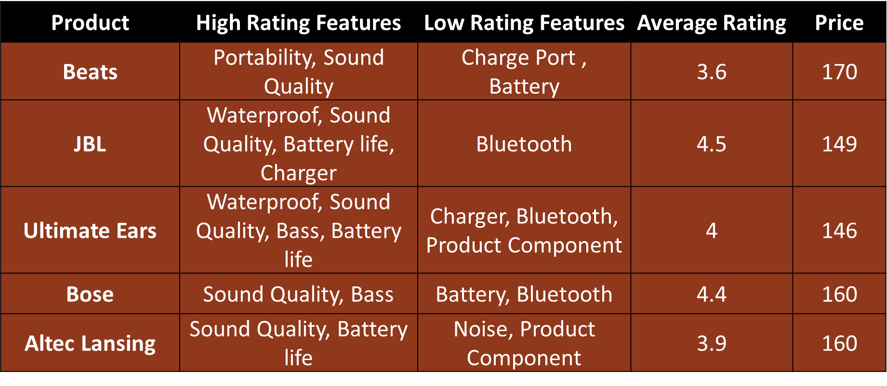
Analyzing Amazon’s Customer Reviews using SAS Test Miner for Devising Product Launch Strategies
Manideep Mellachervu
Manideep Mellachervu Anvesh Reddy Minukuri
Oklahoma State University Comcast Corporation
Oklahoma State University
Conclusion
Abstract
Introduction
Methods
Results 1
Results 2
Conclusion
This feature analysis helps retailers and companies to understand customer expectations to create future products that meet the needs of their customers and gain business value. Additionally, this analysis prototype also benefits the amazon retailers to constantly view and evaluate the customer’s reviews and increase their brand loyalty by following the above recommendations.
References
Acknowledgements
Retail e-commerce sales worldwide from 2014 to 2021, Statista 2018. Accessed August 2018. “https://www.statista.com/statistics/379046/worldwide-retail-e-commerce-sales/”.
Goutam Chakraborty, Murali Pagolu, Satish Garla, Text Mining and Analysis: Practical Methods, Examples, and Case Studies Using SAS® by SAS Institute Inc 2014, Accessed 20 Mar 2017.
Getting Started with SAS® Text Miner 13.2. Cary, NC: SAS Institute Inc., Accessed 20 Mar 2017.
Jin Meizi, Jiawen Liu, Goutam Chakraborty. March 2014. “A Way to Fetch User Reviews from iTunes Using SAS®.” Proceedings of the SAS Global Forum, Washington D.C.
Goutam Chakraborty, Jiawen Liu and Mantosh Kumar Sarkar. 2016. “Feature-Based Sentiment Analysis on Android App Reviews Using SAS® Text Miner and SAS® Sentiment Analysis Studio.” Proceedings of the SAS Global Forum, Las Vegas.
I sincerely thank my professors Dr. Goutam Chakraborty and
Dr. Miriam McGaugh for their constant support and guidance through every phase of this project.

