Slide 1
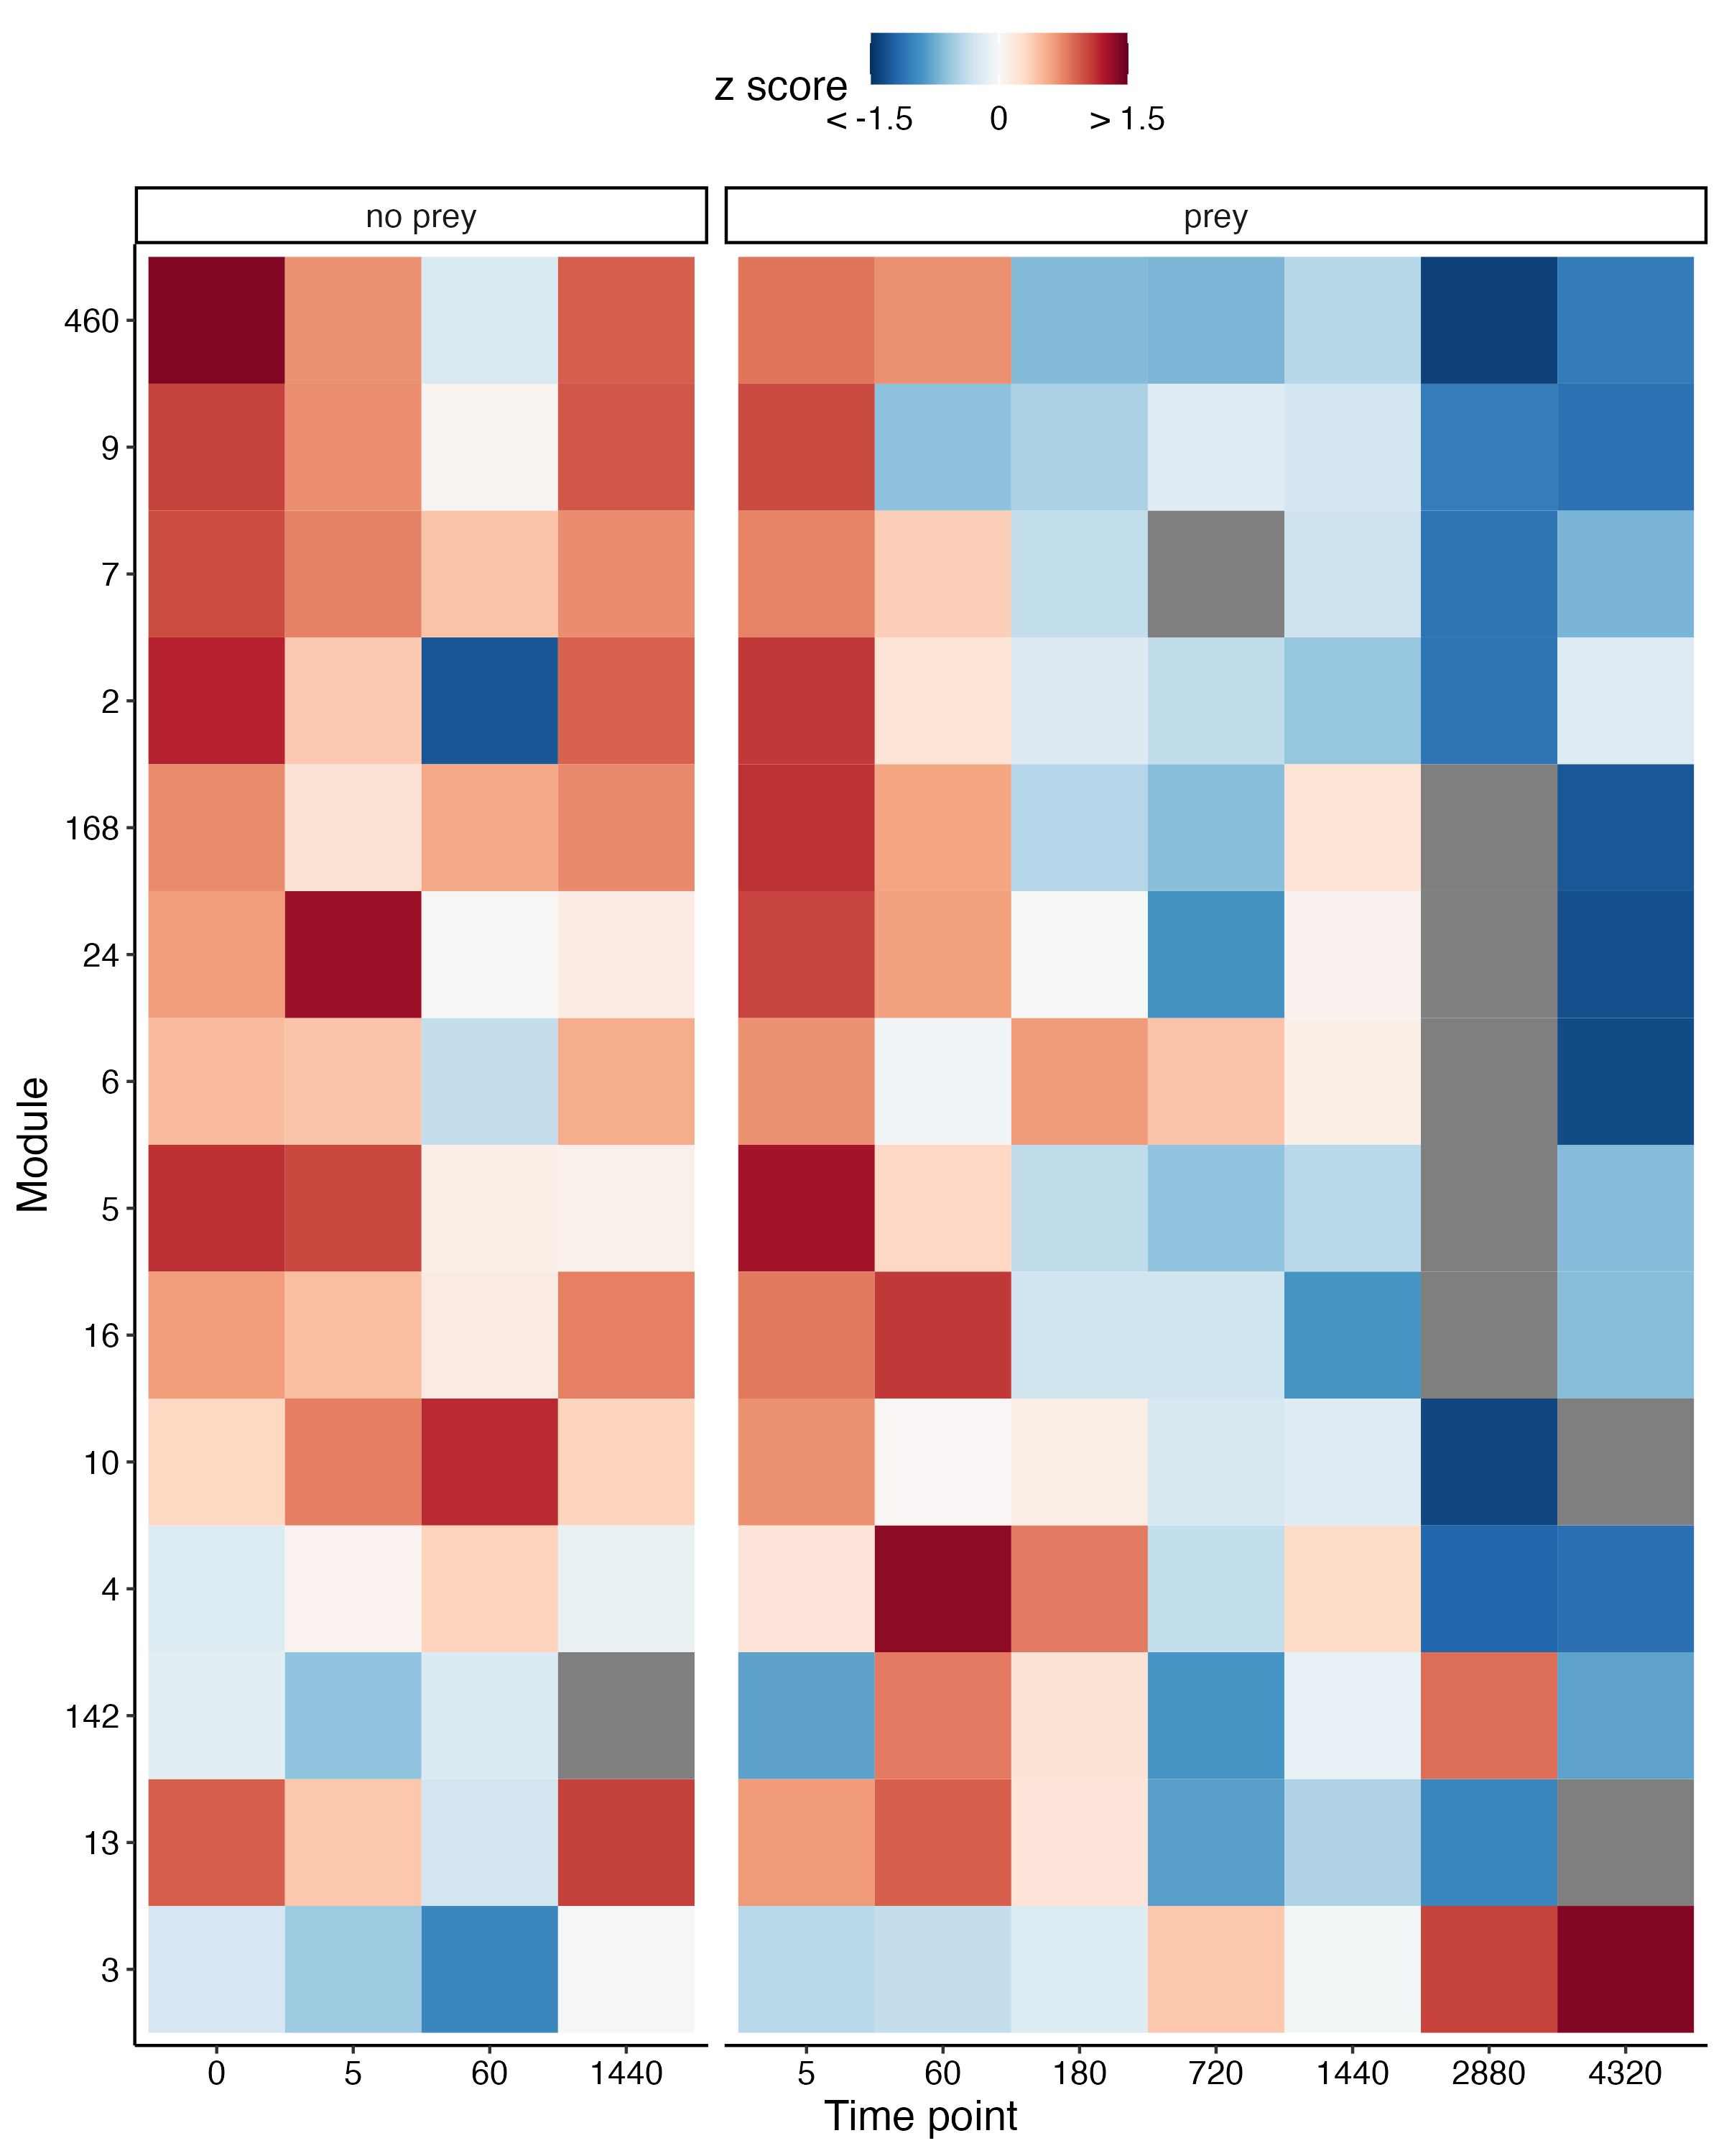
Network Modules
module | n
3 | 3009
2 | 1684
4 | 1455
10 | 1239
7 | 750
9 | 668
6 | 531
16 | 418
13 | 178
5 | 36
24 | 35
168 | 22
142 | 10
460 | 6

Slide 2

Enzymes in Network Modules
 | Literature Review | RNA-seq BLAST Hit in Module(s) | # of BLAST Hits in Module(s) | # of BLAST Hits total | # of Modules | Modules
Phosphatase | x | x | 84 | 119 | 9 | 2,3,4,6,7,9,10,13,16
Protease | x | x | 34 | 74 | 8 | 2,3,4,6,7,9,10,16
Chitinase | x | x | 8 | 9 | 3 | 3,9,19
Glucanase | x | x | 2 | 2 | 1 | 3
Esterase | x | x | 37 | 61 | 9 | 2,3,4,5,7,9,10,24,168
Peroxidase | x | x | 18 | 33 | 6 | 2,3,4,7,10,16
Nuclease | x | x | 27 | 39 | 8 | 2,3,4,6,7,9,10, 16
Glucosaminidase |  |  | 0 | 0
Glucosidase |  | x | 13 | 23 | 8 | 2,3,4,6,7,9,10,13
Amylase | x | x | 16 | 21 | 4 | 2,3,10,16
Lipase |  | x | 31 | 41 | 7 | 2,3,4,5,7,9,10
Ribonuclease |  | x | 9 | 11 | 3 | 2, 3,10
Phosphoamidase |  |  | 0 | 0 | 0
Xylosidase |  | x | 2 | 6 | 2 | 3,10
Urease |  | x | 3 | 4 | 3 | 2, 10,16

Slide 3
Enzymes in Network Modules
x | n | Phosphatase | Protease | Chitinase | Glucanase | Esterase | Peroxidase | Nuclease | Glucosaminidase | Glucosidase | Amylase | Lipase | Ribonuclease | Phosphoamidase | Xylosidase | Urease
3 | 3009 | x | x | x | x | x | x | x |  | x | x | x | x |  | x
2 | 1684 | x | x |  |  | x | x | x |  | x | x | x | x |  |  | x
4 | 1455 | x | x |  |  | x | x | x |  | x |  | x
10 | 1239 | x | x |  |  | x | x | x |  | x | x |  | x |  | x | x
7 | 750 | x | x |  |  | x | x | x |  | x |  | x
9 | 668 | x | x | x |  | x |  | x |  | x |  | x
6 | 531 | x | x |  |  |  |  | x |  | x
16 | 418 | x | x |  |  |  | x |  |  |  | x |  |  |  |  | x
13 | 178 | x |  | x |  |  |  | x |  | x
5 | 36 |  |  |  |  | x |  |  |  |  |  | x
24 | 35 |  |  |  |  | x
168 | 22 |  |  |  |  | x
142 | 10
460 | 6

Slide 4
Enzymes in Network Modules
module | n
3 | 3009
2 | 1684
4 | 1455
10 | 1239
7 | 750
9 | 668
6 | 531
16 | 418
13 | 178
5 | 36
24 | 35
168 | 22
142 | 10
460 | 6
Phosphatases: 84
module | n
4 | 20
3 | 16
2 | 14
10 | 11
7 | 10
9 | 6
13 | 3
6 | 2
16 | 2

Slide 5
Enzymes in Network Modules
module | n
3 | 3009
2 | 1684
4 | 1455
10 | 1239
7 | 750
9 | 668
6 | 531
16 | 418
13 | 178
5 | 36
24 | 35
168 | 22
142 | 10
460 | 6
Proteases: 34
module | n
2 | 13
3 | 7
9 | 4
7 | 3
4 | 2
6 | 2
16 | 2
10 | 1

Slide 6
Enzymes in Network Modules
module | n
3 | 3009
2 | 1684
4 | 1455
10 | 1239
7 | 750
9 | 668
6 | 531
16 | 418
13 | 178
5 | 36
24 | 35
168 | 22
142 | 10
460 | 6
Chitinases: 8
module | n
3 | 6
9 | 1
10 | 1

Slide 7
Enzymes in Network Modules
module | n
3 | 3009
2 | 1684
4 | 1455
10 | 1239
7 | 750
9 | 668
6 | 531
16 | 418
13 | 178
5 | 36
24 | 35
168 | 22
142 | 10
460 | 6
Glucanases: 2
module | n
3 | 2

Slide 8
Enzymes in Network Modules
module | n
3 | 3009
2 | 1684
4 | 1455
10 | 1239
7 | 750
9 | 668
6 | 531
16 | 418
13 | 178
5 | 36
24 | 35
168 | 22
142 | 10
460 | 6
Esterases: 37
module | n
3 | 12
10 | 8
4 | 7
7 | 3
2 | 2
6 | 2
9 | 1
24 | 1
168 | 1

Slide 9
Enzymes in Network Modules
module | n
3 | 3009
2 | 1684
4 | 1455
10 | 1239
7 | 750
9 | 668
6 | 531
16 | 418
13 | 178
5 | 36
24 | 35
168 | 22
142 | 10
460 | 6
Peroxidases: 18
module | n
3 | 5
4 | 5
7 | 3
10 | 3
2 | 1
16 | 1

Slide 10
Enzymes in Network Modules
module | n
3 | 3009
2 | 1684
4 | 1455
10 | 1239
7 | 750
9 | 668
6 | 531
16 | 418
13 | 178
5 | 36
24 | 35
168 | 22
142 | 10
460 | 6
Nucleases: 27
module | n
3 | 10
2 | 5
7 | 3
10 | 3
16 | 3
4 | 1
6 | 1
9 | 1

Slide 11
Enzymes in Network Modules
module | n
3 | 3009
2 | 1684
4 | 1455
10 | 1239
7 | 750
9 | 668
6 | 531
16 | 418
13 | 178
5 | 36
24 | 35
168 | 22
142 | 10
460 | 6
Glucosaminidases: 0

Slide 12
Enzymes in Network Modules
module | n
3 | 3009
2 | 1684
4 | 1455
10 | 1239
7 | 750
9 | 668
6 | 531
16 | 418
13 | 178
5 | 36
24 | 35
168 | 22
142 | 10
460 | 6
Glucosidases: 13
module | n
10 | 3
3 | 2
4 | 2
13 | 2
2 | 1
6 | 1
7 | 1
9 | 1

Slide 13
Enzymes in Network Modules
module | n
3 | 3009
2 | 1684
4 | 1455
10 | 1239
7 | 750
9 | 668
6 | 531
16 | 418
13 | 178
5 | 36
24 | 35
168 | 22
142 | 10
460 | 6
Amlyases: 16
module | n
2 | 8
3 | 4
10 | 2
16 | 2

Slide 14
Enzymes in Network Modules
module | n
3 | 3009
2 | 1684
4 | 1455
10 | 1239
7 | 750
9 | 668
6 | 531
16 | 418
13 | 178
5 | 36
24 | 35
168 | 22
142 | 10
460 | 6
Lipases: 31
module | n
3 | 8
4 | 6
9 | 5
10 | 5
6 | 3
2 | 2
7 | 2

Slide 15
Enzymes in Network Modules
module | n
3 | 3009
2 | 1684
4 | 1455
10 | 1239
7 | 750
9 | 668
6 | 531
16 | 418
13 | 178
5 | 36
24 | 35
168 | 22
142 | 10
460 | 6
Ribonucleases: 9
module | n
3 | 6
2 | 2
10 | 1

Slide 16
Enzymes in Network Modules
module | n
3 | 3009
2 | 1684
4 | 1455
10 | 1239
7 | 750
9 | 668
6 | 531
16 | 418
13 | 178
5 | 36
24 | 35
168 | 22
142 | 10
460 | 6
Phosphoamidases: 0

Slide 17
Enzymes in Network Modules
module | n
3 | 3009
2 | 1684
4 | 1455
10 | 1239
7 | 750
9 | 668
6 | 531
16 | 418
13 | 178
5 | 36
24 | 35
168 | 22
142 | 10
460 | 6
Xylosidases: 2
module | n
3 | 1
10 | 1

Slide 18
Enzymes in Network Modules
module | n
3 | 3009
2 | 1684
4 | 1455
10 | 1239
7 | 750
9 | 668
6 | 531
16 | 418
13 | 178
5 | 36
24 | 35
168 | 22
142 | 10
460 | 6
Ureases: 3
module | n
2 | 1
10 | 1
16 | 1

