Slide 1
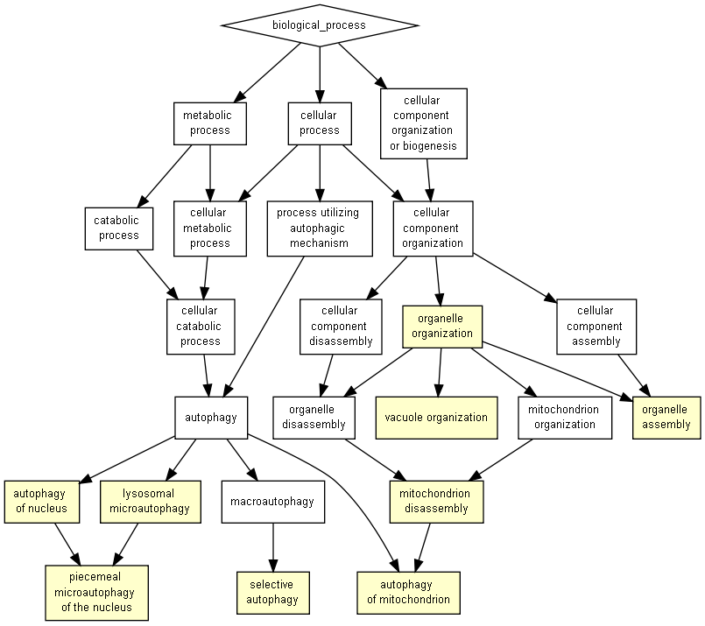
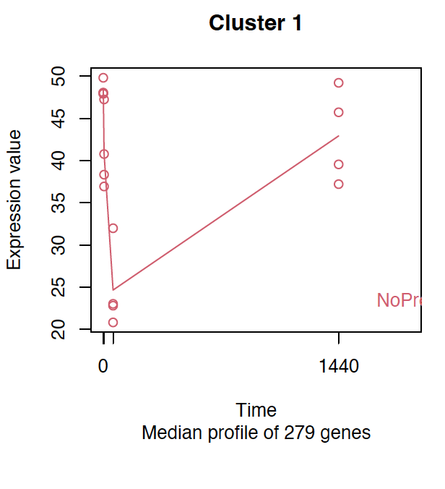
Cluster 1 No Prey vs All

Slide 2
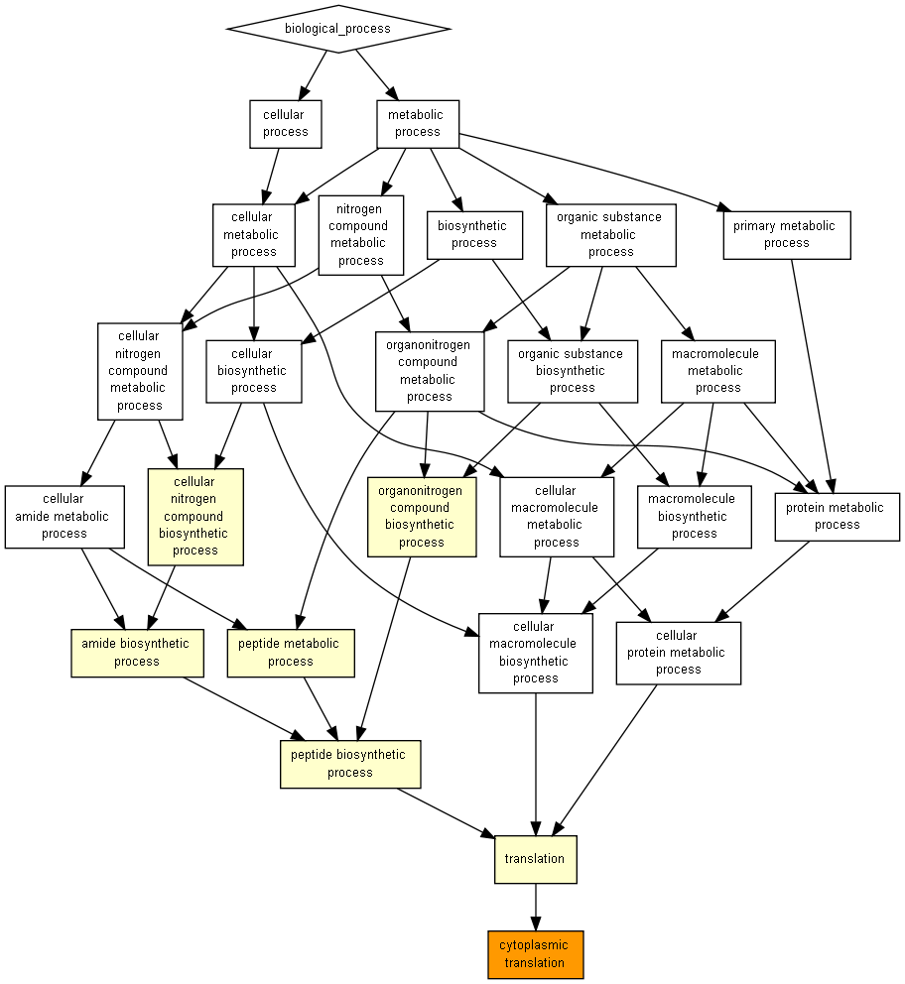
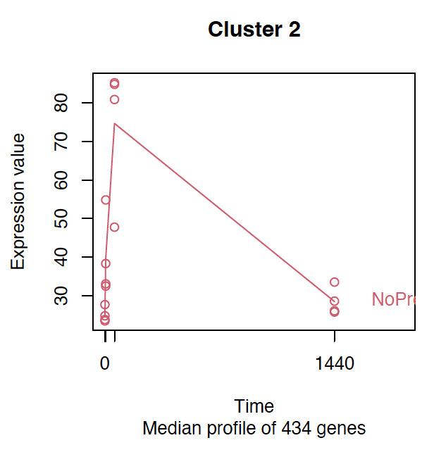
Cluster 2 No Prey vs All

Slide 3
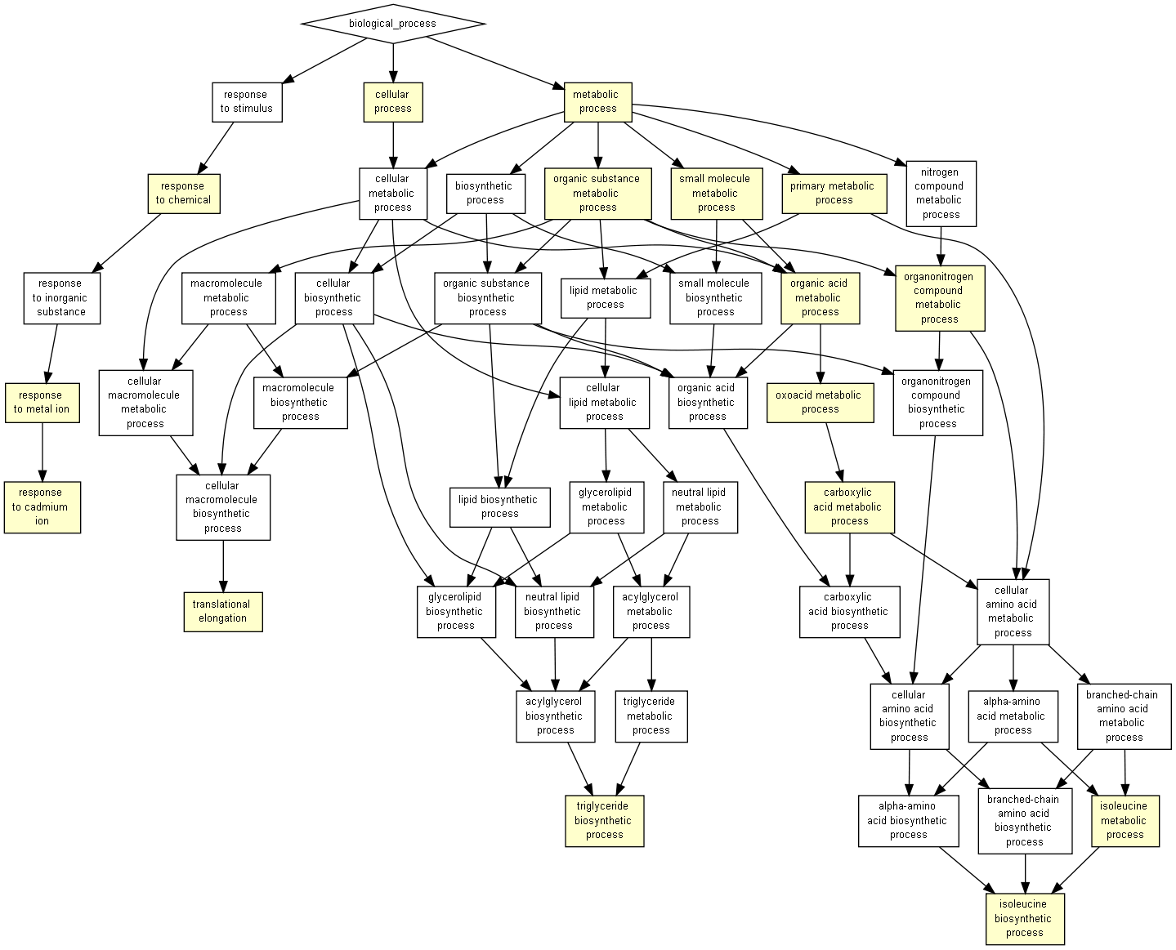
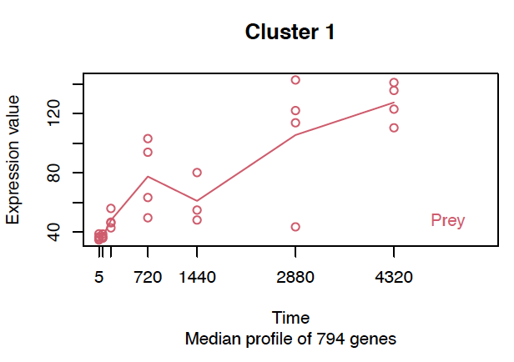
Cluster 1 Prey vs All

Slide 4
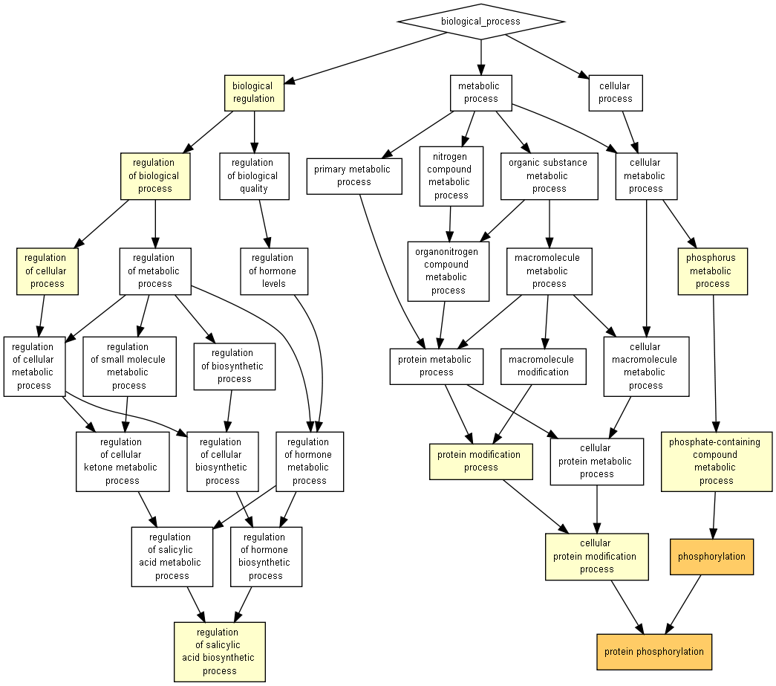
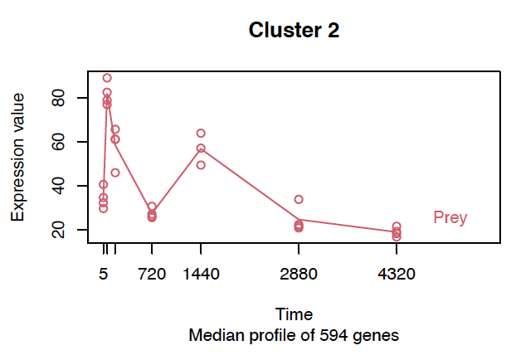
Cluster 2 Prey vs All

Slide 5
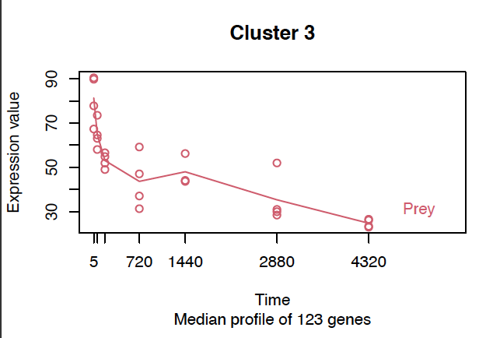
Cluster 3 Prey vs All
There are no GO terms with an enrichment p-value above the value you specified

Slide 6
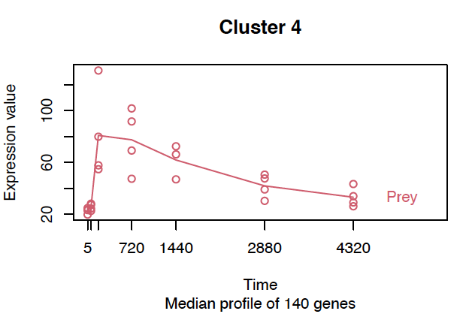
Cluster 4 Prey vs All
There are no GO terms with an enrichment p-value above the value you specified

Slide 7
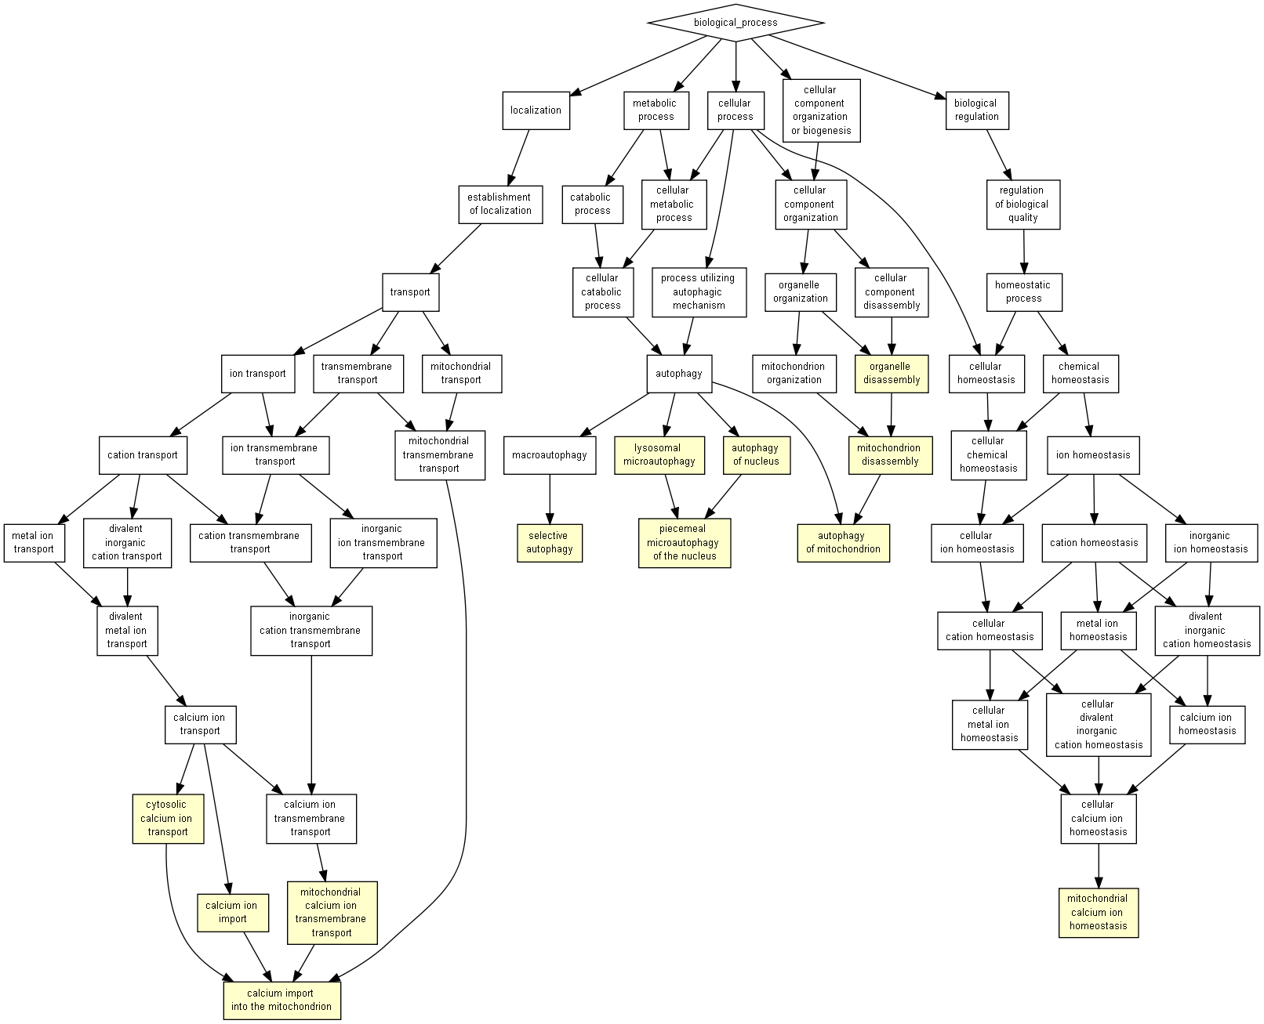
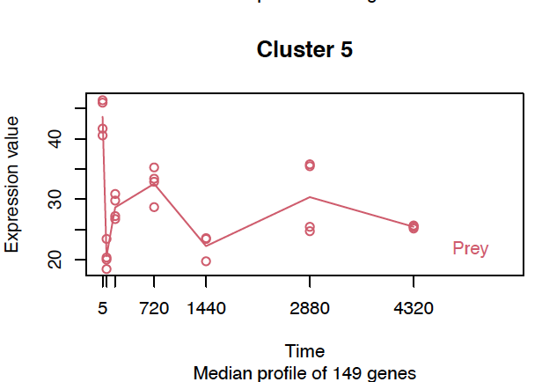
Cluster 5 Prey vs All

Slide 8
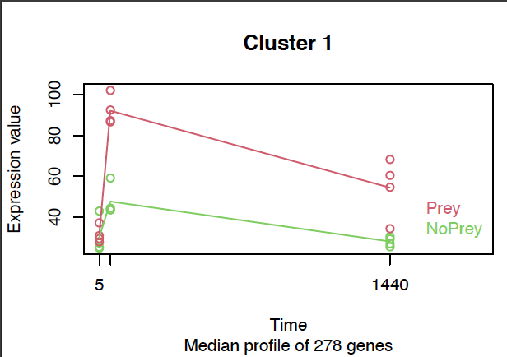
Cluster 1 Shared time points vs All
There are no GO terms with an enrichment p-value above the value you specified

Slide 9
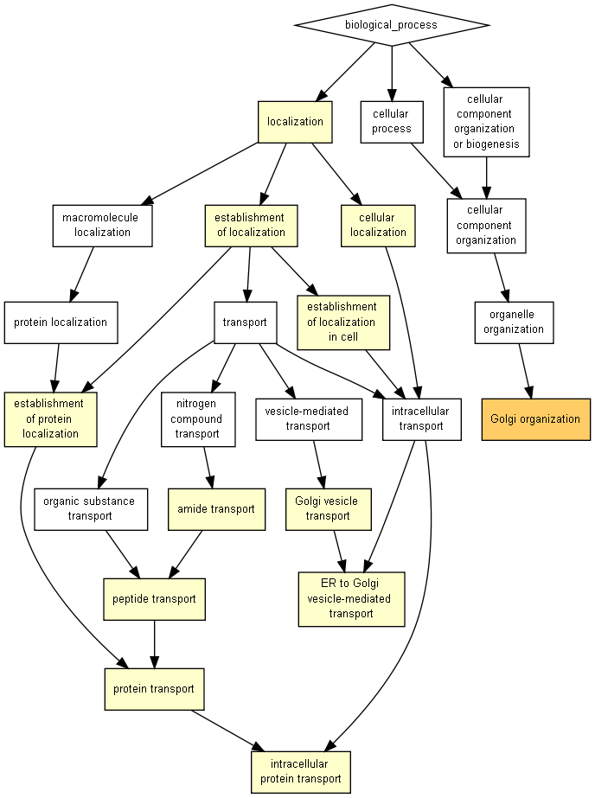
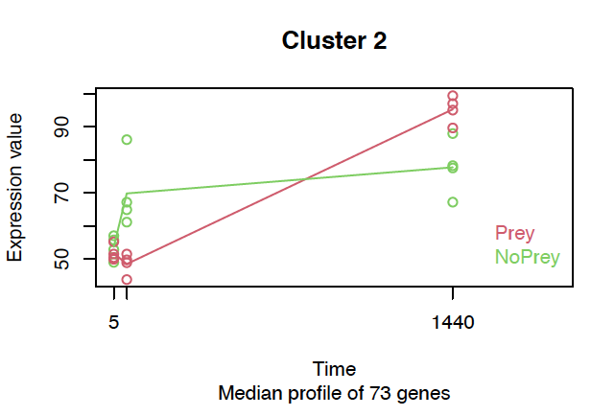
Cluster 2 Shared time points vs All

Slide 10
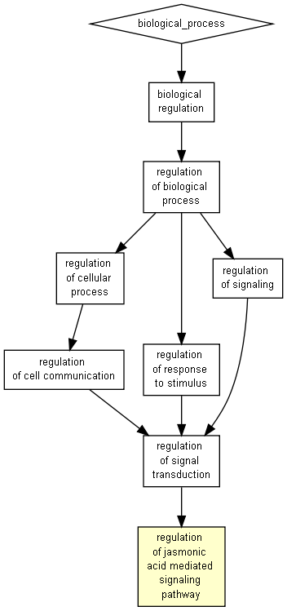
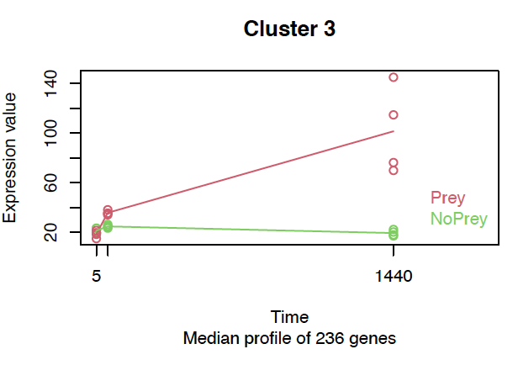
Cluster 3 Shared time points vs All

Slide 11
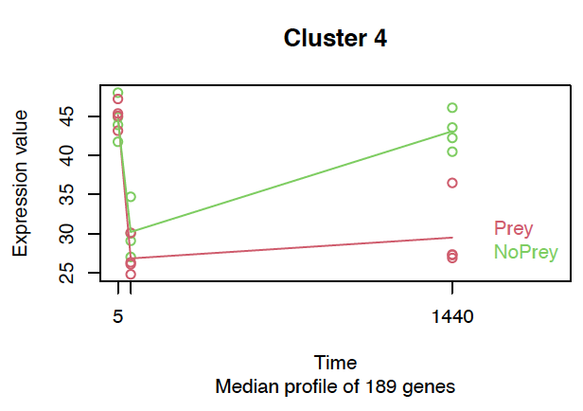
Cluster 4 Shared time points vs All
There are no GO terms with an enrichment p-value above the value you specified

Slide 12
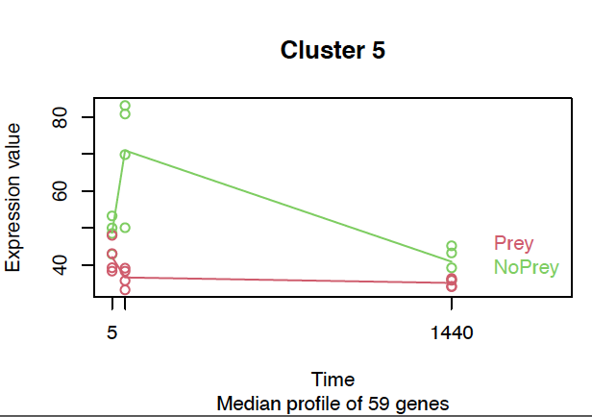
Cluster 5 Shared time points vs All
There are no GO terms with an enrichment p-value above the value you specified

Slide 13
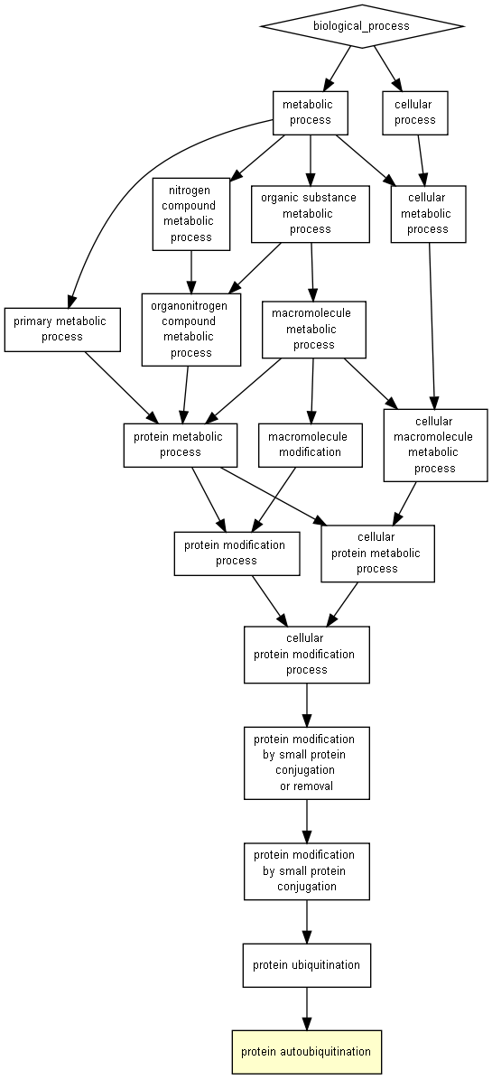
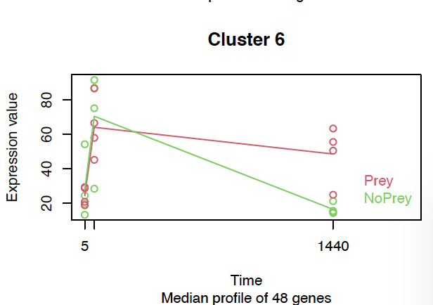
Cluster 6 Shared time points vs All

