Slide 1
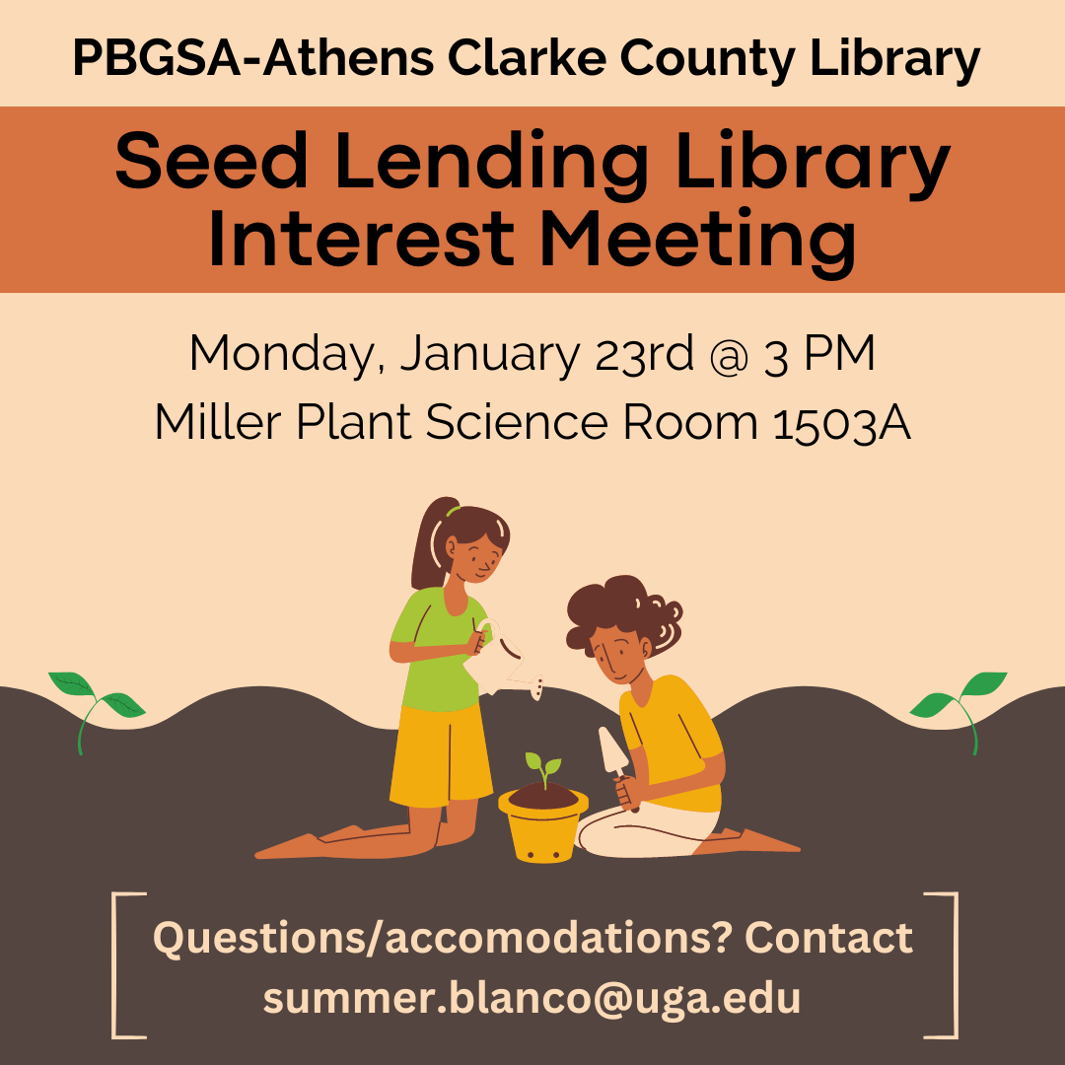

Slide 2
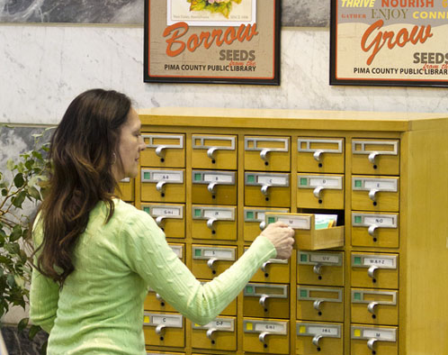
What?
“The basic idea is this: you check out a packet of seeds, plant them, and let some of them go to maturity. You then harvest that next generation of seeds, and return them to the library so other people can check them out.”
https://ischool.syr.edu/seed-libraries-what-they-are-how-to-start-one/

Slide 3
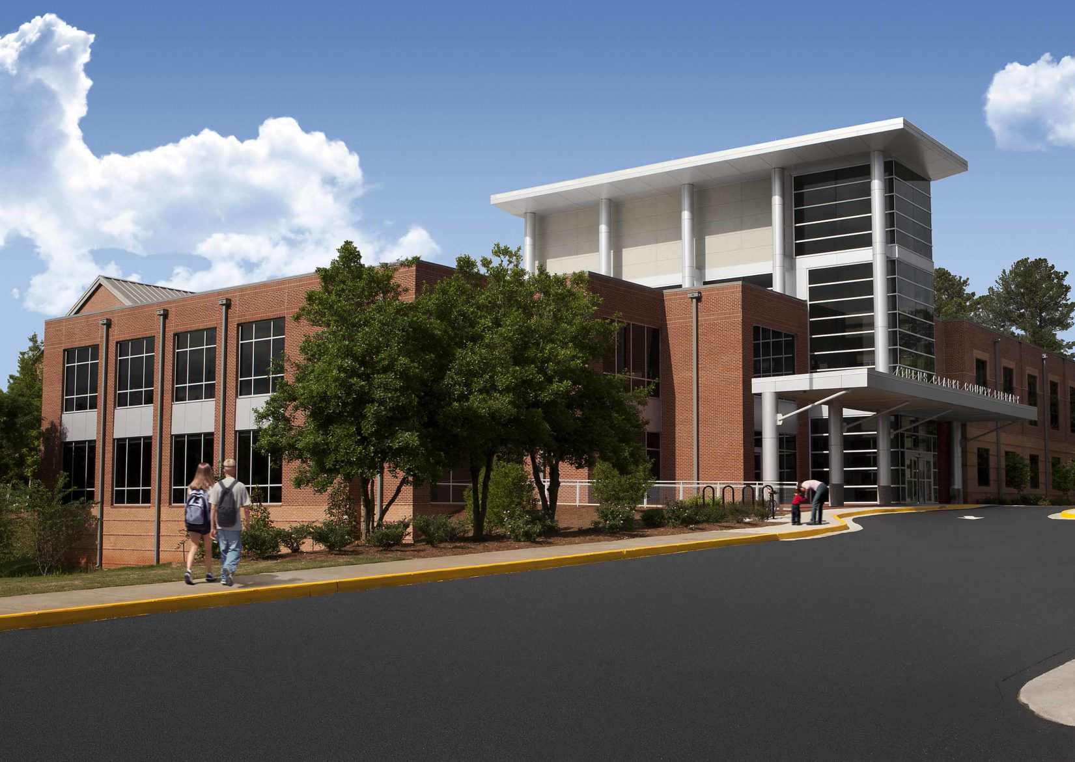
Where?
Athens-Clarke County Library
Open 7 days a week to the public
2025 Baxter St, Athens, GA 30606

Slide 4

Who?
Gretchen Elm
Information Services Librarian
Jacqueline Ann Reis
Social work intern
PBGSA volunteers
PBUSA volunteers

Slide 5

How?
Right now
Get seed donations!
Get cabinet or drawers to store seeds
Future
Materials for creating the library
Drawer & divider labels
Binder with information on seed in collection
Check in/check out materials
Create & print signage
Coin envelopes for seeds
Weekly inventory & maintenance of library!

Slide 6

When?

Slide 7

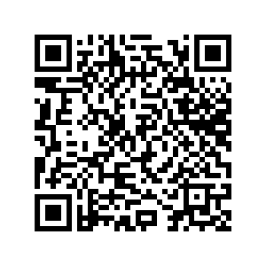
Community Input

Slide 8

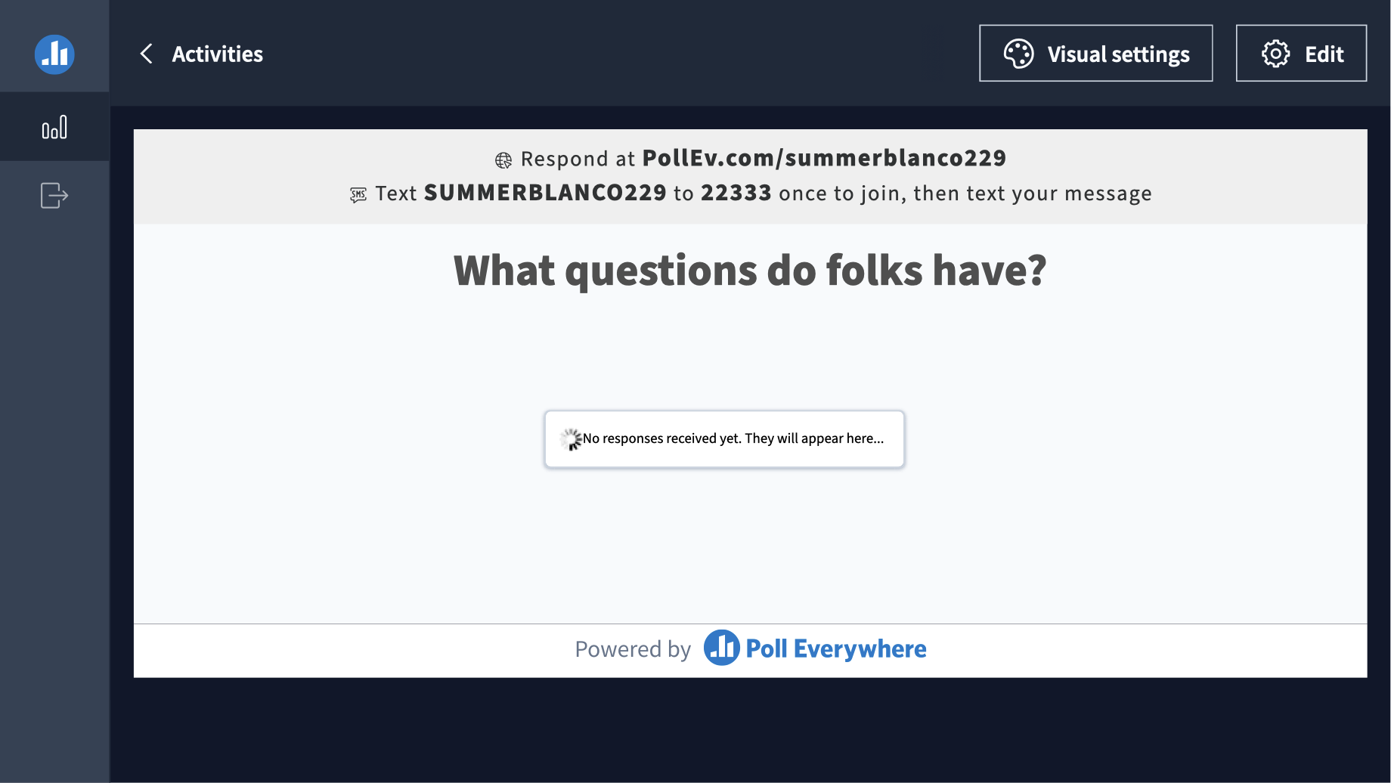
Questions

