Slide 1

DSC 530 – FINAL PROJECT
HARSIMAR MANGAT

Slide 2
Hotel Bookings -
Dataset- Hotel Bookings data from Kaggle.com
https://www.kaggle.com/jessemostipak/hotel-booking-demand
Questions to answer:
Can you build a model to determine what is the best average daily rate, looking at the following parameters:
Month #
Lead Time to stay
Reservation Status

Slide 3
Variables being investigated
Lead Time: The lead time before the customers stay at the hotel
ADR (Average Daily Rate): The average daily rate paid for the stay
Total of Special Requests: # of Special Requests
Reservation Status: No-Show, Check-out, canceled
# of Adults: # of Adults
Arrival Date Month: When did they arrive (month #)
Stay in Week Nights: How many week nights did they stay?

Slide 4
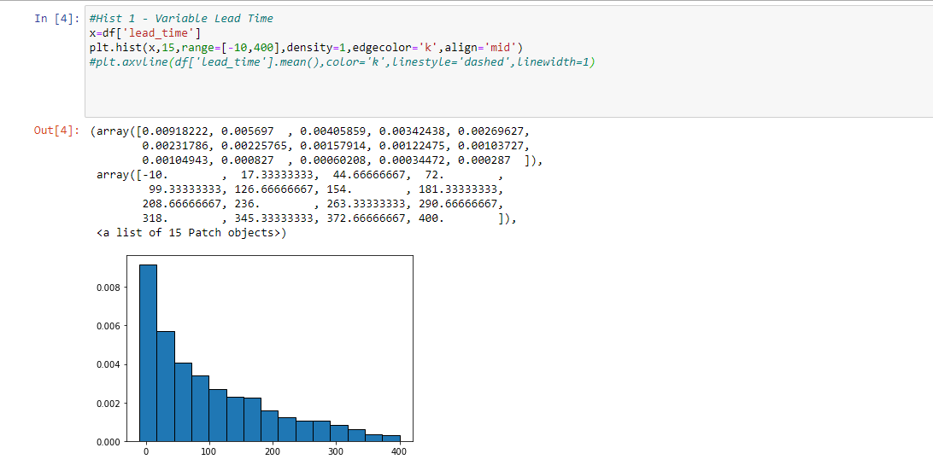
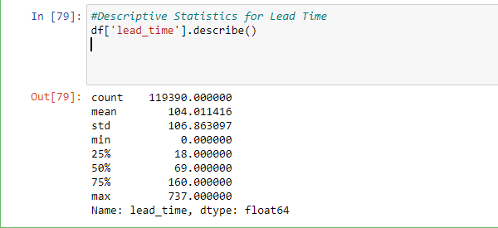
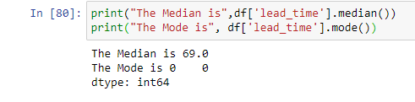
Variable 1: lead Time
Variable 1: Lead Time - Histogram
Variable 1: Lead Time - Analysis
Lead Time Variable is right skewed. This signifies the mode is closer to the left of the graph, and smaller than the mean. This means there could be a number of data points, that are greater than the mode.
This is the result that many of the lead time values are 0-5. These are not considered outliers, because these would be customers who book hotels the day of, which are equally relevant customers

Slide 5
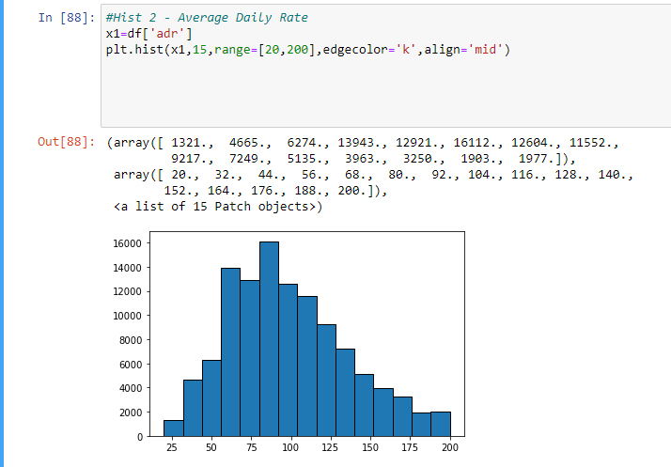
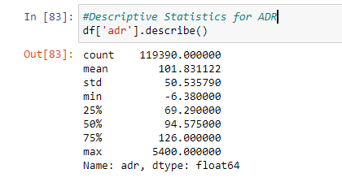
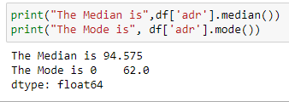
Variable 2: ADR
Variable 2: ADR- Histogram
Variable 2: ADR- Analysis
Average Daily Rate (ADR) is almost normally distributed. It looks like we have a slightly right skew.
We checked with the descriptive statistics, our median & mode is less than our average
We took out the values greater than $200/day because of the low frequency & anything less than $20/day. The logic there was the values less than $20/day may be errors, and values greater than $200, since there were so little, would only skew the bulk of the data set, which is between $20 – $200.

Slide 6
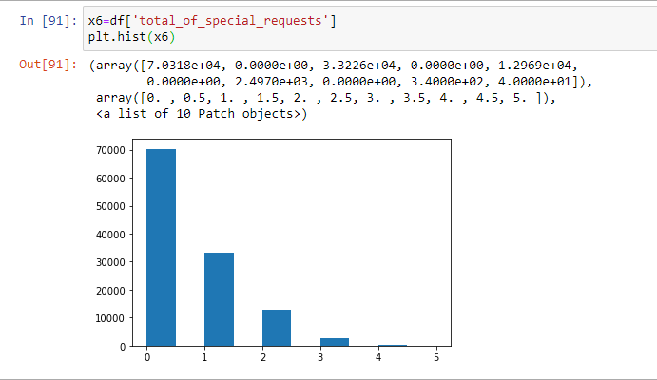
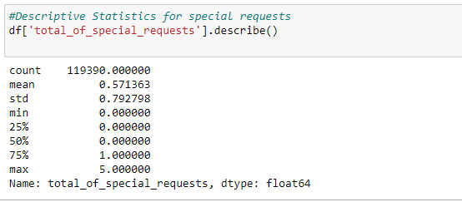
Variable 3: Total of Special Requests
Variable 3: Total of Special Requests- Histogram
Variable 3: Total of Special Requests- Analysis
Special Requests is clearly right skewed, significantly.
This is because most bookings did not have any special requests. We do not want to throw away those values. What would be interesting is to make a condition, special request == 1,
The descriptive statistics behind this variable is not as valuable, as useful information is contained in the whole numbers that signify the ‘total requests’
However, the breakdown makes sense, as the average is .57 – it leans less than 1, because of all the zeroes.

Slide 7
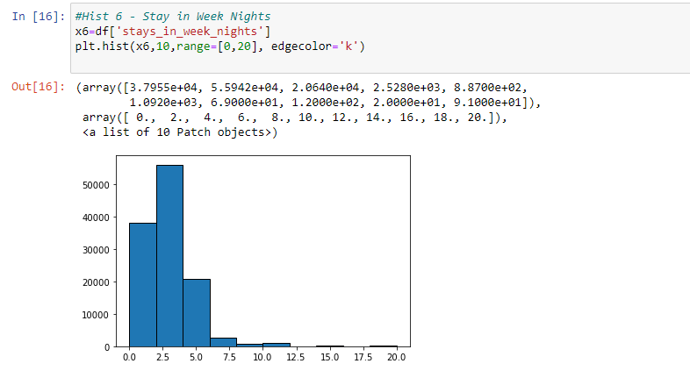
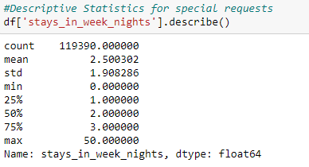
Variable 4: Stay in Week Nights
Variable 4: Stay in Week Nights
Variable 4: Stay in Week Nights

Slide 8
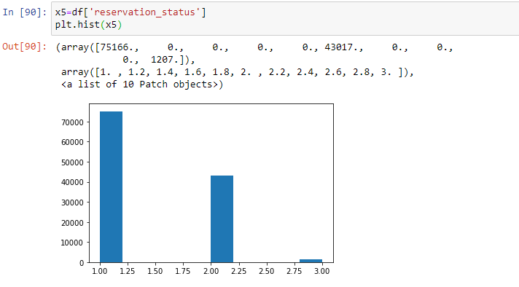
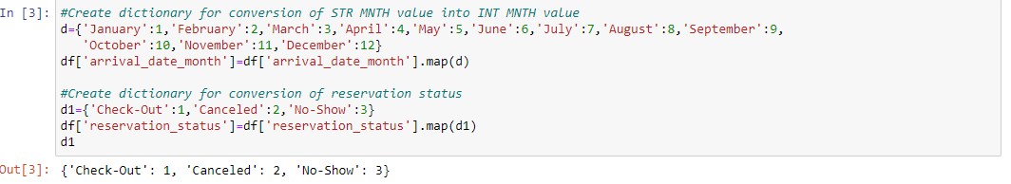
Variable 5: Stay in Week Nights
Variable 5: Reservation Status
Variable 5: Reservation Status

Slide 9
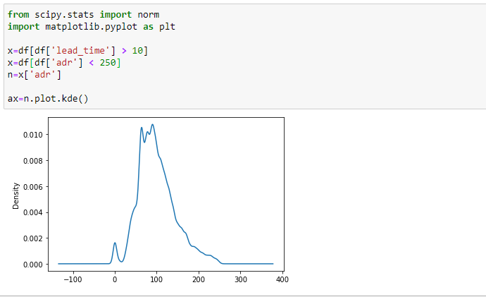
PDF
When looking at the probability density function, we created 2 scenarios:
Scenario 1: Filter the data-frame where we looked at all values where lead time was greater than 10 days
Scenario 2: On top of looking at everything greater than 10 days, we looked at the average daily rate of less than $250
Our PDF shows us that the values we see a greater density is close to 100.

Slide 10
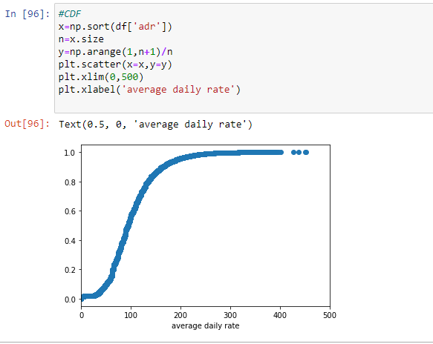
CDF
The CDF of the ADR confirms the extrapolation we did by looking at the ADR Histogram, where we pulled out values less than 20, and greater than 250.
We see that almost 95% of all the values are less than $200/day

Slide 11
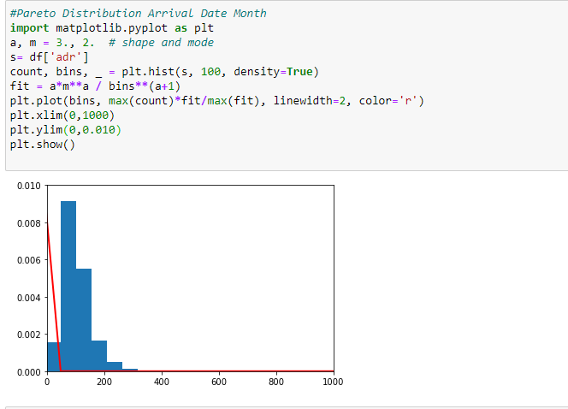
PARETO DISTRIBUTION

Slide 12
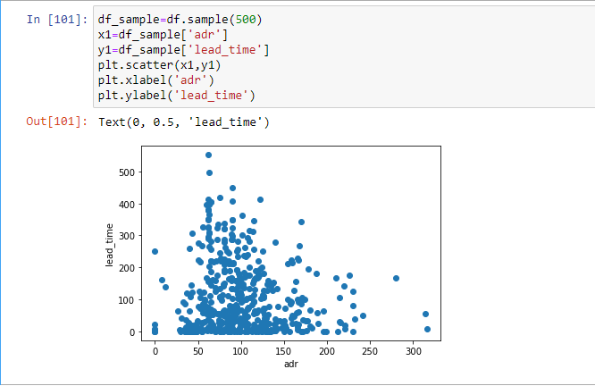
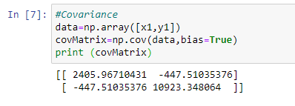
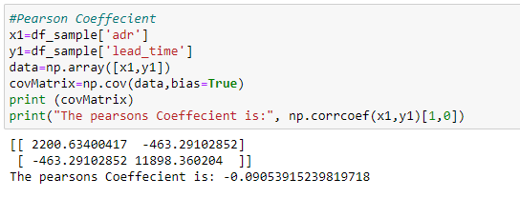
Scatter Plot: ADR vs Lead Time
SCATTER PLOT: ADR vs Lead Time
Analysis on ADR vs Lead Time
Pearson Coefficient between adr and lead time is negative, indicating (if any) a inverse relationship but because the value is so close to 0, we can extrapolate since the R value is so low, there is little to no correlation between the two variables

Slide 13
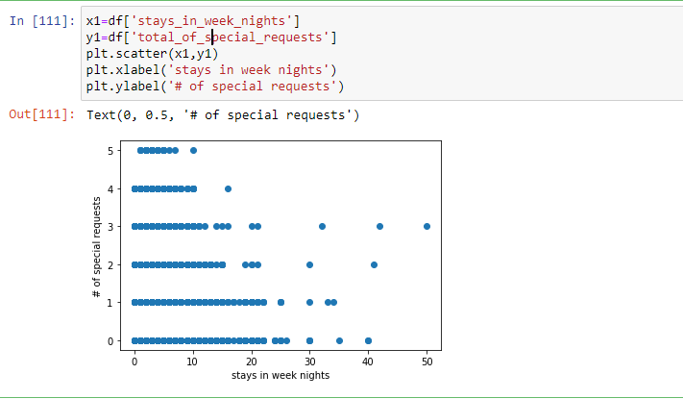
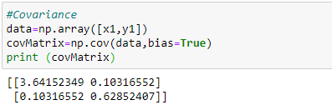
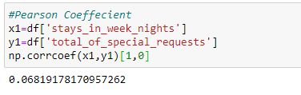
Scatter Plot: ADR vs Lead Time
SCATTER PLOT: Stays in Week Nights vs Total of Special Requests
Analysis on Stays in Week Nights vs Total of Special Requests
Pearson Coefficient between total special requests and stay in week nights is positive, indicating (if any) a regular relationship but because the value is so close to 0, we can extrapolate since the R value is so low, there is little to no correlation between the two variables.

Slide 14
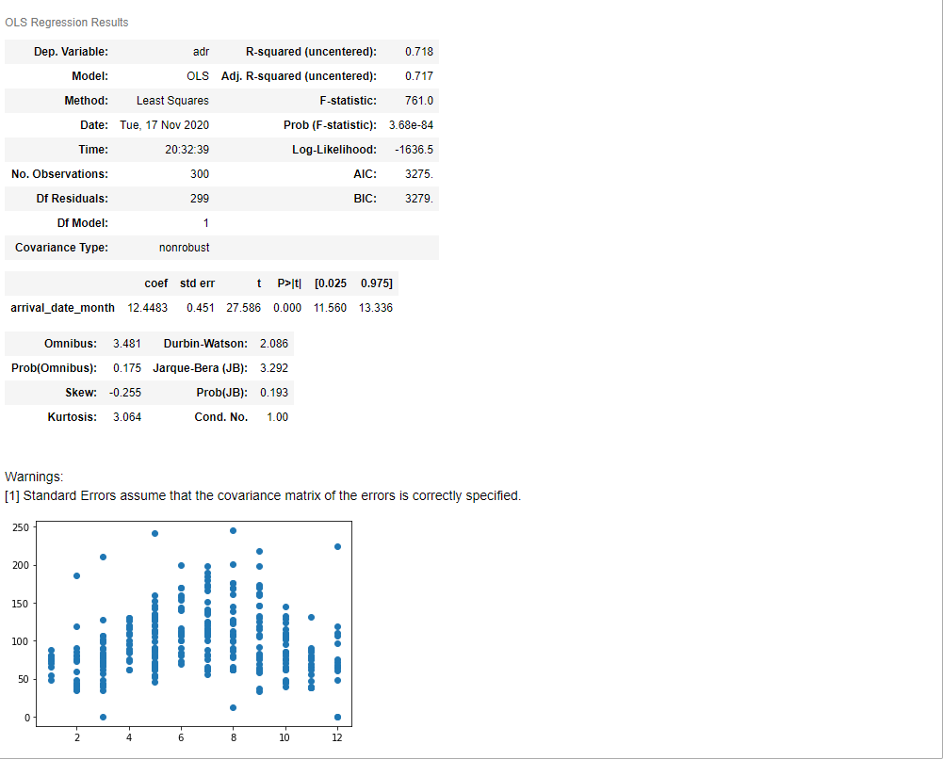

Hypothesis Test
H0: Month # has no impact on the average daily rate
HA: Average Daily rate is influenced by the Month
The R Squared value is .718. We can presume, a R squared value greater than .6 indicates moderate correlation between the two values
The p value is < 0.05, therefore, we can reject the null hypothesis.

Slide 15
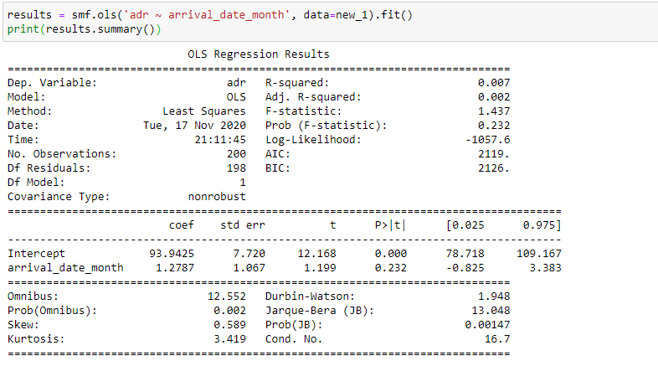
Regression Test 1
Our first regression test was to determine if average daily rate could be determined by arrival month.
Our hypothesis test indicated we would reject the null hypothesis, which is that there is no relationship
What we see with the regression output is that there is a minor correlation (with the R Squared value), but a positive correlation. In addition, our P value is much higher than .05.

Slide 16
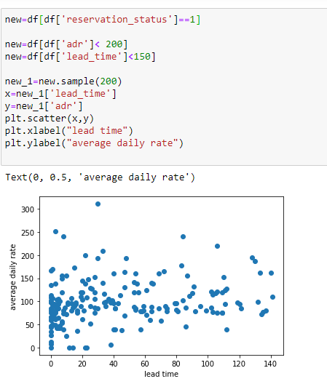
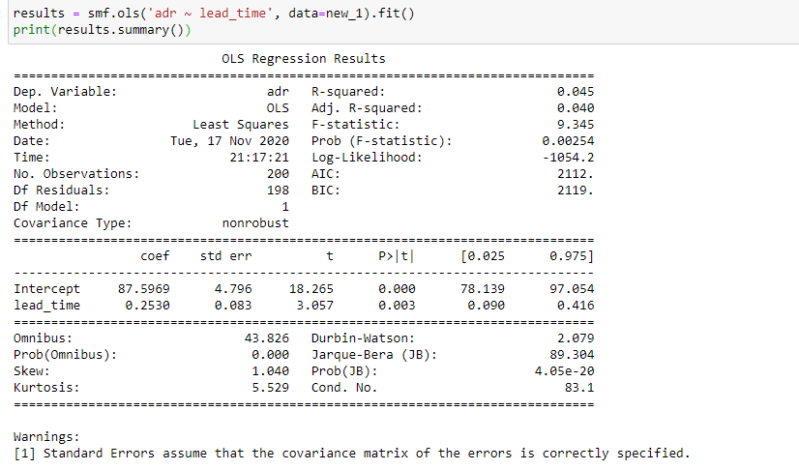
Regression Test 2
Our 2nd regression test, we modify the data set to look at the following:
Reservation Status == 1; Customers who checked out
Average Daily Rate from 0 - $199
Lead time prior to booked date 0 – 150 days
Our R squared value from the regression results is .045 (while low), we still have a positive and fairly low correlation relationship between the variables.
The p value is less than .05, and it is statistically significant.

Slide 17
PROJECT CODE
Jupyter Notebook snapshot

Slide 18
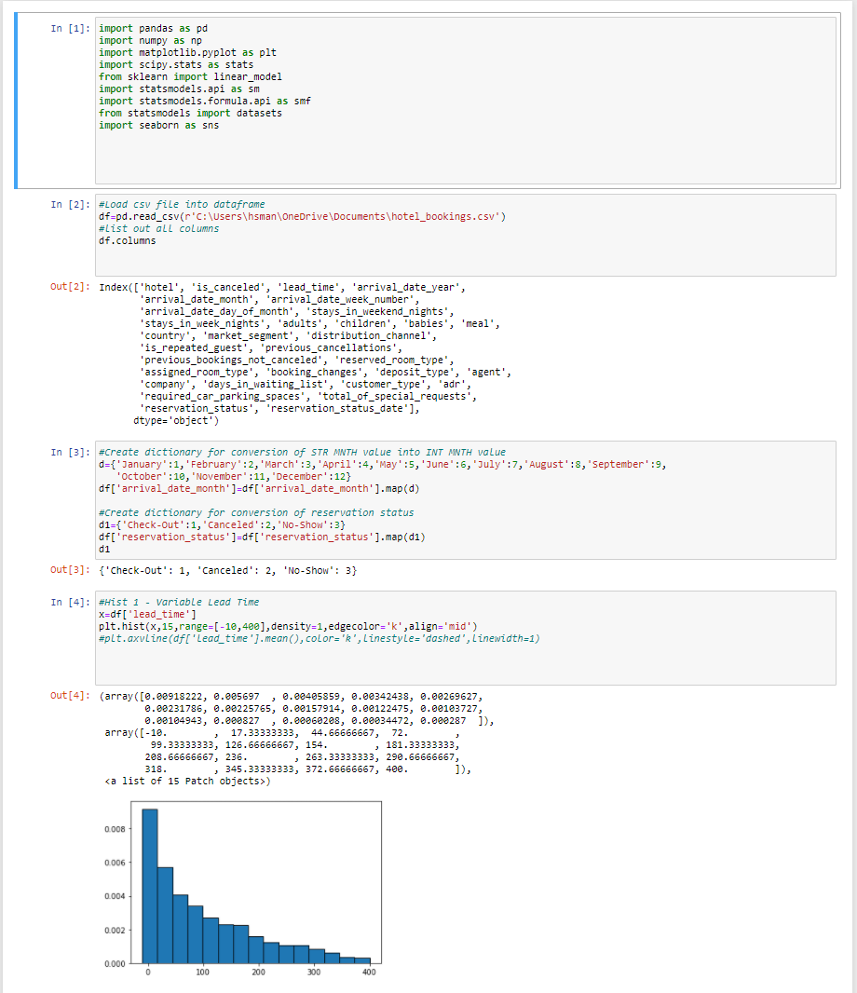
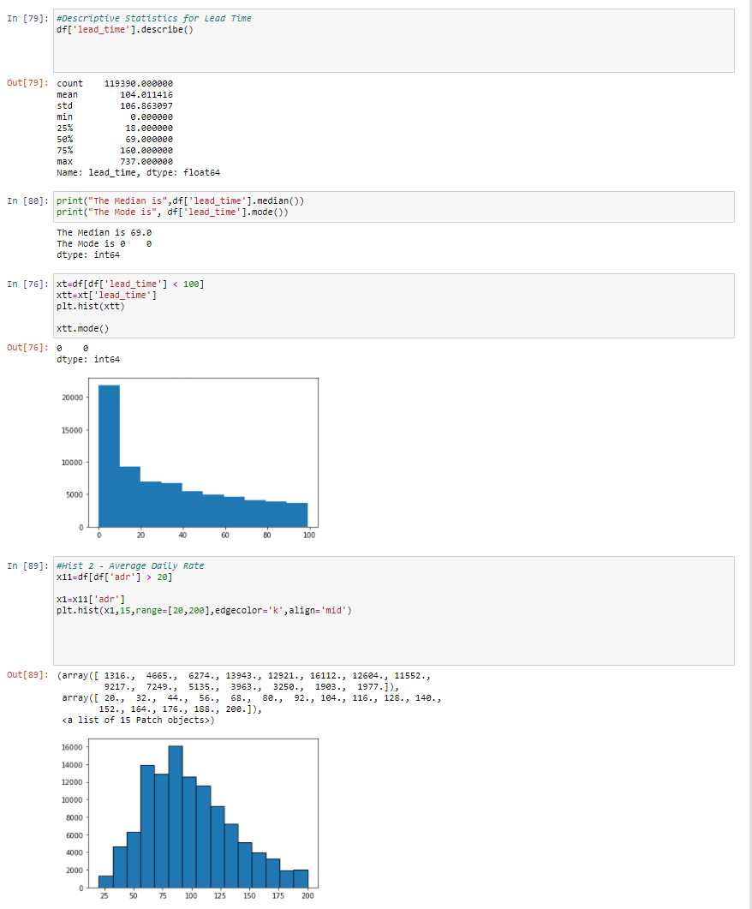
CODE SNIPIT
1
2

Slide 19
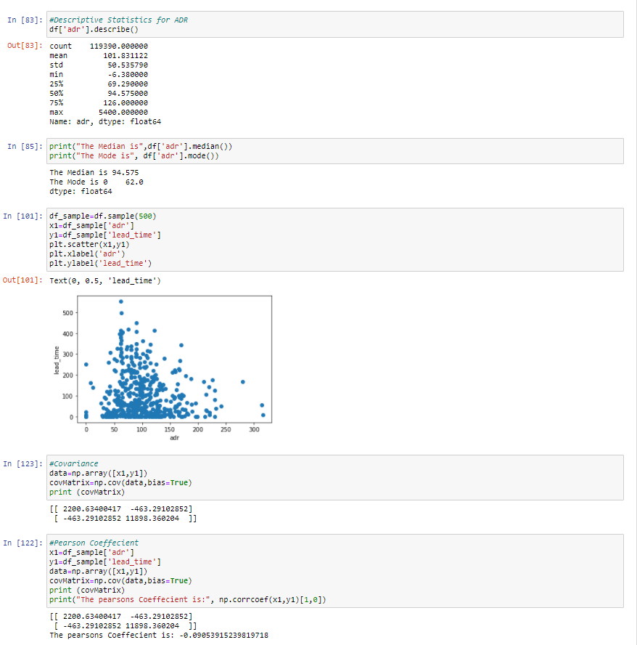
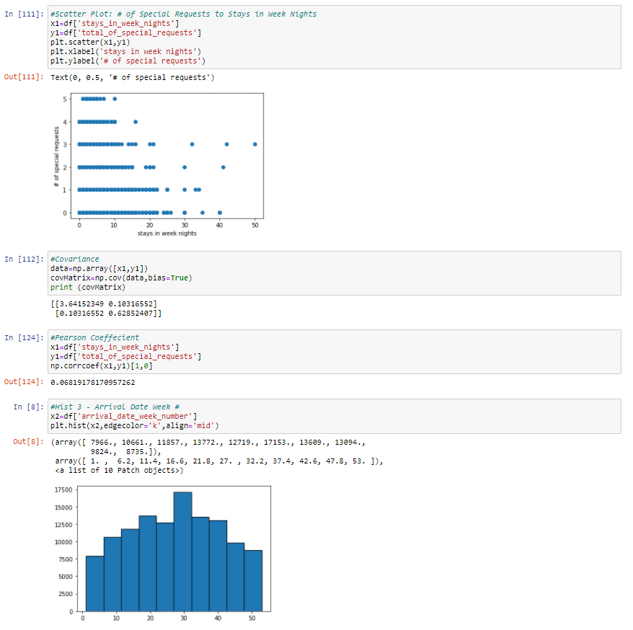
CODE SNIPIT
3
4

Slide 20
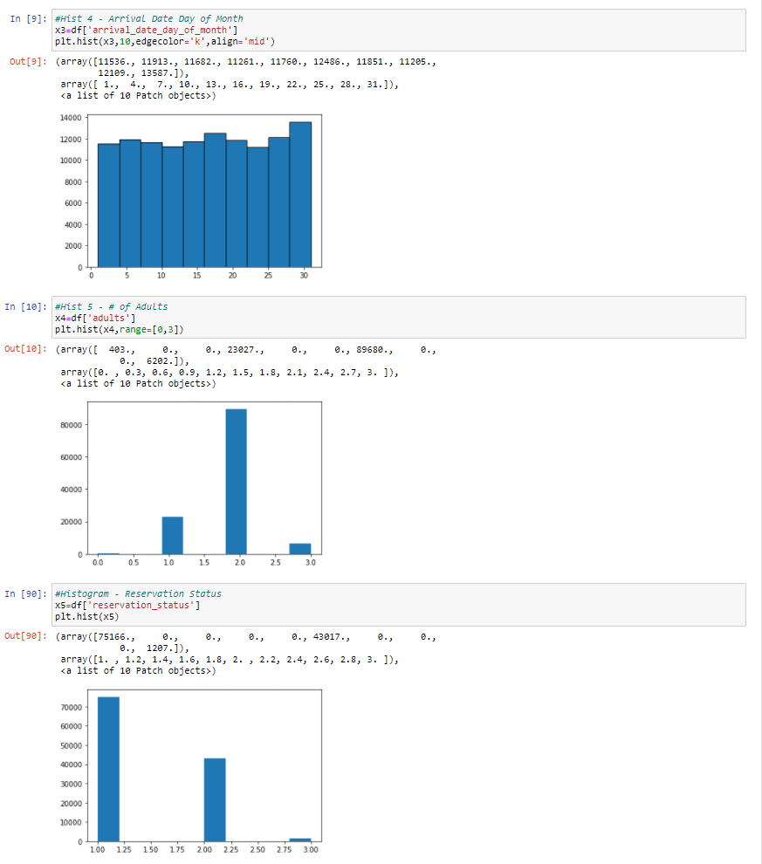
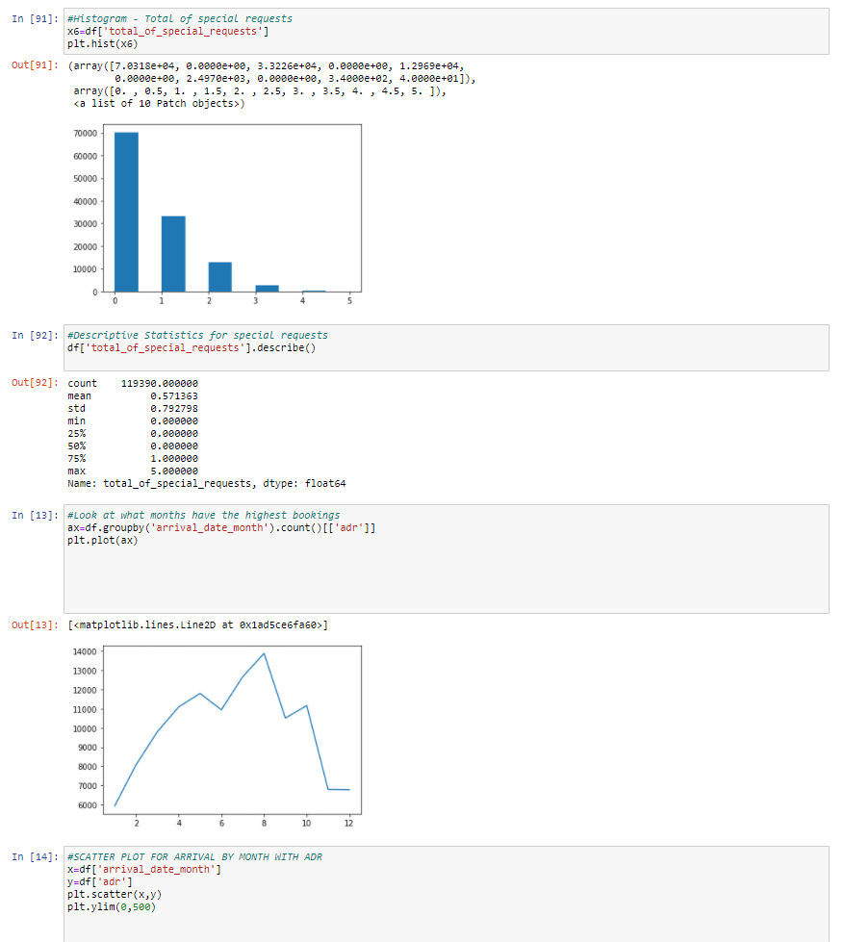
CODE SNIPIT
5
6

Slide 21
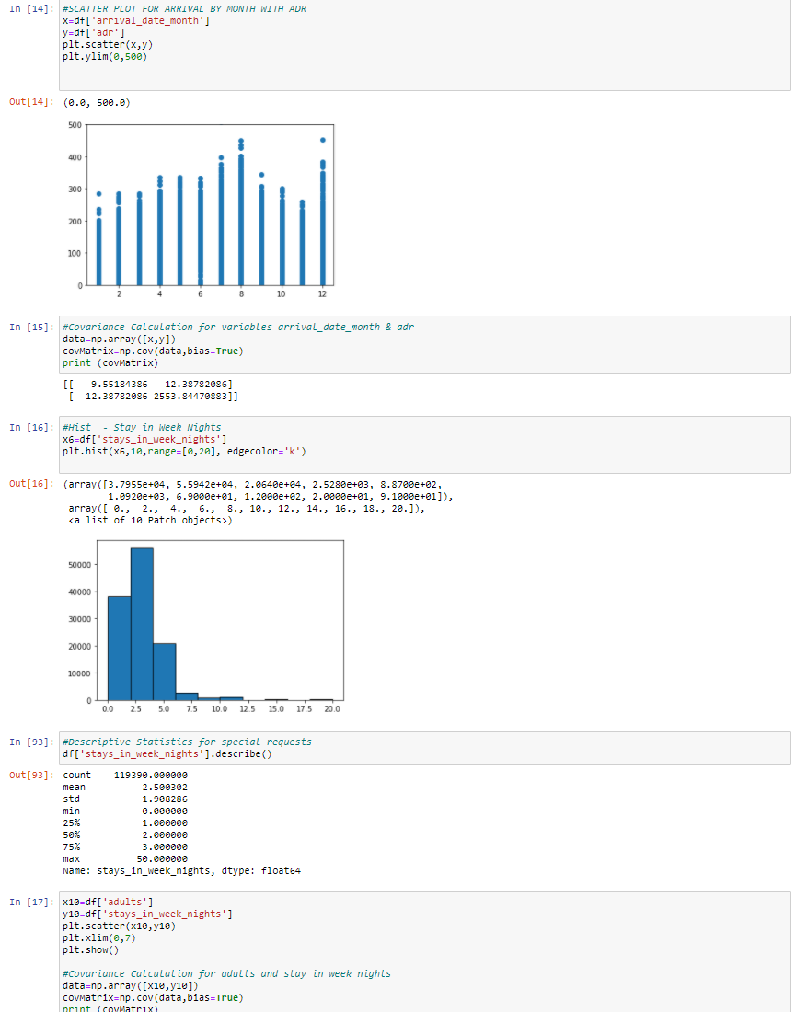
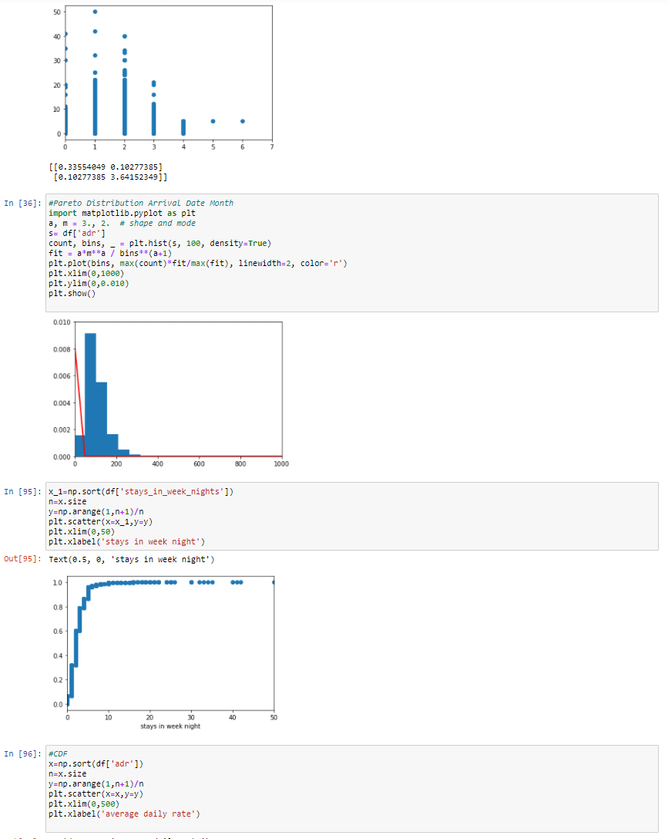
CODE SNIPIT
6
7

Slide 22
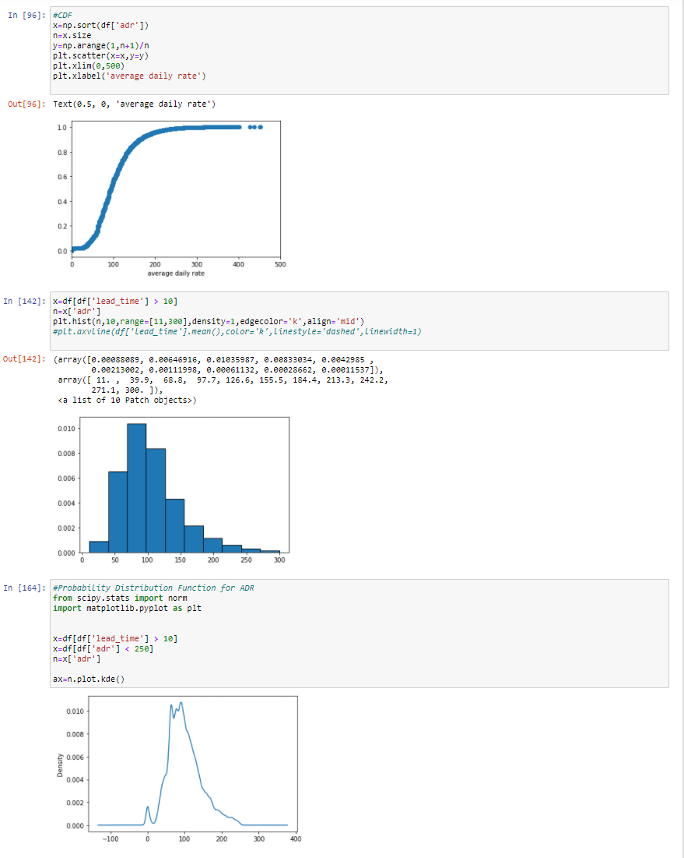
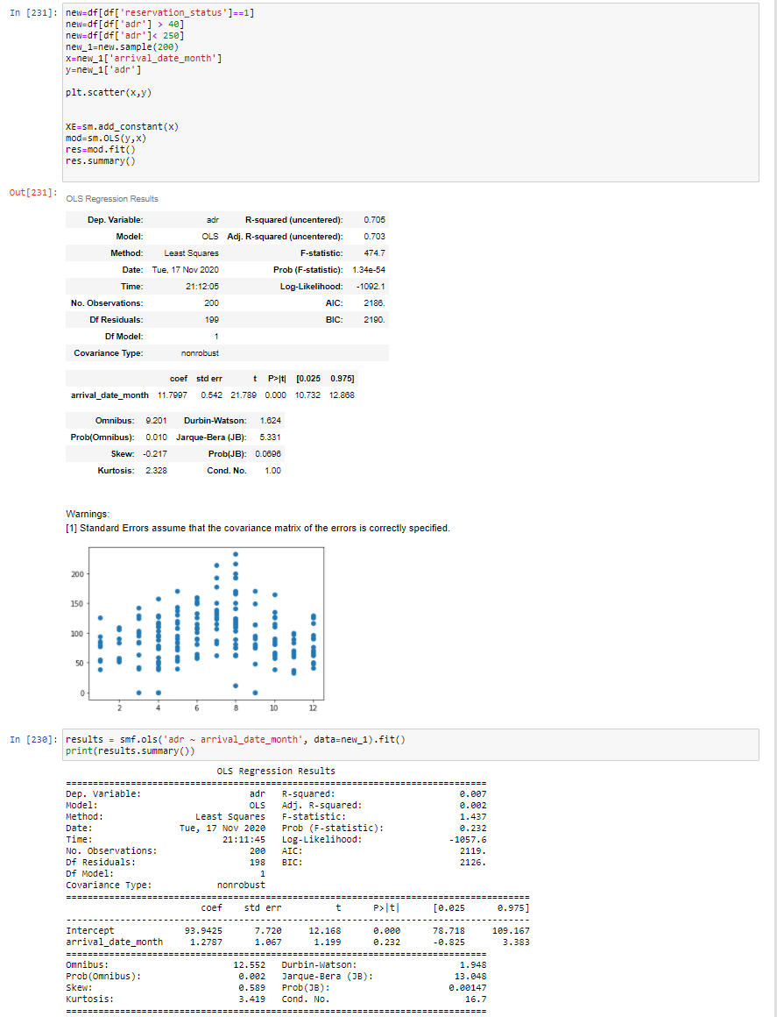
CODE SNIPIT
7
8

Slide 23
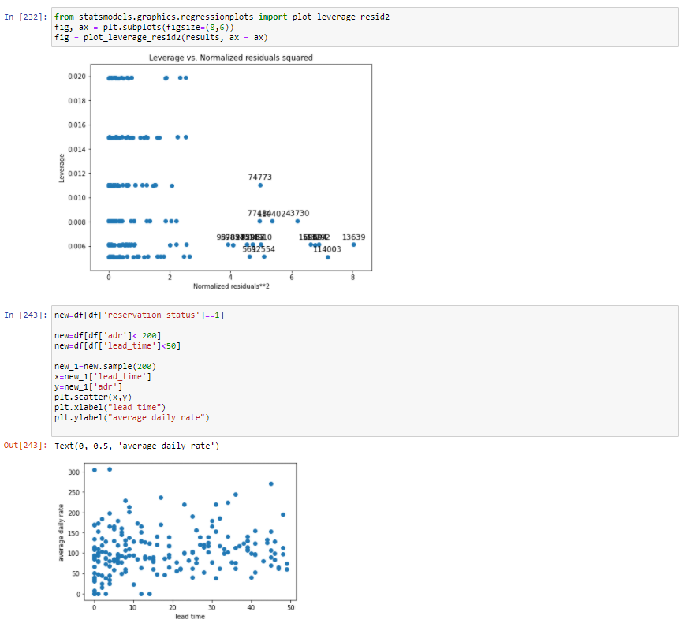
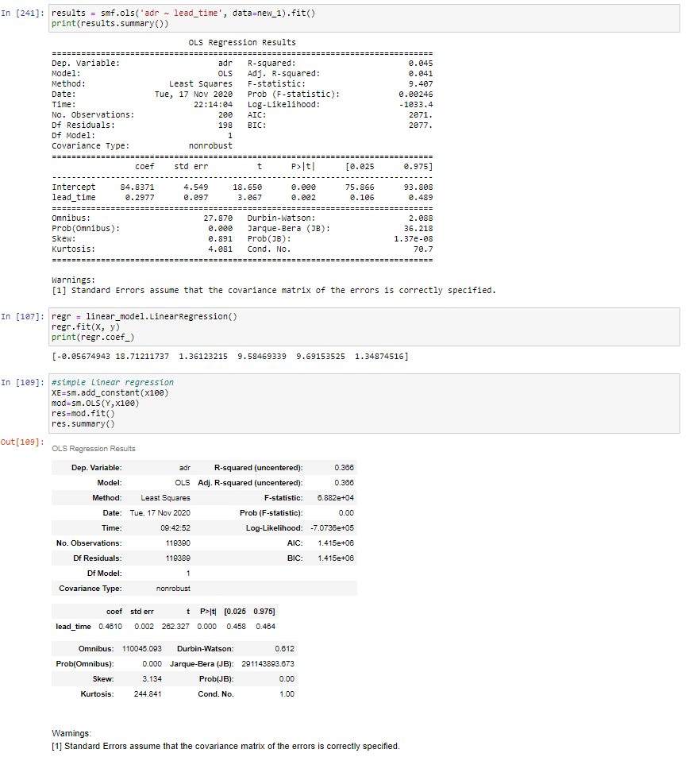
CODE SNIPIT
8
9

Slide 24
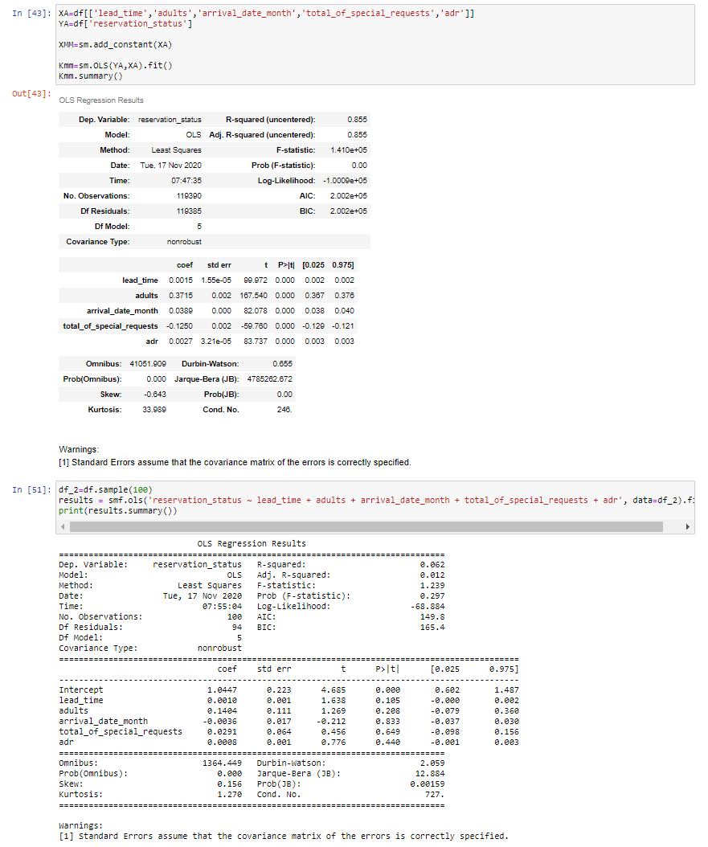
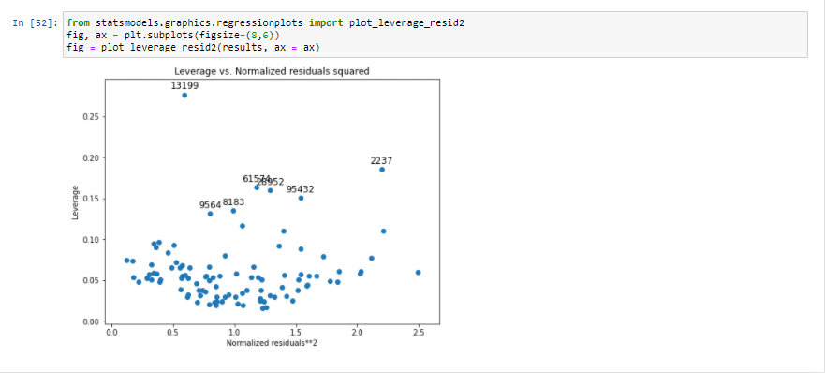
CODE SNIPIT
10
11

