Slide 1

Indux 5.p HACKATHON 2025
TITLE PAGE
Problem Statement ID –
Problem Statement Title-
Theme-
PS Category- Software/Hardware
Team ID-
Team Name (Registered on portal)

Slide 2
SafeTwin AI —
Dynamic Emergency Digital Twin
VISTARAZ
Detailed explanation of the proposed solution
Interactive 2D/3D Digital Twin: Converts floorplans into real-time graphs of rooms, corridors, doors,
stairwells & exits.
Dynamic Hazard Simulator: Models Fire, Toxic Gas & Flood with real-time occupant evacuation.
AI Optimization Engine: Compares AI Rerouting, Exit Load-Balancing & Nearest-Exit strategies.
Command Dashboard: Tracks Clearance Time, Hazard Exposure, Door Queues & Egress Throughput.
How it addresses the problem
Dynamic Evacuation: Redistributes crowds away from hazards, reducing choke points & stampede risk.
Proactive Rehearsal: Simulates 8+ failure scenarios including blocked stairs, rapid fire & power outages.
Explainable Decisions: Uses transparent safety scoring J(p) instead of black-box AI.
Innovation and uniqueness
Physics-Aware Optimization: Minimizes evacuation time, hazard exposure & congestion together.
Zero-Install Architecture: Browser/edge-ready 60 FPS runtime without costly GPU clusters.
Interactive Sandbox: Places hazards anywhere and tests building resilience in <5 seconds.

Slide 3
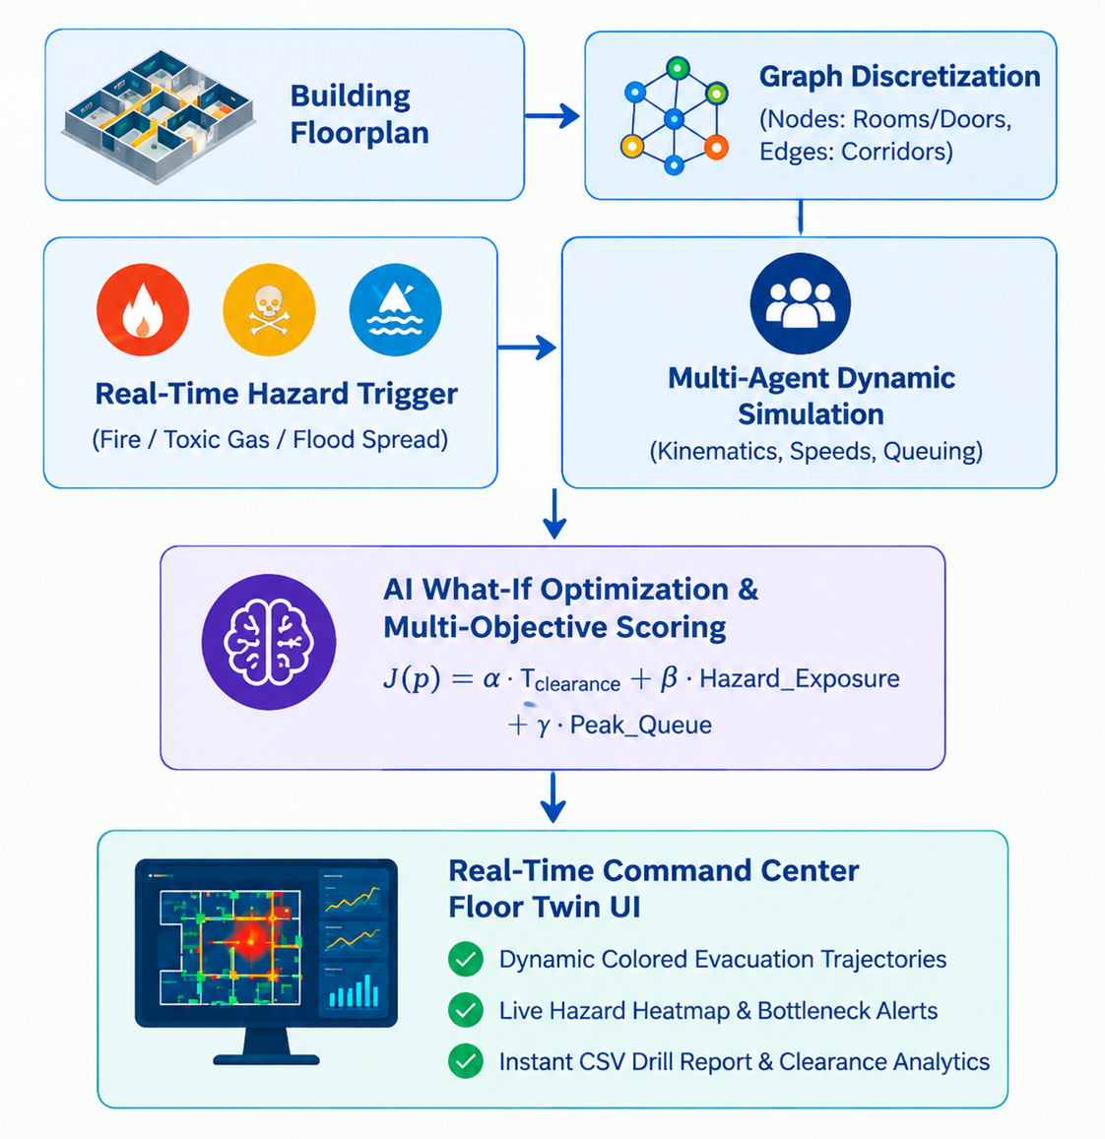
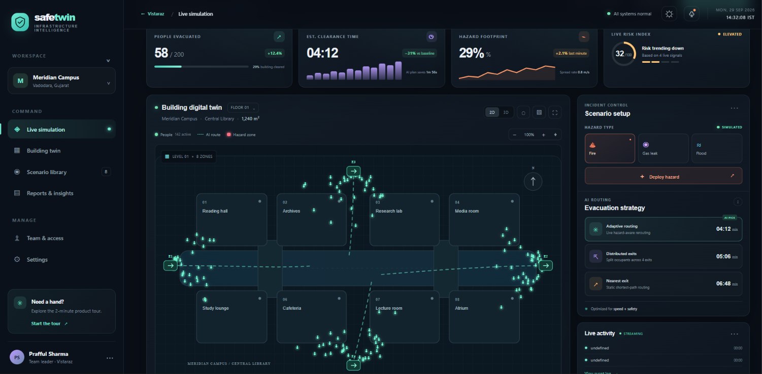
TECHNICAL APPROACH
VISTARAZ
Your Team Name
Technologies to be used
Frontend & Visualization: ES6+ JavaScript, HTML5 Canvas/SVG, CSS3.
Simulation & Algorithms: A*, Modified Dijkstra, Social Force/Velocity Models, Cellular Automata.
Data & State: JSON Graph Schemas, Session State, Modular Router (pages/).
Hardware & IoT — Phase 2: MQ-2/Thermal Sensors, MQTT/WebSocket Telemetry, Privacy-Safe Occupancy Counters.
Working Prototype Status
2-Screen Application: Landing Showcase + Live Command Dashboard.
Scenario Library: 8 presets + interactive click-to-deploy
hazard engine.
Strategy Optimizer: Live comparative metrics with
1×/ 2×/ 4× replay & step inspection.

Slide 4
FEASIBILITY AND VIABILITY
VISTARAZ
Your Team Name
Feasibility of the Idea
Technically Feasible: Mature graph/agent modeling; client-side and scalable via REST/WebSocket APIs.
Operationally Viable: Zero invasive hardware; works with existing CAD/BIM floor layouts.
Economically Viable: Reduces drill costs, downtime & potential insurance costs through virtual simulation.
Potential Challenges & Risks
Data Ingestion: Varied CAD formats & unstandardized floor geometry.
Human Behaviour: Panic, counter-flow & unpredictable movement.
Sensor Reliability: Latency, failures & packet loss during emergencies.
Strategies to Overcome
Standardized Spatial Parser: GeoJSON + IFC/BIM conversion support.
Stochastic Agent Modelling: Variable speeds (0.8–1.6 m/s), stumbling & group behaviour.
Fail-Safe Architecture: Offline routing fallback + clear synthetic/live feed labelling.

Slide 5
IMPACT AND BENEFITS
VISTARAZ
Your Team Name
Impact on Target Audience (Safety & Facility Managers)
  Replaces Static Maps: Upgrades paper plans to interactive, dynamic simulations.
  Proactive Hazard Testing: Stress-tests blocked exits and spreading hazards instantly.
  Data-Backed Drills: Pinpoints crowd bottlenecks before conducting real-world drills.
Multi-Dimensional Benefits
Social & Safety:
  Prevents stampedes by balancing exit loads and eliminating choke points.
  Ensures safer, more inclusive egress planning without drill disruption.
Economic & Operational:
  Cuts costly operational downtime needed for physical drill planning.
  Provides data-driven reports for audit compliance and safety investments.
Environmental:
  Replaces static printed floorplans with a reusable digital twin.
  Reduces resource waste and logistical overhead of frequent live trials.

Slide 6
RESEARCH AND REFERENCES
VISTARAZ
Your Team Name
Research & Project Links
  GitHub Repository: https://github.com/mellowpraful/safetwin
  Live Prototype (Vercel): https://safetwin.vercel.app
  Video Pitch / Demo: https://drive.google.com/drive/u/0/folders/1XGxJciehxYa9nqYVdGOtwGU-iTIB6Rns?lfhs=2
Key Research & Technical References
  Crowd Dynamics & Evacuation Modelling:
    Helbing Social Force Model & Cellular Automata Principles for synthetic crowd flow and bottleneck analysis.
    NFPA 101 (Life Safety Code) standards for exit capacities, stairwell widths, and maximum travel distances.
  Graph Theory & Dynamic Pathfinding:
    Dijkstra & A* Multi-Objective Heuristics with dynamic penalty weights for hazard proximity and corridor queuing.
  Digital Twin & EHS Safety Frameworks:
    ISO 22301 / NIST Building Safety Guidelines for emergency rehearsal, incident preparedness, and drill validation.

