Slide 1
Vistaraz
विस्ताराज़ — a friend for your mind
A trust-first, tiered mental-health platform for college students. The first step to feeling better shouldn't feel heavy.
AI → Peer → Counselor → Crisis | Anonymous · No signup · 24×7 | EN / HI / MR / GU
College Hackathon Round — Pitch Deck

Slide 2
The Problem
WHY EXISTING SYSTEMS FAIL
• Step 1 today is 'book a counselor' — feels heavy, like confessing.
• Students delay or never seek help because of stigma.
• ~15% of Indian students show depression symptoms (NIMHANS).
• Campus counselor shortage is real — can't be hired away.
• One-size-fits-all portals ignore the trust gap.
~15%
show depression symptoms
1 in 4
delay help due to stigma
Few
campus counselors per 1000

Slide 3
Insight: Stigma isn't a counselor-shortage problem. It's a FIRST-STEP problem.
Lower the first step to a 2-minute anonymous mood check-in — no login, no stranger. Everything else (peer, counselor, crisis) builds from that moment of trust.
Heavy first step → nobody comes. Light first step → trust → help scales.

Slide 4
The Solution — 4 Trust Layers
NOBODY HITS A DEAD END
1 · AI Companion
2 · Peer Support
3 · Counselor
4 · Crisis
Anonymous 24/7. Mood check-ins, journaling, breathing. Detects severity, routes.
Trained senior students ('Peer Listeners', NIMHANS/iCall module). Anonymous rooms.
Book with only an anonymous ID to admin. Shared pool across colleges fixes shortage.
One-tap helplines (iCall, Vandrevala, Tele-MANAS 14416). Auto-triggered on risk.
→
→
→

Slide 5
Full Product — What's Inside
ONE PROTOTYPE, MANY SURFACES
🤖 AI triage — mood + 3 Q's → severity & routing (LLM-ready)
🚨 SOS button — hold-to-call → crisis overlay
🤝 Peer support — anonymous rooms + 1:1 listener + chat
🧑 Counselor + Admin — shared pool, anon ledger, impact
🎨 Dashboard — mood chart, streak, badges, insights
🌍 i18n EN/HI/MR/GU — language switch across app
📝 Journal & 🫂 CBT — private entries + thought record
🌙 Dark + Contrast — themes persisted locally
🧭 Breathing — animated 4-4-4-4 box breathing
🛡 Privacy + My Data — delete-all, admin-blind
💬 Community — anonymous feed + kind reactions
⚙ Gamification — streaks & achievement badges

Slide 6
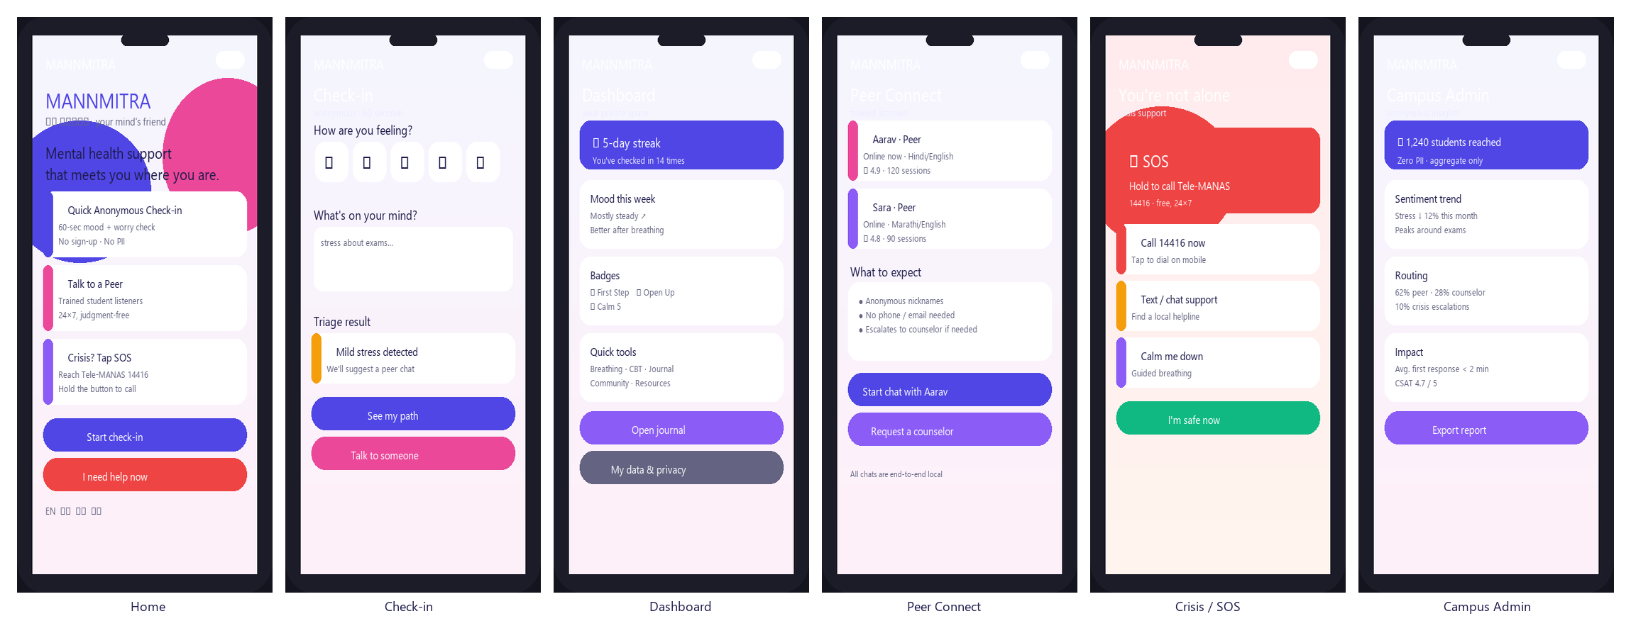
Product Preview
WHAT YOU'LL SEE IN THE DEMO
Six core surfaces — all anonymous, all offline-capable, all installable as a PWA.

Slide 7
Live Demo Flow
60-SECOND CLICKABLE STORY
• Landing → 'Start anonymously' (no signup, onboarding tour)
• Mood slider + 3 questions → rule-based triage
• Low/medium → routed to Peer Support room
• Type a risk phrase → Crisis overlay auto-triggers
• SOS hold-to-call button → instant helplines
• Dashboard: streak, badges, 'lowest on Monday' insight
• CBT + Community + Counselor/Admin + Privacy 'My Data'
Try it live:
Open index.html → checkin.html triage.js is a pure function: score({mood, text, answers}) → severity: low | medium | high → route: self | peer | crisis Same interface a real LLM slots into later.

Slide 8
Architecture
FROM DEMO TO PRODUCTION
• Client: HTML/JS + global Crisis/SOS overlay
• Anonymous session store — zero PII (opaque anon_id)
• 4 services: Triage · Peer Match · Booking · Crisis
– Demo: rule-based triage + localStorage
– Prod: FastAPI + LLM (Gemini) behind score()
• Data: hashed logs, TTL auto-delete, encrypted
• Helpline registry: iCall / Vandrevala / Tele-MANAS
Trust Funnel
Browser (anon)
API / BFF
Triage · Peer · Booking · Crisis
Encrypted Data Layer

Slide 9
Privacy & Safety by Design
JUDGES ASK — WE SHOW
Anonymous ID
Blind booking
Local-first demo
Auto-purge
No name/email/phone. Opaque anon_id only.
Admin sees ID + slot. No faculty/parent view.
Check-in state stays on device.
Hashed logs, short TTL in production.
Consent-gated
Encrypted
🚨 SOS + Crisis
🌍 Multilingual
Identities revealed only by you.
TLS + column-level encryption at rest.
High-risk language auto-escalates, never routes around.
Stigma is worse vernacular — EN/HI/MR/GU.

Slide 10
Built for Bharat
MULTILINGUAL + ACCESSIBLE
• Language switcher: English, Hindi, Marathi, Gujarati
• Resource library published in all four languages
• Crisis keywords detected across languages in triage
• Stigma is worse in vernacular, non-metro contexts
• High-contrast mode + keyboard focus + ARIA labels
• Dark mode for late-night, low-stimulation use
Languages
• English — EN
• Hindi — हिन्दी (HI)
• Marathi — मराठी (MR)
• Gujarati — ગુજરાતી (GU)

Slide 11
Scalability & Business
B2B2C MODEL
• Sell to colleges as a subscription
– Cheaper than hiring 5 in-house counselors each
• Shared counselor pool across colleges
– One network serves many campuses → solves shortage
• Peer volunteers self-replenish each batch
– Near-free, compounding supply of listeners
• CSR / wellness-fund subsidies for low-income camps
Unit economics
• College pays per-student/yr subscription
• Counselor cost amortized across N colleges
• Peer layer = ~0 marginal cost
• Retention via trust, not forced signup

Slide 12
Impact (Demo Metrics)
WHAT SUCCESS LOOKS LIKE
14
38,200
1,284
Colleges onboarded
Lives reached
Check-ins (30d)
612
298
41
Routed to peer
Routed to counselor
Crisis escalations

Slide 13
Why It's Credible
FRAMEWORKS & TRUST ANCHORS
• Peer Listener certification aligned with NIMHANS & iCall training frameworks
• Crisis routing uses verified national helplines: Tele-MANAS 14416, iCall (TISS), Vandrevala
• Anonymous-first mirrors global best practice (7 Cups, Crisis Text Line) adapted for India
• Resource library in Hindi, English, Marathi & Gujarati — targets worse vernacular stigma
• Safety built-in: high-risk language auto-escalates, never routes around crisis

Slide 14
The Ask
• Pilot with 3 colleges next semester — measure check-in → counselor conversion
• Partnership intro to a telehealth/counselor network for the shared pool
• Mentorship on campus wellness-fund / CSR funding path
Vistaraz — विस्ताराज़. A friend for your mind. Light first step. Real trust. No dead ends.
Demo: vistaraz/index.html · In crisis: 14416 (Tele-MANAS)

