Slide 1

Clinical Imaging in All of Us
How should All of Us integrate imaging to maximize scientific value while managing privacy, cost, and burden?
November 3, 2026
John Giannini
Geoff Ginsburg
Charlie Apgar
Kate Hartmann
Notes:
Accessibility Tips for Section 508 Compliance
This template includes various Accessibility Dos and Don’ts for meeting the Rehabilitation Act of 1973 Section 508 and other information accessibility requirements for presentations.
This guidance is not exhaustive and does not ensure complete compliance. If you have questions regarding content and formatting, please consult your Section 508 Compliance Officer.
You are welcome to save this template to preserve the compliance notes or remove them as you design your presentation.
For further color contrast examples, see slide 12.
**********
Dos:
Name your presentation. The Title box can accommodate 100-106 characters (including spaces).
Use standard fonts, such as Arial, Calibri, or Times New Roman. (This template uses Arial.)
Black is the ideal font color. You can also use a very dark color for the proper contrast against a white or light background, see on this current title slide.
The presentation must use the All of Us logo found on this page.

Slide 2
Background
Notes:
Today I’ll outline what imaging could add to All of Us, how our pilot approaches fit together, and a framework for making those data useful. The aim is to get your input on the science we should prioritize and the kinds of imaging data researchers would need.

Slide 3
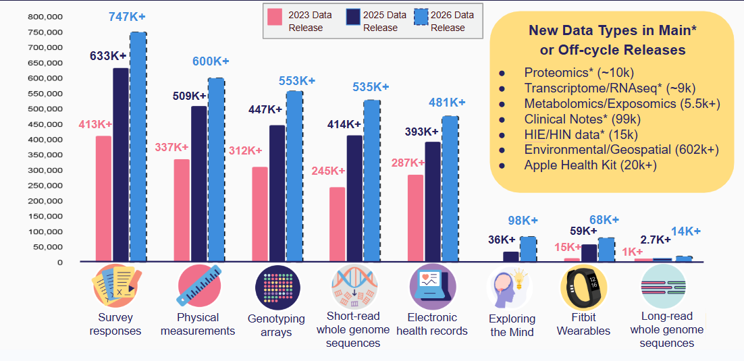
Why imaging matters to All of Us
What can imaging data add?
Reveal silent disease before symptom onset
Replace billing codes with quantitative metrics
Capture organ structure and morphology
Track biological aging trajectories
Notes:
Right now, All of Us phenotypic data relies heavily on EHR data like billing codes, which are episodic and only capture disease after severe symptoms appear.
Medical imaging delivers the missing biological ground truth. It detects subclinical disease years earlier, replaces binary diagnosis codes with precise, continuous tissue measurements, and tracks structural aging over time.
Adding imaging bridges the gap between genomic predisposition and real clinical outcomes, positioning All of Us as the world's most complete precision medicine cohort.

Slide 4
How could All of Us differentiate in the imaging data landscape?
Imaging-first repositories
Disease/Domain-focused cohorts
Large Cohort Studies
The Cancer Imaging Archive (TCIA)
Medical Imaging and Data Resource Center (MIDRC)
Have: Routine clinical imaging data at scale
Gap: Longitudinal clinical data and genomics
Alzheimer's Disease Neuroimaging Initiative (ADNI)
Framingham Heart Study
Have: Longitudinal clinical data and genomics
Gap: Smaller, protocol-specific imaging collections
UK Biobank (UKBB)
Have: Prospective research imaging, clinical, and genomics data at scale
Gap: Real-world disease imaging, CT imaging
All of Us can differentiate by linking real-world clinical imaging with longitudinal EHR and genomic data at national scale.
Notes:
This slide is meant to put All of Us in the context of the major imaging resources that already exist.
At one end, we have imaging-first repositories like TCIA and MIDRC. These provide large amounts of routine clinical imaging, but they generally have more limited longitudinal clinical context and genomic linkage.
Then there are disease- or domain-focused cohorts like ADNI and Framingham. These are much more deeply characterized longitudinally and often include genomics, but their imaging collections are smaller and typically tied to specific protocols or disease areas.
And then there are large cohort studies like UK Biobank, which has demonstrated the power of linking imaging, clinical data, and genomics at scale. But its imaging is largely prospective research imaging, with less representation of real-world disease imaging and CT.
Researchers heavily utilize imaging data in ADNI and UKvBiobank, they both have over ~500 published manuscripts per year using imaging data.
That creates a distinct opportunity for All of Us: to combine real-world clinical imaging with longitudinal EHR and genomic data at national scale.

Slide 5
The strategic challenge
Imaging value depends on the research question, and coverage, anatomy, and acquisition protocols vary widely.
1
Scientific value
Cost and burden
Sample size, curation, data transfer, and compute requirements differ across modalities and providers.
2
Images, reports, and linked clinical data create different privacy risks, while clinical imaging may also reflect access to care.
3
Privacy and bias
Notes:
The challenge is that imaging varies considerably in scientific value, cost and risk. A small set of validated measurements may answer one question, while another needs the full image. Clinical scans also reflect who receives care and why they were scanned. Our approach therefore needs to match the data we collect and share to the research question, while accounting for provider burden, privacy and selection bias.

Slide 6
Proposed framework: four imaging data layers
Raw images
What else can be learned? Pixels for new methods and reprocessing.
L3
Derived features
What was measured? Reusable phenotypes, masks and other features.
L2
Reports / findings
What was described? Report text and validated structured findings.
L1
Metadata
What exists? Modality, anatomy, protocol, timing and study linkage.
L0
Recommendation: support all four layers, with broad reuse of metadata, findings and derived phenotypes.
Notes:
We propose organizing imaging into four data layers: metadata describing what exists, reports and structured findings capturing what was observed, derived features providing reusable measurements, and raw images supporting new methods and reanalysis.
Each layer has scientific value. Researchers could answer many questions using findings and derived phenotypes linked to the rest of All of Us.
Our recommendation is to support all four layers, with broad reuse of those data products and selective access to raw images when the science requires them.

Slide 7
Pilot Approaches
Notes:
We’re pursuing three complementary approaches that make the framework concrete: collecting standardized images, connecting to existing clinical images, and extracting useful information from reports.

Slide 8
Three Pilot Approaches
Each pilot illustrates a different way to make imaging-related data available for research.
Eyes on Health
MIDRC Pilot
CLAD Imaging Report
Prospective data collection
Standardized eye imaging
Reusable retinal measures
Retrospective CT and OCT
Partner-hosted images
Linked Workbench access
Existing clinical reports
NLP-assisted extraction
Structured research variables
Notes:
Each pilot illustrates a different route to useful research data. Eyes on Health starts with standardized prospective eye imaging. MIDRC focuses on access to existing clinical CT and OCT. Center for Linkage and Acquisition of Data (CLAD) illustrates how report extraction can turn clinical findings into structured variables. Together, they help us explore which information researchers need, how we can obtain it, and what can be reused across studies.

Slide 9
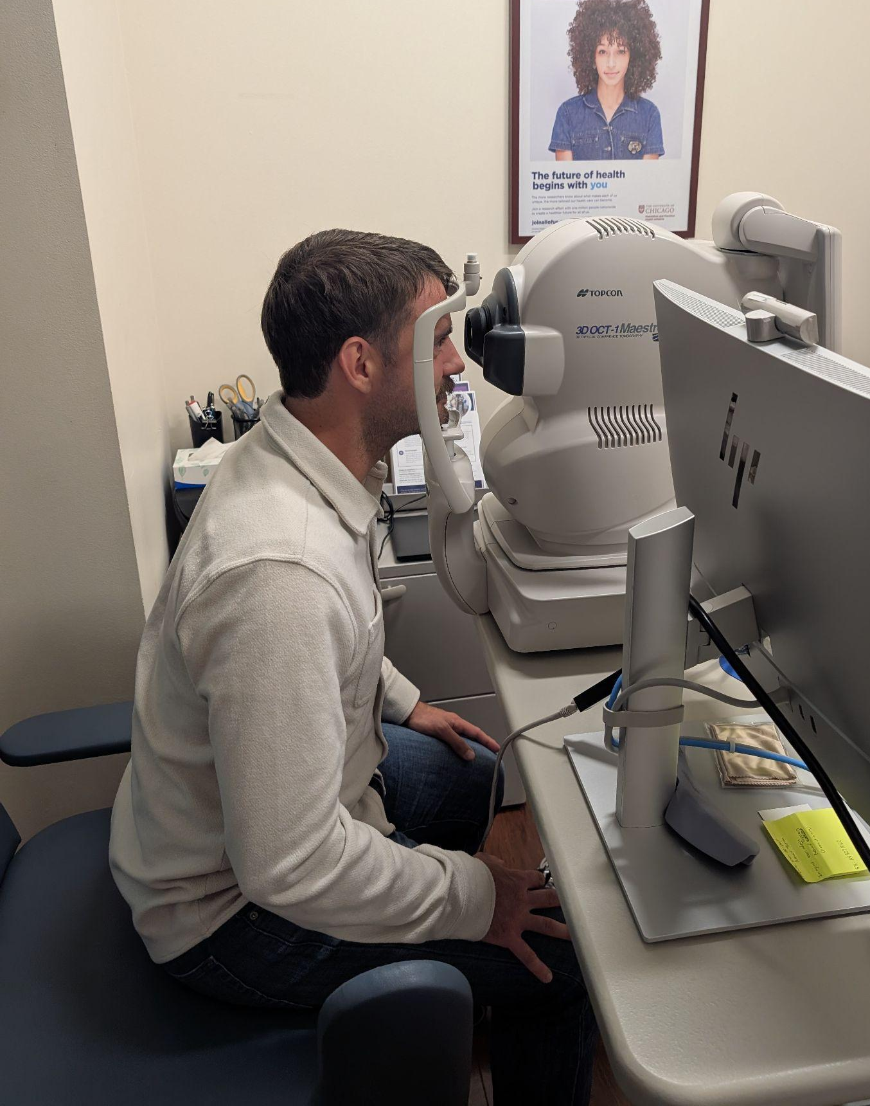
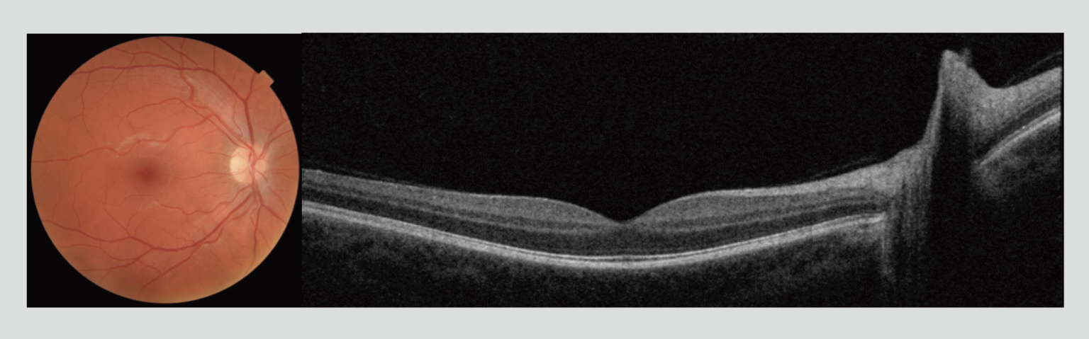
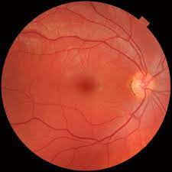
Eyes on Health PRS: prospective imaging and derived data
Prospective collection
Optical Coherence Tomography
Fundus photographs, OCT and OCT angiography
Standardized device and protocol
First expected imaging-derived data
  OCT-derived retinal layer thicknesses
Color Fundus Photo
Healthy retina SD-OCT. Source: Topcon.
x2
L3
L2
Source: Webvision
L0
Notes:
Eyes on Health is a partnered research study that collects standardized eye images, including fundus photographs, OCT and OCT angiography. The common device and protocol support consistent measurements across participants. Retinal layer thickness is the first derived imaging data expected to become available. That gives researchers quantitative phenotypes they can link to other All of Us data without processing the raw images themselves.

Slide 10
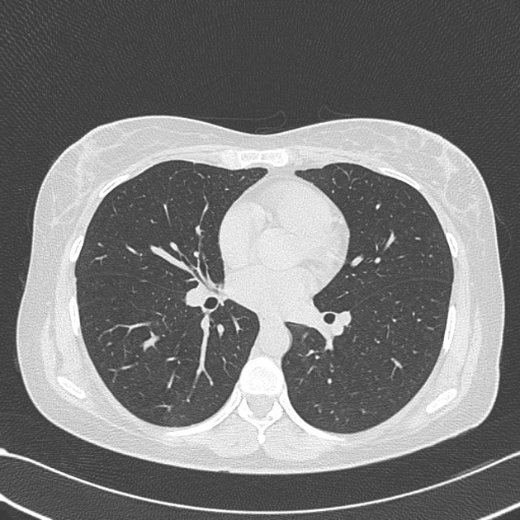
MIDRC: linked access to retrospective CT and OCT
Retrospective clinical images
Chest Computed Tomography
Optical Coherence Tomography
HPO-sourced retrospective CT/OCT imaging data
Local participant linkage and de-identification
Images in a controlled MIDRC partition
Workbench APIs for approved researchers
Healthy retina SD-OCT. Source: Topcon.
L3
L3
L2
L2
L1
L0
L0
Notes:
The MIDRC pilot starts with CT and OCT images already collected in clinical care. The planned approach links those studies to All of Us participants locally, de-identifies the images, and makes them accessible through a controlled partner environment. Approved researchers would connect through Workbench interfaces. This gives us a practical example of partner-hosted imaging access, while preserving the linkage to the broader All of Us dataset.

Slide 11
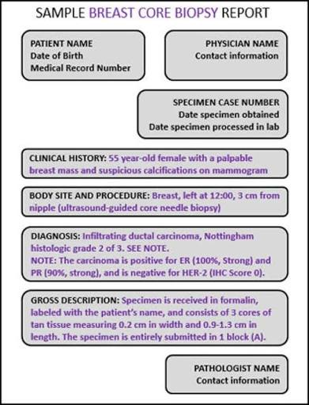
CLAD Imaging Report Pilot: usable phenotypes from clinical reports
Retrospective imaging report extraction
Molecular pathology reports, including genomic testing PDFs
NLP extracts selected variables and maps them to the OMOP data model
Report-derived research data without routine image transfer
L1
L0
Notes:
CLAD illustrates the value of information already captured in clinical reports. The supplied demonstration focuses on molecular pathology reports and genomic testing PDFs. NLP can extract selected findings, with expert validation, and map them into structured research variables. Radiology reports offer a related application of that approach. The broader lesson is that the report layer can support research without routinely transferring or reprocessing the underlying images.

Slide 12
Proposed Framework
Notes:
With those examples in mind, I’ll connect the four data layers to concrete research questions, then discuss priorities, access and where the data could reside.

Slide 13
Match the data layer to the science
Develop or verify a method
L3
Can a new algorithm measure a feature the existing products miss?
One participant, One chest CT
Analyze a reusable phenotype
L2
How does a validated emphysema measure relate to later outcomes?
Identify documented findings
L1
Several research questions
Was emphysema described in the report?
Discover a cohort
L0
Who has a chest CT with the needed anatomy and protocol?
Metadata + findings + derived measures can answer many questions. Some questions require pixels.
Notes:
The data layer we need depends on the scientific question. Take one participant’s chest CT.
Metadata tells us the scan exists and helps us find an appropriate cohort. Reports tell us whether emphysema was described. Derived features let us analyze a quantitative emphysema measure and link it to later outcomes. Raw images let us develop new methods or measure something the existing data products missed. “one image many uses”
The proposal is to support all four layers, making reusable data broadly useful while providing access to pixels when the science requires them.

Slide 14
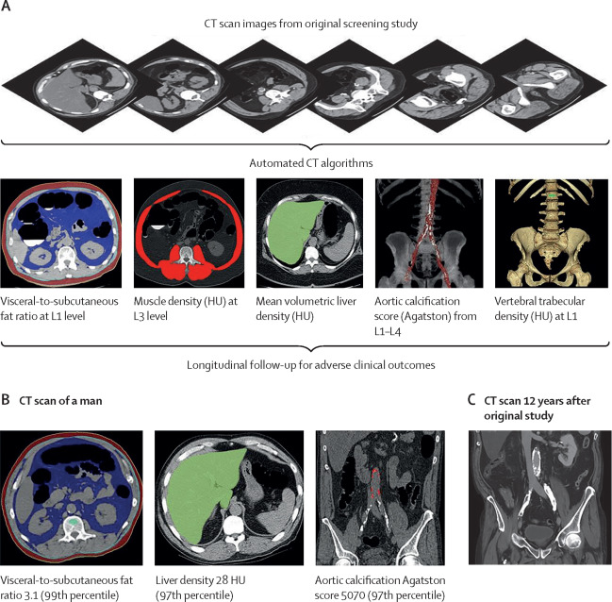
High-value extracted features: CT
Standardized measurements can serve many studies without repeating image processing.
Feature family | Example research product | Key interpretation
CT segmentation | Organ and structure masks | TotalSegmentator masks define anatomy
CT volume / shape | Liver, kidney and lung volumes | Requires adequate organ coverage
CT body composition | Visceral/subcutaneous fat and muscle | Validated amounts and attenuation
CT calcification | Vascular calcium burden | Scoring depends on CT protocol
CT bone | Vertebral attenuation or density | Calibration and quality checks
Pickhardt, et. al., 2020
Notes:
A CT scan can yield reusable measurements of anatomy, body composition, vascular calcium and bone. Segmentation tools such as TotalSegmentator identify structures; additional methods turn those regions into quantitative phenotypes. The figure illustrates this with abdominal CT. Which measurements are valid depends on the anatomy covered, acquisition protocol and quality checks. The opportunity is to produce well-documented measures once so many researchers can use them.
(A) Schematic depiction of the automated process for assessing fat, muscle, liver, aortic calcification, and bone from original abdominal CT scan data. (B) Case example in an asymptomatic 52-year-old man undergoing CT for colorectal cancer screening. At the time of CT screening, he had a body-mass index of 27·3 and Framingham risk score of 5% (low risk). However, several CT-based metabolic markers were indicative of underlying disease. Multivariate Cox model prediction based on these three CT-based results put the risk of cardiovascular event at 19% within 2 years, at 40% within 5 years, and at 67% within 10 years, and the risk of death at 4% within 2 years, 11% within 5 years, and 27% within 10 years. At longitudinal clinical follow-up, the patient suffered an acute myocardial infarction 3 years after this initial CT and died 12 years after CT at the age of 64 years. (C) Contrast-enhanced CT performed 7 months before death for minor trauma was interpreted as negative but does show significant progression of vascular calcification, visceral fat, and hepatic steatosis. HU=Hounsfield units.

Slide 15
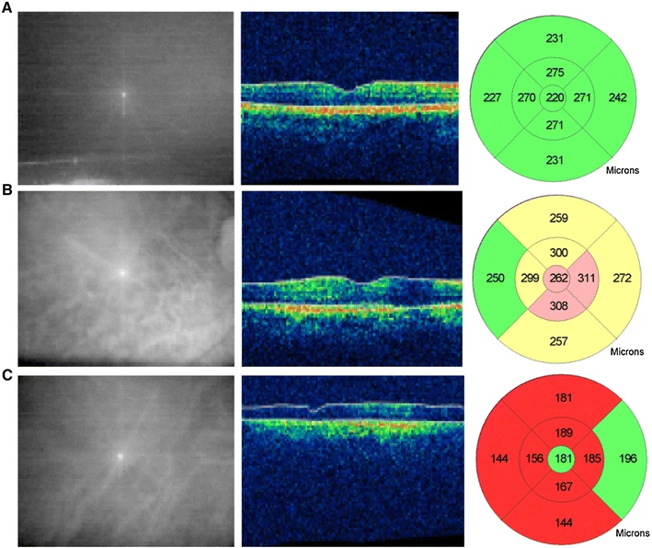
High-value extracted features: OCT
Standardized measurements can serve many studies without repeating image processing.
Feature family | Example research product | Key interpretation
OCT retinal layers | Macular, retinal nerve fiber layer and ganglion cell thickness | Micrometers by eye, layer and sector
OCT structural abnormalities | Drusen volume; intraretinal or subretinal fluid volume | Quantifies structural disease burden; requires validated segmentation and adequate scan coverage
OCTA microvasculature | Vessel density; foveal avascular zone area; perfusion deficits | Sensitive to device, segmentation, motion and signal quality
Ascaso, et. al., 2014
Notes:
OCT provides a cross-sectional view of the retina that can be converted into measurements by layer and location. Beyond thickness, validated methods can quantify abnormalities such as drusen or fluid, while OCT angiography adds measures of the microvasculature. The image here illustrates structural OCT and thickness maps. These are potential research products, with different validation needs; retinal layer thickness remains the first derived data expected from Eyes on Health.
OCT scan showing a cross-sectional image of the different retinal layers around the fovea in: a a normal control, b a patient with mild cognitive impairment (MCI), c a patient with Alzheimer’s disease. The central macular thickness is increased in a MCI patient (262 µm), and decreased in an AD patient (181 µm) as compared with a healthy control

Slide 16
Use case 1: multimodal phenotyping
Can imaging explain differences in health risk among people with similar BMI?
Potential study
Combine CT measures of visceral fat, muscle and vascular calcification with labs, medications and physical activity.
Scientific value
Identify more precise cardiometabolic phenotypes.
Test added value for predicting cardiovascular events.
Data needed
Derived CT measures, acquisition metadata, and linked clinical outcomes
Pickhardt, et. al., 2020
Notes:
People with similar BMI can have very different fat distribution, muscle quality and vascular disease. CT gives us quantitative measures of those differences.
By linking those measurements to labs, medications and physical activity, All of Us could identify more precise cardiometabolic phenotypes. We could then test whether imaging improves prediction of cardiovascular events and helps explain why people with similar clinical risk profiles experience different outcomes.

Slide 17
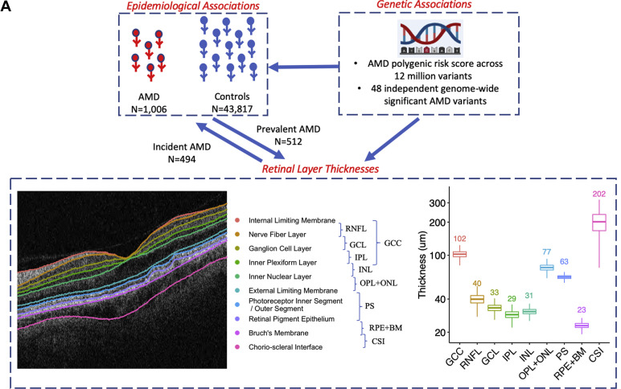
Use case 2: Connecting genetic risk to measurable tissue changes
How does inherited disease risk appear in organ structure before a clinical diagnosis?
Potential study
Link OCT retinal layer thickness to genetic variants, polygenic risk scores and subsequent eye disease.
Scientific value
Connect genetic susceptibility to tissue changes. Identify candidate early markers of disease.
Data needed
Derived OCT measures, genomics, and linked diagnoses
Zekavat, et. al., 2022
Notes:
Imaging can help connect inherited susceptibility to measurable tissue changes before a clinical diagnosis.
For example, we could link OCT retinal thickness to genetic variants and polygenic risk scores, then examine who later develops eye disease. Published UK Biobank research illustrates this approach for macular degeneration.
All of Us could extend these questions across different populations and clinical contexts, helping identify candidate early markers and generate hypotheses about disease biology.
age-related macular degeneration (AMD). A, Diagram showing study schema. This study performed epidemiologic associations of 9 retinal layer thicknesses with prevalent and incident AMD and also genetic associations of an AMD polygenic risk score across 20 million variants and across 48 independent genome-wide significant AMD variants from Fritsche et al.14 Distribution of retinal layer thicknesses in micrometers is displayed to the right of the retinal layer schematic.

Slide 18
Use case 3: longitudinal disease progression
Who changes over time, who remains stable,
and which factors help explain the difference?
Baseline phenotype
Comparable repeat
Later outcomes
CT organ or tissue measures; OCT retinal thickness
Within-person change with consistent measurement
Disease, treatment response or clinical events
Examples: muscle loss, organ remodeling or retinal thinning in eligible repeat-imaging cohorts.
Notes:
Repeat imaging lets us move from a snapshot to measuring change within a person. With comparable scans, we could examine muscle loss, organ remodeling or retinal thinning and relate those changes to later clinical outcomes. The key is distinguishing biological change from differences in acquisition or measurement. This requires an eligible repeat-imaging cohort; repeat OCT isn’t assumed in the initial Eyes on Health collection.

Slide 19
Modality priorities as tiers for discussion
Tier 1: build on
current efforts
Tier 2: expand
for defined questions
Tier 3: specialized
partnerships
OCT / fundus
Chest CT
Strong reusable phenotypes and existing pilot pathways.
X-ray / mammography
Ultrasound / echo
Electrocardiogram (waveform)
Value depends on the phenotype, coverage and protocol.
Targeted MRI
PET, digital pathology
Clinical photographs
Distinct format, scale or privacy needs.
Metadata and report discovery can span all tiers. These groupings are proposals, not a fixed ranking.
Notes:
These groupings are a starting point for discussion, based on current efforts, scientific opportunity and practical readiness. Tiering will depend heavily on the research question.
OCT, fundus imaging and chest CT give us an initial foundation. Other modalities could follow when a clear research question justifies the acquisition and curation effort. The tiers should remain flexible, and metadata and reports may be useful across all of them. ECG is an adjacent waveform data type rather than an imaging modality.

Slide 20
Access tiers follow representation and residual risk
Public
Registered
Controlled
Controlled Tier Plus
(CT+) In Planning
Aggregate
availability
Generalized
products
Detailed
phenotypes
Sensitive
products
Counts of CT/OCT studies with small-cell protections.
Low-risk availability indicators or validated findings.
Detailed measures, findings and selected de-identified images.
Additional application for specialized research access.
Illustrative imaging assignments: subject to policy and privacy review
Notes:
The same scan can generate products with different privacy risks, from aggregate counts to detailed measurements and raw images. These examples illustrate how access might vary with the representation and remaining risk.
They are proposed imaging placements, not final assignments or a statement of current availability. Derived data still need review, and sensitive products may require additional controls. The goal is to preserve scientific usefulness with appropriate protections.
Scans of the head that might contain facial features, like head CT or MRI, may need special placement in CT+

Slide 21
Imaging access models: a proposed hybrid approach
Centralized
Federated
Hybrid
Research copies in one program repository
Common tools and curation
Export and storage burden
Images remain with a program partner
Approved queries, retrieval or local compute
Ongoing integration and support
Central discovery and reusable products
Raw images held centrally or by partners
Shared governance
Initial preference: hybrid, with image location driven by science, privacy, cost and partner capacity.
Notes:
There are three ways to organize imaging access. A centralized model brings images into one program repository. A federated model keeps images with partners or HPOs and connects researchers through approved access. A hybrid model combines these approaches.
Our initial preference is hybrid: centralize discovery and reusable data products, while allowing raw images to reside where the science, privacy requirements, cost and HPO capacity make sense.
MIDRC provides a concrete example of partner-hosted access. We’d welcome the committee’s input on where this approach fits—and where centralizing images would better support the science.

Slide 22
Science Committee input
Which scientific priorities would make this most useful to researchers?
Framework
Does the four-layer model support the science?
Use cases
What essential question(s) is/are missing?
Science priorities
Which modalities and derived data matter most?
Notes:
We’d like your input on three things: whether the four-layer framework supports the science, which important use cases we’ve missed, and which modalities and derived measures deserve priority. It would be especially helpful to identify a few concrete research questions, the data needed to answer them, and when raw images are essential. That will help us turn the framework into a useful research resource.

Slide 23
Parting thought
Imaging is not one new data type. It is a spectrum of representations, and All of Us can unlock substantial scientific value from metadata, reports, and reusable derived phenotypes while selectively making raw images available when the science requires them.
Notes:
The central idea is that imaging offers several useful representations. We can create substantial value from metadata, reports and reusable phenotypes, while retaining access to raw images for questions that require them. Starting with the science lets us choose the right representation and access model, and focus investment where it will be most useful to researchers.

Slide 24
Questions

Slide 25





Thank You!
https://www.nih.gov/allofus
https://researchallofus.org/
@AllofUsResearch
#JoinAllofUs
Notes:
NOTE
Do not use the outdated All of Us logo with the "Precision Medicine Initiative” tagline/slogan.
Preferred website links can be ResearchAllofUs.org (includes the Data Browser) and JoinAllofUs.org

Slide 26
Industry-aligned imaging: opportunity and model-sharing limits
Potential partners | Opportunity for All of Us | Policy tension
CT / radiology: GE HealthCare, Aidoc | Sponsor imaging acquisition, curation, annotation, and reusable derived phenotypes | Companies may seek models they can deploy commercially
OCT / retinal imaging: Topcon Healthcare | Link imaging to clinical outcomes; evaluate performance across populations | All of Us currently prohibits exporting models trained on participant-level data
Device manufacturers and imaging SI developers | Support development and independent validation of SI-enabled medical devices seeking FDA authorization | NIH also restricts sharing and retention of generative models developed using controlled-access genomic data
Notes:
Right now, All of Us phenotypic data relies heavily on EHR data like billing codes, which are episodic and only capture disease after severe symptoms appear.
Medical imaging delivers the missing biological ground truth. It detects subclinical disease years earlier, replaces binary diagnosis codes with precise, continuous tissue measurements, and tracks structural aging over time.
Adding imaging bridges the gap between genomic predisposition and real clinical outcomes, positioning All of Us as the world's most complete precision medicine cohort.

Slide 27
Opportunistic phenotyping: more science from existing scans
A scan acquired for one clinical reason can yield
additional phenotypes for research.
Example: an existing body CT
What makes the data reusable
Measure fat, muscle, organs, bone and vascular calcium where the scan supports them.
Link these measures to health over time.
A common extraction method and quality checks.
Clear units, source links and versions.
No additional scan for the participant.
Who gets imaged still matters. Research phenotyping does not automatically imply clinical screening.

Slide 28
The HPO perspective: a sustainable contribution model
HEALTH CARE PROVIDER ORGANIZATIONS
The program should fund onboarding and continuing work
for the contribution model each HPO can support.
Metadata and reports
Managed image export
Supported local compute
Map studies and participant links.
Extract and validate findings.
Maintain corrections and refreshes.
Extract from imaging archives.
De-identify and check quality.
Transfer to a program or partner store.
Provide compute and storage.
Review approved workloads.
Fund security and ongoing support.
Shared needs: clear agreements, ownership of errors, withdrawal handling and researcher support.
Federation changes where work occurs. A sustainable model funds both local and central responsibilities.
18
Sources: MIDRC statement of work; Eyes on Health playbook; strategy report
Notes:
Suggested speaking time: 1.25 minutes.
HPO participation is a long-term operational partnership. Metadata and report contributions still require extraction, linkage, local validation and maintenance. Image export adds work in imaging archives, de-identification, quality checks and transfer. A local-compute approach retains different obligations: infrastructure, monitoring, software updates, workload review and staff continuity.
The accepted MIDRC statement of work explicitly funds crosswalk generation and extraction through site subcontracts, illustrating one way to support that work. Eyes on Health has additional participant-facing acquisition, consent and transfer responsibilities. Define who corrects errors, propagates withdrawals, maintains refreshes and supports researchers. A useful starting preference is program-funded extraction or managed environments where feasible, with supported local nodes where institutional constraints or science require them.
Sources and context:
KKed SOW+MIDRC_JPG_accepted.docx, Project Overview; Scope of Work, Buckets A and B; Local Crosswalk Protocol; Federated Access, Security, and Workbench Integration. Proposed activities require All of Us IRB approval. Targets describe scope, not completed enrollment or released datasets.
Eyes on Health __ Partnered Research Study Playbook_v2.2.docx, section 1.0: Imaging Protocol and Extracted Metric Export; section 4.0: Image and Data Handling.
Clinical Imaging Strategy for the All of Us Research Program, August 24, 2026 (clinical_imaging_strategy_report.docx), especially Scientific Opportunity, Data Layers, and HPO Partnership. Recommendations and proposed access assignments are treated as proposals, not adopted policy.

