Slide 1
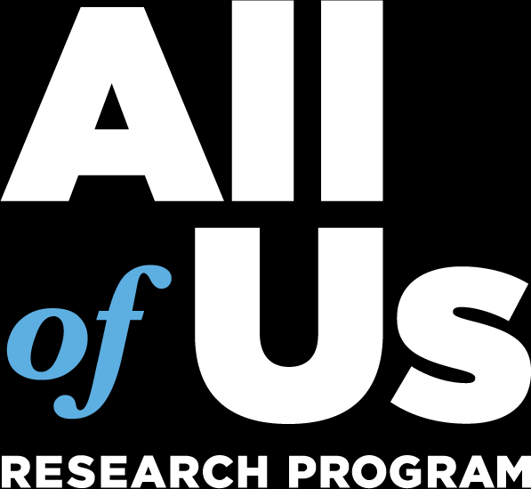
How the 22 research themes map onto the 8 roadmap focus areas
We tagged 1,653 papers and 20,165 workspaces with a bottom-up 22-theme taxonomy, then assigned each theme to the roadmap's 8 focus areas. Work with no clean home is an orphan, and the orphans are the evidence for the proposed changes.
ROADMAP FOCUS AREAS, BY SHARE OF PAPERS
WHAT HAS NO CLEAN HOME: THE ORPHANS
Prevalent Common & Rare Conditions
73.4%
Methods, AI/ML & phenotyping
~18% of papers, the single largest body of work with no home.
Genetics & Biology
53.4%
→ Evidence for a new “Data, AI & Methods” focus area.
Health Equity
51.1%
Wearables & digital health
~5% of papers; matured to a steady state, but homeless.
Lifestyle, Substance & Behavioral
18.5%
→ Fold into the new methods area, or elevate.
Return of Results
11.2%
Multi-omics beyond genomics
Buried inside “Genetics & Biology”; ~1% today, rising with 2026 releases.
Healthy Aging & Resilience
5.5%
→ Evidence to rename it “Genetics, Multi-omics & Biology.”
Maternal & Child Health
2.7%
Imaging & radiomics
Buried in methods; ~0.6% of papers, barely delivered yet.
Environment
0.5%
→ A gap to flag: a 2023+ priority the corpus isn't meeting.
Themes can map to more than one area, so shares are share-of-corpus-touched and sum to >100%.
Overall, ~9% of papers and ~14% of workspaces carry no focus area at all.
The 8 areas mostly hold, but methods/AI, wearables, multi-omics and imaging have no clean home. That gap is the case for the proposed roadmap changes.

