Slide 1

But can I live there?
An Exploration of NYC’s Department of Buildings Permit Issuance Data using Machine Learning
By Melissa Munz

Slide 2

The Quest:
Predicting whether a property is Residential or Not Residential (Commercial)

Slide 3
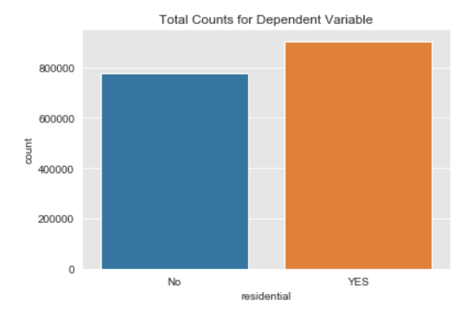
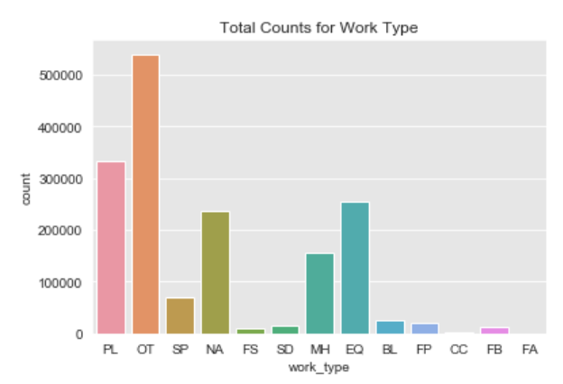
Initial Exploration:
-All DOB permits issued in NYC from 2013-2019
- 3.6 MILLION rows
- 60 total features
-Documentation all across the internet

Slide 4


Slide 5
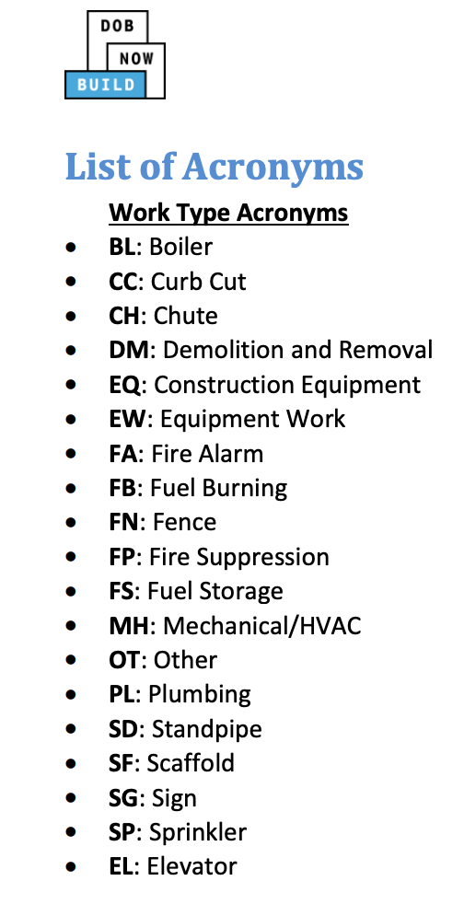
The Data: So Many Categories!
- self certification (Y, N, NA)
- borough
- nonprofit (Y, N)
- work type (recoded)
- job type (recoded) - A2, A3, A1, NB, DM, SG
- permit type (recoded) - EW, PL, EQ, AL, NB, FO, SG, DM
- permittee license type (recoded) - GC, MP, FS, OB, SI, NW, OW, RA, PE
- owner business type (recoded)
- permit sequence
- council district (26)
Dropped:
Most locations (census tract, zip, lat-long, etc)
Permit and job numbers
Any feature with badly recorded data
One-hot-encoded EVERYTHING!
Notes:
Work type (new building, alterations, demolitions)
job type (A2, A3, A1, NB, DM, SG)
permit_type (EW, PL, EQ, AL, NB, FO, SG, DM)
permittee license type (GC, MP, FS, OB, SI, NW, OW, RA, PE)

Slide 6
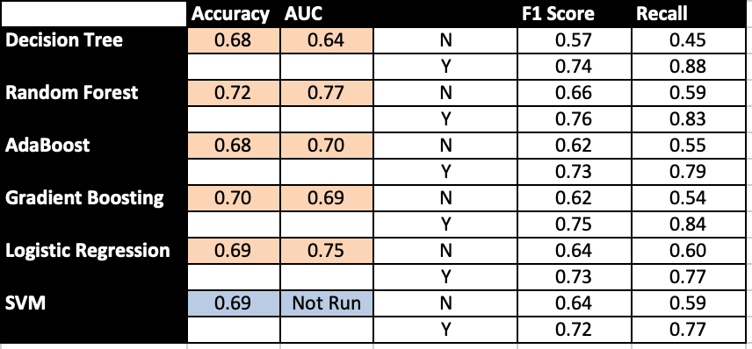
Testing Models:
Baseline Classifier:
0.53
Models has similar precision scores

Slide 7
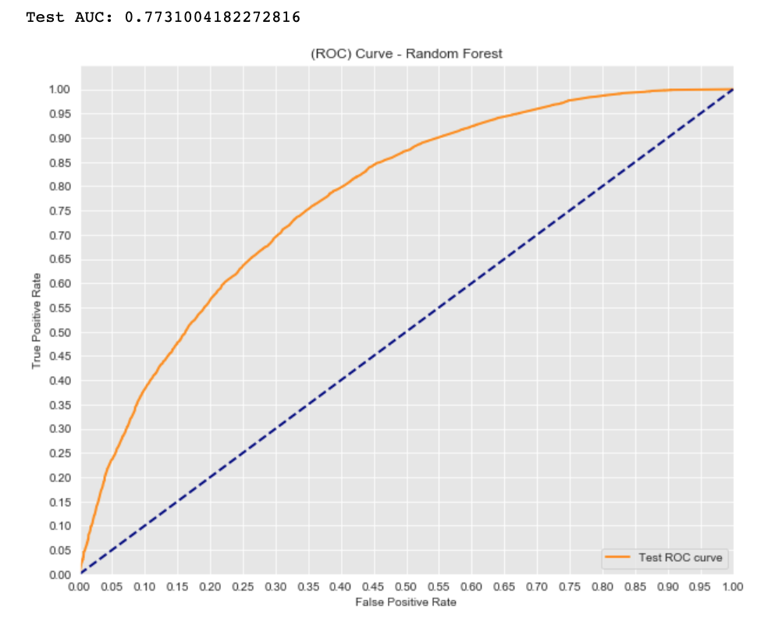
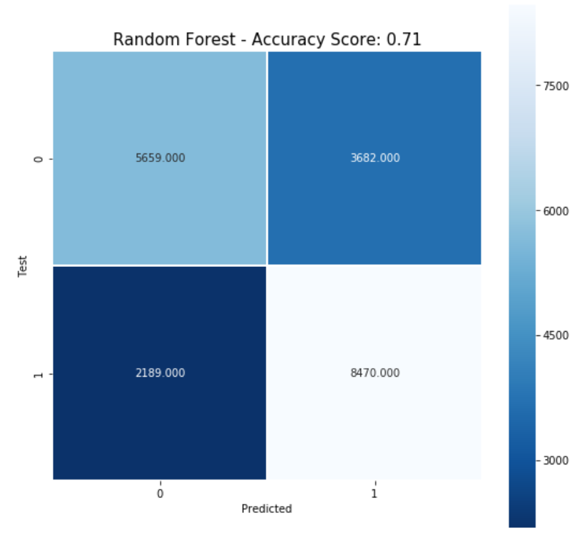
WINNER - Random Forest
AUC = .77
Accuracy = .71
F1 Score YES = .76
Notes:
ROC is a probability curve and AUC represents degree or measure of separability. It tells how much model is capable of distinguishing between classes.

Slide 8
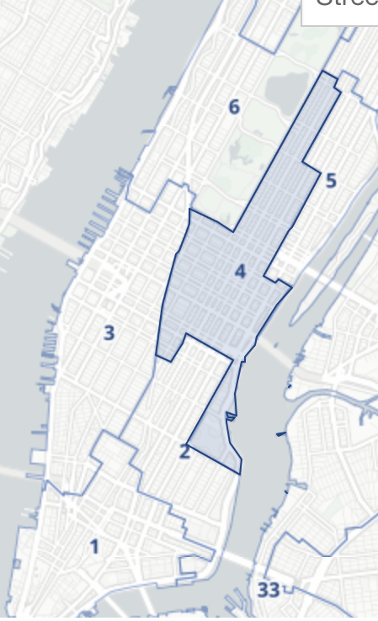
Interesting Takeaways:
City Council District 4
Mechanical and Other work permit types
New Buildings and Demolitions
Manhattan
Self certification
Nonprofit (NYCHA)

Slide 9

PLENTY O’ PROBLEMS
Data leakage
API slow
Processing speed low with so much data
Could not use GridSearch or run most models on full dataset
Disproportionate data
Too many related categorical variables (dropped)
Messy government dataset
Make sure to update your Sklearn

