Slide 1


Predicting Congressional Bill Passage
EXPLORATION USING NLP AND CLASSIFICATION
By Melissa Munz // Flatiron 2020

Slide 2

INTRODUCTION
THE QUESTION:
Can we predict which bills will pass the House of Representatives?
Notes:
Data from Congressional BIlls.org and webscraped Congress.gov.

Slide 3
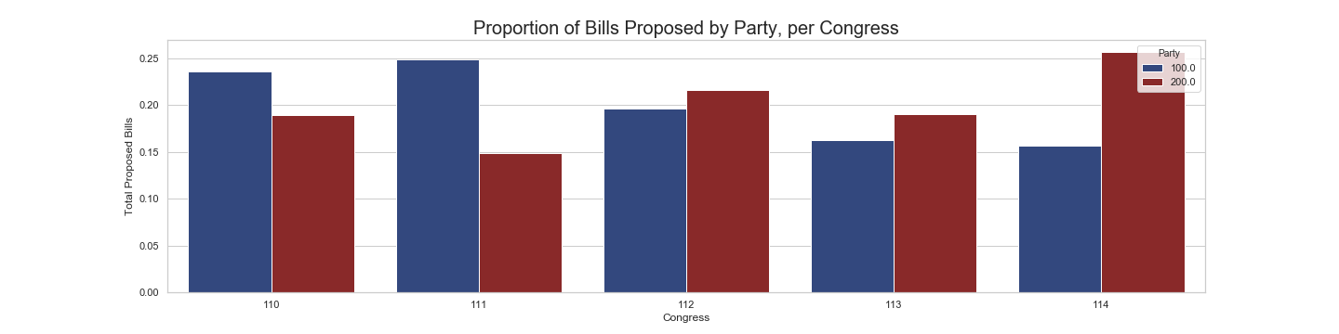
OVERVIEW: BY CONGRESS
110TH CONGRESS
111TH CONGRESS
112TH CONGRESS
113TH CONGRESS
114TH CONGRESS
Data spanned 10 years, with 51,067 total bills.
Jan 3, 2007 – Jan 3, 2009
Senate: Democratic
House: Democratic
Jan 3, 2009 – Jan 3, 2011
Senate: Democratic
House: Democratic
Jan 3, 2011 – Jan 3, 2013
Senate: Democratic
House: Republican
Jan 3, 2013 – Jan 3, 2015
Senate: Democratic
House: Republican
Jan 3, 2015 – Jan 3, 2017
Senate: Republican
House: Republican

Slide 4
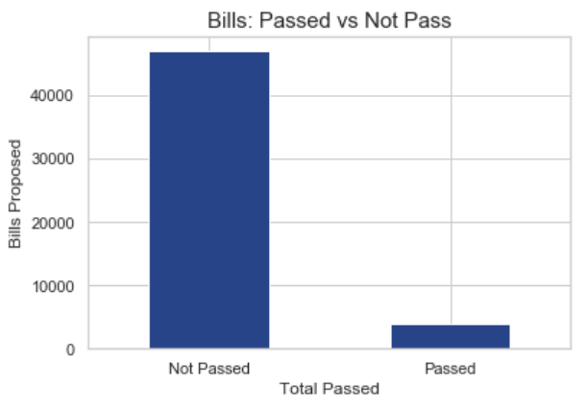
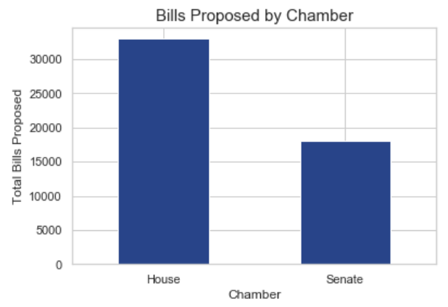
OVERVIEW: BREAKDOWN BY BILL PASSAGE
Most bills originate in the House.
Significantly more bills proposed than passed represents substantial class imbalance.
Nearly twice as many bills originate in the House.
Dataset included bills only: Resolutions and Joint Resolutions were removed.
Notes:
Of a total 51,000 bills over 10 years, less than 5000 were passed.

Slide 5
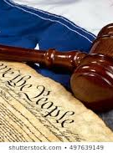
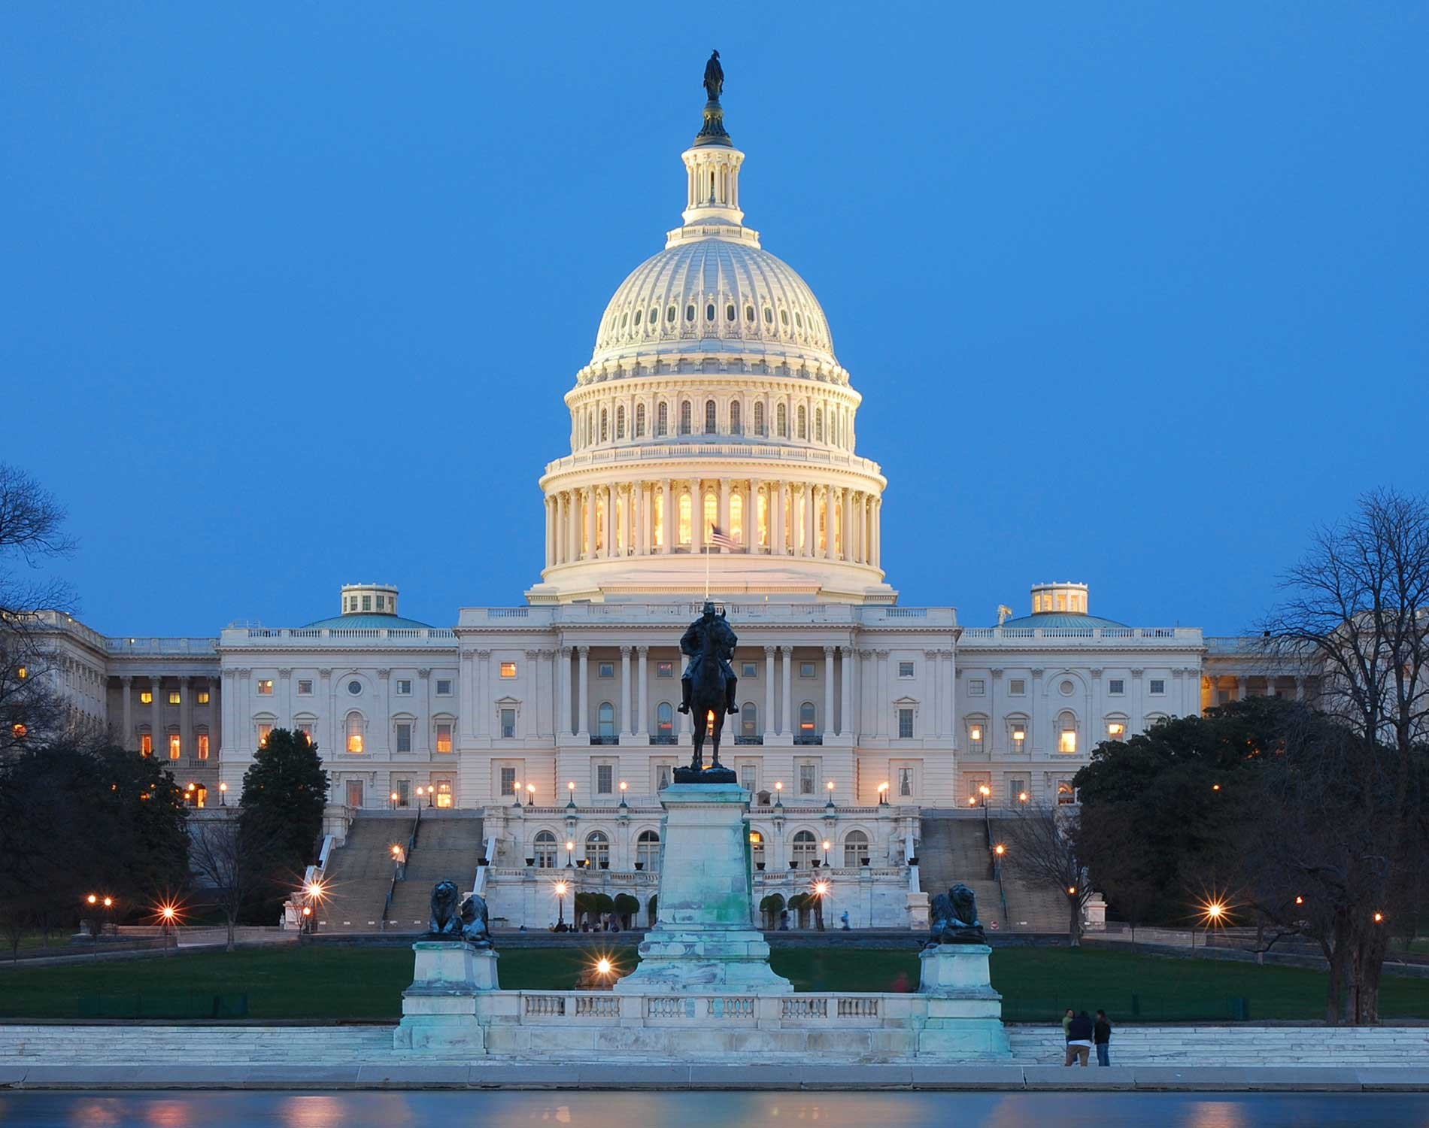
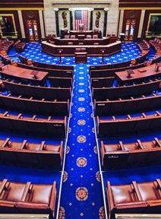
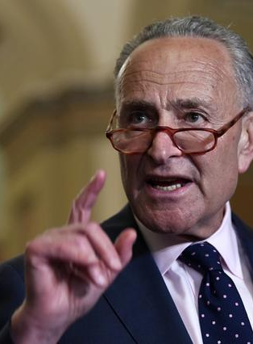
OVERVIEW OF FEATURES
01
02
03
04
BILL FEATURES
OUTCOME
CONGRESSIONAL
SPONSOR
- SUMMARY
- TITLE
-SPONSORS
- PASSED HOUSE
- PASSED SENATE
- LAW
- VETO
- CONGRESS
- MAJORITY
- FIRST CLASS
-CHAMBER
- PARTY
- STATE
- GENDER
-NAME

Slide 6
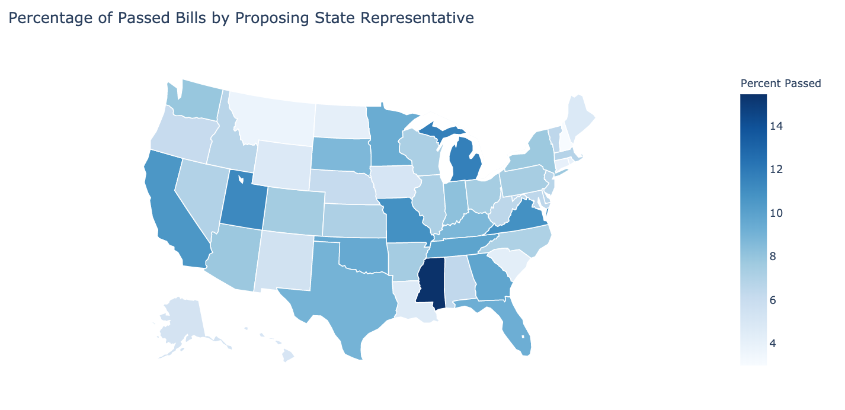
OVERVIEW: BY STATE
BILL PASSAGE BY STATE
-CA, NY, TX produce the most bills overall.
-MS passes proportionately the most bills
-CA passes the most bills of the big three states.

Slide 7
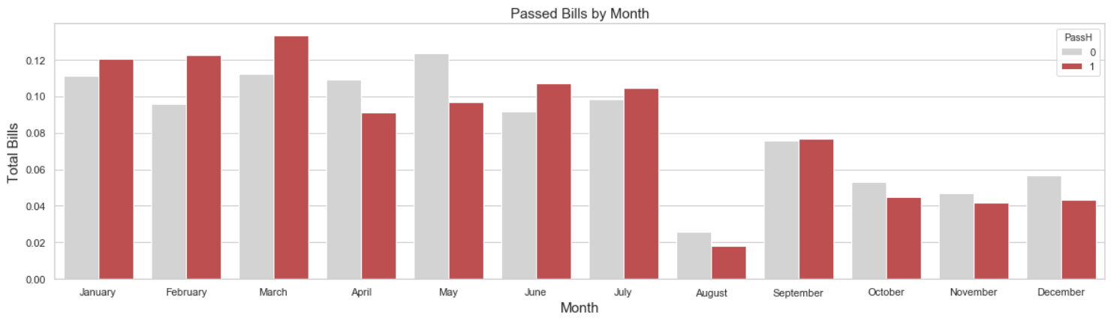
INTRODUCTION
BILL PASSAGE BY MONTH
The most bills are introduced and pass in February and March.
The fewest bills are passed in May.
The fewest overall bills are proposed in August, during the ‘August Recess’.
Notes:
Proportion of bill proposed by month
Another that scales proportion of bills passed

Slide 8
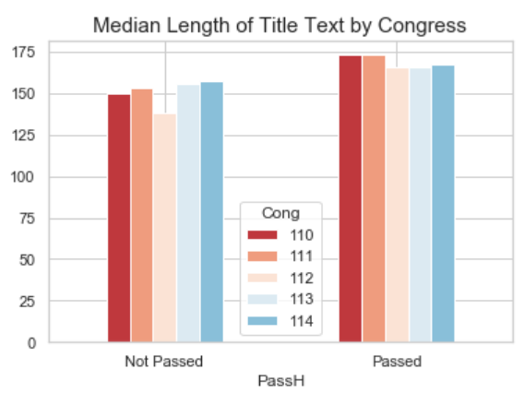
OVERVIEW
NATURAL LANGUAGE PROCESSING
Both the bill Titles and Summaries were tokenized and used for topic modeling using Latent Dirichlet Allocation
Topics and Title Lengths were later incorporated as features in final classification modeling.

Slide 9
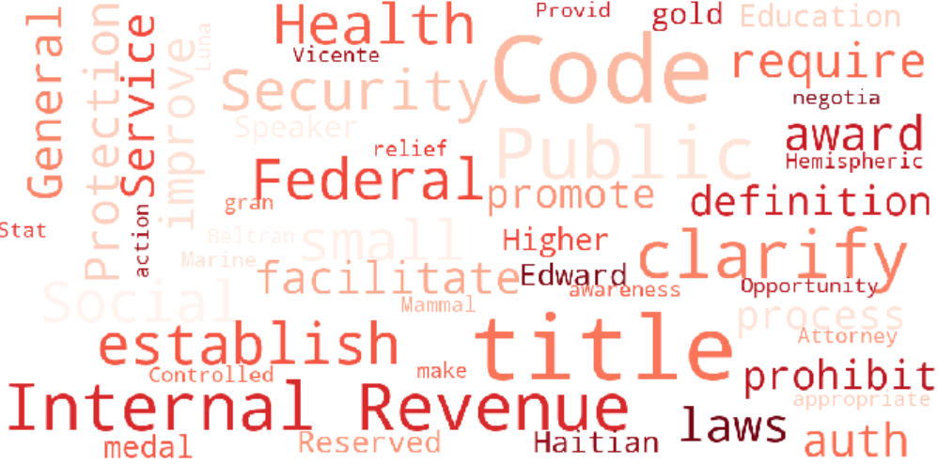
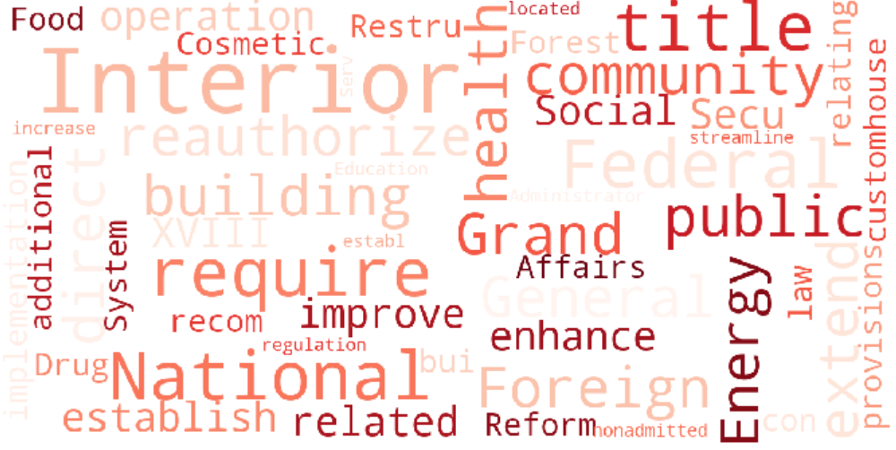
NATURAL LANGUAGE PROCESSING
First Look: Words by Bill Passage
NOT PASSED
PASSED

Slide 10
Reviewing Bill Text
US Interior - Land Preservation
Specific Tariffs
Examples of Passed Bill Summaries:
110-HR-1011
“To designate additional National Forest System lands in the State of Virginia as wilderness or a wilderness study area, to designate the Kimberling Creek Potential Wilderness Area for eventual incorporation in the Kimberling Creek Wilderness, to establish the Seng Mountain and Bear Creek Scenic Areas, to provide for the development of trail plans for the wilderness areas and scenic areas, and for other purposes.”
“To suspend temporarily the duty on mixtures of Reactive Red 198 and Reactive Red 239.'
112-HR-3970
Notes:
Make clearer what bills these are

Slide 11
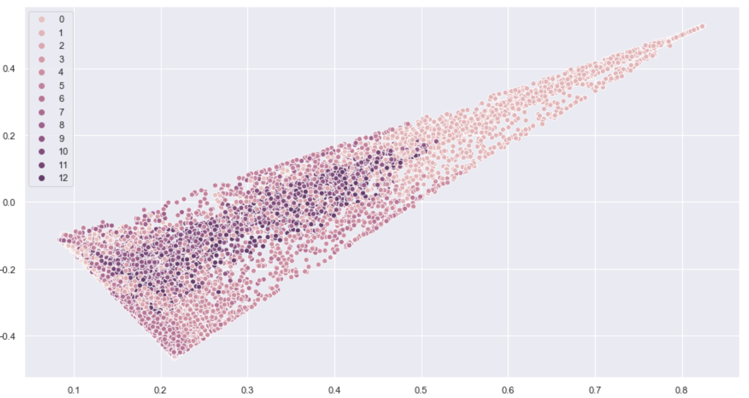
TOPIC MODELING PROCEDURE
Topic Distribution using Singular Value Decomposition
 | Topic Modeling
Tokenize | Custom Spacy
CountVectorizer | Limit total words
Latent Dirichlet Allocation | Gridsearch/ Human Review
Final Output | 13 Topics
Final Topics: Immigration, Energy, Veterans Affairs, Entitlements, Defense, Appropriations, Taxes, Tariffs, Federal Grants, Transport Regulation, Education, US Interior, Healthcare
Notes:
Used gridsearch or large differences

Slide 12
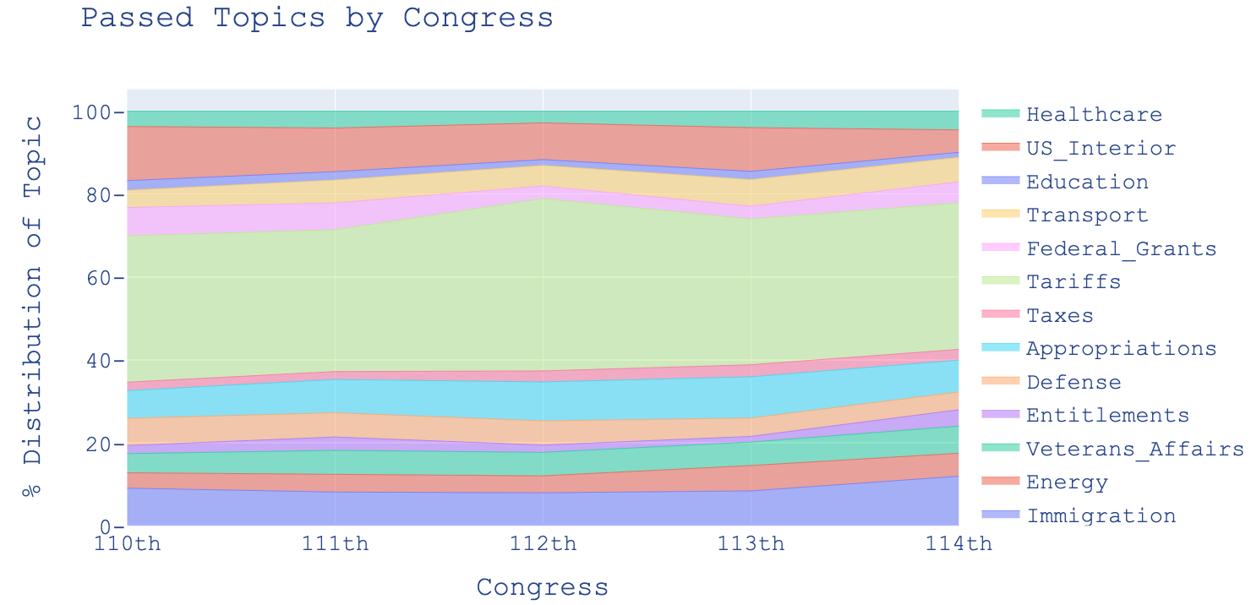
TOPICS OVER TIME
Tariff related bills make up a huge amount of passed bills because they are often proposed individually.
Note a decrease in US Interior environmental bills as congress grows more conservative, and a slow increase towards Immigration.
Notes:
Break the yaxis into groups, maybe include years to show change over time

Slide 13
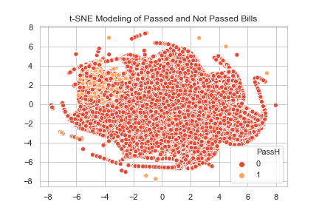
INTRODUCTION
CLASSIFICATION
Predicting Bills Passage: After adding topics features time for classification. Major focus on recall because of class imbalance.

Slide 14
ATTEMPTS TO IMPROVE MODEL PERFORMANCE
Modeling Single Topic
Weighting the Classes
Text Only Predictions
Dropping 112th Congress
Undersampling
Modeling Only Topics
Using only the best distributed topic yielded improved predictions.
Significantly improved model performance in all cases!
The model containing only modified text performed similarly to the top model.
Actually lowered effectiveness of the predictions
Concern over data loss,
Testing modeling with pruned features.
Notes:
SHOULD I TALK MORE ABOUT the single topic model?

Slide 15
CHOOSING A MODEL
COMPARING MODELS
Feature Engineering
 | Pass | Precision | Recall | Accuracy | F1-Score | AUC
Naive- Bayes | 0 1 | 0.92 0.72 | 1.00 0.07 | 0.92 | 0.96 0.13 | 0.53
Logistic Regression | 0 1 | 0.96 0.19 | 0.72 0.70 | 0.72 | 0.72 0.30 | 0.79
Stochastic Gradient Descent (loss=log) | 0 1 | 0.96 0.21 | 0.78 0.62 | 0.77 | 0.86 0.31 | 0.80
Random Forest | 0 1 | 0.94 0.78 | 0.99 0.28 | 0.93 | 0.96 0.41 | 0.64
Engineered Sparse Features
One Hot Encoded Categorical
Scaled Numeric
Chose models which allowed balanced class weights
Modeling focused on recall because of the significant class imbalance in bill passage.
Notes:
Recall more important because want to knwo if there is any chance of the bill passing at all

Slide 16
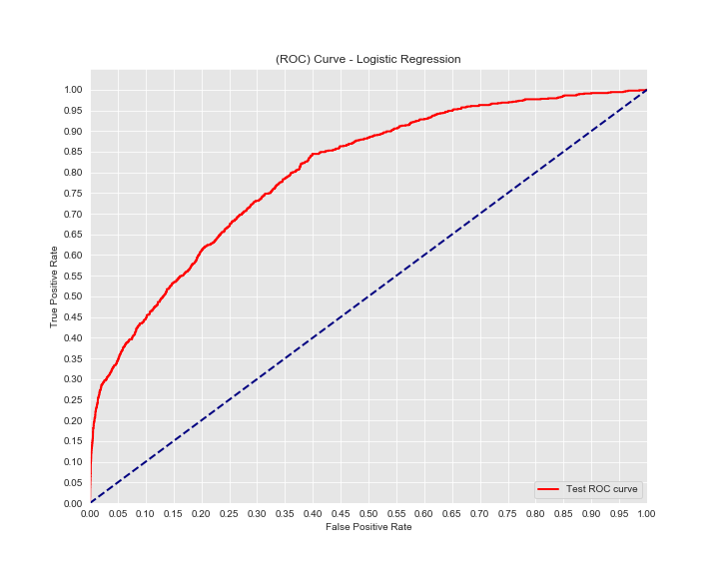
FINAL MODEL
LOGISTIC REGRESSION
with Meta Features, Engineered Features, and Topics
ROC/AUC Curve:
 | Passed | Precision | Recall | Accuracy | F1-Score | AUC
Logistic Regression | 0 1 | 0.96 0.19 | 0.72 0.70 | 0.72 | 0.72 0.30 | 0.79
Logistic Regression had the best recall score of all the models, meaning it was best at predicting the minority class, which was Passed House. It also performed best for the text-only model.
Main takeaway: It is hard to predict bill passage!
Notes:
What is the final and what are the inputs (

Slide 17
OVERVIEW:
Topic 7 - Tariffs
US Territories
Bill Title Length
Cosponsors
Small States
Districts in Large States
Feature Importances:
Tariff related bills represent a large portion of passed bills.
Territories propose very few bills, but their bills are usually passed.
As seen in graph earlier, longer title length was associated with bill passage
Passed bills had more sponsorship from multiple congresspersons.
Congresspersons from mall states that propose few bills but had high levels of passage: VT, DE, MS
Congresspersons from districts in large, well represented states: CA, TX, NY

Slide 18

LIMITATIONS
CLASS IMBALANCE
DATA LEAKAGE
NATURAL LANGUAGE
SLOW WEB-SCRAPING
General Limitations to the Modeling:
A dominant issue throughout the process was the lower amount of passed bills.
Many of the features started with are strongly related to bill passage and had to be discarded.
It is difficult to get definitive outcomes since much of the success hinges on human review.
Was not able to obtain all summaries in time allotted, so focused on most recent 10yrs of Congresses.

Slide 19
01
02
03
40 Years of Congress
Stacked Modeling
Bill Introduction Data
FURTHER RESEARCH:
Online records go back to the 93rd Congress, in 1973 - input them all into the EDA and models to see changes over time.
Models for meta-features and text data could mean great outcomes with the inclusion of stacking techniques.
Continue this analysis by including data regarding the number of times a bill is introduced before it passed.

Slide 20
CONCLUSIONS
Based on what you’ve learned from this presentation, it’s your turn.
Try to write a passing bill!

