Slide 1
2 Week Challenge
Kieran Abelen

Slide 2
Employee Management System
15 hours of work
Ability to search a MySQL database for employee details
Interface between client database interactions
One query at a time
Basic query builder used to achieve this
Strict interaction query interactions
Session management

Slide 3
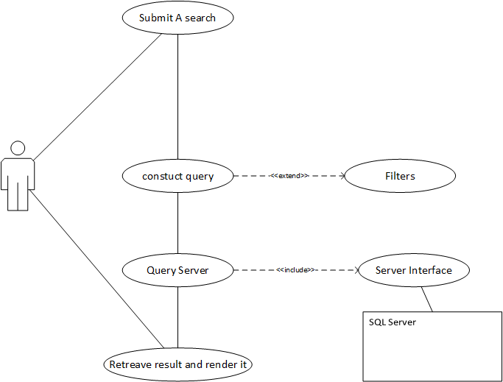
Use Case

Slide 4
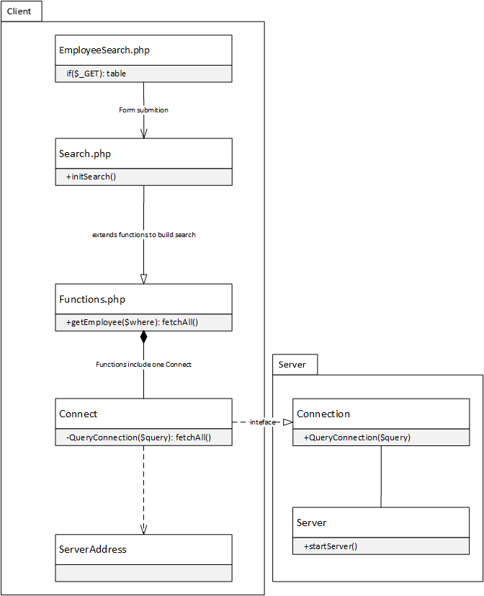
Class Diagram

Slide 5
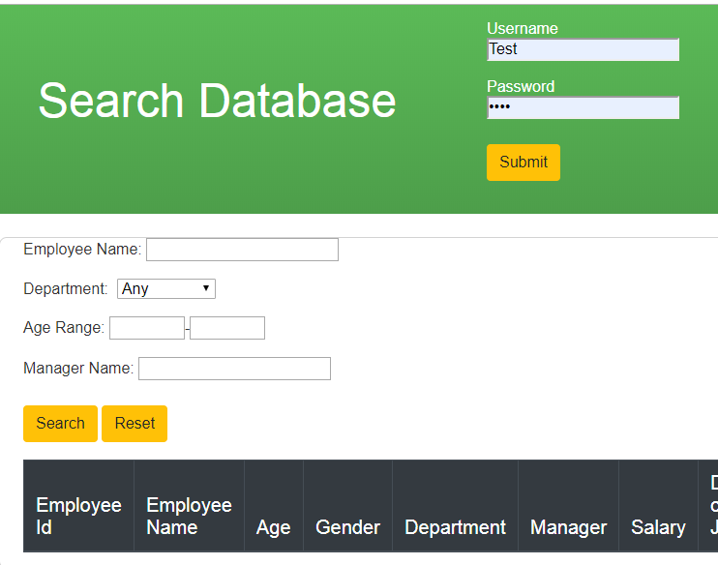
Employee Search

Slide 6
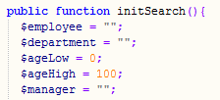
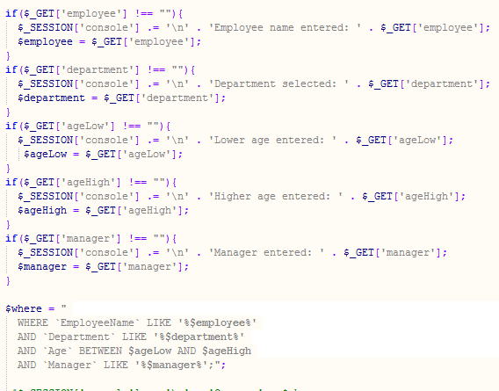
Query Builder

Slide 7
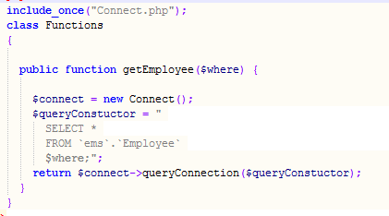
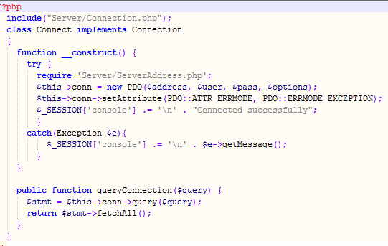
Open Connection to Server

Slide 8
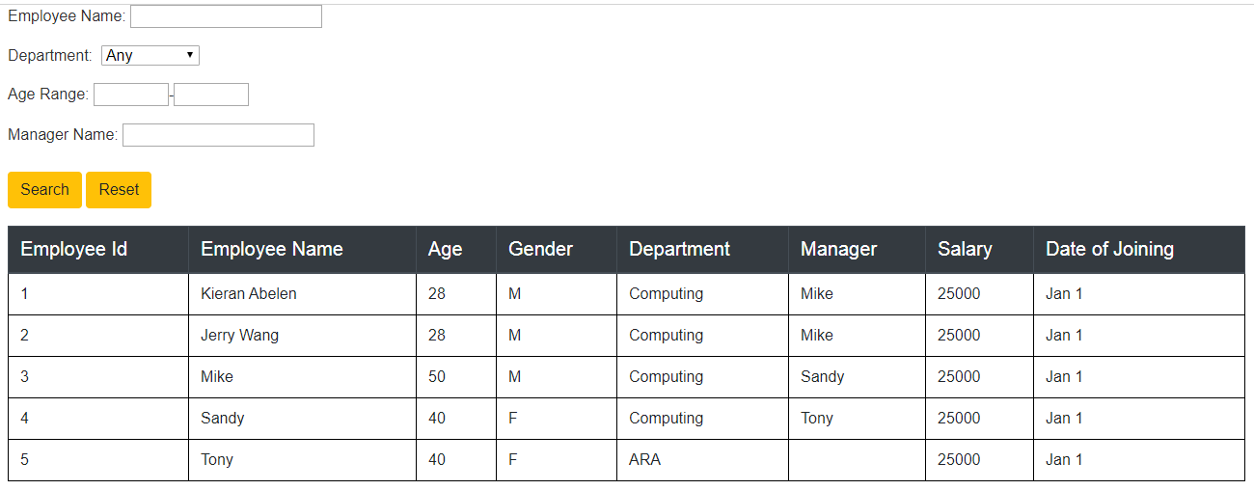
Employee Table

Slide 9
Difficulties
Getting the class relations set up
Unit testing in PHP
Session variables corrupting
Implementing my design when I spend more time researching

Slide 10
Lesson learned
Other approached outside unit testing selenium
Challenge is really hard when Ara provides a lot of the code/platform
Getting good client question in early
Applying what I have learned to my future Ara projects

