Slide 1
Visualizing Reviewer Trends & Sentiment Over Time
A Technology Review

Slide 2

Background
Data
Reviews on movies are created by critics and have an impact on the success and awards of a given movie. These reviews include chunks of text that describe the movie and the review. We are interested in providing the user information about how a critic rates movies over time so they can see if there is variation in rating and sentiment over the years.
To achieve this goal we will need to use packages for data manipulation, visualization (for exploratory analysis) and learning.
List of movies that came out from 1903 to 2011
List of reviews from Rotten Tomatoes from 1929 to 2013 including their score, the reviewer, and the reviewer contents

Slide 3
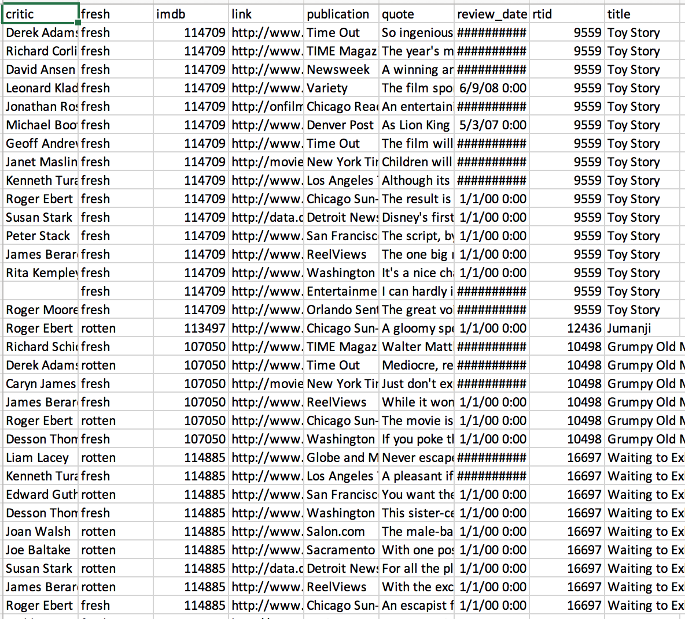
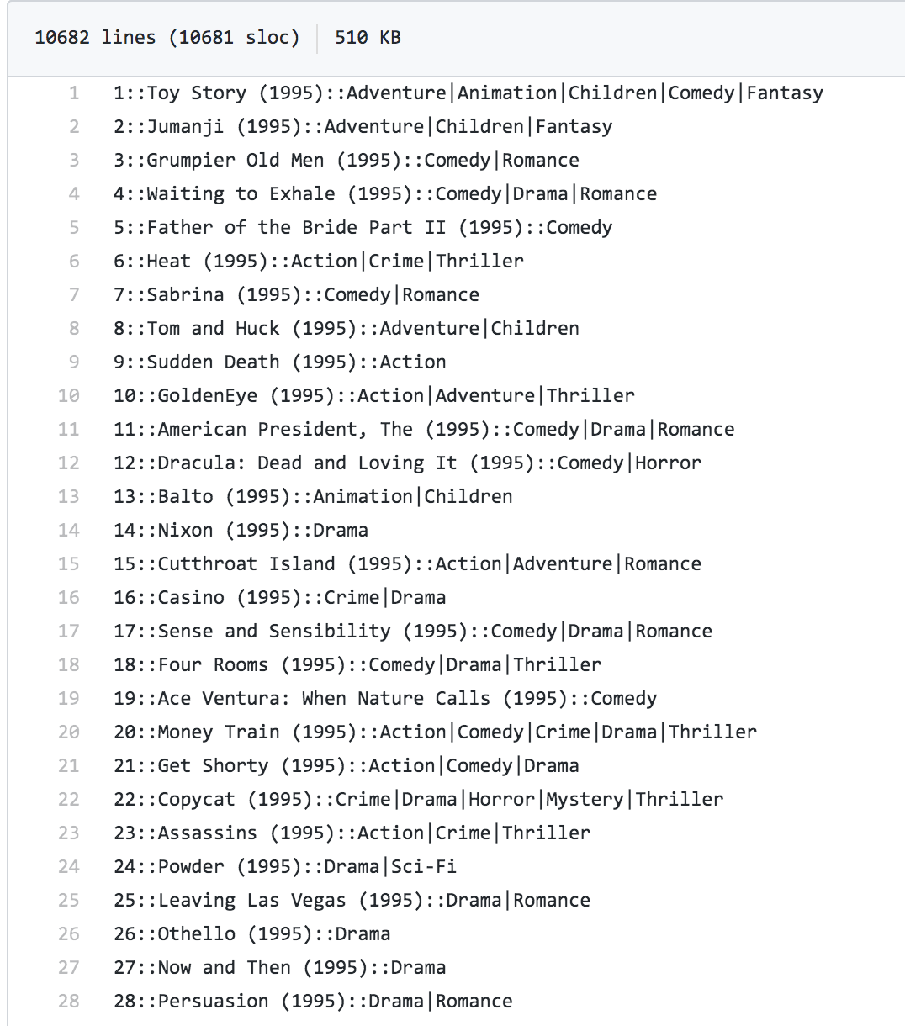
Data

Slide 4

Use Case Example
USER INPUT: User selects the name of a movie reviewer. SYSTEM: Pulls movie review data for the selected reviewer, visualizes the rating distribution over time SYSTEM OUTPUT: System shows visualization of rating distribution to the user SYSTEM ASKS: Would you like to the movies that this critic has reviewed? And the sentiment ? USER INPUT: Yes or No SYSTEM OUTPUT: Either displays a list of movies and their sentiment score or ends

Slide 5
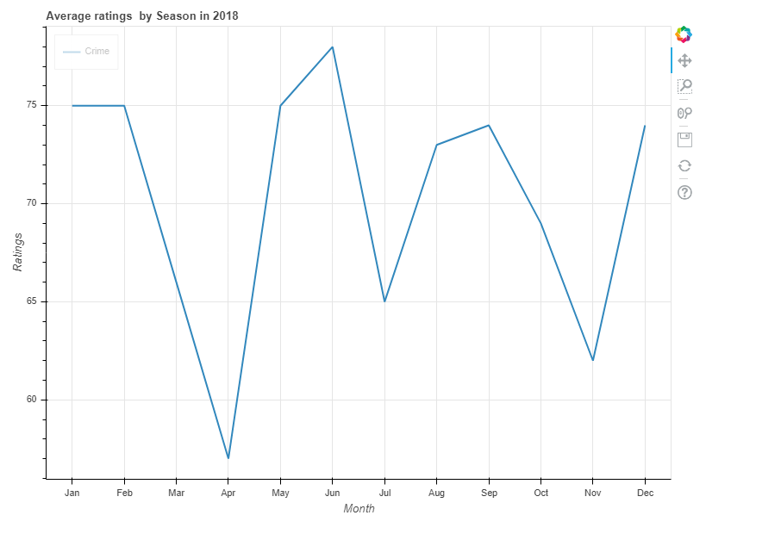
Use Case Example - Output 1
Input: Reviewer Name/ Time Span
Eg: Derek Adams 01/01/2018-12/31/2018
Output: A rating trend line within the time span
Package Usage: Pandas/ Bokeh

Slide 6
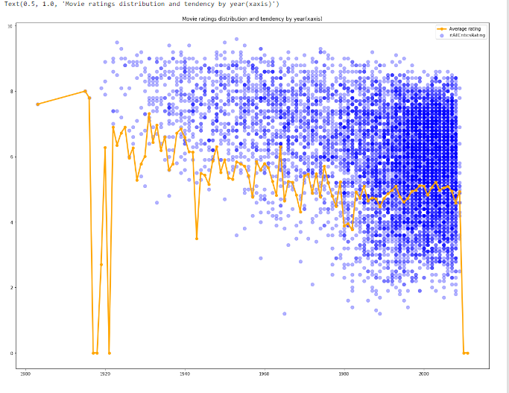
Use Case Example - Output 2
Input: All Interested Reviewers /Time Span
Output: Movie Ratings Distribution Over Year
Package Usage: Pandas/ Matplotlib

Slide 7
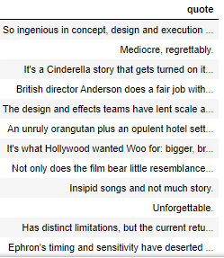
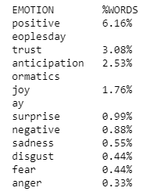
Use Case Example - Output 3
Input: Reviewer Name Eg: Derek Adams
Output: Example Quotes/ Sentiment Score
Package Usage: Numpy/ NLTK

Slide 8

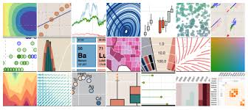
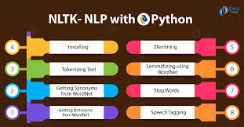

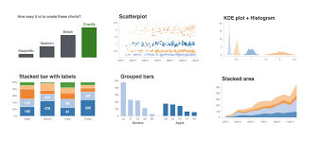
Needs
- Data Wrangling Package (pandas and numpy) - Visualization Package (bokeh or matplotlib) - Sentiment Analysis/Learning Package (NLTK or SpaCy)
bokeh
matplotlib
Notes:
Screenshots of different packages

Slide 9
Library Packages Options (Visualization)
Package 1 - Bokeh*
Pros: It has high-performance interactivity over very large or streaming datasets
It allows viewers to explore the data themselves for some really complex data which works as a dashboard
Cons: The interactivity is limited. It only offers a 2-D, grid-like canvas with axes as the baseline
Package 2 - MatPlotLib
Pros: Good for basic plotting -- bars, pies, lines, scatter plots, etc.
Most popular and easy to use without a lot of code.
Cons: It doesn’t allow any interaction.
It is heavily reliant on other packages.
Notes:
Olivia

Slide 10
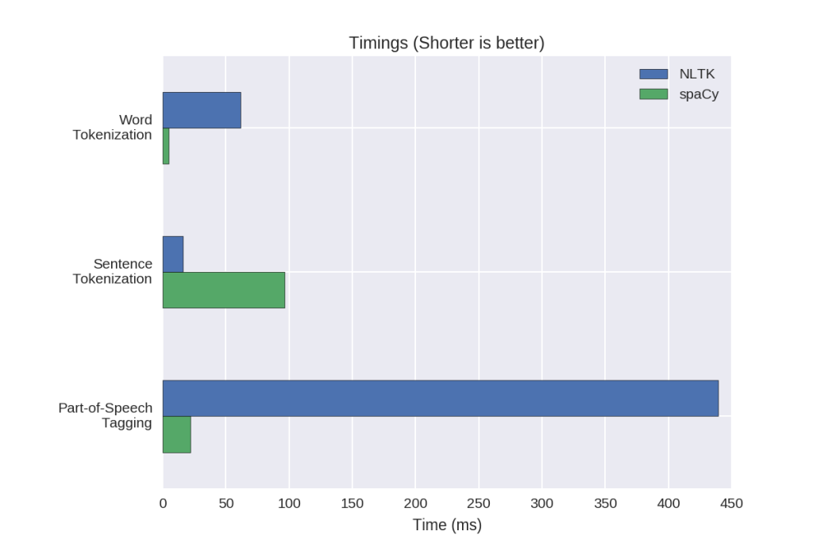
Library Packages Options (Sentiment Analysis)
Package 1 - NLTK
Pros:
It provides accessible interfaces to a lot of corpora and lexical sources mapped to machine learning algorithms, as well as a robust choice of parsers and utilities.
Cons: Too many algorithms to choose from for a particular problem which is boon for a researcher but a bane for a developer.
Not efficient compared to SpaCy.
Package 2 - SpaCy*
Pros:
It claims to be ‘'industrial-strength natural language processing. SpaCy keeps the best algorithm for a problem in its toolkit and keep it updated as state of the art improves.
Performance is better.
Cons:
It doesn’t support multiple languages.
Notes:
Olivia

