Slide 1
Introduction
Giulio Melloni

Slide 2

Introduce Yourself
Hi all, I’m Giulio Melloni and I’m a Solutions Architect in NTT DATA in the Data & Analytics Business Line and Azure and Databricks Competence Center.
Moreover, I’m like an «envangelist» of Databricks since I’m talking about this everytime I’m attending a conference or a talk inside my company.
Contacts:
📧 giulio.melloni@itsrizzoli.com
📞 +39 3407531919
👥 melmello
🌐 melmellogarage

Slide 3
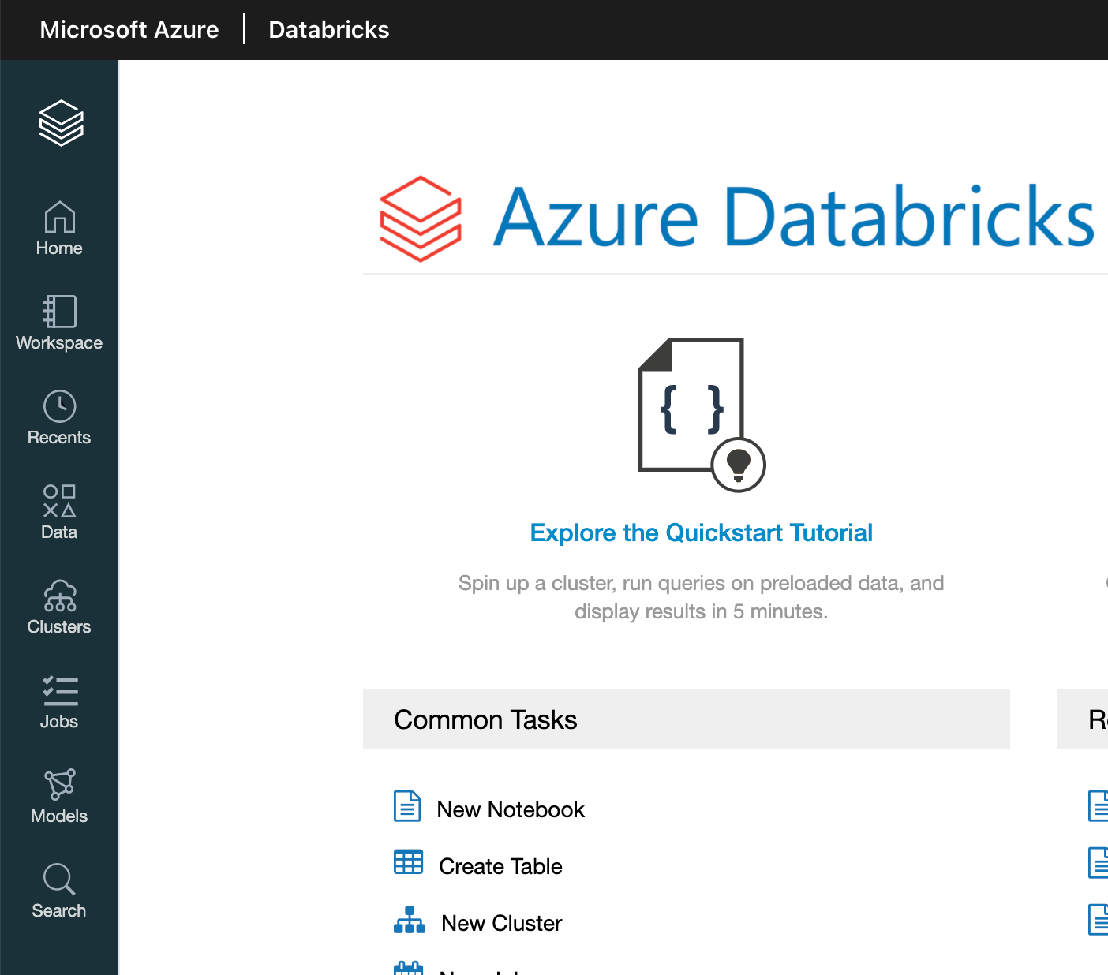
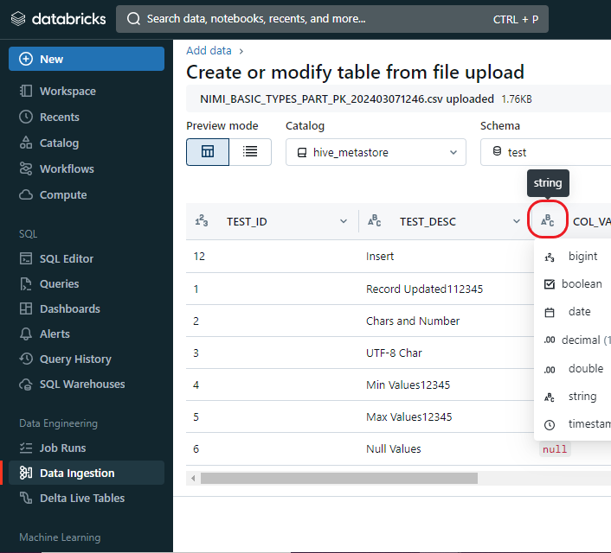
Introduce Yourself
I graduated in Computer Science and Engineering, Data Science specialization, at Politecnico di Milano in 2019, and I started working for a small web agency company.
In 2020 I immediately moved into the Big Data world discovering Databricks and starting building my first analytical solution: an end-to-end framework that would have replaced the Google Analytics reports.
In 2022 I moved to another company where I developed a medallion architecture in Cloudera, and where I followed a migration from Oracle to Databricks from an architectural point of view.
In 2023 I joined NTT DATA, where I started working for an international client on a project based on a Data Mesh framework. Now I am allocated on the sales domain, creating ETL flows that ingest excel files, outputs from surveys all over the world.
Basically, I always used Databricks since the first days I stared working, and I’ve had the pleasure of seeing the framwork growing up in its maturity.
2020
2024

Slide 4
Agenda
Big Data Introduction
Big Data
Spark
Databricks
Delta
Data Types
Spark
Notebook
SQL
Transformations & Actions
Lazy Evaluation
Dataframes & RDD
Spark Deep Dive
Partitioning & Shuffling
Wide & Narrow Transformations
Cache & Persist
Optimize
Medallion Architecture
Databricks Repos
Unit, Integration, Data Test
Databricks Features
Spark Streaming
Autoloader
Workflows & Azure Data Factory
Delta Live Tables
Monitoring
Databricks Platform + Closing
Unity Catalog
Data Masking
Machine Learning
Your questions
Lakehouse Fundamentals Quiz

Slide 5
Calendar
2024/10/29 | 09.00 – 18.00 | Big Data Introduction
2024/11/05 | 09.00 – 18.00 | Spark
2024/11/12 | 09.00 – 18.00 | Spark Deep Dive
2024/11/19 | 09.00 – 18.00 | Databricks Features
2024/11/26 | 09.00 – 18.00 | NO CLASS!
2024/12/03 | 09.00 – 18.00 | Databricks Platform + Closing
2024/12/10 | 09.00 – 13.00 | Final Test

Slide 6
The Exam
It will be on two different aspects
Theory on Spark & Databricks:
Single & Multiple Choice
Drop Down Menu
Build Lists
Drag & Drop
Exercise in PySpark & SQL

Slide 7
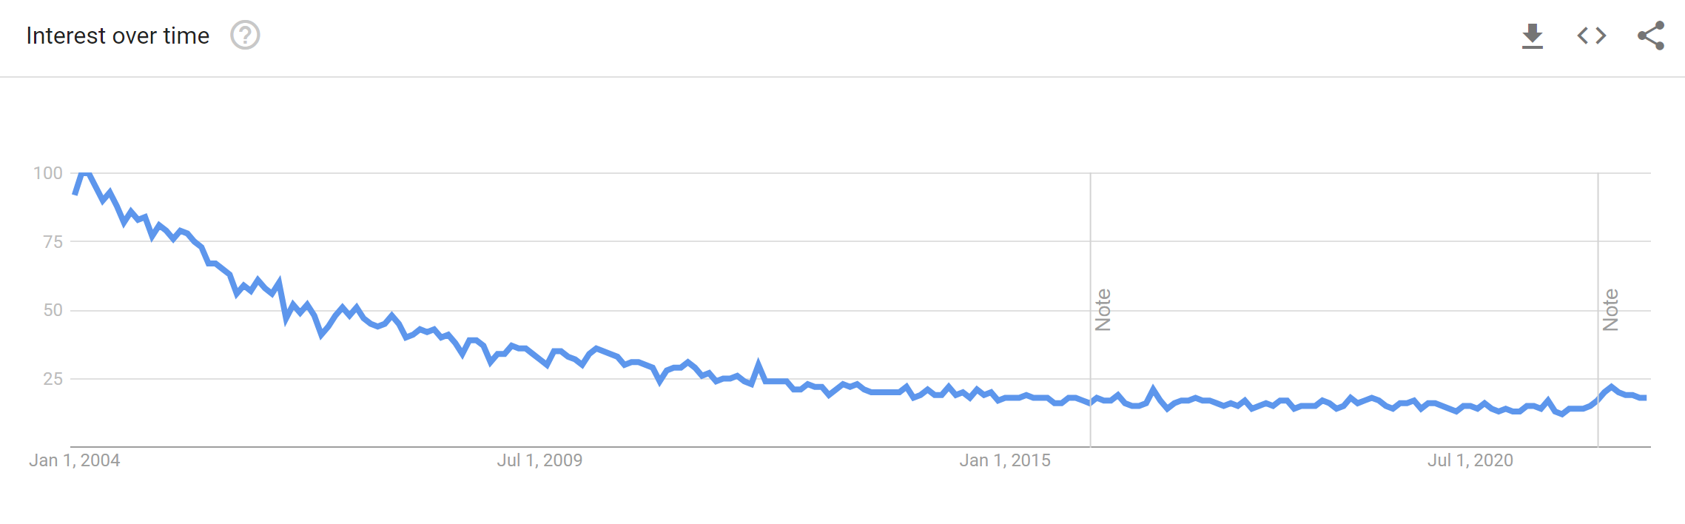
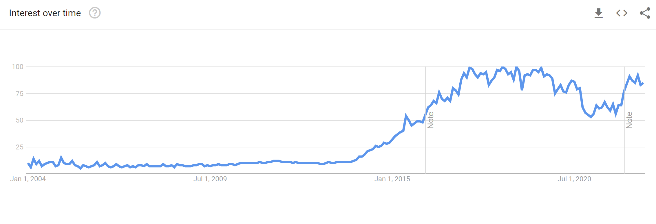
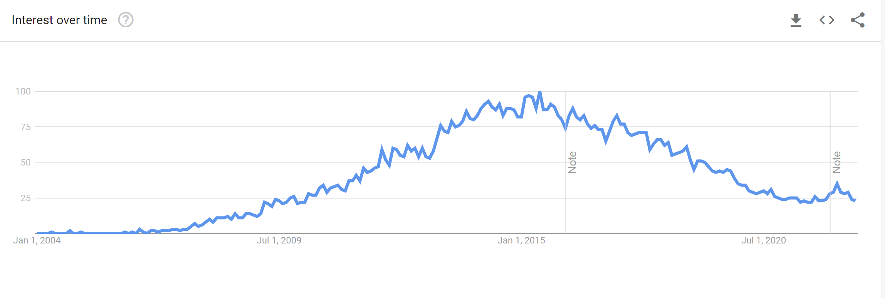
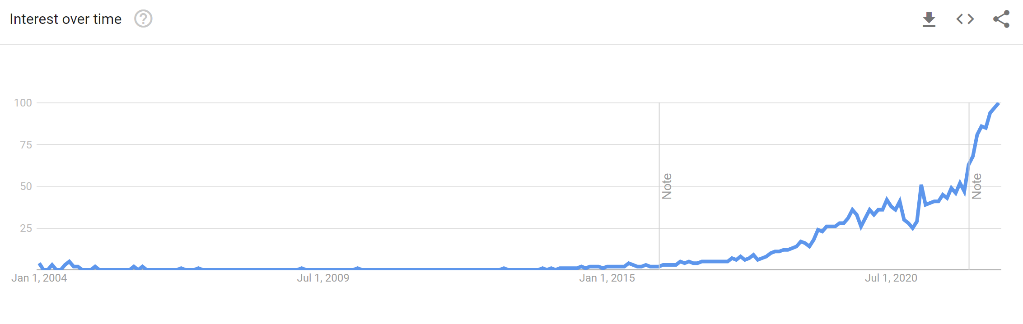
Why is this course relevant?
SPARK (2009)
DWH (late 90s)
HADOOP (2005)
CLOUD
(BIG QUERY 2011, SNOWFLAKE 2012, DATABRICKS 2013)
Ref: Google Trends

Slide 8
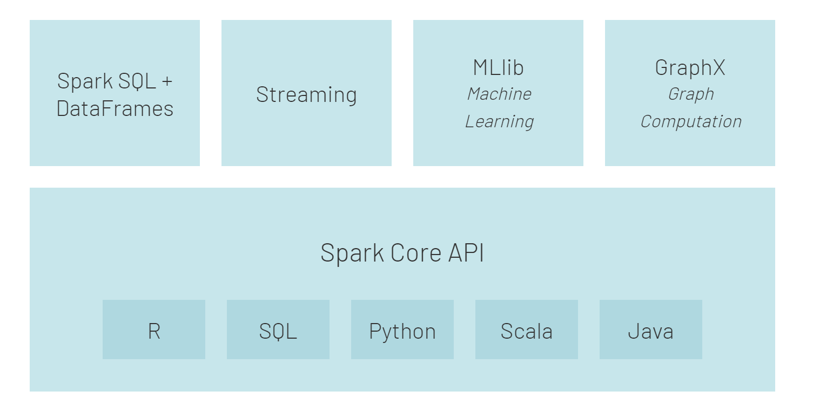
Why Spark?
Simplicity. Rich API for quick and easy interaction with data at scale.
Speed. Designed for speed outperforming Hadoop’s MapReduce
Support. Wide range of programming languages (eg Java, Python, Scala, R) and integration with storage solutions.
Ref: Gettting Started with Spark

Slide 9
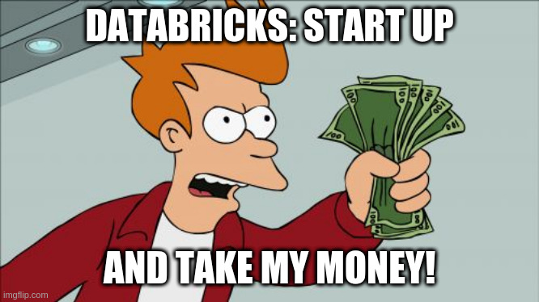
Why Databricks?
By creators of Apache Spark™
Easy to setup clusters
One platform for DE and DS

Slide 10
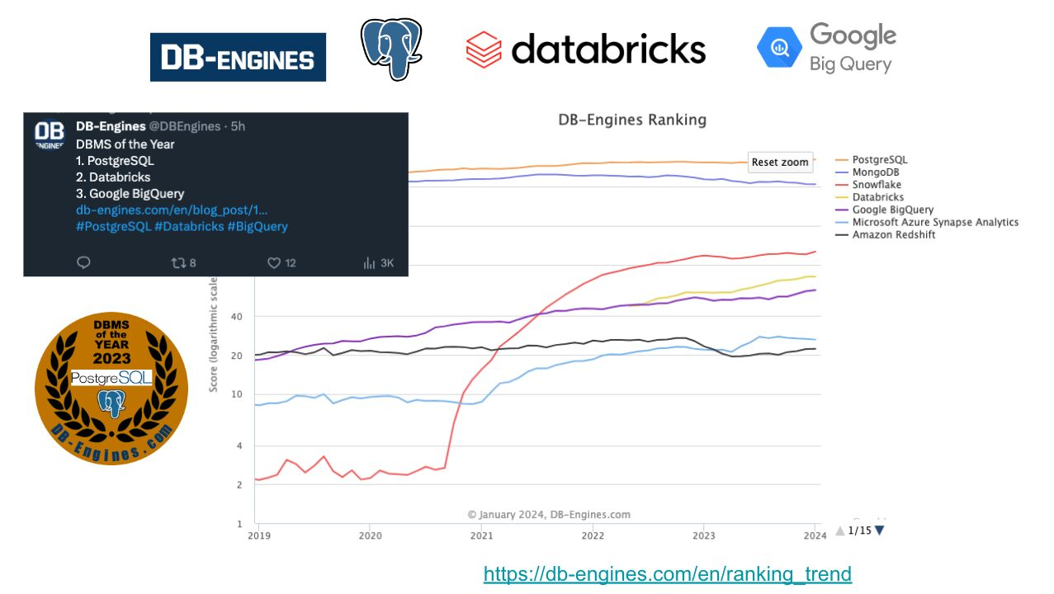
DBMS of the Year (2023)

Slide 11
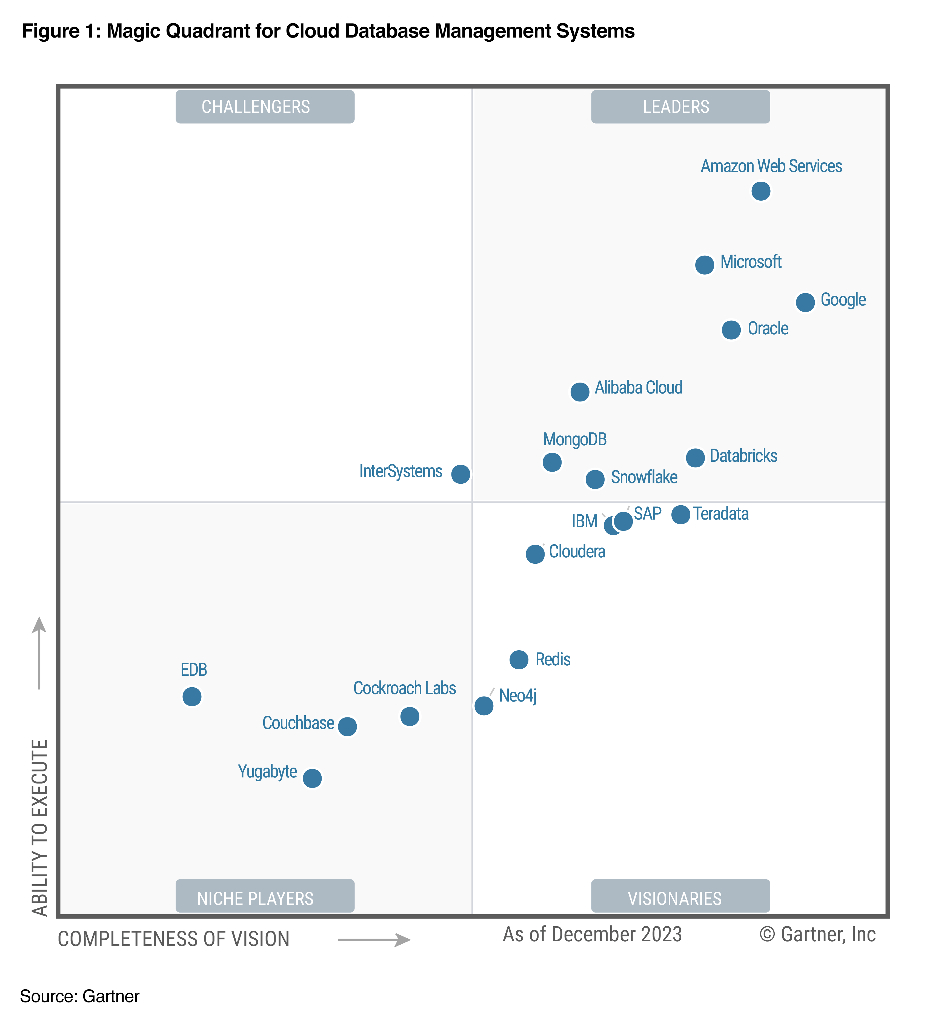
Gartner Magic Quadrant for Cloud Database Management Systems

Slide 12
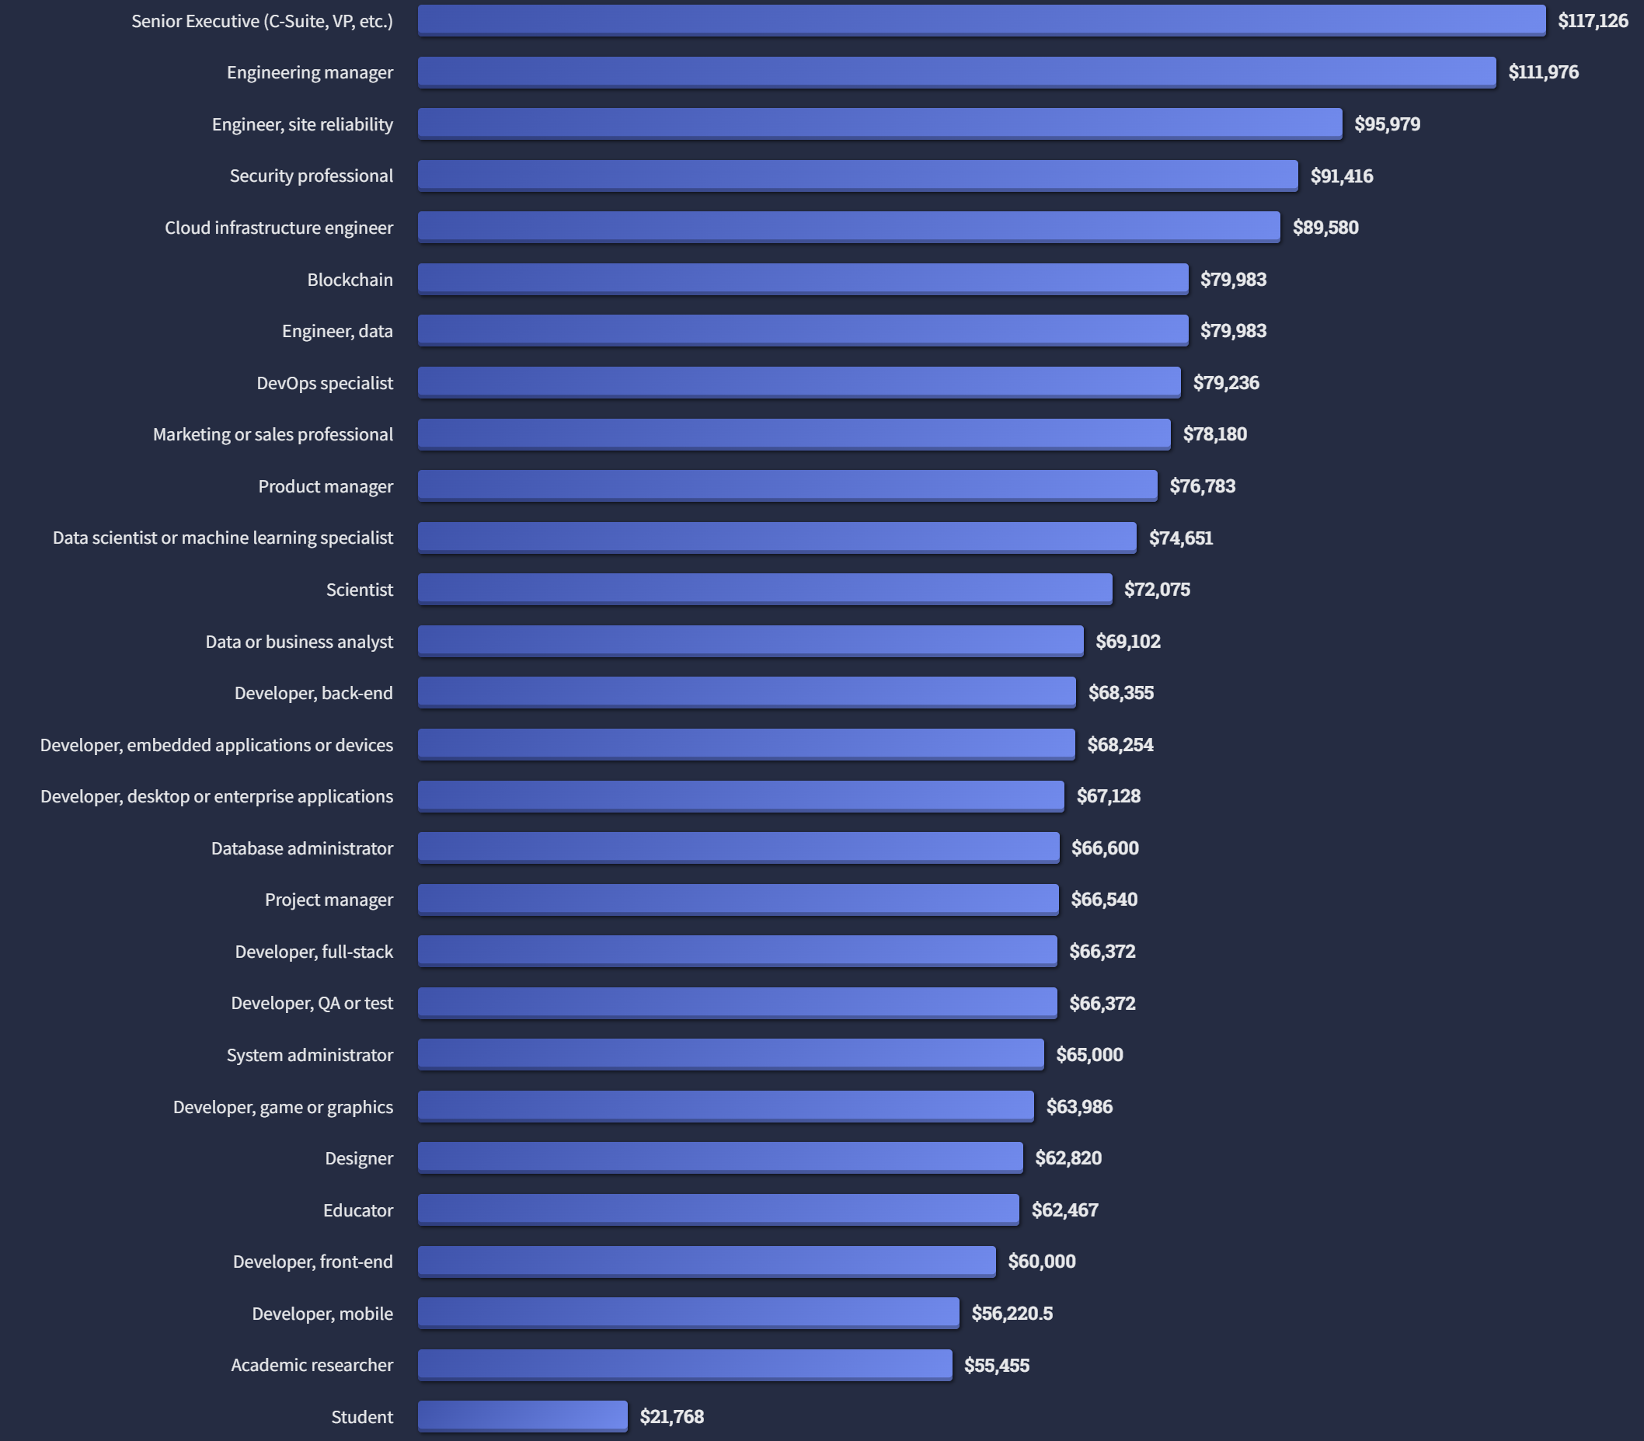
Why is this course relevant?

Slide 13
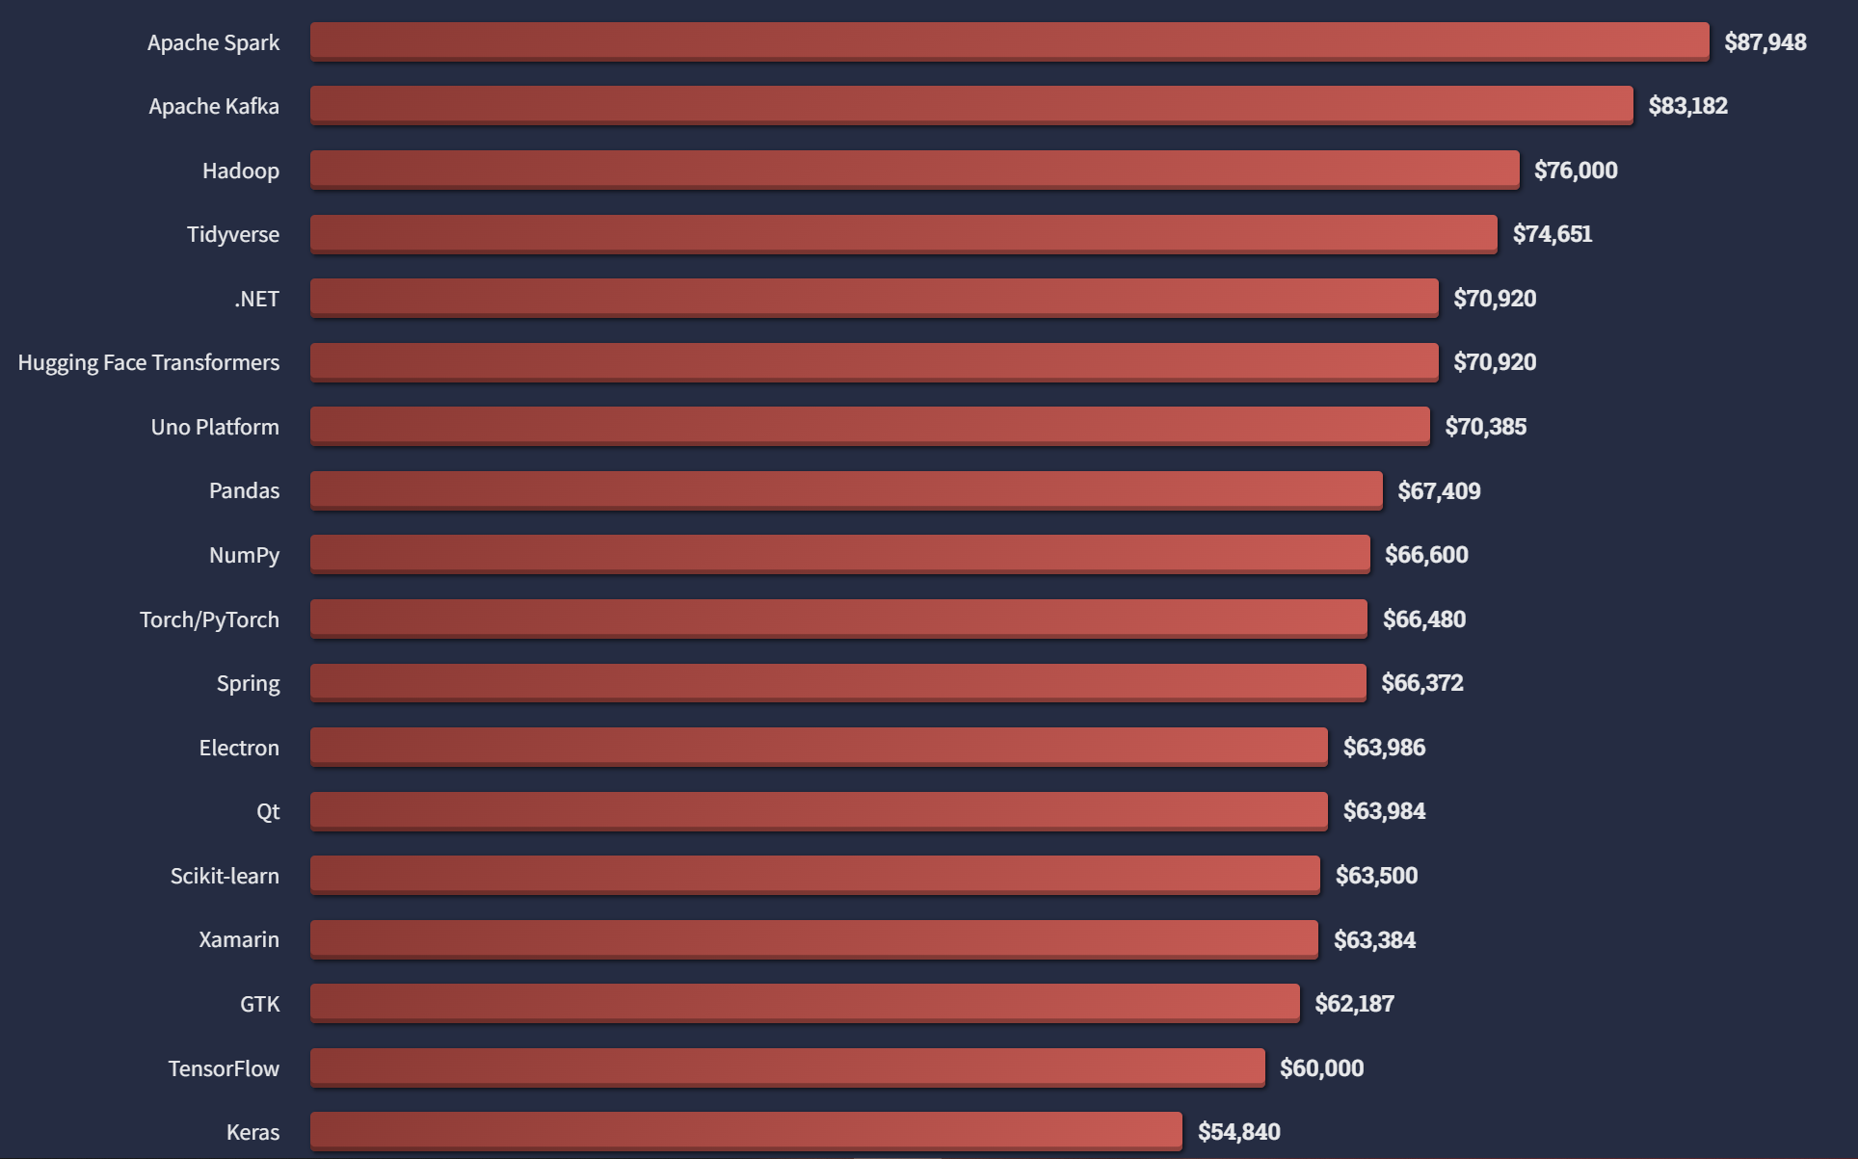
Why is this course relevant?

Slide 14
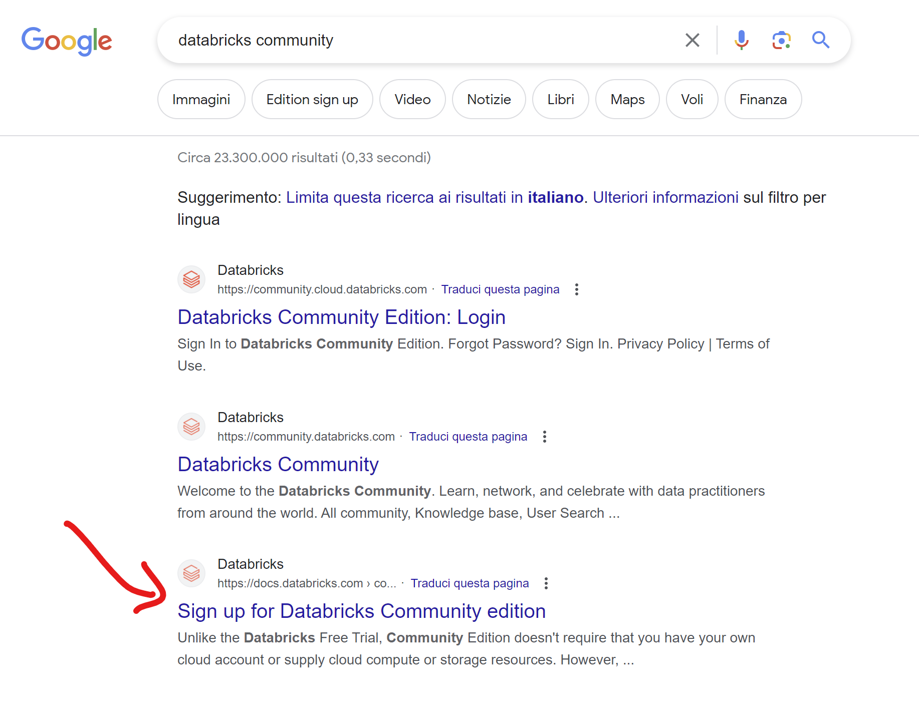
Setup Databricks Community
Guide: create a Community Edition account

Slide 15
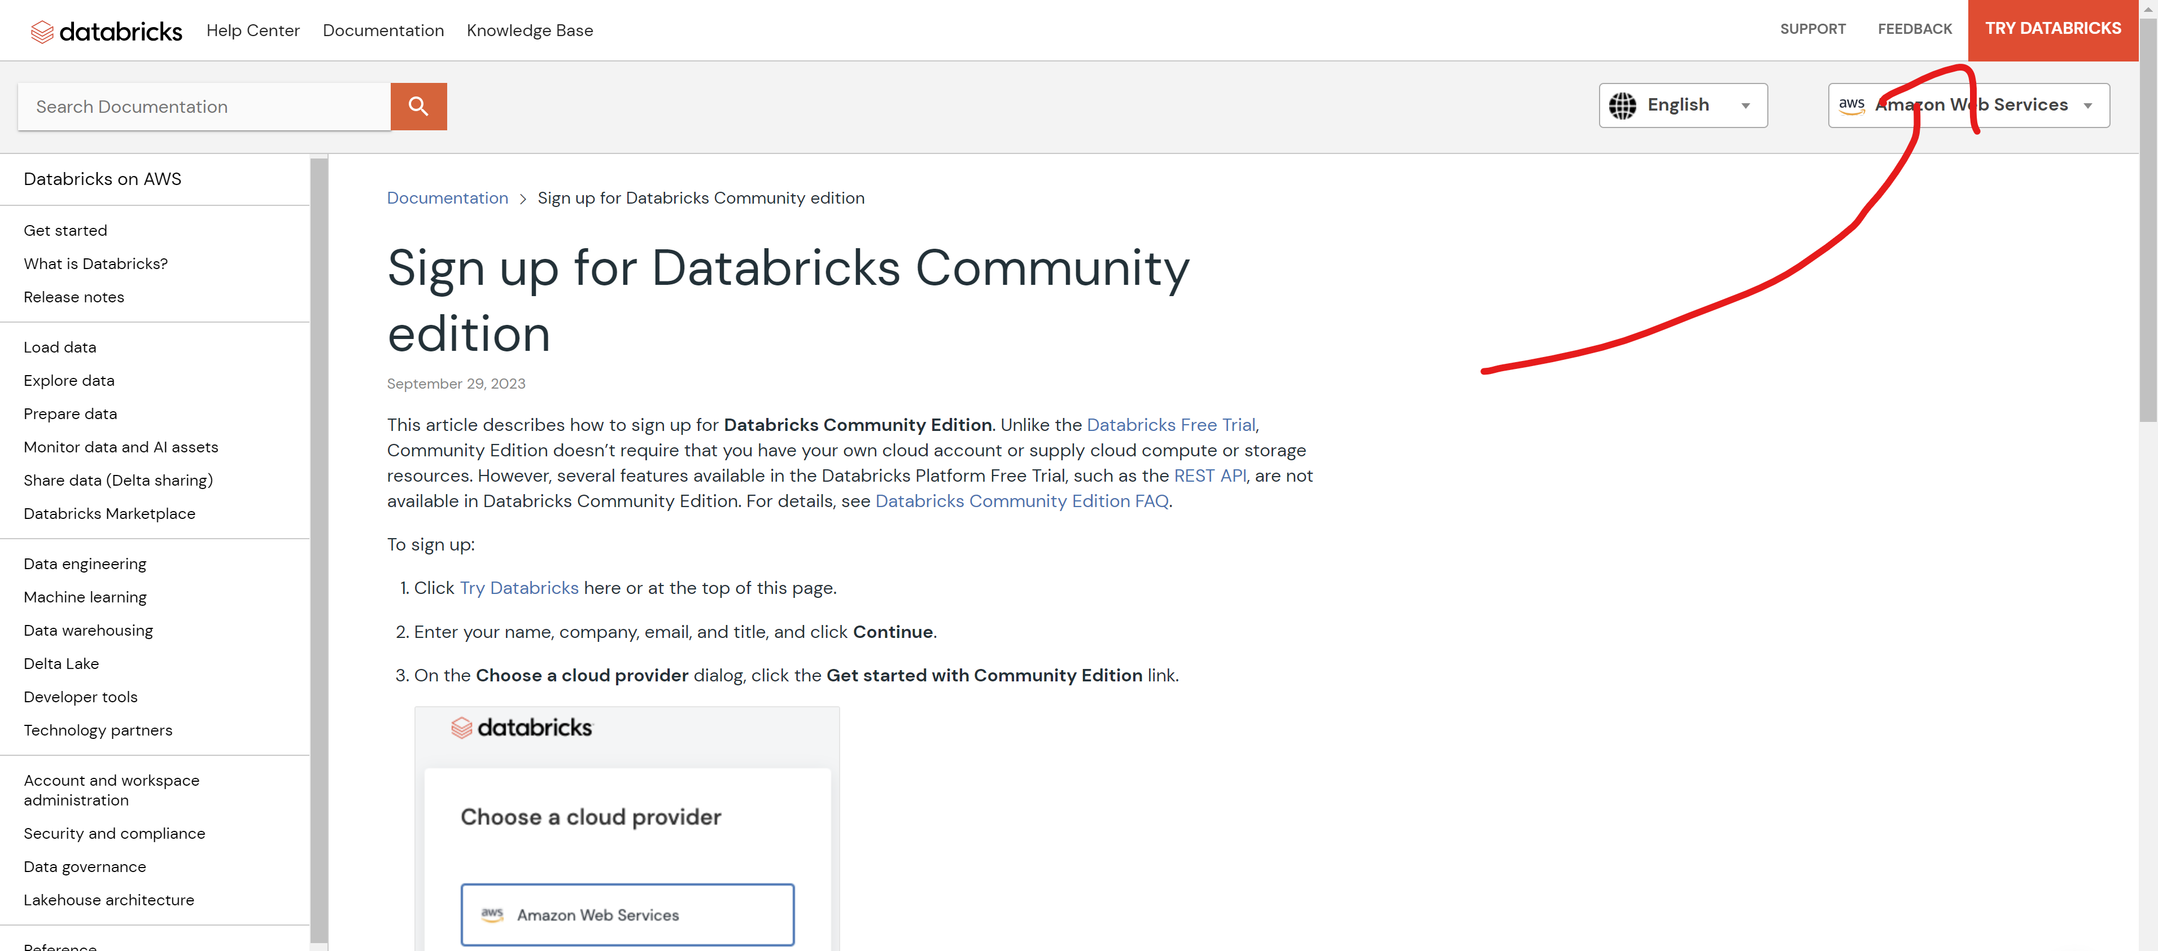
Setup Databricks Community

Slide 16
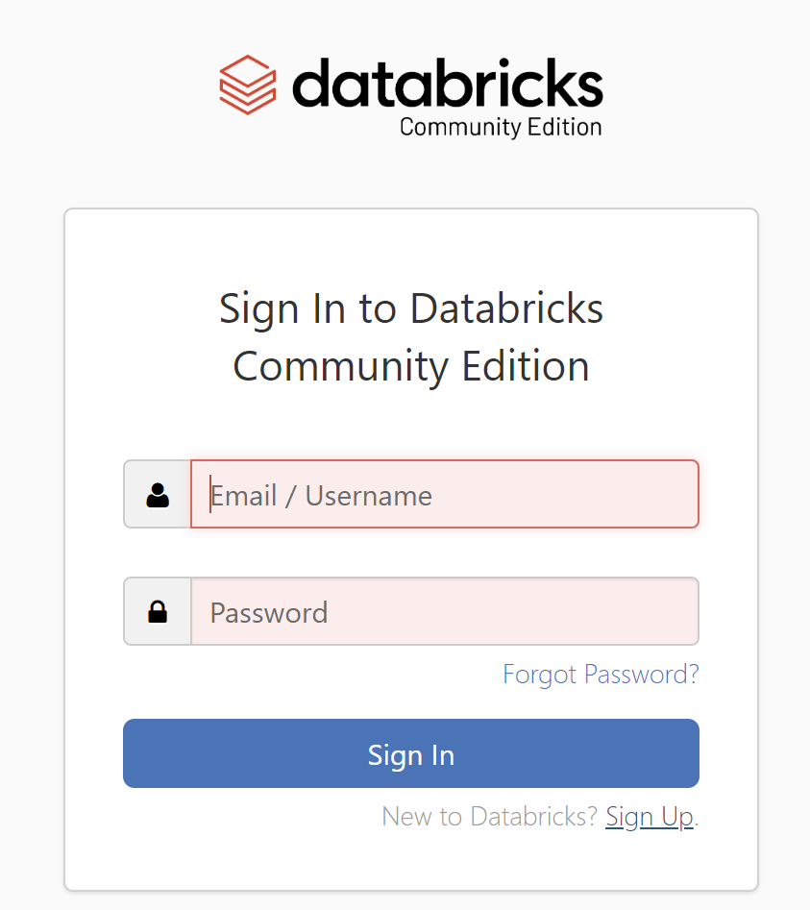
Setup Databricks Community

Slide 17
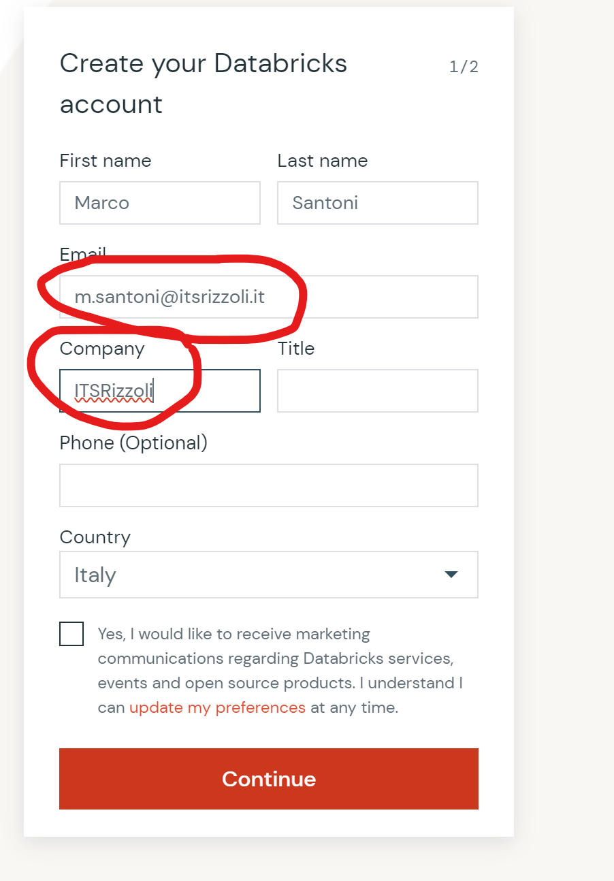
Setup Databricks Community

Slide 18
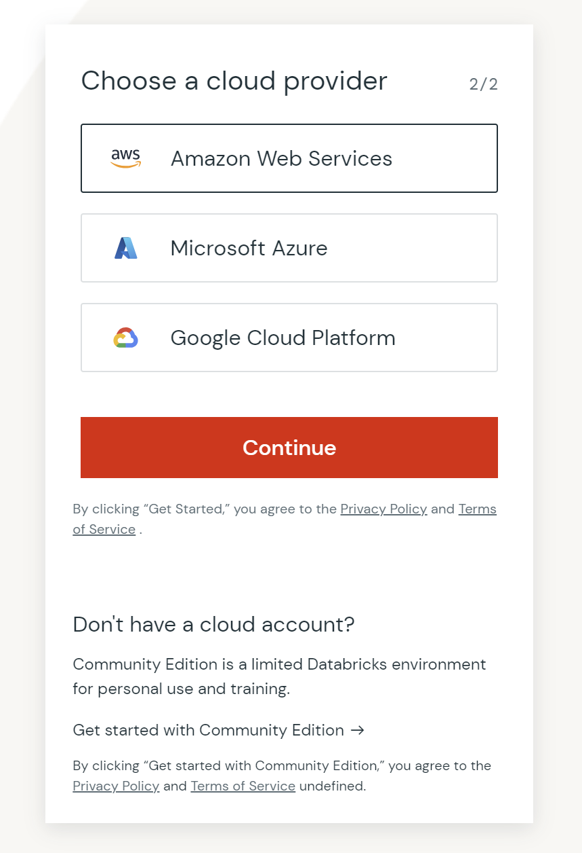
Setup Databricks Community

