Slide 1
ESS Social Trends
European Social Survey
Jorge Benavente, Nestor Gomez, Melissa Morales, and Renee Perez

Slide 2
What is ESS?
The European Social Survey (ESS) is a pan-European research infrastructure providing freely accessible data for academics, policymakers, civil society and the wider public.
This survey is conducted every 2 years and we used this data to identify any social trends across these 4 specific European countries: Finland, Hungary, Switzerland and United Kingdom, over the years of 2001 to 2022.
Each presenter will be showcasing the different trends discovered while analyzing the data.
Source: European Social Survey
https://www.europeansocialsurvey.org/

Slide 3
Human Values
Values are basic, fundamental beliefs that
guide and motivate attitudes or actions
21 personal values + 4 political beliefs
Surveys pulled from Finnish, Swiss, Hungarian, and British citizens
Reveals attitudes of highly regarded values
Country | Number of Correlations R²> 0.5 | Number of Correlations R²> 0.7
Great Britain | 9 | 1
Switzerland | 4 | 1
Hungary | 165 | 24
Finland | 153 | 17
Notes:
Please insert at least 1 question, and at least 2 visualizations to support the Q&A.
Must include numbers per the project requirements.

Slide 4
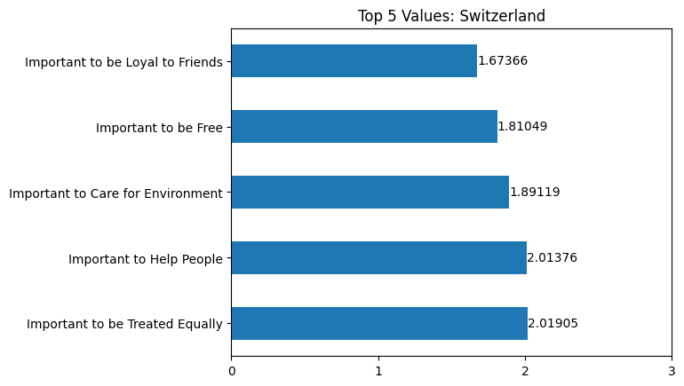
Which personal values resonate with
Swiss Citizens?
1 = Very much like me
2 =Like me

Slide 5
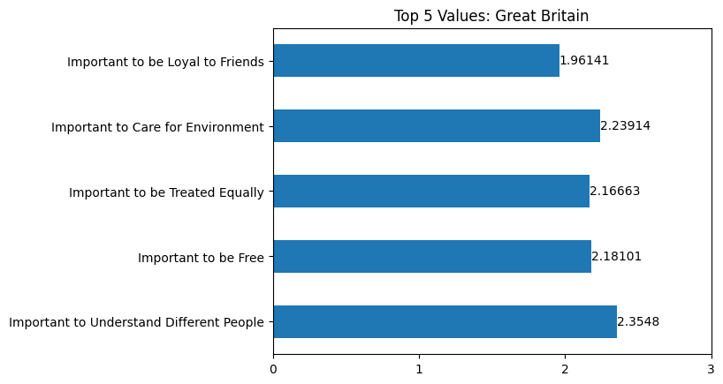
Which personal values resonate with
British Citizens?
2 = Like me
3 = Somewhat like me

Slide 6
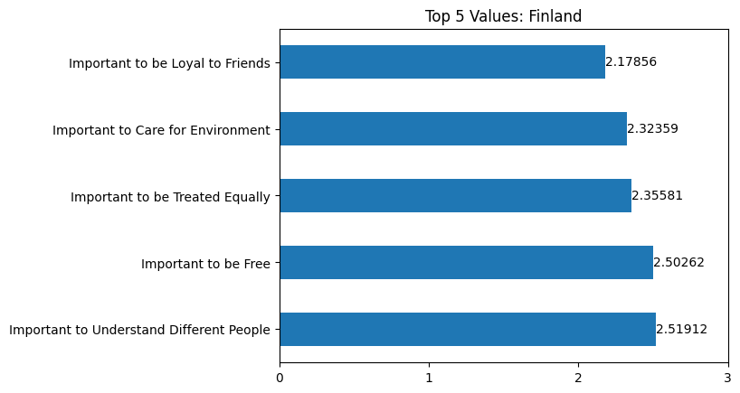
Which personal values resonate with
Finnish Citizens?
2 = Like me
3 = Somewhat like me

Slide 7
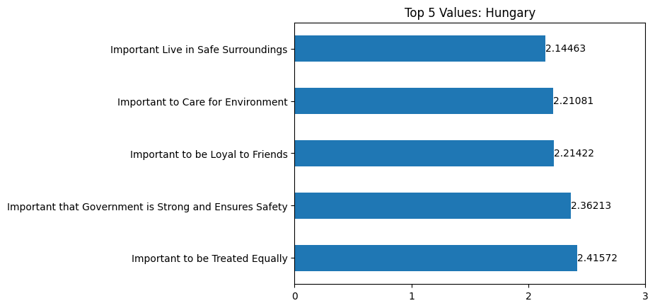
Which personal values resonate with
Hungarian Citizens?
2 = Like me
3 = Somewhat like me

Slide 8
Which personal values are likely to be correlated amongst Swiss Citizens?
Rank | Value 1 | Value 2 | R² Value | Commentary
1 | Trust in Politicians | Trust in Political Parties | 0.77 | Strong, positive correlation
2 | Trust in Politicians | Satisfaction with national government | 0.53 | Positive correlation
3 | Trust in Politicians | Trust in Legal System | 0.52 | Positive correlation

Slide 9
Which personal values are likely to be correlated amongst British Citizens?
Rank | Value 1 | Value 2 | R² Value | Commentary
1 | Trust in Politicians | Trust in Political Parties | 0.84 | Strong, positive correlation
2 | Important to show abilities and be admired | Important to be successful and that people recognize achievements | 0.59 | Positive Correlation
3 | Important to help people and care for others well-being | Important to be loyal to friends and devote to people close | 0.57 | Positive Correlation
4 | Trust in Politicians | Satisfaction with national government | 0.56 | Positive correlation
5 | Important to seek fun and things that give pleasure | Important to have a good time | 0.55 | Positive correlation

Slide 10
Which personal values are likely to be correlated amongst Finnish Citizens?
Rank | Value 1 | Value 2 | R² Value | Commentary
1 | Trust in Politicians | Trust in Political Parties | 0.85 | Strong, positive correlation
2 | Important to be loyal to friends and devote to people close | Important to help people and care for others well-being | 0.81 | Strong, positive correlation
3 | Important to be loyal to friends and devote to people close | Important to care for nature and environment | 0.79 | Strong, positive correlation
4 | Important to understand different people | Important to help people and care for others well-being | 0.78 | Strong, positive correlation
5 | Important to be loyal to friends and devote to people close | Important to understand different people | 0.77 | Strong, positive correlation

Slide 11
Which personal values are likely to be correlated amongst Hungarian Citizens?
Rank | Value 1 | Value 2 | R² Value | Commentary
1 | Important to care for nature and environment | Important to be loyal to friends and devote to people close | 0.81 | Strong, positive correlation
2 | Important to care for nature and environment | Important to live in secure and safe surroundings | 0.77 | Strong, positive correlation
3 | Important to live in secure and safe surroundings | Important to be loyal to friends and devote to people close | 0.76 | Strong, positive correlation
4 | Important to care for nature and environment | Important that government is strong and ensures safety | 0.75 | Strong, positive correlation
5 | Important to live in secure and safe surroundings | Important that government is strong and ensures safety | 0.75 | Strong, positive correlation

Slide 12
What is the Interplay between
Chronic Internet Usage,
Position on the Political Spectrum, and Broader Trust in Authority?
Is high internet usage a predictor of political leanings?
How is trust in authority affected by political ideology?

Slide 13
Relevant Variables & Scales
Trust | Political Leaning | Internet Usage
0 / No trust at all | 0 / Left | Bounds: 0 to 1440 minutes
1 | 1
2 | 2
3 | 3
4 | 4
5 | 5 / Moderate | Exclusions
6 | 6 | Answers that did not fit on this scale: Failed to answer Refused to answer Did not know Not applicable
7 | 7
8 | 8
9 | 9
10 / Complete trust | 10 / Right
Notes:
Freeform entry, with bounds of 0 minutes up to 1440 minutes/24 hours
Note: Max self-reported internet usage maxed out at 1230 (20.5 hours)

Slide 14
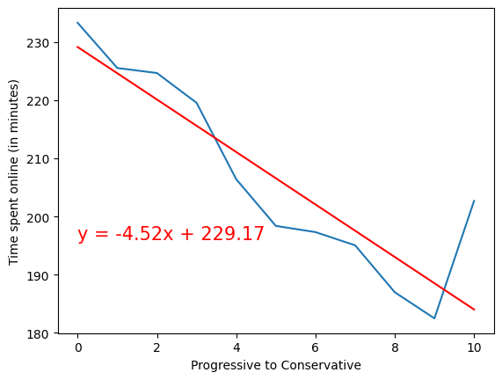
Is internet usage a predictor of political leanings?
R-value: - 0.889
Very strong correlation
Consistent pattern with an interesting exception

Slide 15
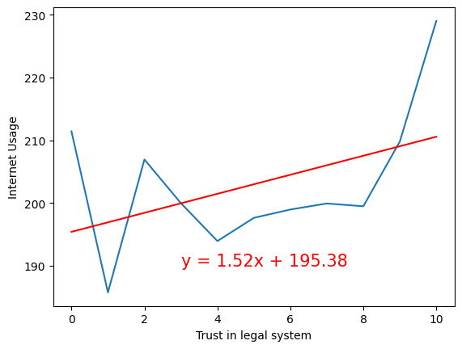
Does excessive internet use correlate with trust of authority on its own?
R-value: 0.447
Moderate correlation
Large spikes at either end

Slide 16
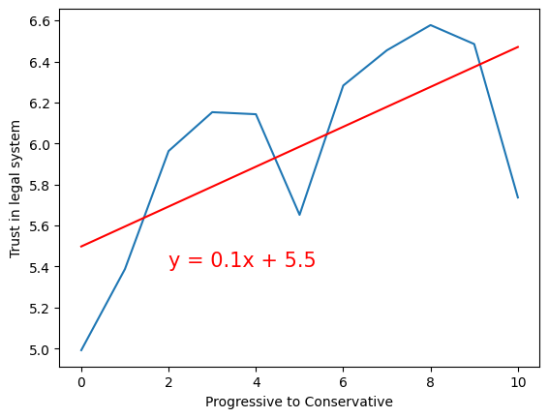
How is trust in authority affected by political ideology?
R-value: 0.648
Strong correlation
Bimodal distribution

Slide 17
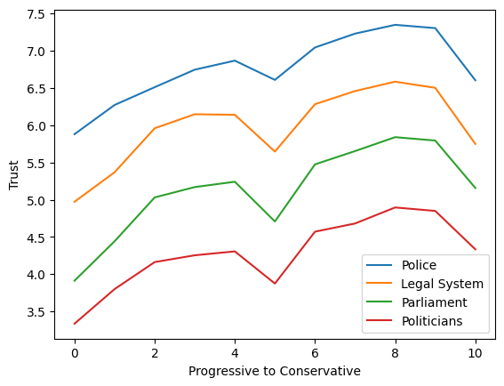
Trust in Authority, More Broadly
Similar trends across other measures of authority

Slide 18
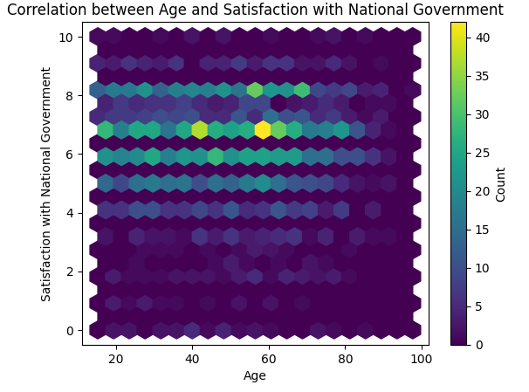
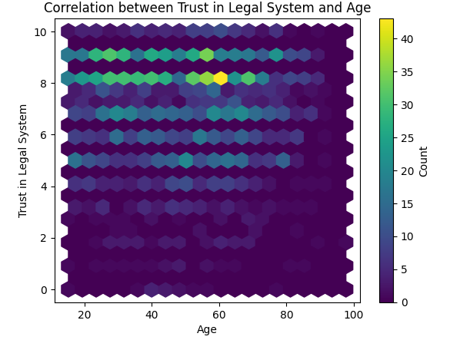
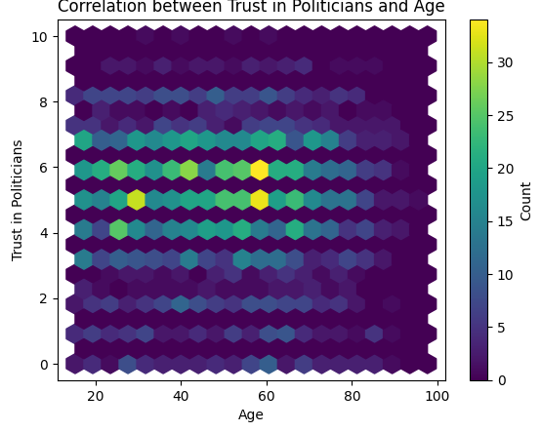
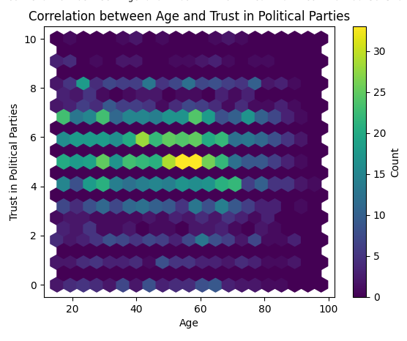
Does age have any correlation with overall trust in the legal system in Finland?
Rank | Value 1 | Value 2 | R² Value | Commentary
1 | Satisfaction with Government | Age of Respondent | -0.05 | Very weak, negative correlation
2 | Trust in Legal System | Age of Respondent | -0.14 | Weak, negative correlation
3 | Trust in Politicians | Age of Respondent | -0.11 | Weak, negative correlation
4 | Trust in Political Parties | Age of Respondent | -0.11 | Weak, negative correlation
Renee Perez

Slide 19
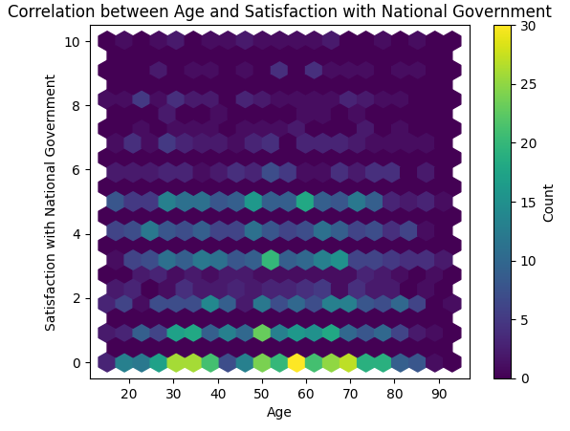
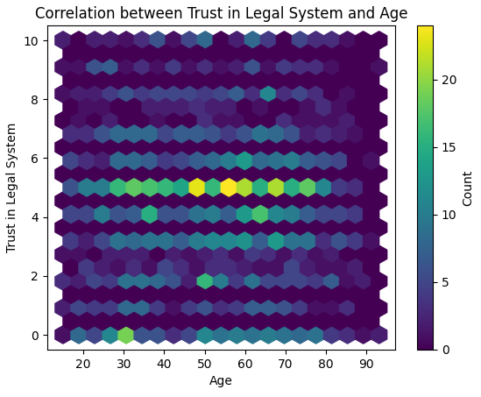
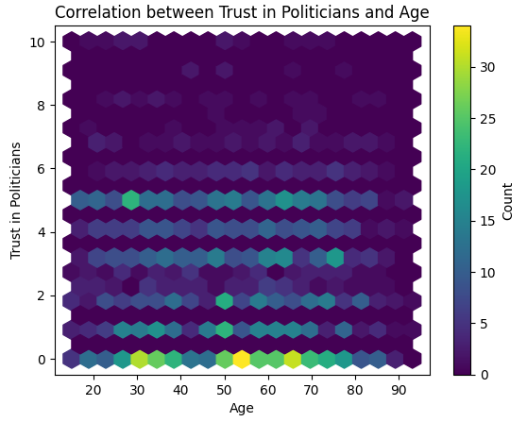
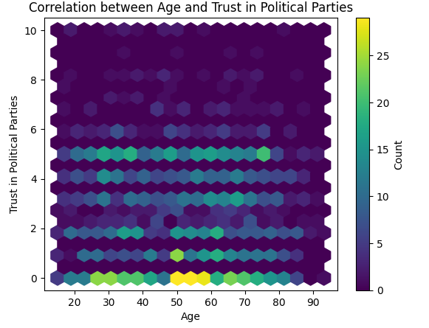
Does age have any correlation with overall trust in the legal system in Hungary?
Rank | Value 1 | Value 2 | R² Value | Commentary
1 | Satisfaction with Government | Age of Respondent | 0.11 | Weak, positive correlation
2 | Trust in Legal System | Age of Respondent | 0.003 | Extremely weak, positive correlation
3 | Trust in Politicians | Age of Respondent | 0.08 | Very weak, positive correlation
4 | Trust in Political Parties | Age of Respondent | -0.05 | Very weak, negative correlation
Renee Perez

Slide 20
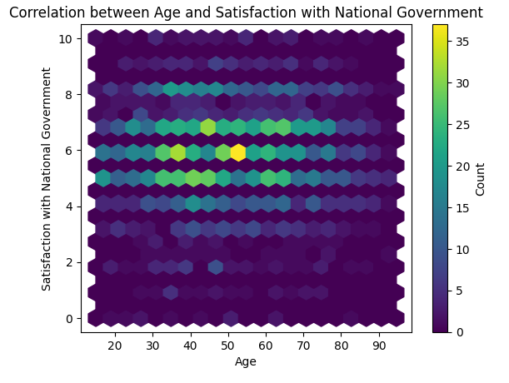
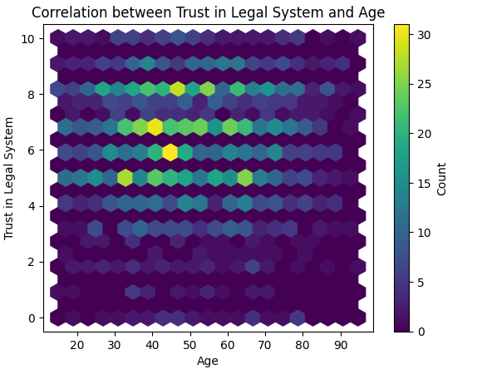
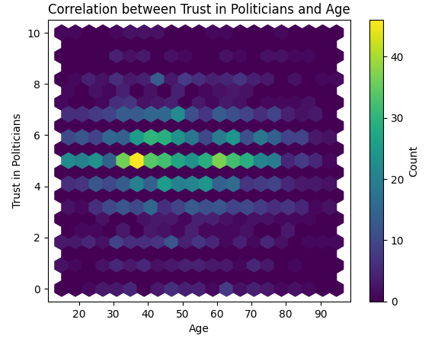
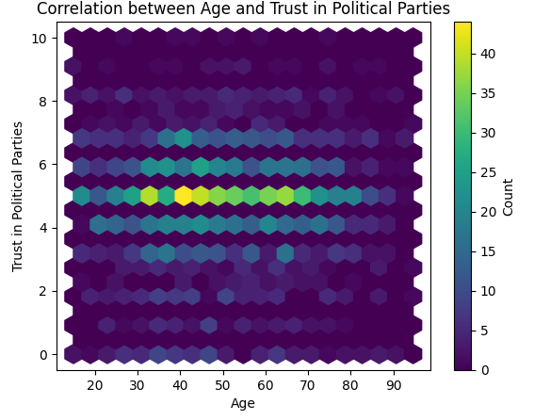
Does age have any correlation with overall trust in the legal system in Switzerland?
Rank | Value 1 | Value 2 | R² Value | Commentary
1 | Satisfaction with Government | Age of Respondent | -0.03 | Very weak, negative correlation
2 | Trust in Legal System | Age of Respondent | -0.09 | Very weak, negative correlation
3 | Trust in Politicians | Age of Respondent | 0.03 | Very weak, positive correlation
4 | Trust in Political Parties | Age of Respondent | -0.05 | Very weak, negative correlation
Renee Perez

Slide 21
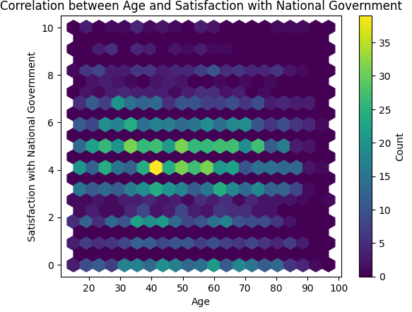
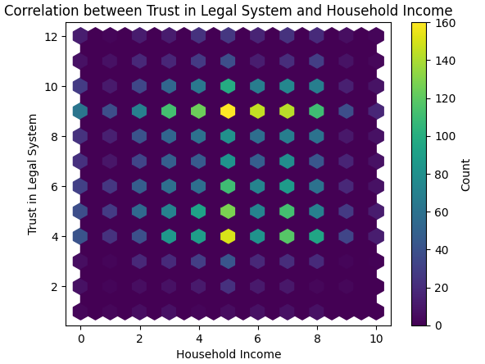
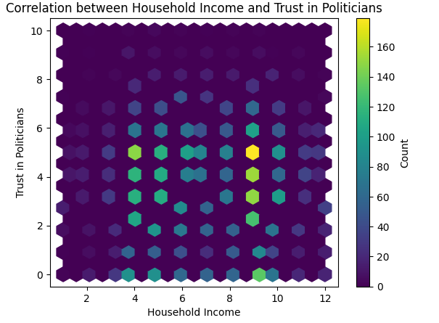
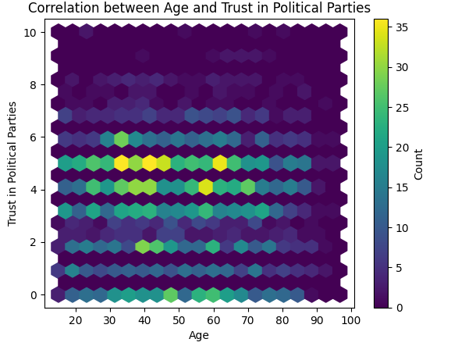
Does age have any correlation with overall trust in the legal system in United Kingdom?
Rank | Value 1 | Value 2 | R² Value | Commentary
1 | Satisfaction with Government | Age of Respondent | -0.08 | Weak, negative correlation
2 | Trust in Legal System | Age of Respondent | -0.02 | Weak, negative correlation
3 | Trust in Politicians | Age of Respondent | -0.04 | Weak, negative correlation
4 | Trust in Political Parties | Age of Respondent | -0.03 | Weak, negative correlation
Renee Perez

Slide 22
Age vs. Overall Trust in Government Summary
In summary and contrary to belief, there were no strong correlations between age of the respondent and their overall trust in the government and/or legal system.
This may be due to the fact that the government in Finland, Hungary and United Kingdom operates under a single authority. Although, Switzerland has a very democratic approach and still there were no correlations of note.
Renee Perez

Slide 23
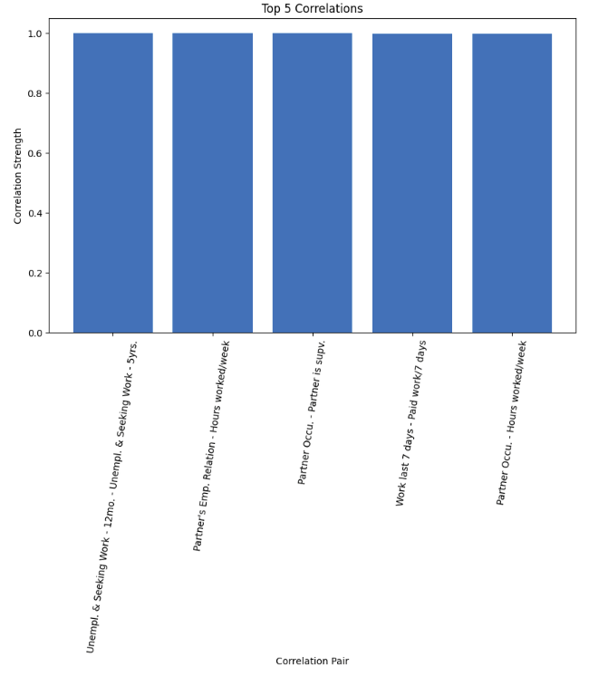
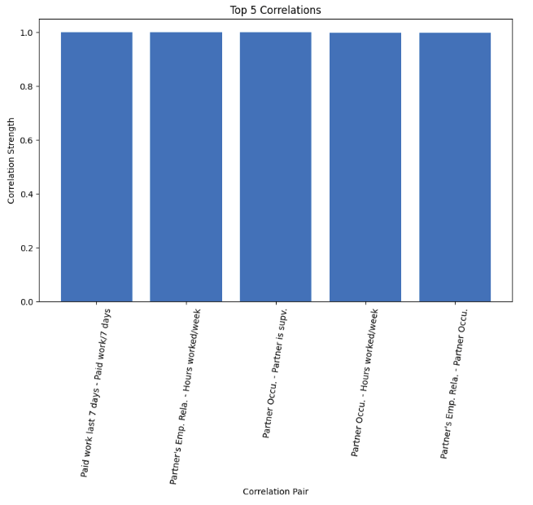
Were there any patterns in survey responses for each country? See below the top response correlations for each country:
United Kingdom
Finland
Renee Perez

Slide 24
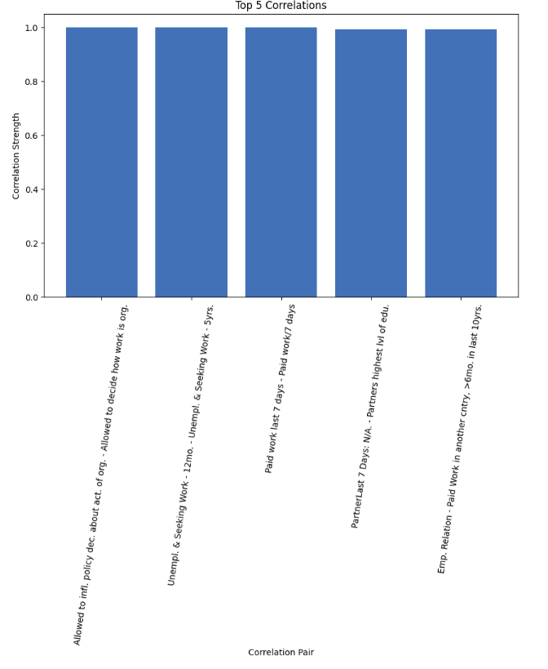
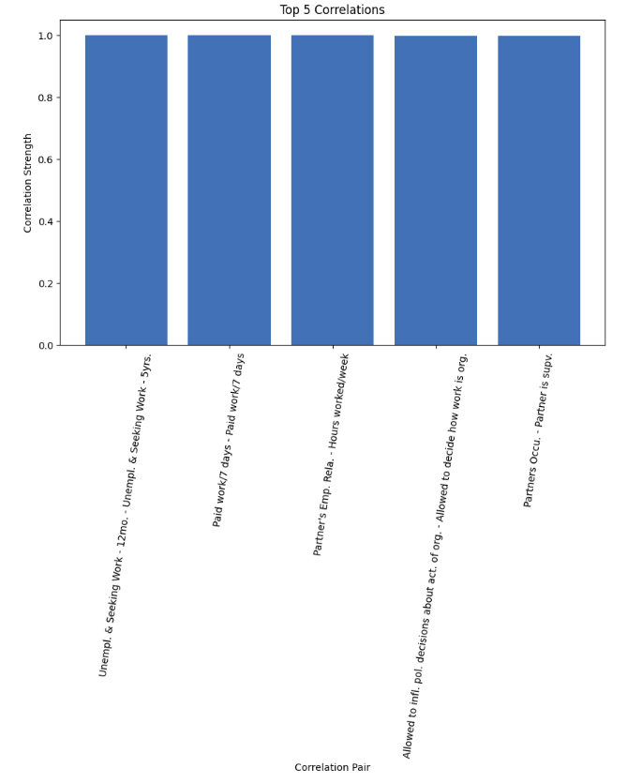
Were there any patterns in survey responses for each country? See below the top response correlations for each country:
Hungary
Switzerland
Renee Perez

Slide 25
Survey Response Patterns Summary
In summary, the most notable correlations were from Finland, Switzerland and the United Kingdom. The data shows that there was a strong correlation in responses stating that their partner's occupation included being responsible for supervising other employees. The other correlations, although similar in significance, did not represent any substantial information. For example, many of them responded that they worked in the last 7 days, and got paid for work in last 7 days.
Renee Perez

Slide 26
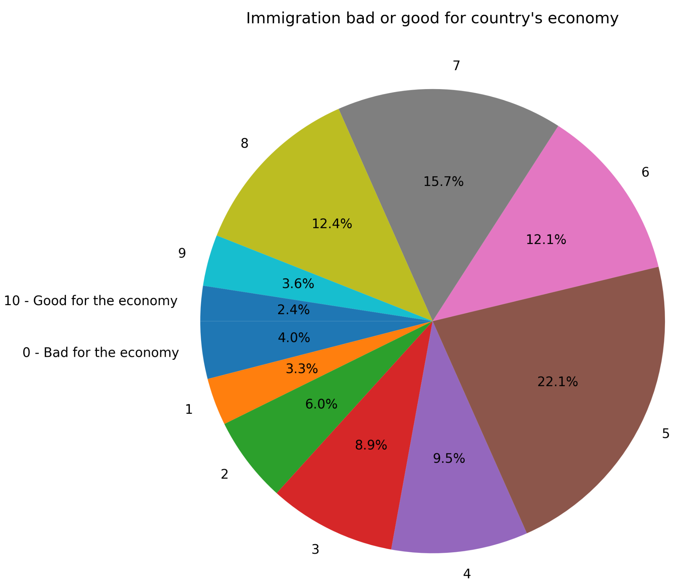
Views on Immigration
The one of final questions examined how social attitudes on immigration affect our four key variables. The question explored respondents' views on immigration and its impact on their respective countries' economies. Whether immigrants are beneficial or not to the overall economy is beyond the scope of this question. Instead, it should be recognized that the emotional investment, whether positive or negative, is central to our key variables.

Slide 27
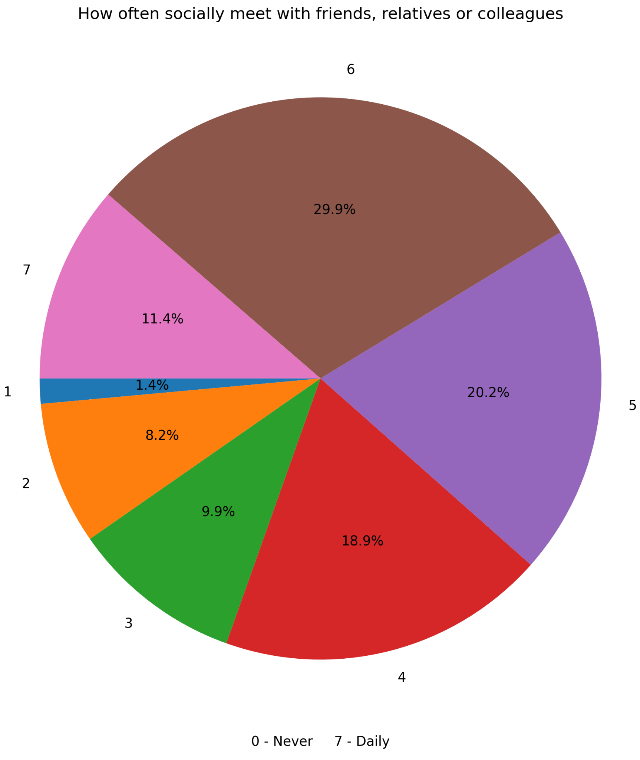
Social habits
The previous question examined the impact of sociability habits on four key variables. It considered the frequency with which individuals meet friends, relatives, or colleagues. Although the distribution of these interactions is unclear, an increase in isolation is often associated with negative outcomes. While sociability alone may not be the primary factor determining whether an individual develops a negative or positive perspective on these four key variables, the presence or absence of sociable interactions could itself be influenced by factors such as financial stability, access to communal spaces, or opportunities for socialization.

Slide 28
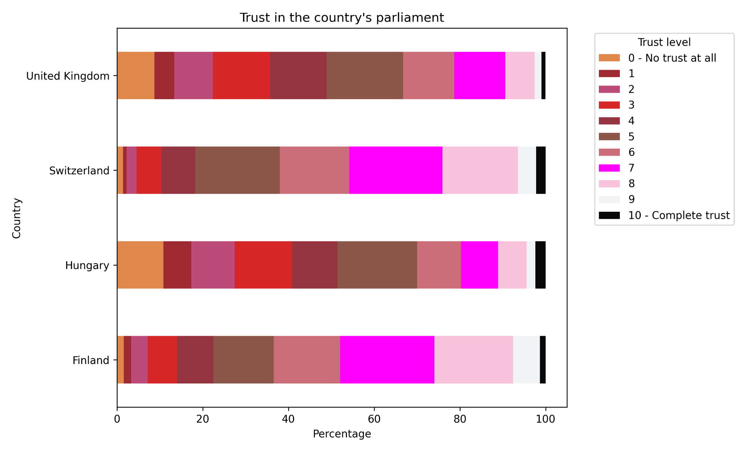
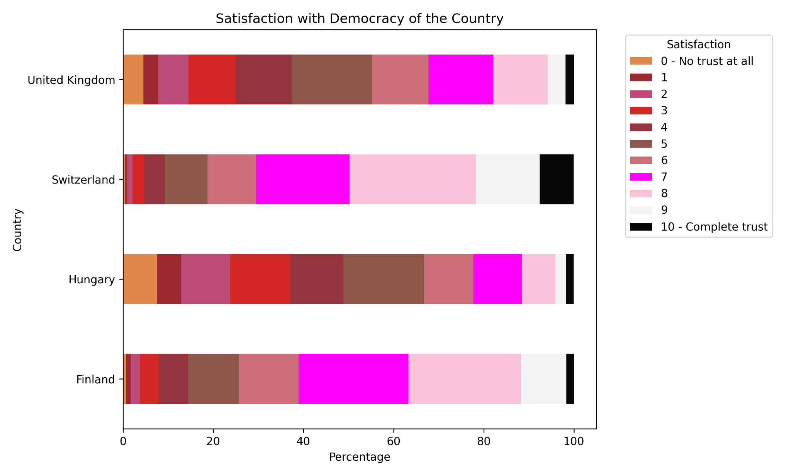
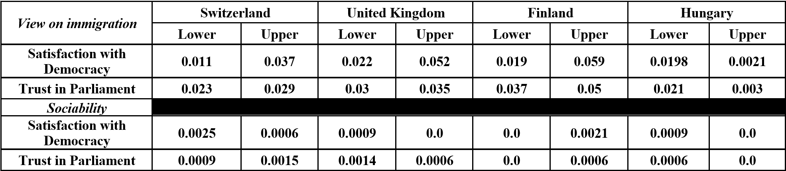
Satisfaction with Democracy & Trust in Parliament
The left shows the amalgamated views on satisfaction with democracy and views on parliament. ESS 1- 10 were used.

Slide 29
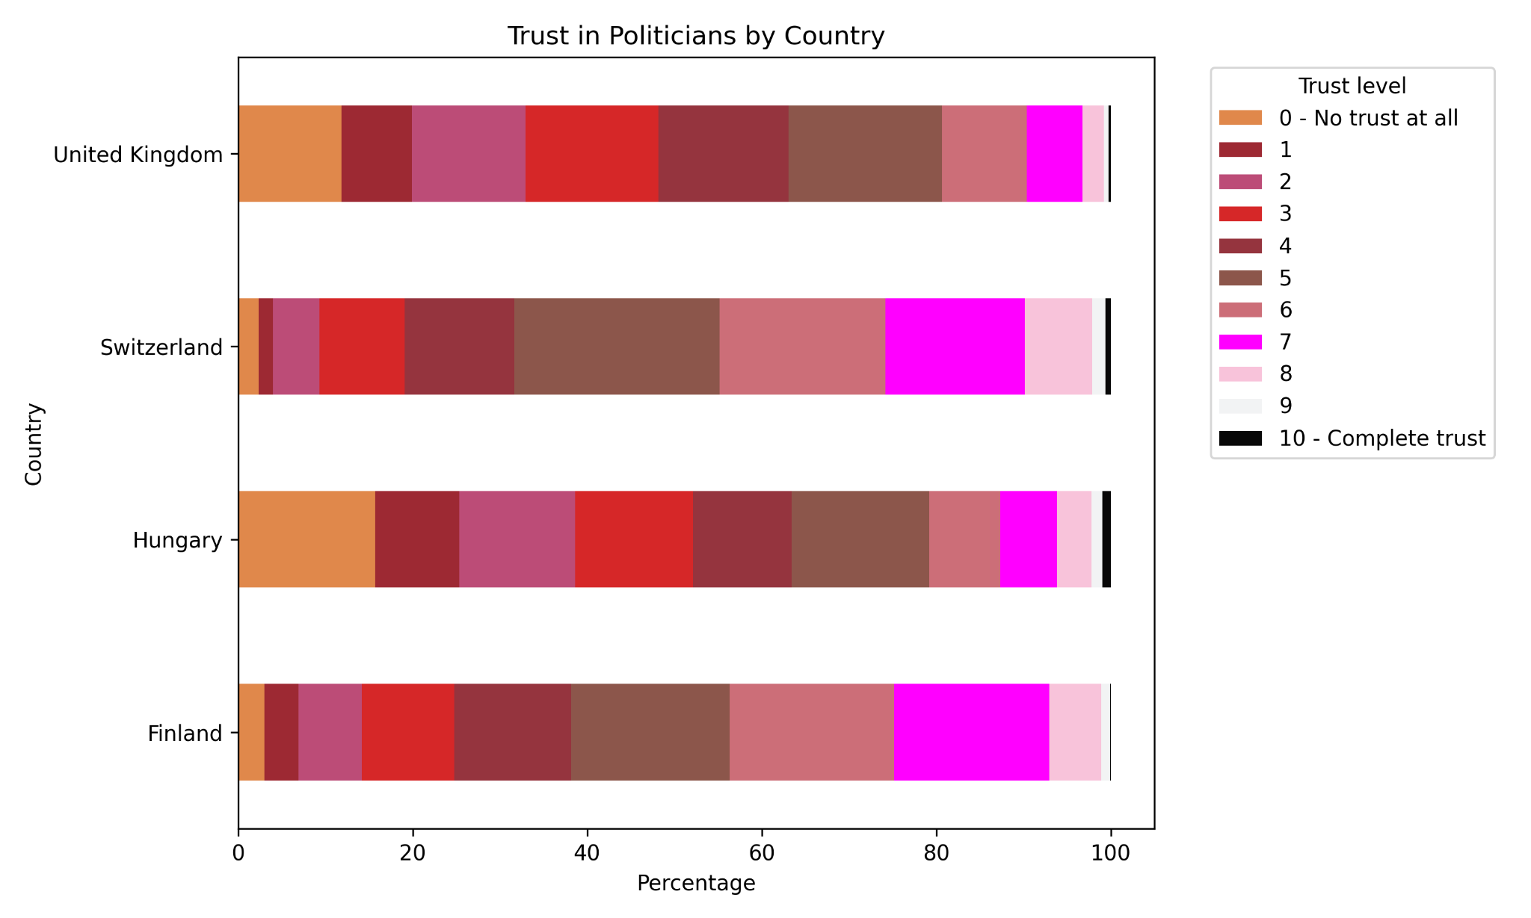
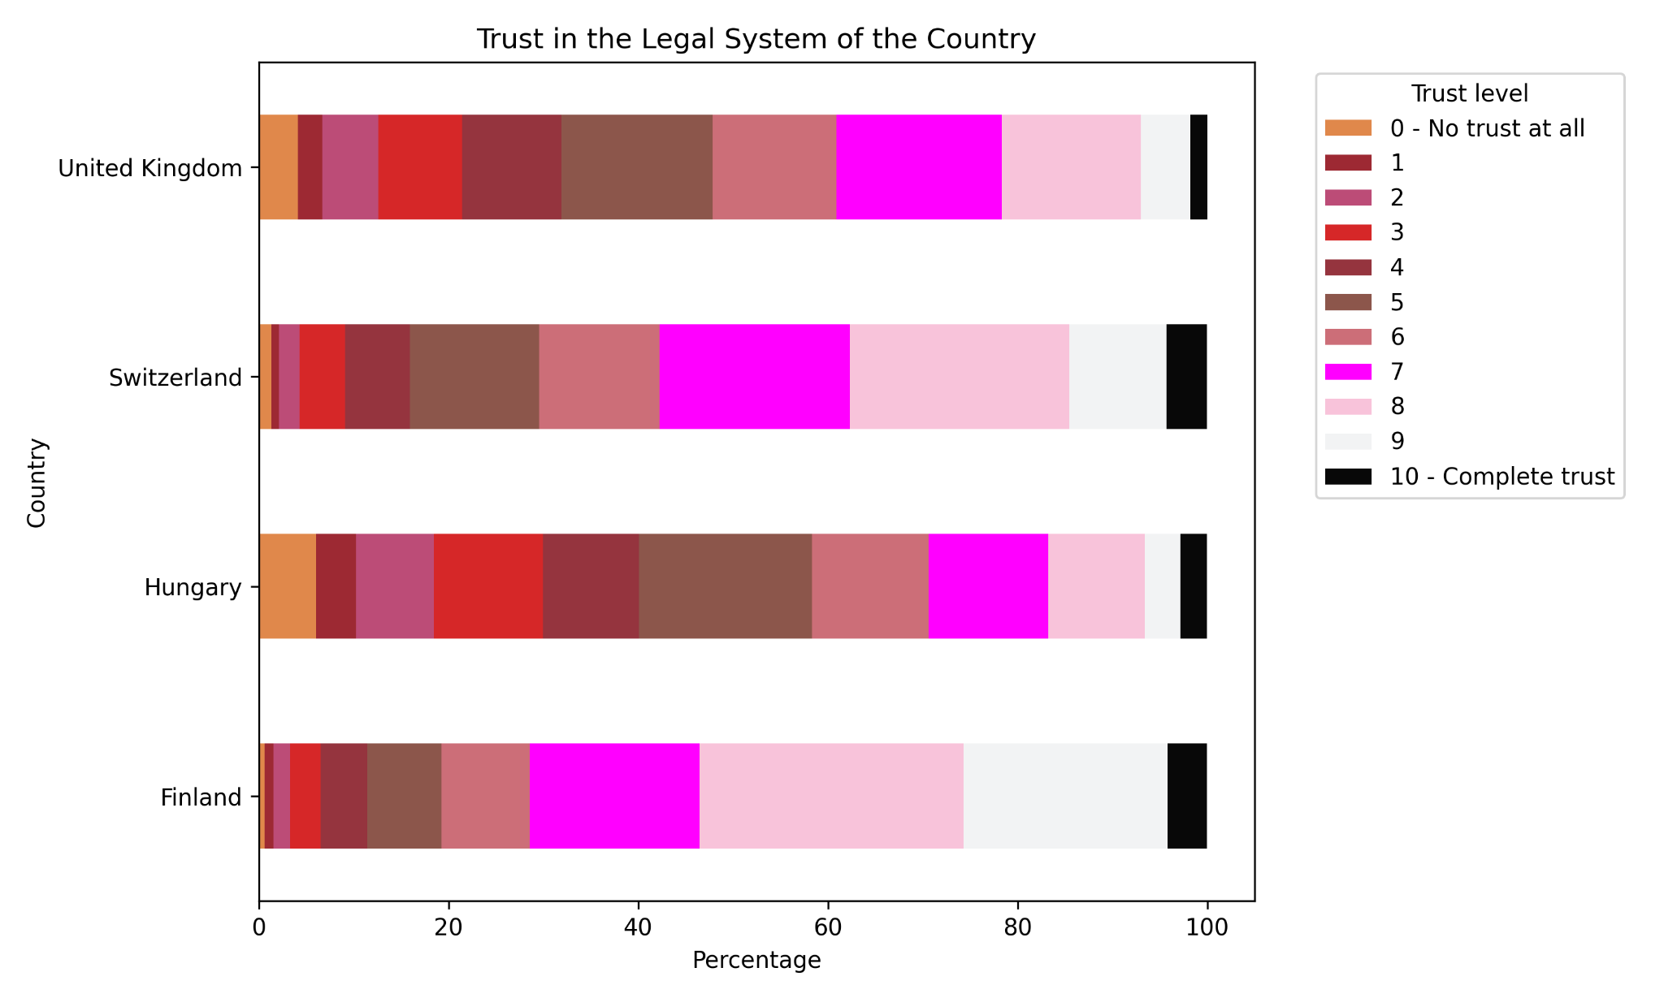
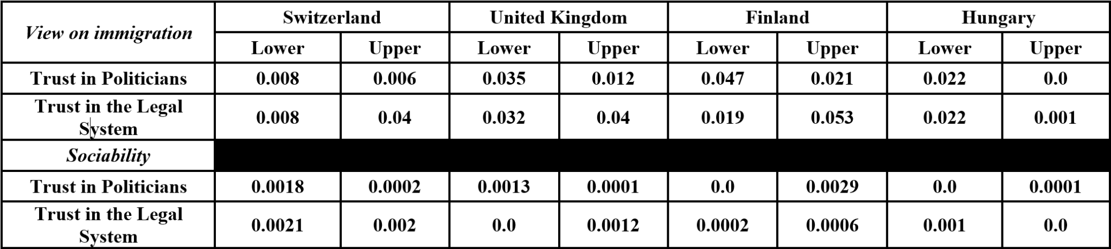
Trust in Politicians & Trust in the Legal system
The left shows the amalgamated views on Politicians and the legal system. ESS 1- 10 were used.
The sample included over 40K individual across four countries.

Slide 30
GitHub Link
Link to Project through GitHub:
https://github.com/melmelmorales/team_one

