Slide 1
Grooming
Backlog grooming is a recurring event for agile product development teams. The primary purpose of a backlog grooming session is to ensure the next few sprints worth of user stories in the product backlog are prepared for sprint planning.
At the end of a backlog session, you should have a prioritized list of user stories. The work completed during these sessions will ultimately lead to a greater shared understanding and smoother, more efficient sprint planning meetings.

Slide 2
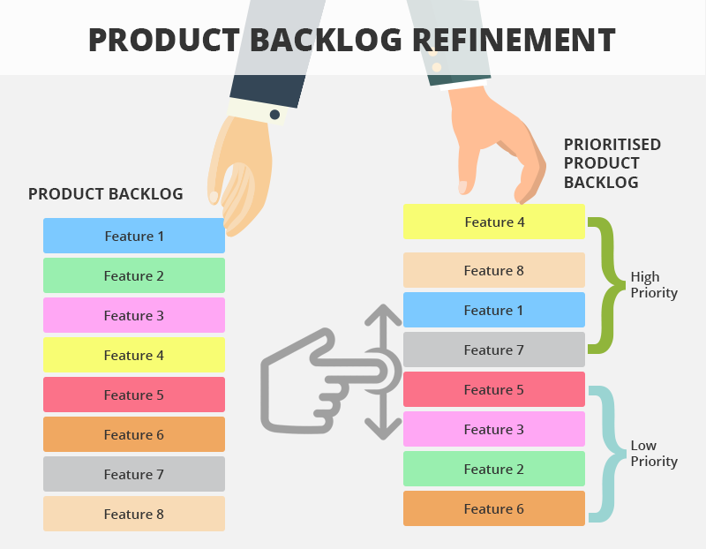

Slide 3
STORY POINT
Story points are a unit of measure for expressing an estimate of the overall effort that will be required to fully implement a product backlog item or any other piece of work
When we estimate with story points, we assign a point value to each item.
Story points rate the relative effort of work in a Fibonacci-like format: 1, 2, 3, 5, 8, 13, 20 …

Slide 4
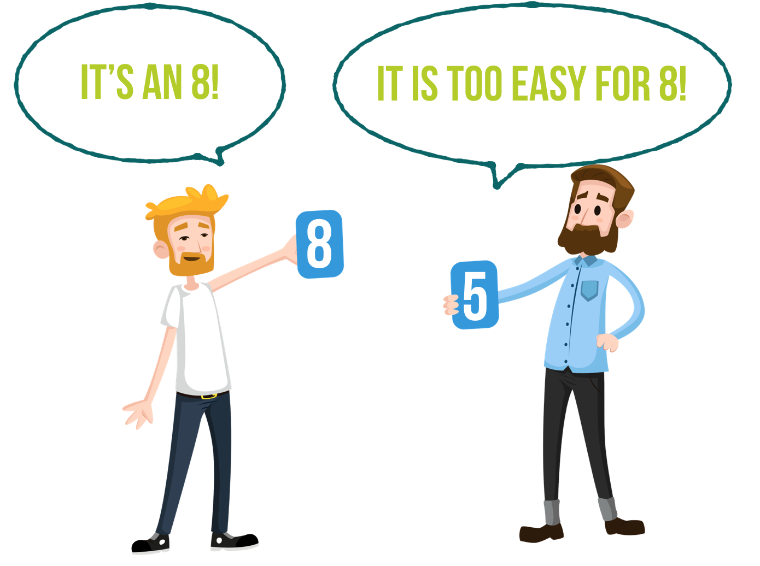
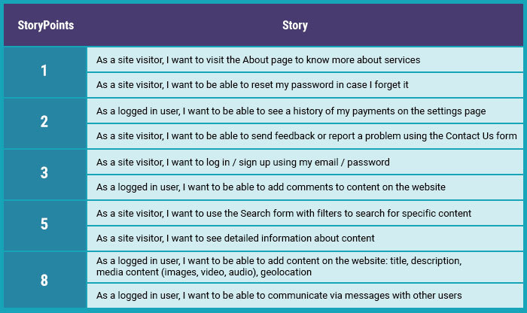
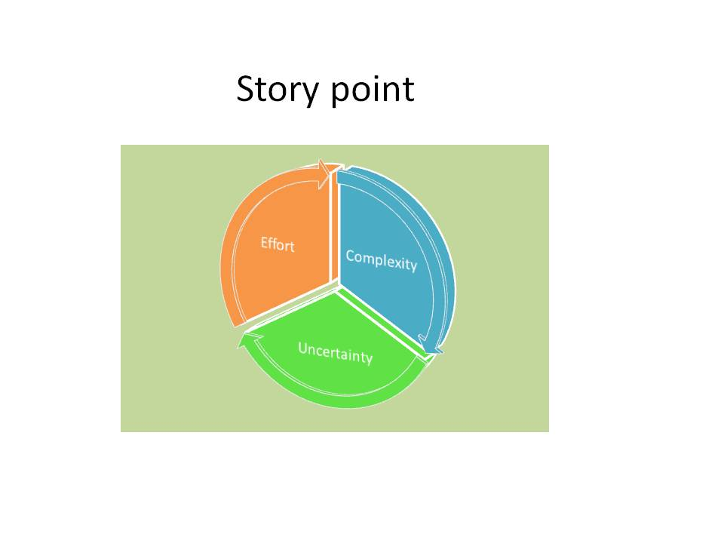

Slide 5
SPRINT PLANNING
Sprint planning is an event in scrum that kicks off the sprint. The purpose of sprint planning is to define what can be delivered in the sprint and how that work will be achieved. Sprint planning is done in collaboration with the whole scrum team
Sprint Planning answers the following:
What can be delivered in the Increment resulting from the upcoming Sprint?
How will the work needed to deliver the Increment be achieved?

Slide 6
