Slide 1
OpenClaw + Gemma 4 (Local on GTX 1050 Ti)
Melody Wang

Slide 2
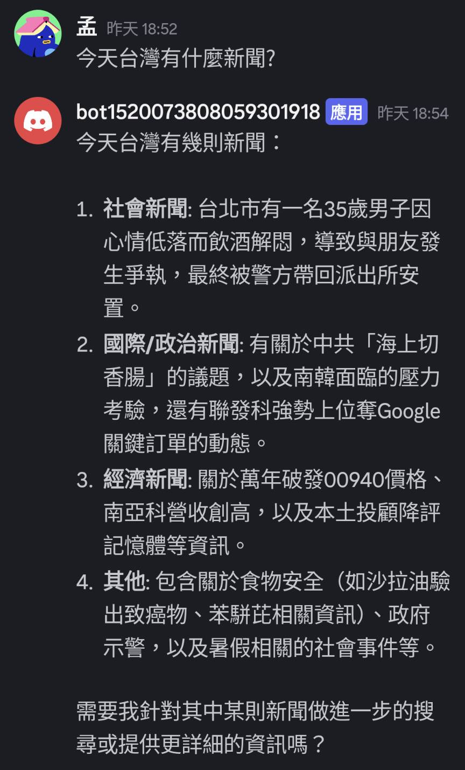
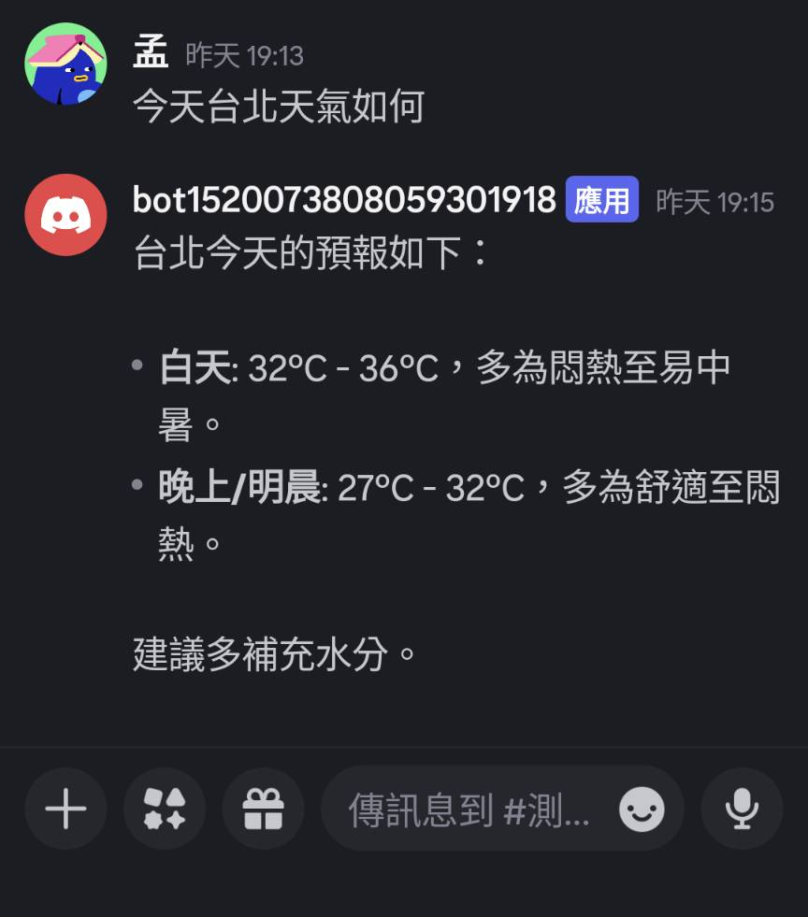

Slide 3
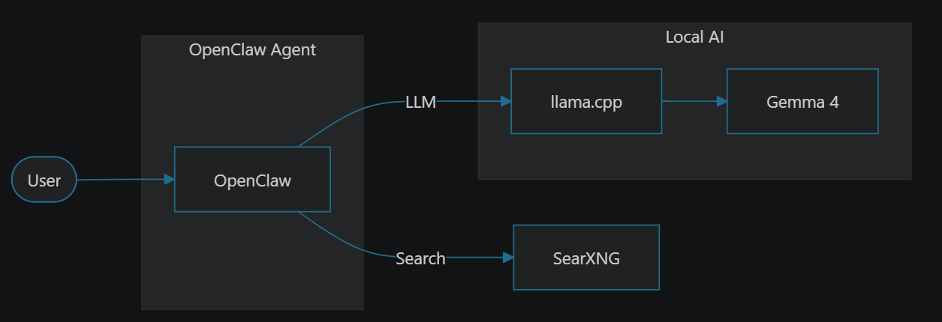
Architecture

Slide 4
Device Info
Windows WSL, Ubuntu 22.04
CPU: Intel(R) Core(TM) i5-8400 CPU @ 2.80GHz, 6 cores
RAM: 24 GB, 22GB for WSL
GPU: NVIDIA GeForce GTX 1050 Ti, 4GB VRAM
CUDA 12.6

Slide 5
Preparations - Environment
Windows and WSL
GPU driver on windows
Docker on WSL
WSL settings (firewall and memory)
Python uv on WSL
GPU for WSL (Optional, if LLM is run on WSL)
GPU driver on WSL
Cuda on WSL
NVIDIA Container Toolkit on WSL

Slide 6
Preparations - LLM
Download and build llama.cpp
Download LLM Gemma4 E2B (Why Gemma 4? More on this later.)
Run LLM by llama.cpp

Slide 7
Preparations - SearXNG
Download docker compose file and example .env
edit .env
start the service
Why SearXNG? Original using duckduckgo
Ideal: user request -> Agent -> web search -> titles and URLs -> web fetch specific URL -> response
Truth: user request -> Agent -> web search -> response
When the Agent(LLM) falls short, better tools matter more.

Slide 8
Preparations - Discord
Go to Discord Developer Portal, create bot
Copy bot token
Add bot into Discord server

Slide 9
OpenClaw Setup
Clone github repo
Setup openclaw by script
Setup SearXNG
docker exec -it openclaw-openclaw-gateway-1 bash
export SEARXNG_BASE_URL="http://<your self-hosted SearXNG IP>:<port>"
openclaw configure --section web
openclaw plugins install @openclaw/searxng-plugin
openclaw plugins list # check if searxng in list
exit
docker compose restart

Slide 10
OpenClaw Connect to Discord
Turn on Developer Mode
Check Discord server Id
Edit ~/.openclaw/openclaw.json
{
"channels": {
"discord": {
"enabled": true,
"token": "<discord token>",
"groupPolicy": "allowlist",
"guilds": {
"<discord server id>": {
"requireMention": false,
"slug": "my-server"
}
}
}
}
}

Slide 11
LLM Parameters and Comparison
Model | Quantization | KV cache | Result
Qwen 3.6 35B A3B | Q1 | f16 | Reply slowly
 | Q4 | f16 | Reply slowly
Gemma4 E2B | Q4 | q8_0 | Answer quality is low
 | Q4 | f16 | Correctly handle request 6.48 t/s (pure chat test on llama.cpp: 1. ask hello, 2. introduce algorithm)
Gemma4 E2B MTP | Q4 | f16 | Correctly handle request 16.93 t/s (pure chat test on llama.cpp: 1. ask hello, 2. introduce algorithm)
Gemma4 E4B QAT | Q2 | f16 | Incorrect response when hello
Qwen 3.5 2B | BF16 | f16 | Failed to call web search tool

Slide 12
Summary
With the same parameter scale, dense models perform better than MoE models in agent tasks.
KV cache precision affects agent performance; FP16 performs better than Q8_0 or Q4_0 quantization.
MTP models generate faster than non-MTP models. However, they only support one request at a time, making them suitable for single-user LLM scenarios.

Slide 13
References
OpenClaw github repo
huggingface unsloth/gemma-4-E2B-it-GGUF
huggingface unsloth/gemma-4-E2B-it-GGUF MTP
SearXNG installation

