Slide 1
Qwen3.6 35B A3B on 1050ti
Melody Wang

Slide 2
Device Info
Windows WSL, Ubuntu 22.04
CPU: Intel(R) Core(TM) i5-8400 CPU @ 2.80GHz, 6 cores
RAM: 24 GB, 22GB for WSL
GPU: NVIDIA GeForce GTX 1050 Ti, 4GB VRAM
CUDA 12.6

Slide 3
Preparations
GPU driver on windows
GPU driver on WSL
Cuda on WSL
Docker on WSL
NVIDIA Container Toolkit on WSL
Python uv on WSL
WSL settings (firewall and memory)

Slide 4
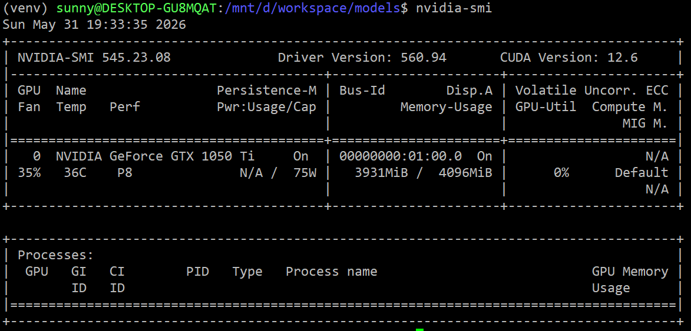

Slide 5
Setup Python uv Environment
uv venv --python 3.12
source .venv/bin/activate
pip install huggingface_hub

Slide 6
Download Model
mkdir -p unsloth/Qwen3.6-35B-A3B-GGUF
nohup hf download unsloth/Qwen3.6-35B-A3B-GGUF --include "Qwen3.6-35B-A3B-UD-IQ1_M.gguf" --local-dir unsloth/Qwen3.6-35B-A3B-GGUF &
nohup hf download unsloth/Qwen3.6-35B-A3B-GGUF --include "mmproj-F16.gguf" --local-dir unsloth/Qwen3.6-35B-A3B-GGUF &

Slide 7
Check CUDA Architecture
docker pull pytorch/pytorch:2.6.0-cuda12.4-cudnn9-devel
docker run --gpus all -it pytorch/pytorch:2.6.0-cuda12.4-cudnn9-devel bash
python3 -c "import torch; print(torch.cuda.get_device_capability())"
(6, 1)
exit

Slide 8
llama.cpp Turbo Quant Clone
git clone https://github.com/TheTom/llama-cpp-turboquant.git
cd llama-cpp-turboquant
git checkout feature/turboquant-kv-cache

Slide 9
llama.cpp Turbo Quant Building
# in .devops/cuda.Dockerfile
# modify Ubuntu to 22.04, CUDA 12.3.2, gcc12
docker build --build-arg CUDA_DOCKER_ARCH=61 -t local/llama.cpp:server-cuda-12.3-20260531-turboquant --target server -f .devops/cuda.Dockerfile .

Slide 10
Run Model by llama.cpp Docker
docker run -d \
--name llama-cpp-qwen3.6-35b-a3b --gpus all -v /mnt/d/workspace/models:/models -p 11436:11436 \
local/llama.cpp:server-cuda-12.3-20260531-turboquant \
-m /models/unsloth/Qwen3.6-35B-A3B-GGUF/Qwen3.6-35B-A3B-UD-IQ1_M.gguf --mmproj /models/unsloth/Qwen3.6-35B-A3B-GGUF/mmproj-F16.gguf \
--cache-type-k q8_0 --cache-type-v turbo3 \
--ctx-size 262144 --batch-size 512 --ubatch-size 256 --flash-attn on \
--port 11436 \
--host 0.0.0.0 \
--reasoning-budget 0 --reasoning-format none --chat-template-kwargs '{"enable_thinking": false}' \
--no-mmap \
--n-cpu-moe 41

Slide 11
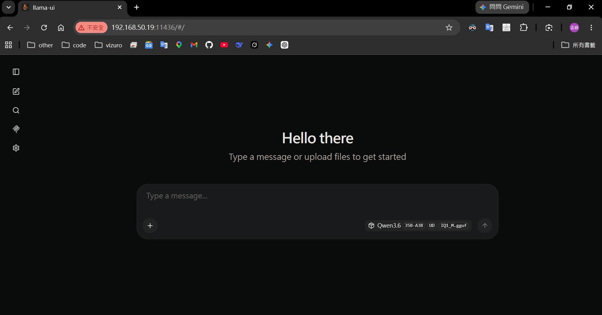

Slide 12
Parameters Comparison
Model type | TTFT | Tokens per second
Qwen 3.6 35B A3B | 0.9 s | 11.75 t/s
Qwen 3.6 35B A3B MTP | 2.2 s | 7.49 t/s
Qwen 3.6 35B A3B Turbo Quant | 0.8 s | 11.18 t/s
Memory:
GPU VRAM 3.2 ~ 3.5 GB
CPU RAM: 8.5 ~ 9.8 GB

Slide 13
References
設定讓外部主機可連上 WSL 內的服務(Port Forwarding)
神人成功在 GTX 1060 6GB 上順跑 Qwen 3.6 35B A3B 模型，只需加入這五個參數
Running a 35B AI Model on 6GB VRAM, FAST (llama.cpp Guide)
unsloth/Qwen3.6-35B-A3B-GGUF

