Slide 1
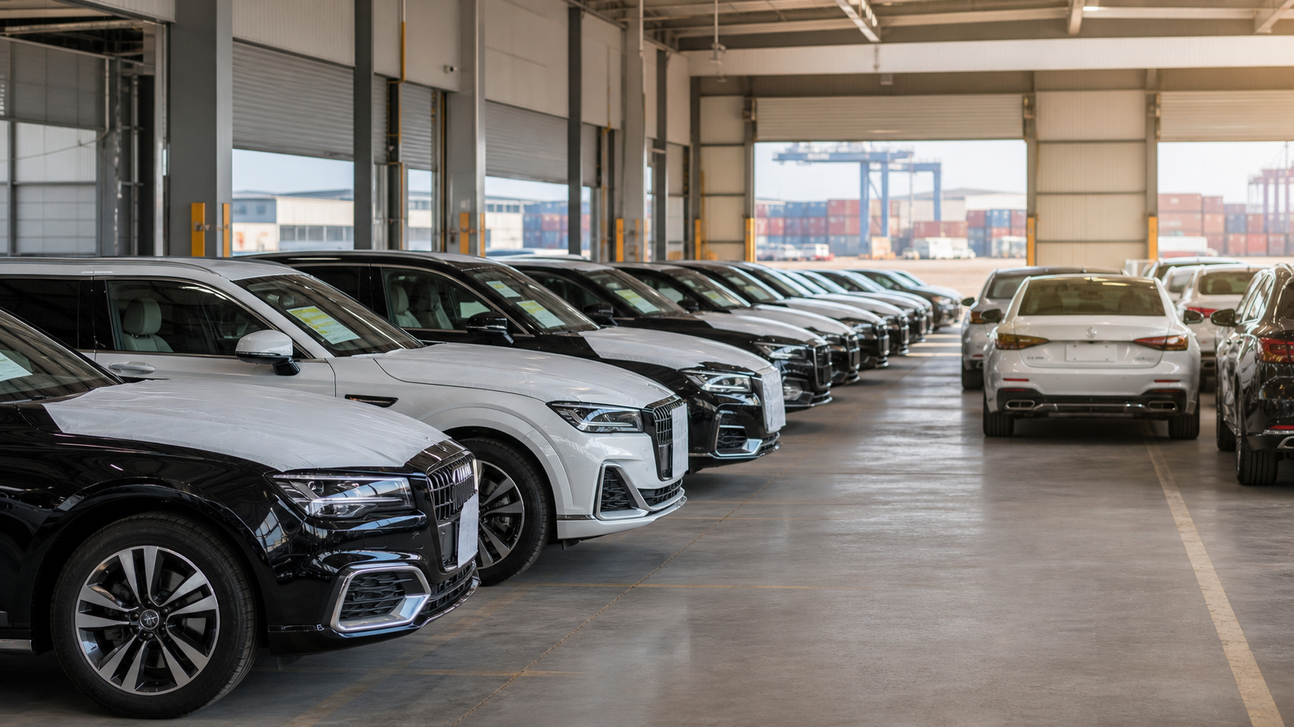

Worlda Global Auto
Vehicle Stock Ready for Export
Available units prepared for overseas buyers.
WhatsApp: +86 13810710061

Slide 2
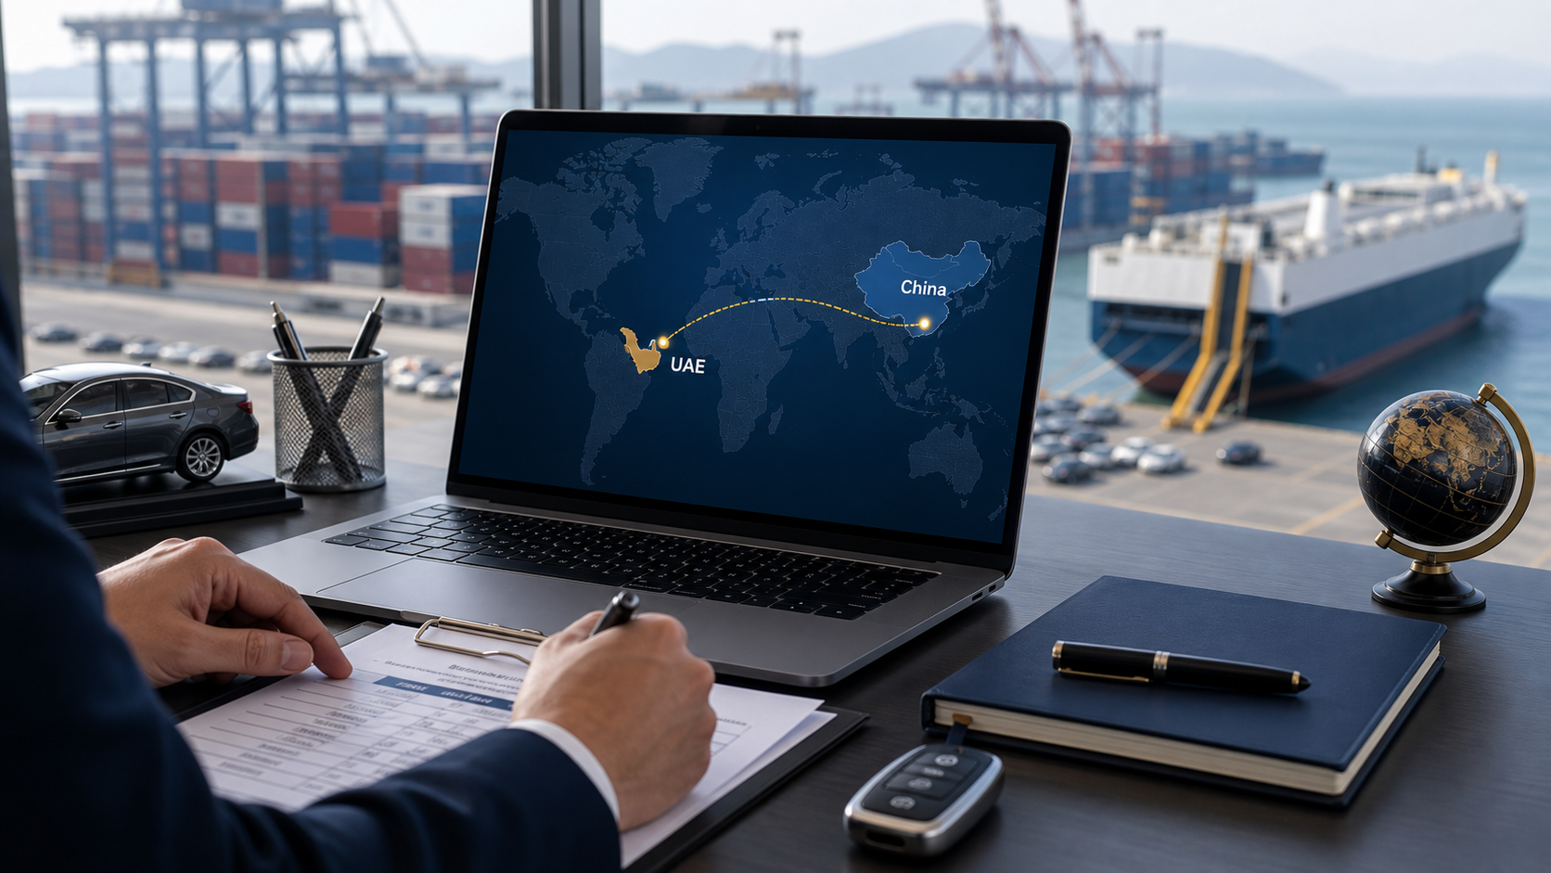
Worlda Global Auto
Destination: United Arab Emirates
Route planning by destination country and port.
WhatsApp: +86 13810710061

Slide 3
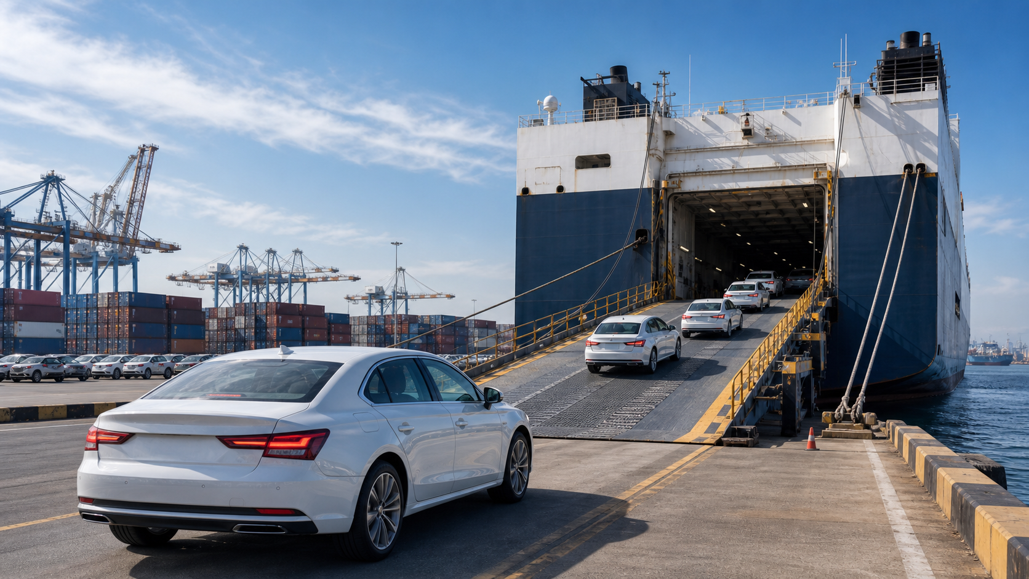
Worlda Global Auto
Port Loading and Shipment Coordination
Sea freight and loading schedule arranged in advance.
WhatsApp: +86 13810710061

Slide 4

Worlda Global Auto
Export Documents Checked Before Shipment
Invoice, packing list, COC and export declaration reviewed.
WhatsApp: +86 13810710061

Slide 5
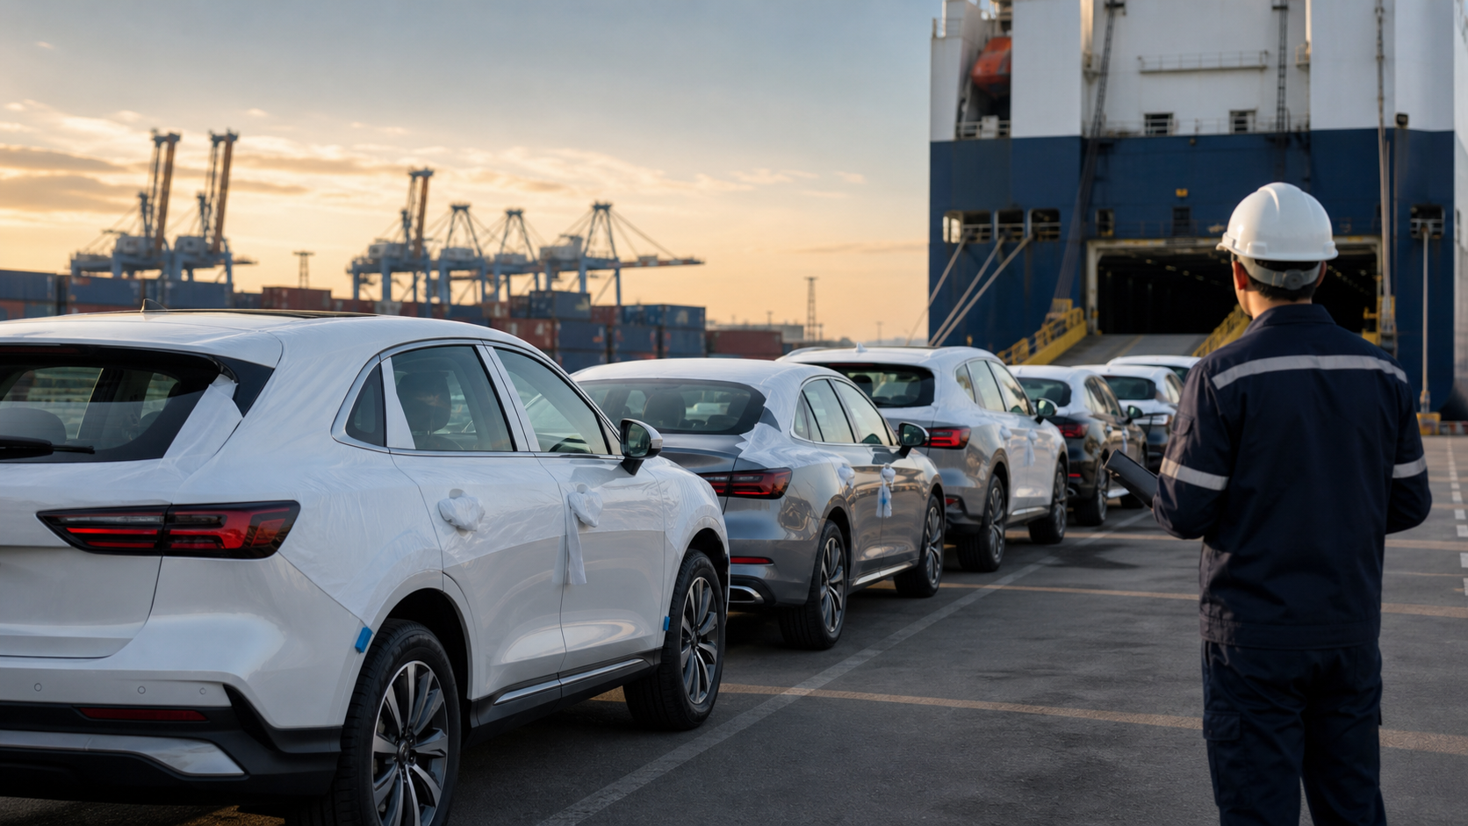
Worlda Global Auto
Vehicles Ready for Global Shipment
Clear export plan before order execution.
WhatsApp: +86 13810710061

