Slide 1
Artificial Neural Networks
Inductive Learning

Slide 2
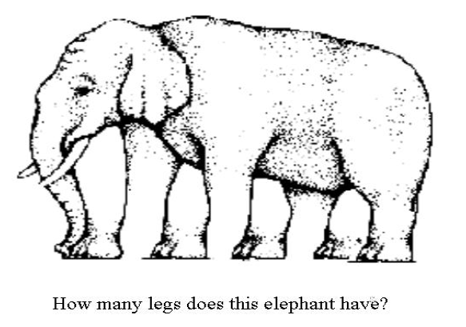

Do we want computer to get confused?
Where can neural network systems help?
• where we can't formulate an algorithmic solution.
• where we can get lots of examples of the behavior we require.
• where we need to pick out the structure from existing data.

Slide 3
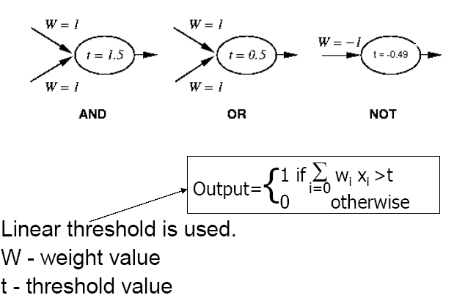
Artificial neural networks

Slide 4
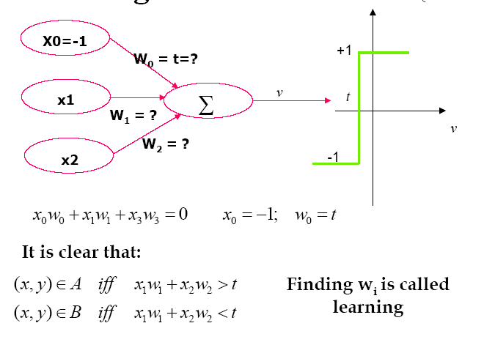
Simple Learning in ANN

Slide 5
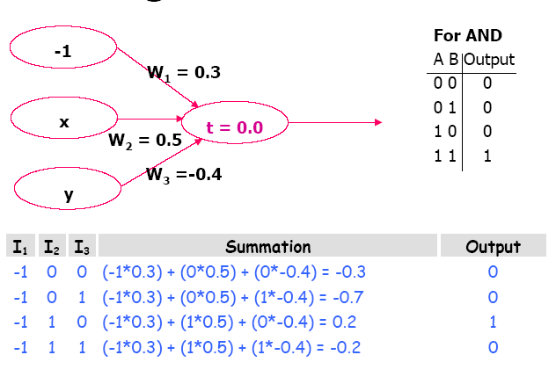
Training in ANN

Slide 6
Notation for ANN
Epoch
Presentation of the entire training set to the neural network (for and [0,0], [0,1],[1,0],[1,1]
Error
The error value is the amount by which the value output by the network differs from the target value. For example if we required the network to output 0 and it out a 1 then the error = -1

Slide 7
Notation for ANN
Target value: When training the net is required to provide with the desired output as well as input. In case of AND function the target value will be 1 for [1,1]
Output (y): The output value from the neuron
I_{i}: Inputs being presented to the neuron
w_{j}: Weight from the input neuron to the output neuron
LR: The learning rate. This dictates how quickly the network converge. It is set by a matter of experimentation. It is typically 0.1.

Slide 8
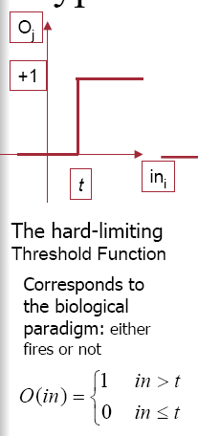
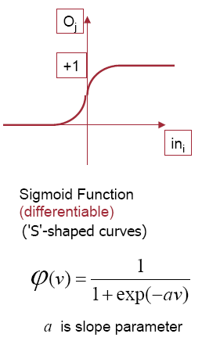
Activation Function

Slide 9
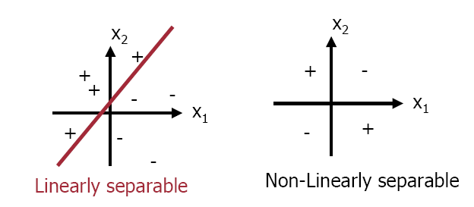
Decision Boundary
Divide feature space by drawing a hyper-plane across it.

Slide 10
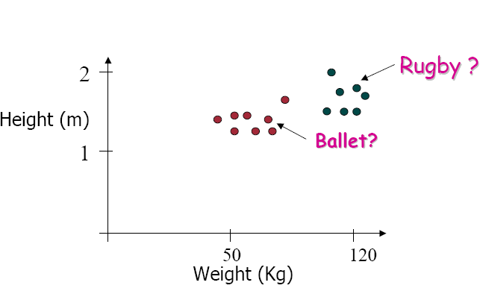
Decision Boundary

Slide 11
Learning Steps
Learn values of weights from I/O pair
Start with random weight
Load training example input
Observe computed output
Modify weights to reduce difference
Iterate over all training example
Terminate when weights stops changing OR when error is very small (approx zero)

Slide 12
Learning Algorithm
While epoch produces an error
present network with next inputs from epoch
Error = T – O
If Error <> 0 then
W_{j} = W_{j} + LR * I_{j} * Error
End if
End While

Slide 13
Learning Algorithm Example
To Learn AND.
Given that initial weight 0,0.4, threshold =0.3, Learning rate=0.25,
W_{j} = W_{j} + LR * I_{j} * Error
w₁ | w₂ | θ | x₁ | x₂ | Σ w_{i}x_{i} | y | t | ∆w₁ | ∆w₂
0.0 | 0.4 | 0.3 | 0 | 0 | 0 | 0 | 0 | 0 | 0

Slide 14
Learning Algorithm Example
W_{j} = W_{j} + LR * I_{j} * Error
To Learn AND.
Given that initial weight 0,0.4, threshold =0.3, Learning rate=0.25,
w₁ | w₂ | θ | x₁ | x₂ | Σ w_{i}x_{i} | y | t | ∆w₁ | ∆w₂
0.0 | 0.4 | 0.3 | 0 | 0 | 0 | 0 | 0 | 0 | 0
0.0 | 0.4 | 0.3 | 0 | 1 | 0.4 | 1 | 0 | 0 | -0.25

Slide 15
Learning Algorithm Example
To Learn AND.
Given that initial weight 0,0.4, threshold =0.3, Learning rate=0.25,
W_{j} = W_{j} + LR * I_{j} * Error
w₁ | w₂ | θ | x₁ | x₂ | Σ w_{i}x_{i} | y | t | ∆w₁ | ∆w₂
0.0 | 0.4 | 0.3 | 0 | 0 | 0 | 0 | 0 | 0 | 0
0.0 | 0.4 | 0.3 | 0 | 1 | 0.4 | 1 | 0 | 0 | -0.25
0.0 | 0.15 | 0.3 | 1 | 0 | 0 | 0 | 0 | 0 | 0

Slide 16
Learning Algorithm Example
To Learn AND.
Given that initial weight 0,0.4, threshold =0.3, Learning rate=0.25,
W_{j} = W_{j} + LR * I_{j} * Error
w₁ | w₂ | θ | x₁ | x₂ | Σ w_{i}x_{i} | y | t | ∆w₁ | ∆w₂
0.0 | 0.4 | 0.3 | 0 | 0 | 0 | 0 | 0 | 0 | 0
0.0 | 0.4 | 0.3 | 0 | 1 | 0.4 | 1 | 0 | 0 | -0.25
0.0 | 0.15 | 0.3 | 1 | 0 | 0 | 0 | 0 | 0 | 0
0.0 | 0.15 | 0.3 | 1 | 1 | 0.15 | 0 | 1 | 0.25 | 0.25

Slide 17
Learning Algorithm Example
To Learn AND.
Given that initial weight 0,0.4, threshold =0.3, Learning rate=0.25,
W_{j} = W_{j} + LR * I_{j} * Error
w₁ | w₂ | θ | x₁ | x₂ | Σ w_{i}x_{i} | y | t | ∆w₁ | ∆w₂
0.0 | 0.4 | 0.3 | 0 | 0 | 0 | 0 | 0 | 0 | 0
0.0 | 0.4 | 0.3 | 0 | 1 | 0.4 | 1 | 0 | 0 | -0.25
0.0 | 0.15 | 0.3 | 1 | 0 | 0 | 0 | 0 | 0 | 0
0.0 | 0.15 | 0.3 | 1 | 1 | 0.15 | 0 | 1 | 0.25 | 0.25
w₁ | w₂ | θ | x₁ | x₂ | Σ w_{i}x_{i} | y | t | ∆w₁ | ∆w₂
0.25 | 0.4 | 0.3 | 0 | 0 | 0 | 0 | 0 | 0 | 0

Slide 18
Learning Algorithm Example
To Learn AND.
Given that initial weight 0,0.4, threshold =0.3, Learning rate=0.25,
W_{j} = W_{j} + LR * I_{j} * Error
w₁ | w₂ | θ | x₁ | x₂ | Σ w_{i}x_{i} | y | t | ∆w₁ | ∆w₂
0.0 | 0.4 | 0.3 | 0 | 0 | 0 | 0 | 0 | 0 | 0
0.0 | 0.4 | 0.3 | 0 | 1 | 0.4 | 1 | 0 | 0 | -0.25
0.0 | 0.15 | 0.3 | 1 | 0 | 0 | 0 | 0 | 0 | 0
0.0 | 0.15 | 0.3 | 1 | 1 | 0.15 | 0 | 1 | 0.25 | 0.25
w₁ | w₂ | θ | x₁ | x₂ | Σ w_{i}x_{i} | y | t | ∆w₁ | ∆w₂
0.25 | 0.4 | 0.3 | 0 | 0 | 0 | 0 | 0 | 0 | 0
0.25 | 0.4 | 0.3 | 0 | 1 | 0.4 | 1 | 0 | 0 | -0.25

Slide 19
Learning Algorithm Example
To Learn AND.
Given that initial weight 0,0.4, threshold =0.3, Learning rate=0.25,
W_{j} = W_{j} + LR * I_{j} * Error
w₁ | w₂ | θ | x₁ | x₂ | Σ w_{i}x_{i} | y | t | ∆w₁ | ∆w₂
0.0 | 0.4 | 0.3 | 0 | 0 | 0 | 0 | 0 | 0 | 0
0.0 | 0.4 | 0.3 | 0 | 1 | 0.4 | 1 | 0 | 0 | -0.25
0.0 | 0.15 | 0.3 | 1 | 0 | 0 | 0 | 0 | 0 | 0
0.0 | 0.15 | 0.3 | 1 | 1 | 0.15 | 0 | 1 | 0.25 | 0.25
w₁ | w₂ | θ | x₁ | x₂ | Σ w_{i}x_{i} | y | t | ∆w₁ | ∆w₂
0.25 | 0.4 | 0.3 | 0 | 0 | 0 | 0 | 0 | 0 | 0
0.25 | 0.4 | 0.3 | 0 | 1 | 0.4 | 1 | 0 | 0 | -0.25
0.25 | 0.15 | 0.3 | 1 | 0 | 0.25 | 0 | 0 | 0 | 0

Slide 20
Learning Algorithm Example
To Learn AND.
Given that initial weight 0,0.4, threshold =0.3, Learning rate=0.25,
W_{j} = W_{j} + LR * I_{j} * Error
w₁ | w₂ | θ | x₁ | x₂ | Σ w_{i}x_{i} | y | t | ∆w₁ | ∆w₂
0.0 | 0.4 | 0.3 | 0 | 0 | 0 | 0 | 0 | 0 | 0
0.0 | 0.4 | 0.3 | 0 | 1 | 0.4 | 1 | 0 | 0 | -0.25
0.0 | 0.15 | 0.3 | 1 | 0 | 0 | 0 | 0 | 0 | 0
0.0 | 0.15 | 0.3 | 1 | 1 | 0.15 | 0 | 1 | 0.25 | 0.25
w₁ | w₂ | θ | x₁ | x₂ | Σ w_{i}x_{i} | y | t | ∆w₁ | ∆w₂
0.25 | 0.4 | 0.3 | 0 | 0 | 0 | 0 | 0 | 0 | 0
0.25 | 0.4 | 0.3 | 0 | 1 | 0.4 | 1 | 0 | 0 | -0.25
0.25 | 0.15 | 0.3 | 1 | 0 | 0.25 | 0 | 0 | 0 | 0
0.25 | 0.15 | 0.3 | 1 | 1 | 0.4 | 1 | 1 | 0 | 0

Slide 21
Learning Algorithm Example
To Learn AND.
Given that initial weight 0,0.4, threshold =0.3, Learning rate=0.25,
W_{j} = W_{j} + LR * I_{j} * Error
w₁ | w₂ | θ | x₁ | x₂ | Σ w_{i}x_{i} | y | t | ∆w₁ | ∆w₂
0.0 | 0.4 | 0.3 | 0 | 0 | 0 | 0 | 0 | 0 | 0
0.0 | 0.4 | 0.3 | 0 | 1 | 0.4 | 1 | 0 | 0 | -0.25
0.0 | 0.15 | 0.3 | 1 | 0 | 0 | 0 | 0 | 0 | 0
0.0 | 0.15 | 0.3 | 1 | 1 | 0.15 | 0 | 1 | 0.25 | 0.25
w₁ | w₂ | θ | x₁ | x₂ | Σ w_{i}x_{i} | y | t | ∆w₁ | ∆w₂
0.25 | 0.4 | 0.3 | 0 | 0 | 0 | 0 | 0 | 0 | 0
0.25 | 0.4 | 0.3 | 0 | 1 | 0.4 | 1 | 0 | 0 | -0.25
0.25 | 0.15 | 0.3 | 1 | 0 | 0.25 | 0 | 0 | 0 | 0
0.25 | 0.15 | 0.3 | 1 | 1 | 0.4 | 1 | 1 | 0 | 0

Slide 22
Architechture
X_{i}
Z_{i}
V_{ij}
W_{ij}
Inputs
y_{i}
Output

Slide 23
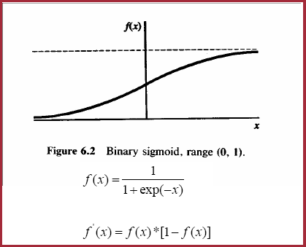
Activation Function

Slide 24
Algorithm
Step 1: Initialized weight
(set all to random values)
While stopping condition is false , do step 2-9
Step 2: For each training pair do step 3-8
Feedforward:
Step 3:
Each input unit (X_{i,} i=1,…….,n) receives input signal X_{i} and broadcast this signal to all units in the layer above (The hidden units).

Slide 25
Algorithm
Step 4: Each hidden unit (Z_{j} , j=1,…..,p) sums its weighted input signals
applies its activation function to compute its output signal
and sends this signal to all units in the layer above (output units).

Slide 26
Algorithm
Step 5: Each hidden unit (Y_{k} , k=1,…..,m) sums its weighted input signals
and applies its activation function to compute its output signal

Slide 27
Algorithm
Backpropagation of Error:
Step 6: Each output unit (Y_{k} , k=1,….,m) receives a target pattern corresponding to the input training pattern, computes its error information term,
Calculates its weight correction term (used to update w_{jk} later)
Calculates its bias correction term (used to update w_{ok} later)
and sends to units in the layer below
f(1-f) for sigmoid

Slide 28
Algorithm
Step 7: Each Hidden unit (Z_{j} , j=1,….,p ) sums its delta inputs (from units in the layer above),
Multiplied by the derivative of its activation function to calculate its error information term,
Calculates its weight correction term (used to update v_{ij} later)
And calculates its bias correction term (used to update v_{0j} later),

Slide 29
Algorithm
Update the weight and bias:
Step 8: each output unit (Y_{k} , k=1,….,m) updates its bias and weights (j=0,…..,p):
Each hidden unit (Z_{j} , j=1,…,p) updates its bias and weight (i=0,……,n):
Step 9: Test Stopping condition

Slide 30
Example (XOR)
X | Y | F
0 | 0 | 0
0 | 1 | 1
1 | 0 | 1
1 | 1 | 0

Slide 31
XOR Architecture
1
V₀₁
1
X₁
V₁₁
Z₁
∑
f
V₂₁
W₀₁
y_{i}
1
W₁₁
∑
f
Inputs
W₂₁
Output
V₀₂
Z₂
V₁₂
X₂
∑
f
V₂₂
X | Y | F
0 | 0 | 0
0 | 1 | 1
1 | 0 | 1
1 | 1 | 0

Slide 32
Example (XOR)
x₁ | x₂ | v₀₁ | v₁₁ | v₂₁ | v₀₂ | v₁₂ | v₂₂ | z₁ | z₂
0 | 0 | -0.3 | 0.21 | 0.15 | 0.25 | -0.40 | 0.1 | 0.43 | 0.56
0 | 1 | -.295 | 0.21 | 0.15 | 0.243 | -0.40 | 0.1
1 | 0
1 | 1
z₁ | z₂ | w₀₁ | w₁₁ | w₂₁ | y₁
0.43 | 0.56 | -0.4 | -0.2 | 0.3 | 0.42
 |  | -0.502 | -0.243 | 0.243

Slide 33
X | Y | F
0 | 0 | 0
0 | 1 | 1
1 | 0 | 1
1 | 1 | 0
Example (XOR)
z_{in1} = -.3(1) + .21(0) + .15(0) = -.3
z₁ = f(z_{in1}) = .43
z_{in2} = .25(1) -.4(0) + .1(0) = 0.25
z₂ = f(z_{in2}) = .56
y_{in1} = -.4(1) - .2(.43)+.3(.56) = -.318
y₁ = f(y_{in1})= 0.42

Slide 34
Example (XOR)
δ₁ = (t₁ – y₁ )f’(y_{in1} )
=(t₁ – y₁ )f(y_{in1} )[1- f(y_{in1} )]
δ₁ = (0 – .42).42[1-.42] = -0.102
ΔW₀₁ = -0.102x 1 = -0.102
ΔW₁₁ = -0.102x 0.43 = -0.04386
ΔW₂₁ = -0.102x 0.56 = -0.05712

Slide 35
Example (XOR)
δ_{in1} = δ₁ w₁₁ = -.102(-.2) = .02
δ₁ = δ_{in1} f’(z_{in1}) = .02(.43)(1-.43)= .005
δ_{in2} = δ₁ w₂₁ = -.102(.3) = -.03
δ₂ = δ_{in2} f’(z_{in2}) = -.03(.56)(1-.56)= -.007
Δv₀₁ = 0.005 x 1 = 0.005 Δv₁₁ = 0.005 x 0.0 = 0.0 Δv₂₁ = 0.005 x 0.0 = 0.0 | Δv₀₂ = -0.007 x 1 = - 0.007 Δv₁₂ = -0.007 x 0.0 = 0.0 Δv₂₂ = -0.007 x 0.0 = 0.0

Slide 36
Example (XOR)
W₀₁ (new) = -0.4 + (-0.102) = -0.502
W₁₁ (new) = -.2 + (-0.04386) = -0.243
W₂₁ (new) = -.3 + (-0.05712) = 0.243
V₀₁ (new) = -0.3 + (0.005) = -0.295
V₁₁ (new) = 0.21 + (0.0) = 0.21
V₂₁ (new) = 0.15 + (0.0) = 0.15
V₀₂ (new) = 0.25 + (-0.007) = 0.243
V₁₂ (new) = -0.4 + (0.0) = -0.4
V₂₂ (new) = 0.1 + (0.0) = 0.1

Slide 37
Thank You

