Slide 1
Software Design Document
Team : The Procastinators Members: Sharmin Mahzabin (3)
Rezwan Mahmud (12)
Roza Tabassum (13)
Melody Soptaka (43)
Maksuda Akhter

Slide 2
Problem Definition
Visualization of Back Propagation
learning in a Multilayer Neural
Network using Android

Slide 3
Architectural Design
Module(s)
Module – 1: Takes weight and bias for each node from the user
Module- 2: Back propagation process will be demonstrated on the given data
Module – 3 :
The process will continue until it can back propagate to its correct input.If the input can be reached; the process will terminate.

Slide 4
Decomposition Description
Takes the input of bias and weight of each node from user
Demonstrates back propagation based on user data
The process terminates if the correct input is being found.
Otherwise it continues

Slide 5
Component Design
Module 1 - Includes all input handling functions
TakeInputActivity
Module 2 – Includes all activities to demonstrate the back propagation using multilayered neural network DemonstrateBackPropagation
Module 3 – Includes all activities to terminate the demonstration if correct input found ; otherwise the process continuess.
TerminationActivity

Slide 6
Data Flow Diagram
Takes weight and bias of each node as input
Demonstrates back propagation
Shows the result if found
Continues the process if the correct input is not found

Slide 7
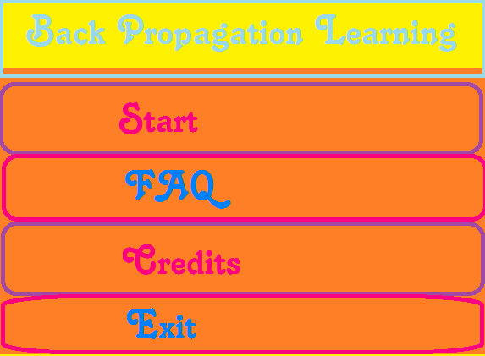
Main Menu

Slide 8
Thank You !

