Slide 1
Microprocessor and Assembly Lab Project
CSE – 2212
Project Name: Bomb Alert!
Sharmin Mahzabin (3)
Melody Soptaka (43)

Slide 2
What about the name?
Okay, the name might be a little confusing to all. But, it’s basically the traditional “Minesweeper” game that almost all of us used to play.

Slide 3
The Basics
There’s a simple 9*9 grid consisting of 81 cells (obvious).
A cell can be in three conditions. It can contain bomb, can be empty or can contain a number.

Slide 4
Basics: Continued
If you’re unlucky, you might click on a bomb-cell on your first try.
If you click on an empty cell, it will continue to discover the empty cells adjacent to it until it finds cells containing numbers.

Slide 5
The Basics: Continued
Now, the numbers you see are the number of bomb-cells adjacent to that numbered cell. Click on the cells keeping the numbers in mind.

Slide 6
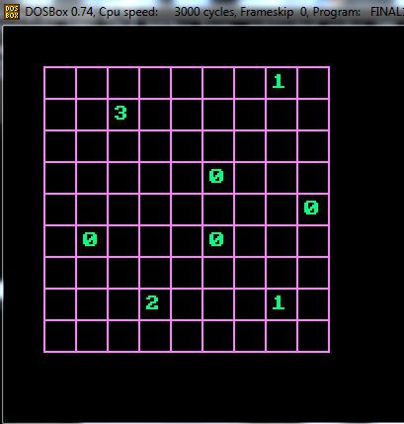
Basics: Continued
Here are the numbered cells we were talking about.

Slide 7
Basics: Continued
So, from the numbers inscribed, you need to discover the safe cells.
When, you find all the safe cells without clicking on any bomb-cells, you win. ☺
Else, you lose. ☹

Slide 8
Screenshots:

Slide 9
Screenshots: Continued

Slide 10
Limitations:
There were a few things we could do a lot better than we did:
We couldn’t randomize the settings of the cells on each round. So there’s a chance one can almost memorize the current settings(after playing for quite some time) and win each time after.

Slide 11
Limitations: Continued
Ar kichu pai na. Pele likhish B|

Slide 12
Gratitude
Thanks to our respected faculties who assigned us the project. It helped us to learn assembly a little better and work with graphics in assembly. Helpful sources:
????? :v :v :v :v :v

