Slide 1
Computer Programming Lab Project
Course:1211
Submitted to:
Dr. Muhammad Asif Hossain Khan
Ms.Anna Fariha
Submitted by:
Sharmin Mahzabin-3
Melody Soptaka-43

Slide 2

Bouncing_Ball: The story behind
// Our game was firstly named “Rapid_Roll” inspired by Nokia’s “Rapid Roll”.
//Then we both agreed that stealing the idea isn’t our thing. So we changed the core idea a bit.
//Instead of moving the ball, we made it bounce.

Slide 3
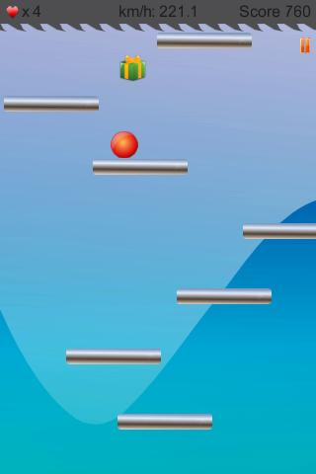
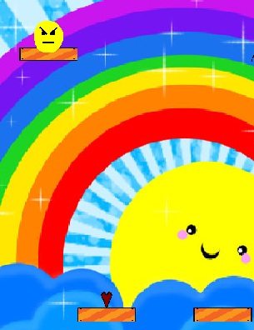
For convenience,
Rapid roll(left) and ours(right)-

Slide 4
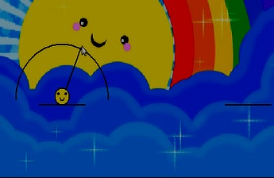
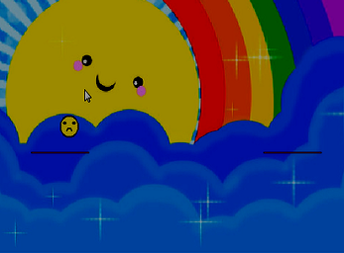
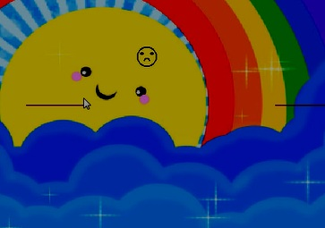

Demonstration:

Slide 5
//Here the main idea is to make the ball jump to the bars near it’s present bar.
//A single mouseclick and the position of the cursor make the ball jump to a direction.
//Of course, there are some difficulties added such as thorns, bombs and also hearts as bonus lives.

Slide 6
“Isn’t it a bit easy?”
Yes, it is, even it’s the simplest game people would make after “snake games”. But we believe it takes quite an effort to put a simple game in a modified manner.
We added some extra features as mentioned in the previous slides and also you might enjoy the different background in our game.

Slide 7
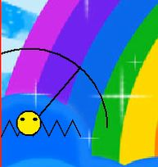
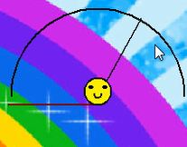


Features:

Slide 8
From the coding perspective:
//Microsoft Visual C++ 2010 compiler was used.
// We used BGI functions to make the game in C++.
// Divided the total code into a few modules that helped us finding any bug if detected.
// Included the libraries we needed.
// We both worked on different modules.

Slide 9
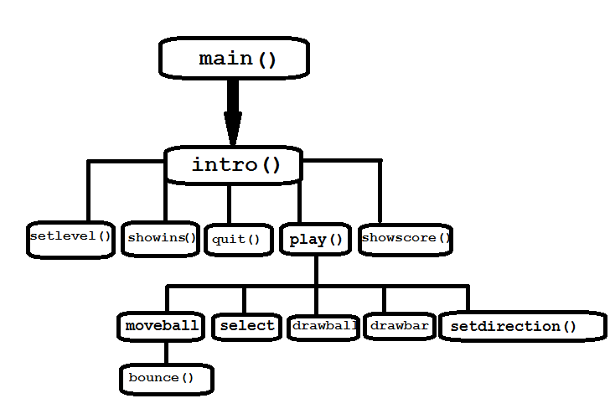
Flow chart:

Slide 10
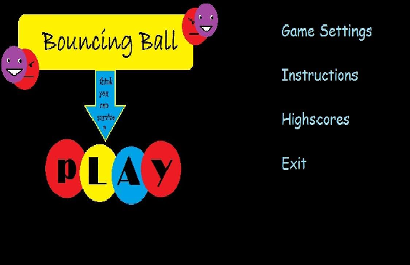
A few screen shots…

Slide 11
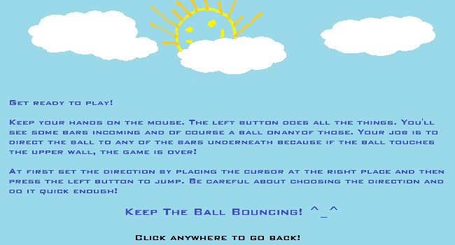
Instructions:

Slide 12
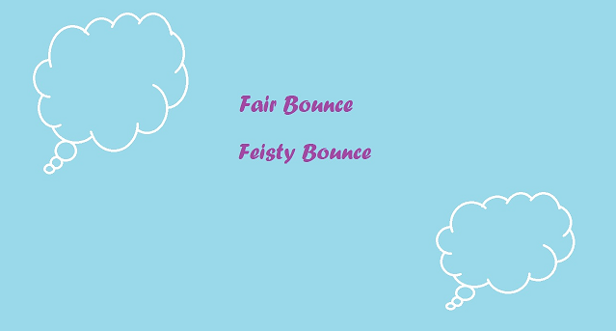

Slide 13
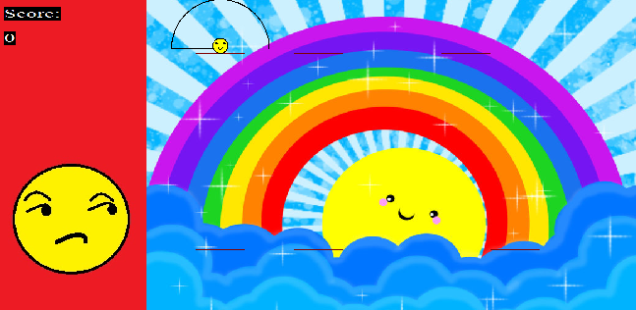

Slide 14
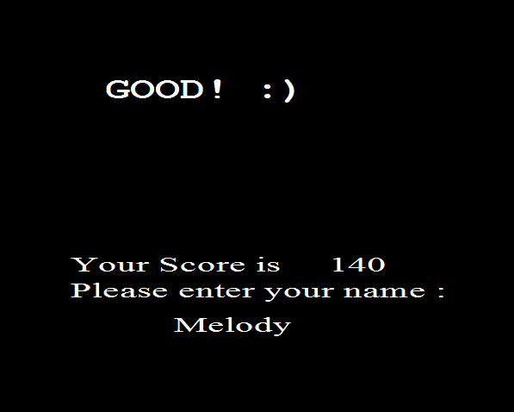

Slide 15
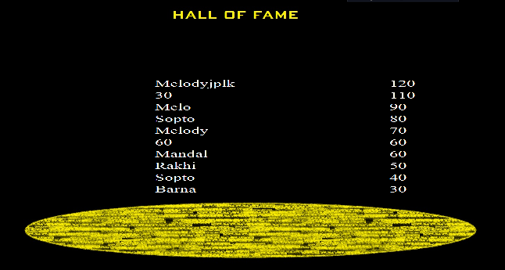

Slide 16
New things to learn…
If we didn’t have to make a project in BGI, we would have never known what can be done by this.
Especially the mouse_moving functions were really amazing! We’ve only seen them in games and now we know how they did it! :D
We learnt to combine coding and graphics together and put up a game like this!
Finally this project made us pretty curious about graphics.

Slide 17
Difficulties that discouraged…
There is always a dark side of every field. Here, after preparing the structure of the game, we found out some bugs-
/* The ball used to vanish at some boundaries.(solved) */
/* Sometimes instead of landing, the ball passed through the bar and ended the game.(solved)*/
The ball blinks too much, causes irritation.

Slide 18

Thank You…

