Slide 1
TB whole-blood transcriptomics: infection, progression, and disease signals
GSE79362 PTB/LTBI and GSE94438 household-contact progression cohort
核心问题
关键比较
主要结论
哪些 whole-blood RNA 信号反映结核发病，而不是单纯暴露或潜伏感染？
GSE79362: LTBI vs PTB；GSE94438: household-contact Control vs PTB/progressor。
两个队列共同指向 IFN、炎症、补体、髓系/中性粒细胞相关通路。
这里的“未感染”需要谨慎：GSE94438 Control 是密切接触者/未进展者，不等价于严格未感染。
GSE79362 更适合回答：在已感染背景下，哪些信号与活动性 TB 相关。
GSE94438 更适合回答：在暴露密接人群中，哪些信号与后续 TB 进展/发病相关。
Prepared from actual curatedTBData analysis outputs in /private/tmp/tb_curated_results

Slide 2
Dataset structure: the two cohorts ask related but not identical biological questions
Dataset | Biological contrast | Labelled n | Site/country | Repeated sampling
GSE79362 | PTB vs LTBI | 355 = 110 PTB + 245 LTBI | South Africa only | Yes: 144 patients; 105 repeated
GSE94438 | PTB/progressor vs household-contact Control | 428 labelled = 101 PTB + 327 Control | Ethiopia / South Africa / The Gambia | Yes: 334 patients; 79 repeated
GSE79362 解释重点
GSE94438 解释重点
分析限制
全体为 South Africa；PTB/LTBI 让我们看见“潜伏感染背景上的活动性疾病信号”。
三国密接队列；site 是优先混杂因素，Control 不是严格健康未暴露人群。
重复采样和采样时间可能影响有效样本量；差异结果需看调整模型敏感性。
GSE94438 GEO total 为 434；curated hg38 也有 434，但 6 个样本缺 TBStatus，因此 labelled analysis 为 428。
GSE79362 curated hg38 保留 355/355。
curatedTBData hg38 reprocessed counts; baseline edgeR unless noted

Slide 3
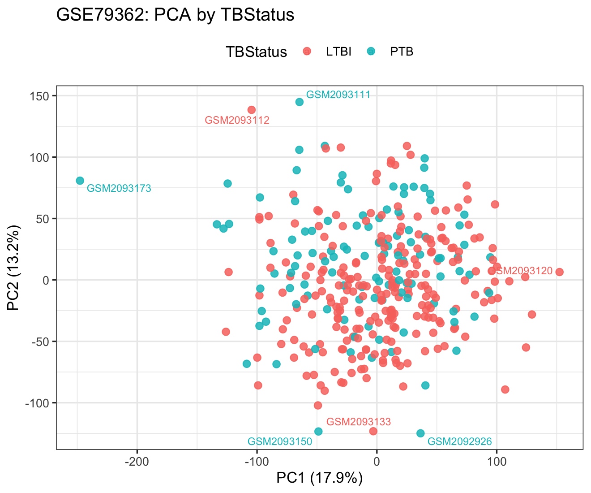
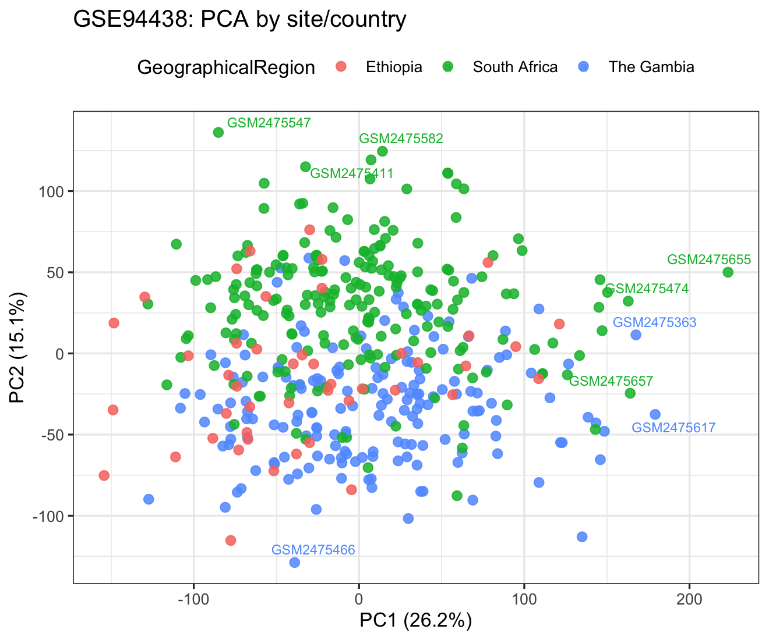
QC: sample-level variation is visible and must be separated from biology
PCA by TBStatus helps assess whether disease/progression is a major source of variance.
GSE94438 must be checked by country/site because geography and population structure can mimic biology.
Library-size and correlation heatmaps were generated as QC outputs; no low-library-size filtering threshold was applied beyond gene-level CPM filtering.
QC plots: library size, PCA by TBStatus, PCA by site/country, sample correlation heatmaps

Slide 4
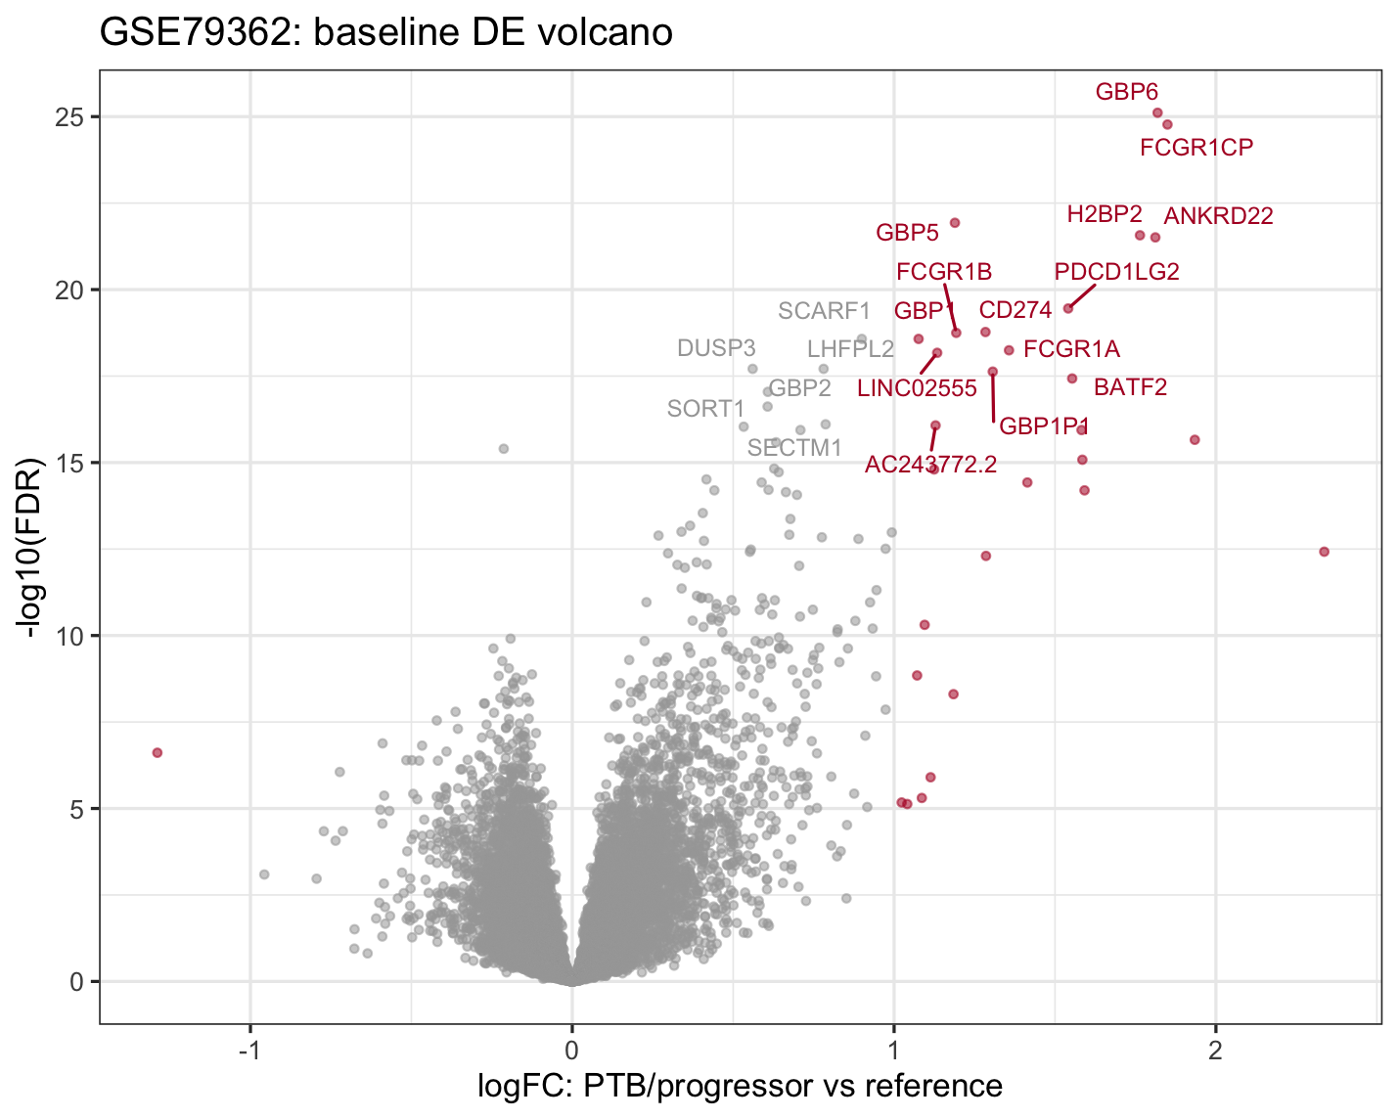
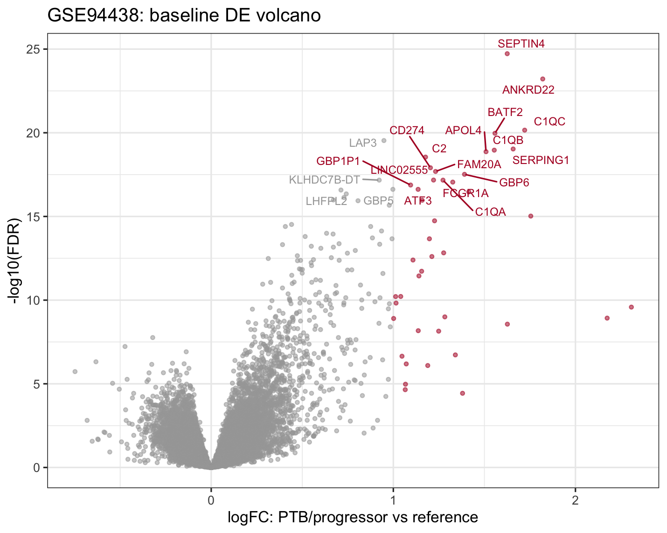
Differential expression: activity/progression is dominated by up-regulated innate immune genes
Dataset | Baseline DEGs | Up | Down | Adjusted sensitivity
GSE79362 | 30 | 29 | 1 | 9 after timepoint + PatientID block
GSE94438 | 43 | 43 | 0 | 41 after site + sex + age
Top disease-associated genes
GSE79362: GBP6, FCGR1CP, GBP5, ANKRD22, PDCD1LG2, CD274, FCGR1B. GSE94438: SEPTIN4, ANKRD22, C1QC, BATF2, SERPING1, C1QB, CD274.
curatedTBData hg38 reprocessed counts; baseline edgeR unless noted

Slide 5
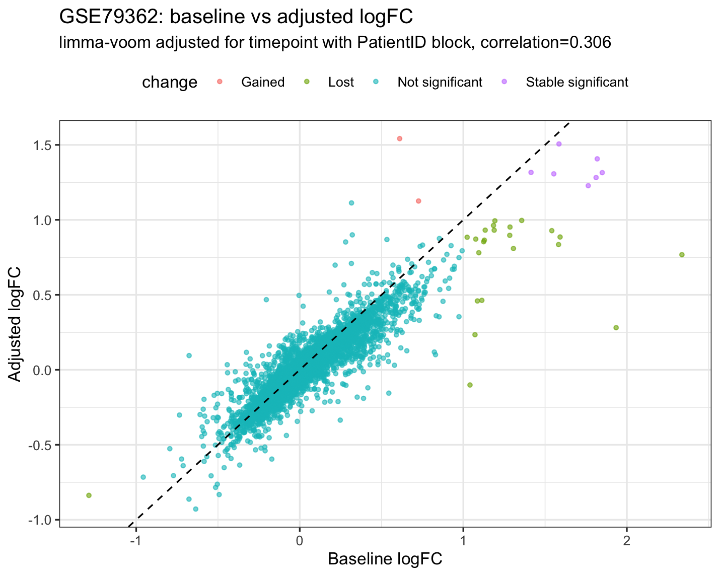
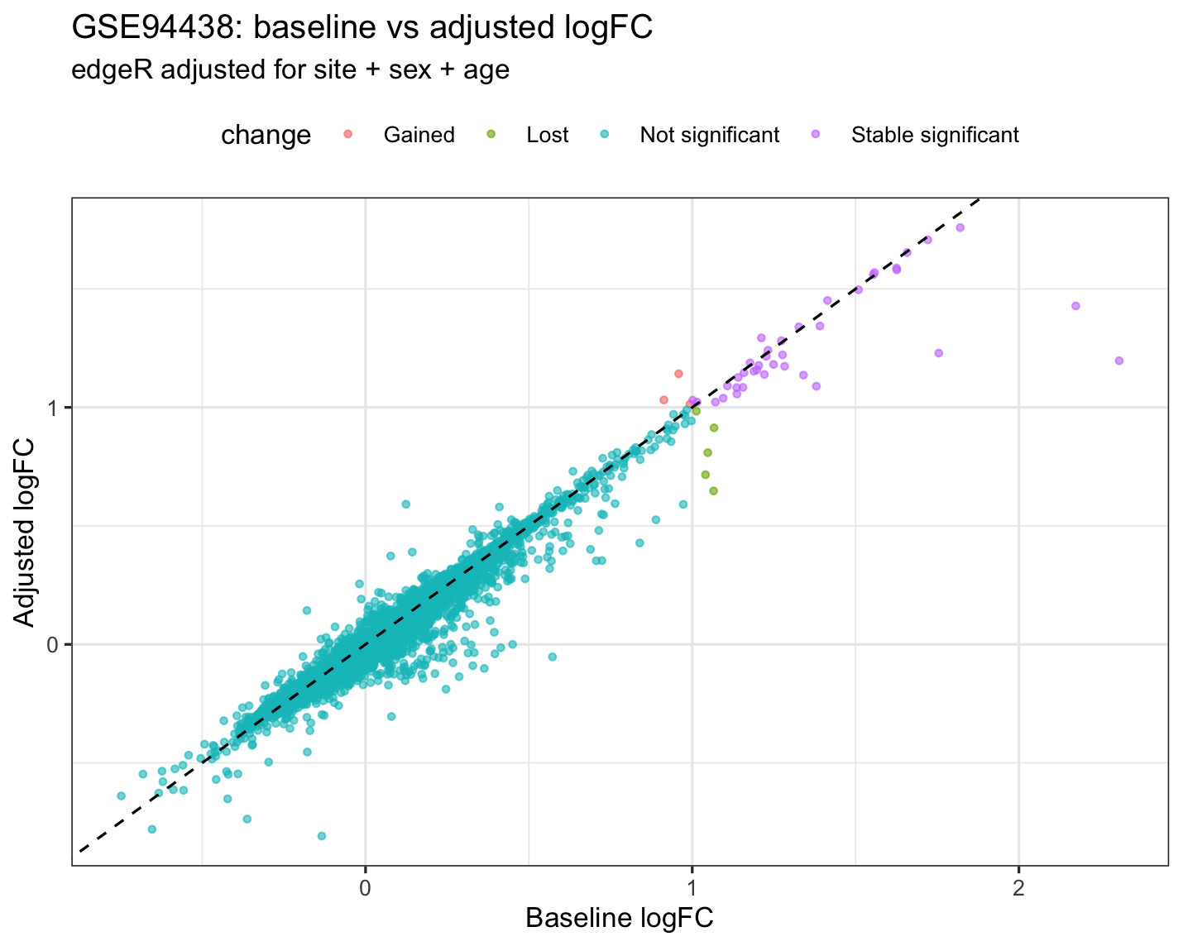
Adjustment matters differently in the two cohorts
GSE79362: repeated longitudinal structure is non-trivial; duplicateCorrelation estimated within-patient correlation ≈ 0.306, and strict DEGs dropped from 30 to 9.
GSE94438: site/sex/age adjustment preserved most disease signal, with strict DEGs 43 to 41.
Interpretation: GSE79362 disease signal is real but sensitive to repeated sampling/time; GSE94438 signal is not simply explained by site.
curatedTBData hg38 reprocessed counts; baseline edgeR unless noted

Slide 6
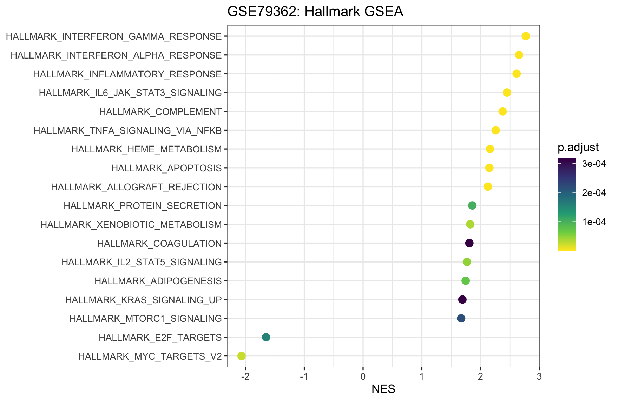
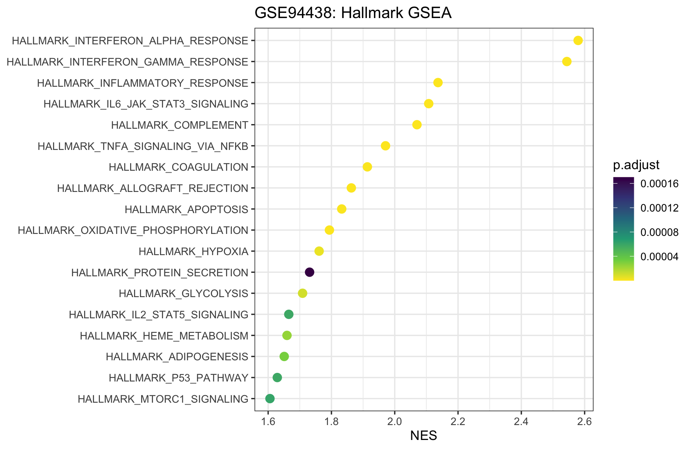
Pathway enrichment: both datasets converge on IFN, inflammation, complement, and innate immunity
Hallmark IFN-α, IFN-γ, inflammatory response, TNF/NFκB, IL6/JAK/STAT3, and complement are strongly positive in both datasets.
These pathways are canonical TB whole-blood signals, but they may reflect leukocyte composition shifts as well as within-cell activation.
GSEA ranking: sign(logFC) × -log10(PValue); FDR values for key Hallmark pathways are extremely small

Slide 7
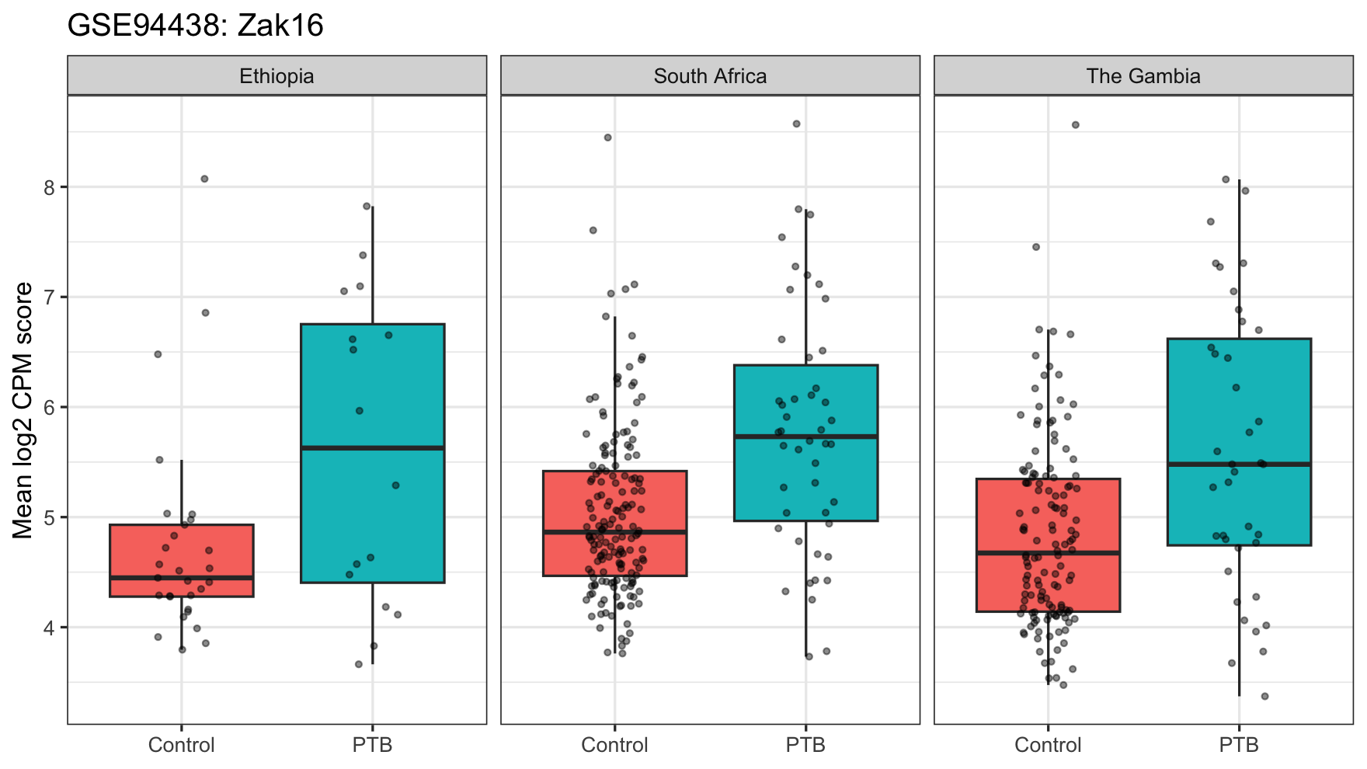
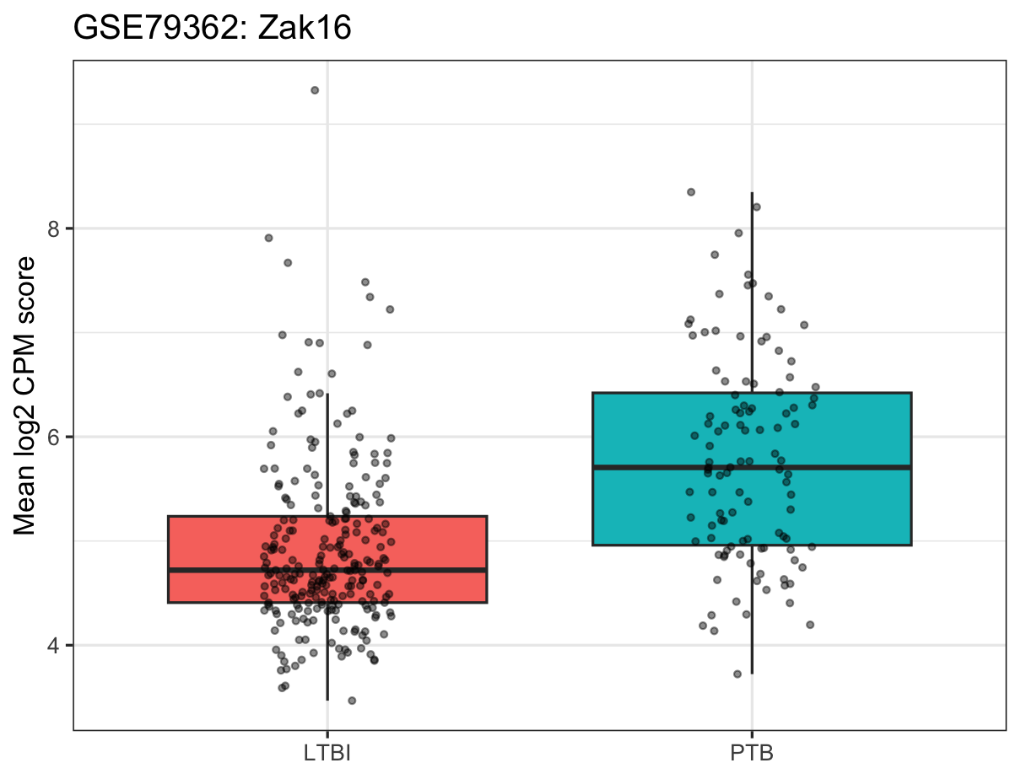
Signature validation: risk scores work better in PTB/LTBI than in household-contact progression
Signature | GSE79362 AUC | GSE94438 AUC | Missing genes
Zak16 | 0.765 | 0.686 | FCGR1B
RISK4 | 0.759 | 0.687 | CDO1
Eleven_gene | 0.771 | 0.694 | FCGR1B
AUC is consistently higher in GSE79362 (≈0.76-0.77) than GSE94438 (≈0.69).
Likely explanation: PTB/LTBI contrast is biologically sharper than predicting progression among heterogeneous household contacts.
GSE94438 site-stratified plots are essential because score distributions vary by country.
curatedTBData hg38 reprocessed counts; baseline edgeR unless noted

Slide 8
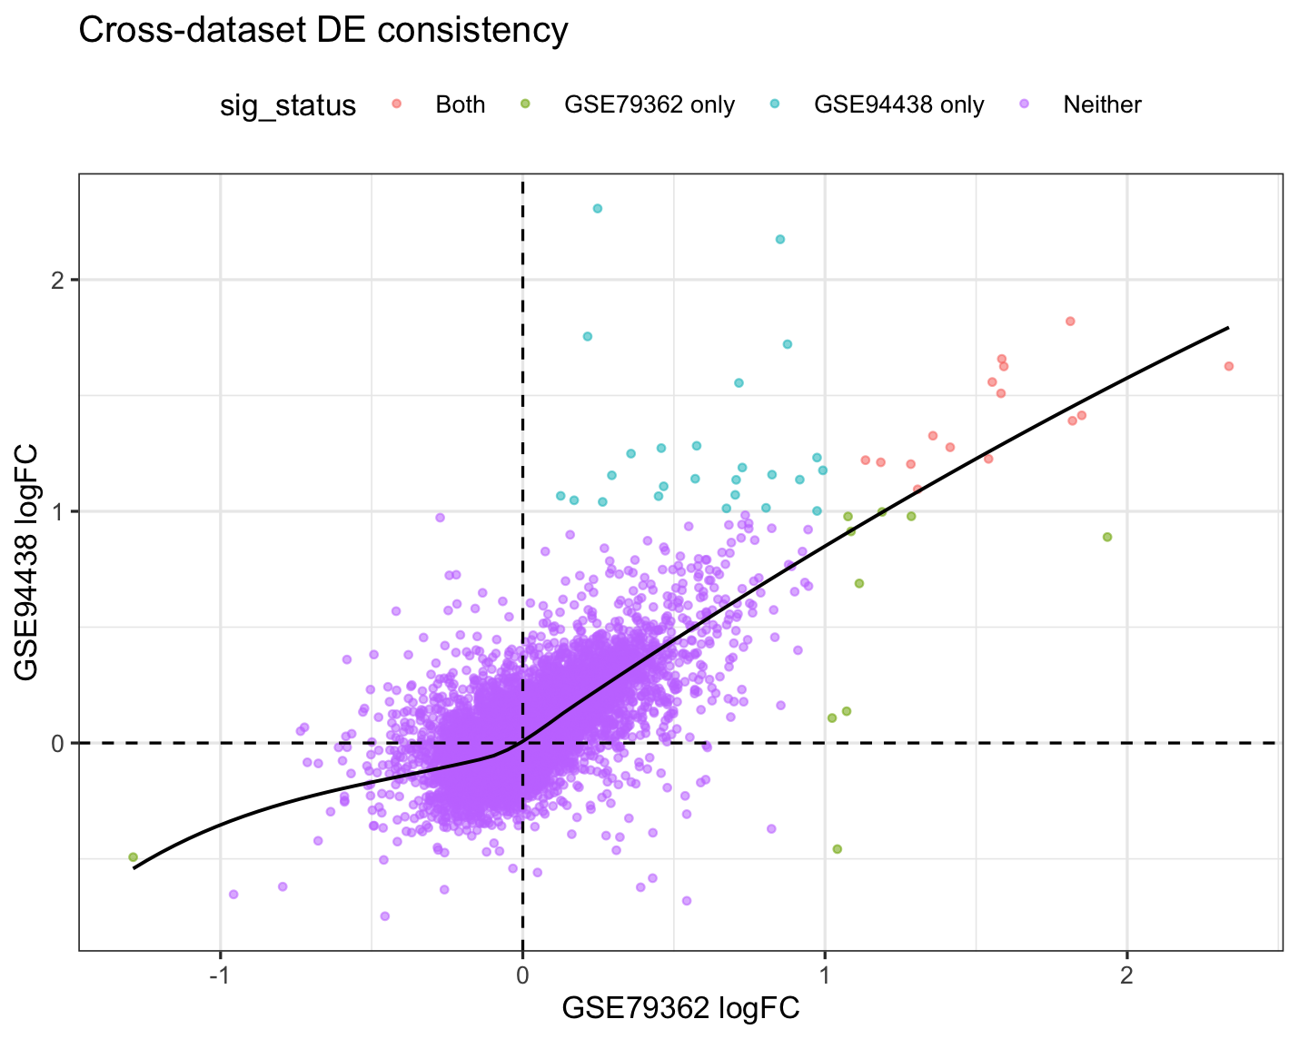
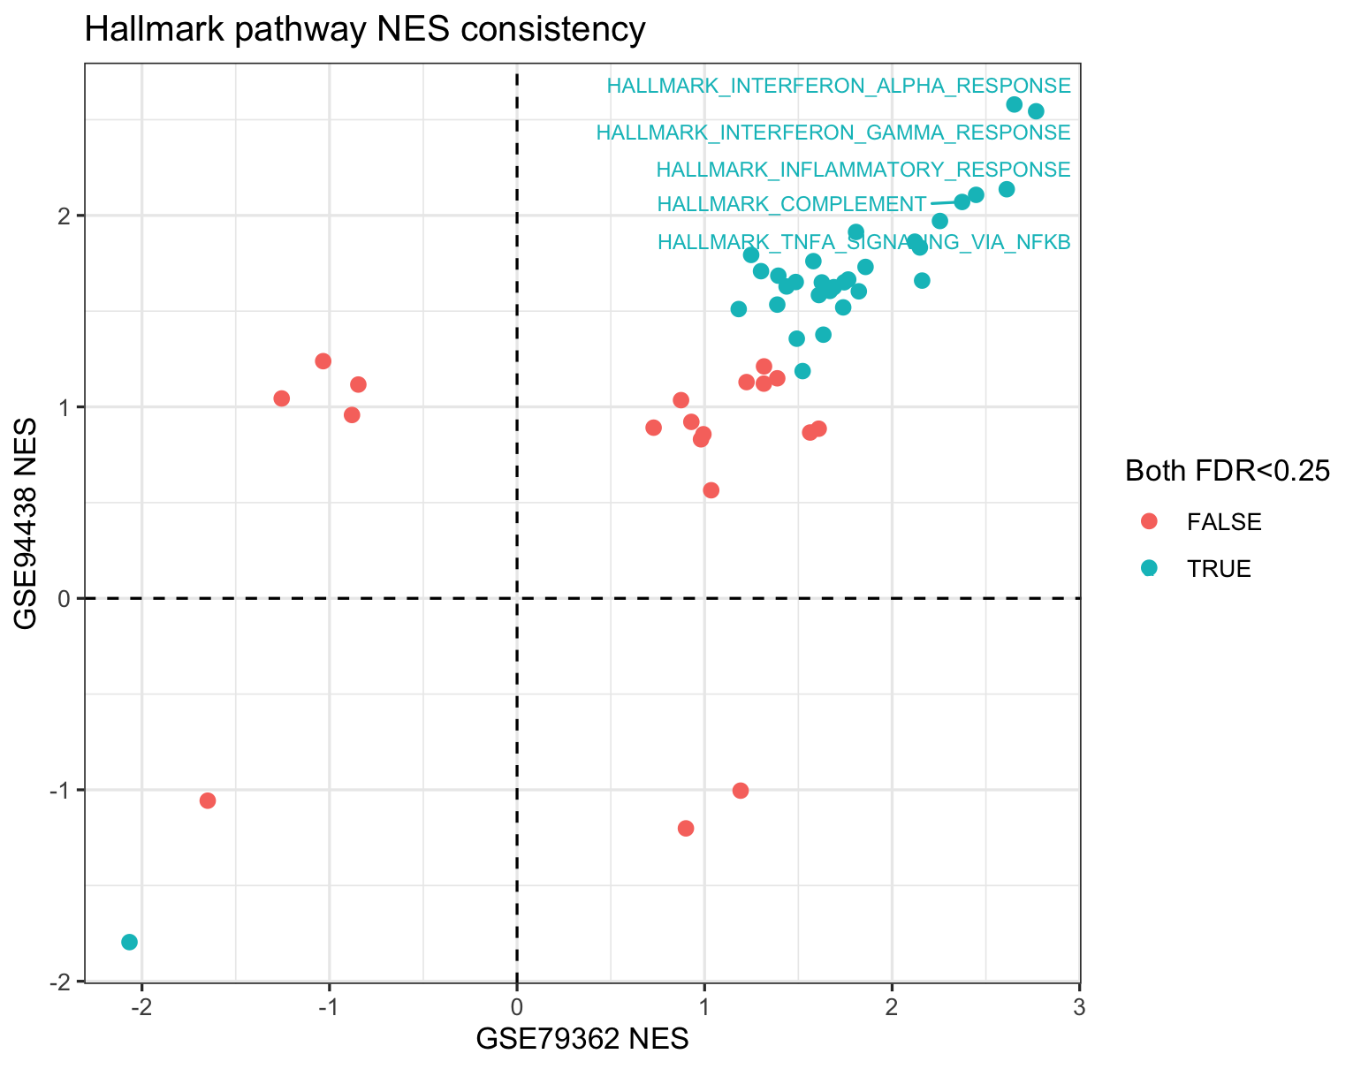
Cross-dataset consistency: pathways agree more strongly than individual genes
Gene-level
Strict DEG overlap
Pathway-level
Shared tested genes: 14,128; logFC Spearman = 0.64
Shared strict DEGs: 15; top-100 overlap: 40
Hallmark NES Spearman = 0.82
curatedTBData hg38 reprocessed counts; baseline edgeR unless noted

Slide 9
Biological interpretation: what is common to infection, disease, and non-progression?
Infected but not diseased / non-progressor
Progression / active TB
Strictly uninfected
LTBI or household-contact Control samples show lower IFN/myeloid/complement score on average; they are not transcriptionally inert, but lack the strong inflammatory disease program.
Common signal: IFN-inducible GBP/ISG genes, antigen/inhibitory checkpoint genes such as CD274, complement C1 genes, and myeloid activation.
Not directly resolved here. GSE94438 controls are exposed household contacts; TST/QFT metadata would be needed to define uninfected subgroups.
共性一：发病/进展状态在两个队列都呈现强 IFN 和 innate immune activation。
共性二：补体和髓系/中性粒细胞通路说明 whole blood 信号很可能受细胞组成影响。
共性三：签名基因表现为连续风险梯度，而不是完美二分类；这符合 TB 从暴露、感染、亚临床到活动性疾病的连续谱。
Do not overinterpret whole-blood DEGs as cell-intrinsic regulation without deconvolution or single-cell validation

Slide 10
Limitations and next analyses
curatedTBData subset: GSE79362 retains 355/355; GSE94438 retains 434 hg38 counts but 6 samples lack TBStatus, leaving 428 labelled samples.
Label definitions differ: GSE79362 is PTB/LTBI, while GSE94438 is household-contact Control/PTB; this affects AUC and DEG interpretation.
Repeated measures matter: GSE79362 adjustment reduced DEGs substantially; baseline-only sensitivity analysis should be considered.
Site/population effect matters most for GSE94438; site adjustment preserved most DEGs but should remain in the final model.
Whole-blood composition is a major caveat; next step should include cell-type deconvolution or validation in sorted/single-cell data.
Take-home message
Across two prospective TB whole-blood RNA-seq cohorts, active/progressive TB is marked by a reproducible IFN–inflammatory–complement–myeloid program; this signal distinguishes disease risk from LTBI/exposed non-progression, but it likely mixes immune activation with leukocyte composition changes.
curatedTBData hg38 reprocessed counts; baseline edgeR unless noted

