Slide 1
TB whole-blood transcriptomics: infection, progression, and active disease
GSE79362 PTB/LTBI and GSE94438 household-contact progression cohort
Central question
Key comparison
Main finding
Which whole-blood RNA signals reflect TB disease rather than exposure or latent infection alone?
GSE79362: LTBI versus PTB. GSE94438: household-contact Control versus PTB/progressor.
Both cohorts converge on interferon, inflammation, complement, and myeloid/neutrophil-associated pathways.
The term “uninfected” should be used cautiously: GSE94438 controls are exposed household contacts or non-progressors, not strictly unexposed healthy individuals.
GSE79362 is best suited to identify active-disease signals on a latent-infection background.
GSE94438 is best suited to identify progression/disease-emergence signals among exposed household contacts.
Prepared from actual curatedTBData analysis outputs in /private/tmp/tb_curated_results

Slide 2
Dataset structure: the two cohorts address related but distinct biological contrasts
Dataset | Biological contrast | Labelled n | Site/country | Repeated sampling
GSE79362 | PTB vs LTBI | 355 = 110 PTB + 245 LTBI | South Africa only | Yes: 144 patients; 105 repeated
GSE94438 | PTB/progressor vs household-contact Control | 428 labelled = 101 PTB + 327 Control | Ethiopia / South Africa / The Gambia | Yes: 334 patients; 79 repeated
How to interpret GSE79362
How to interpret GSE94438
Analytical caveat
All samples are from South Africa; PTB/LTBI primarily captures active-disease biology on a latent-infection background.
This is a three-country household-contact cohort; site is a priority confounder and Control does not mean unexposed.
Repeated sampling and sampling time can inflate the effective sample size; adjusted sensitivity models are therefore essential.
GSE94438 has 434 hg38 count samples in curatedTBData, but 6 lack TBStatus; labelled analyses therefore use 428 samples.
GSE79362 retains 355/355 samples in the curated hg38 matrix.
curatedTBData hg38 reprocessed counts; baseline edgeR unless stated otherwise

Slide 3
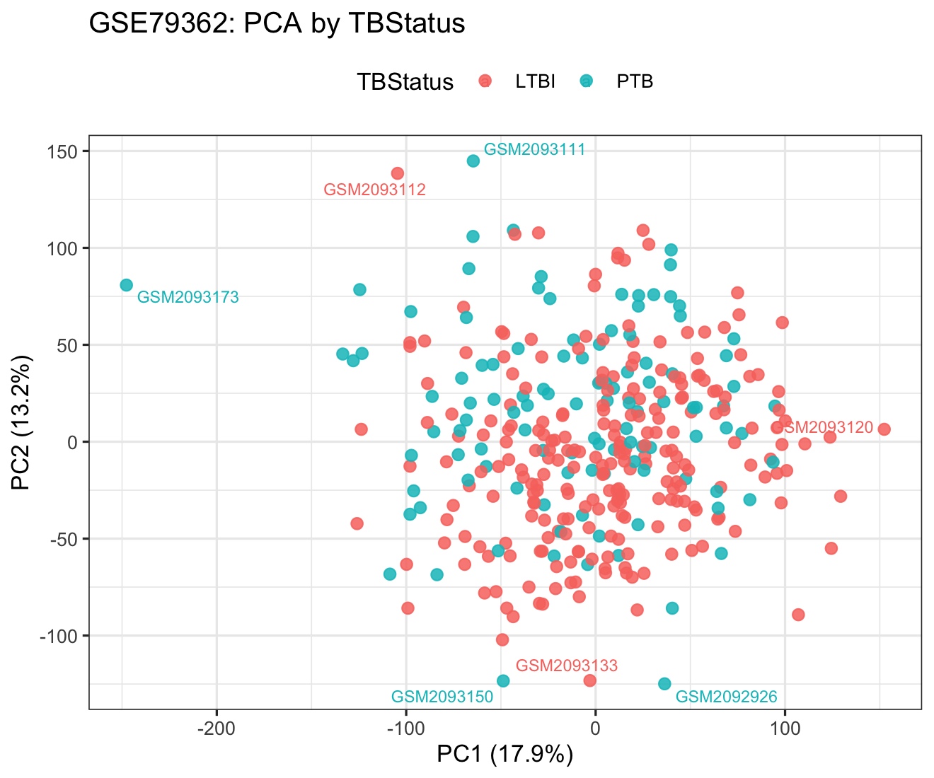
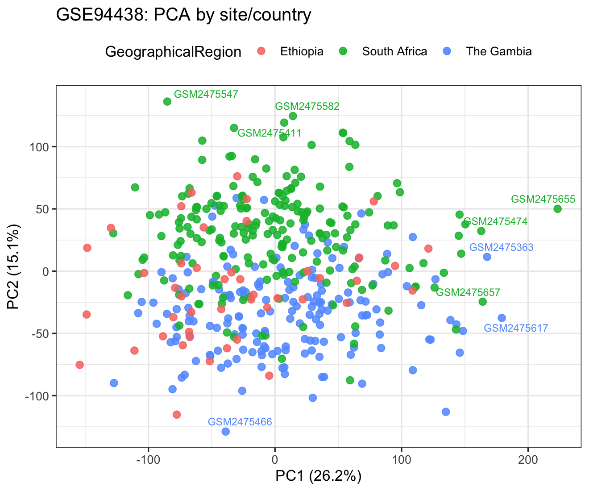
QC: sample-level variation must be separated from biological signal
PCA by TBStatus assesses whether active disease or progression is a major source of variance.
GSE94438 must also be inspected by country/site because geography and population structure can mimic disease biology.
Library-size histograms and sample-correlation heatmaps were generated; gene-level CPM filtering was applied before downstream analyses.
QC outputs: library size, PCA by TBStatus, PCA by site/country, sample-correlation heatmaps

Slide 4
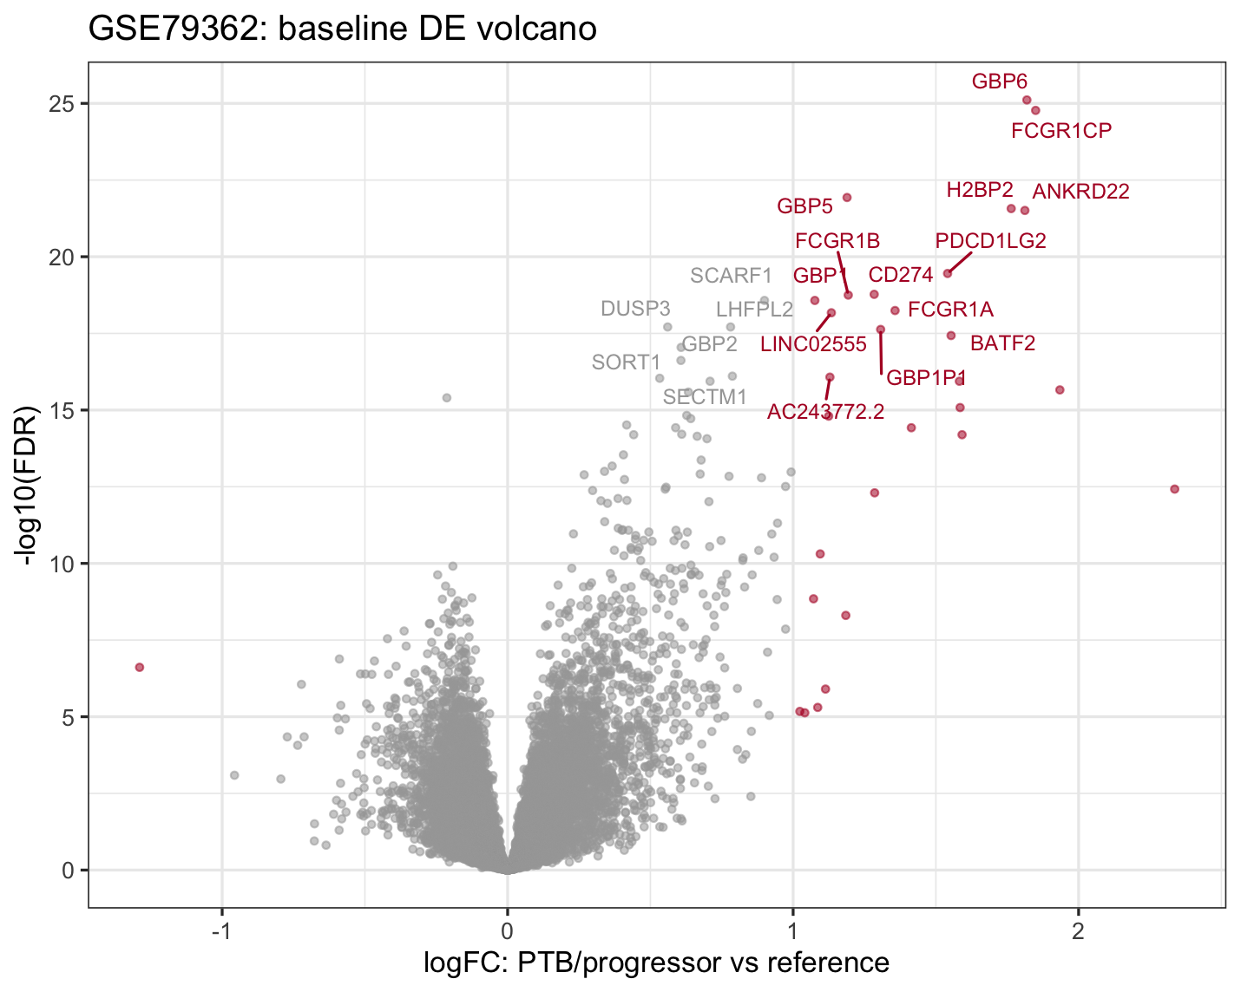
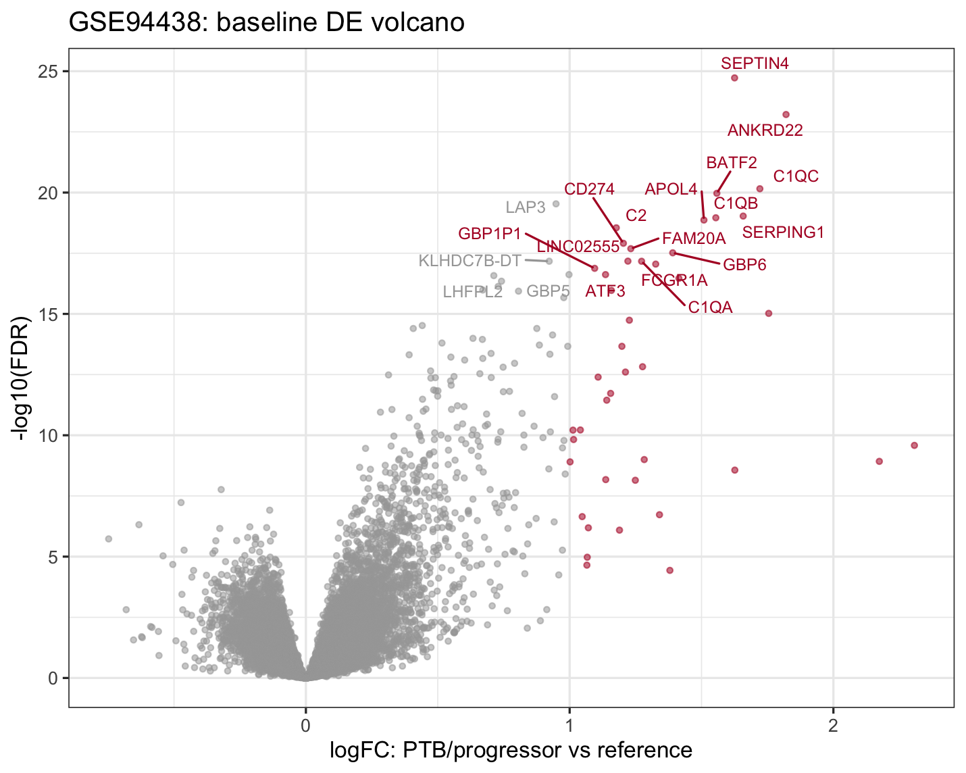
Differential expression: active/progressive TB is dominated by up-regulated innate immune genes
Dataset | Baseline DEGs | Up | Down | Adjusted sensitivity
GSE79362 | 30 | 29 | 1 | 9 after timepoint + PatientID block
GSE94438 | 43 | 43 | 0 | 41 after site + sex + age
Top disease-associated genes
GSE79362: GBP6, FCGR1CP, GBP5, ANKRD22, PDCD1LG2, CD274, FCGR1B. GSE94438: SEPTIN4, ANKRD22, C1QC, BATF2, SERPING1, C1QB, CD274.
curatedTBData hg38 reprocessed counts; baseline edgeR unless stated otherwise

Slide 5
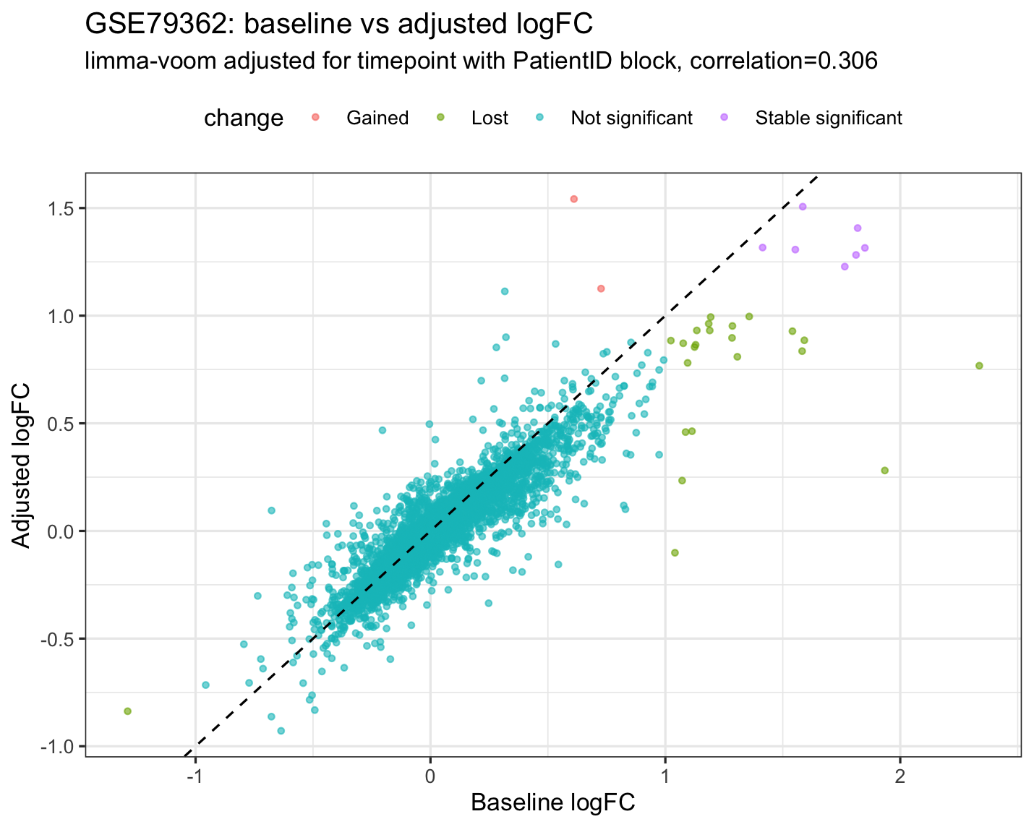
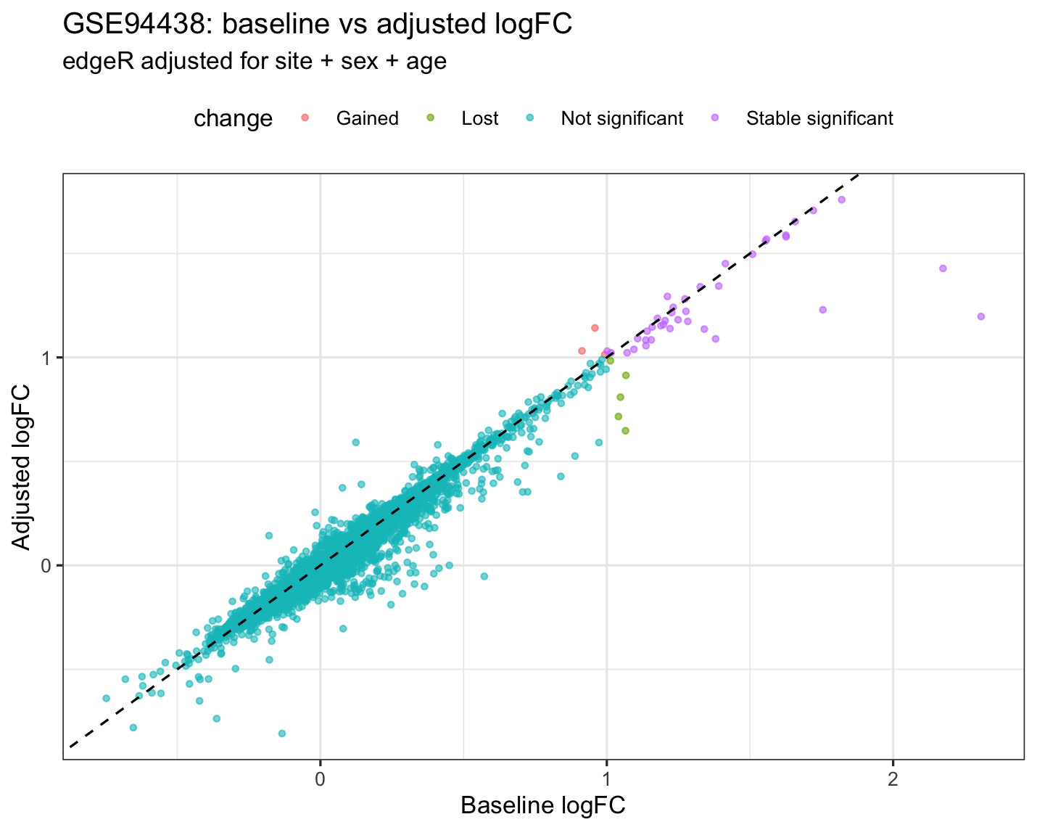
Adjustment affects the two cohorts differently
GSE79362 has a meaningful longitudinal structure: duplicateCorrelation estimated a within-patient correlation of approximately 0.306, and strict DEGs decreased from 30 to 9.
GSE94438 retained most disease-associated signal after adjustment for site, sex, and age, with strict DEGs decreasing only from 43 to 41.
Interpretation: the GSE79362 signal is sensitive to repeated sampling and timepoint, whereas the GSE94438 signal is not simply explained by site.
curatedTBData hg38 reprocessed counts; baseline edgeR unless stated otherwise

Slide 6
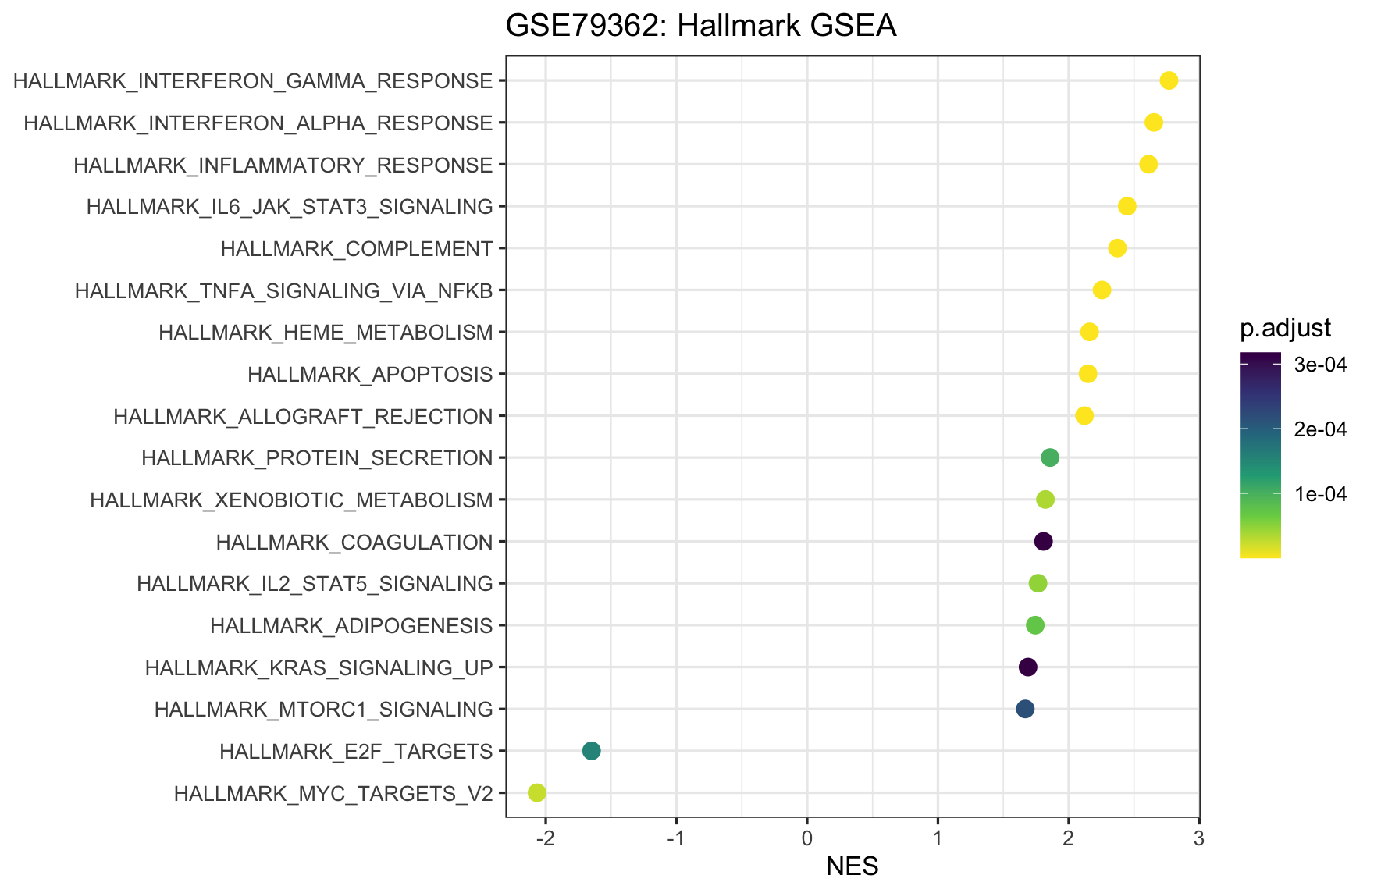
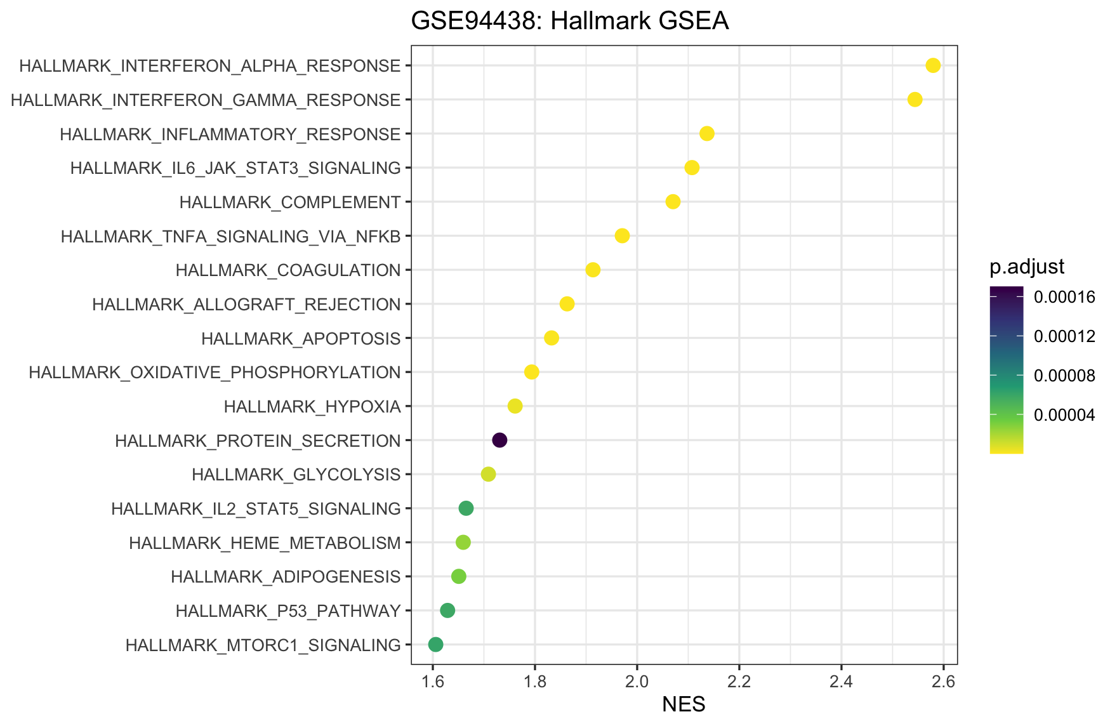
Pathway enrichment: both datasets converge on interferon, inflammation, complement, and innate immunity
Hallmark interferon-alpha, interferon-gamma, inflammatory response, TNF/NF-kB, IL6/JAK/STAT3, and complement pathways are strongly positive in both datasets.
These are canonical TB whole-blood signatures, but they may reflect leukocyte-composition shifts as well as cell-intrinsic activation.
GSEA ranking: sign(logFC) x -log10(PValue); key Hallmark pathways show extremely small adjusted P values

Slide 7
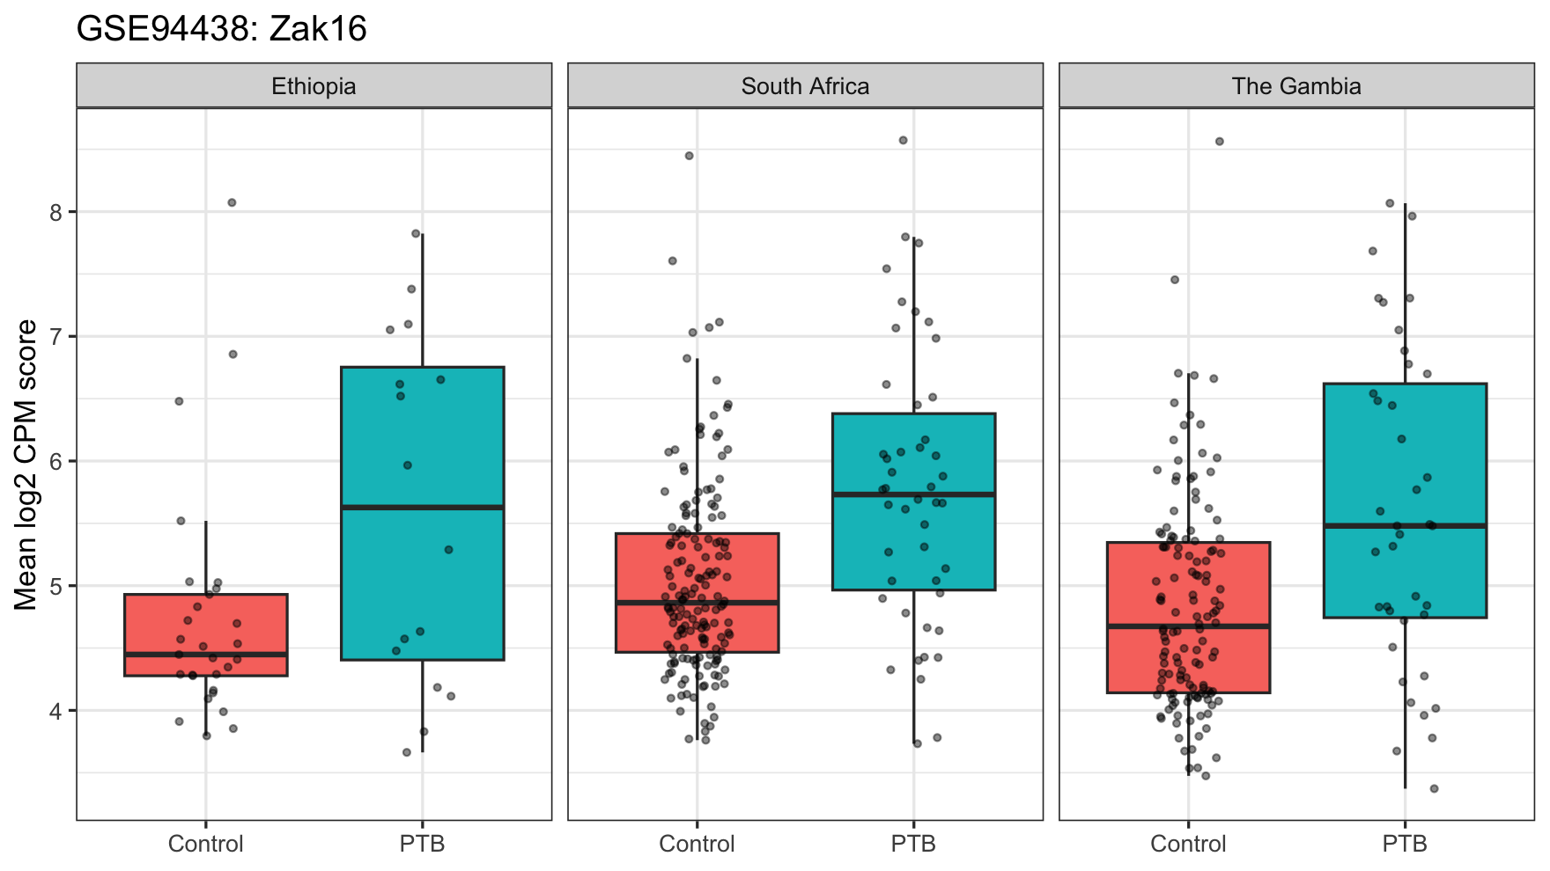
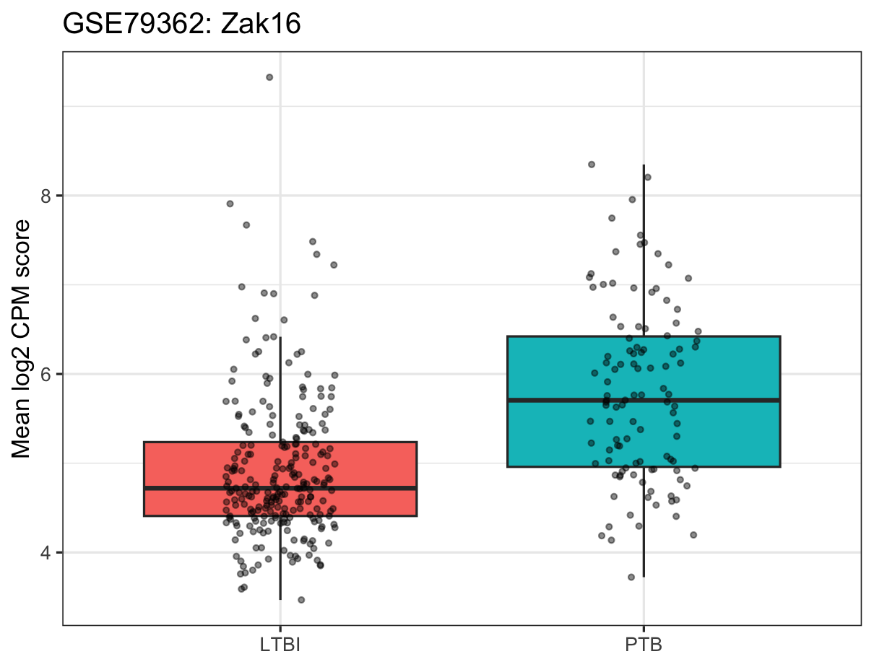
Signature validation: risk scores perform better in PTB/LTBI than in household-contact progression
Signature | GSE79362 AUC | GSE94438 AUC | Missing genes
Zak16 | 0.765 | 0.686 | FCGR1B
RISK4 | 0.759 | 0.687 | CDO1
Eleven_gene | 0.771 | 0.694 | FCGR1B
AUCs are consistently higher in GSE79362, approximately 0.76-0.77, than in GSE94438, approximately 0.69.
This likely reflects a sharper PTB/LTBI contrast compared with the harder task of distinguishing progressors from heterogeneous household contacts.
For GSE94438, site-stratified score plots are essential because score distributions vary by country.
curatedTBData hg38 reprocessed counts; baseline edgeR unless stated otherwise

Slide 8
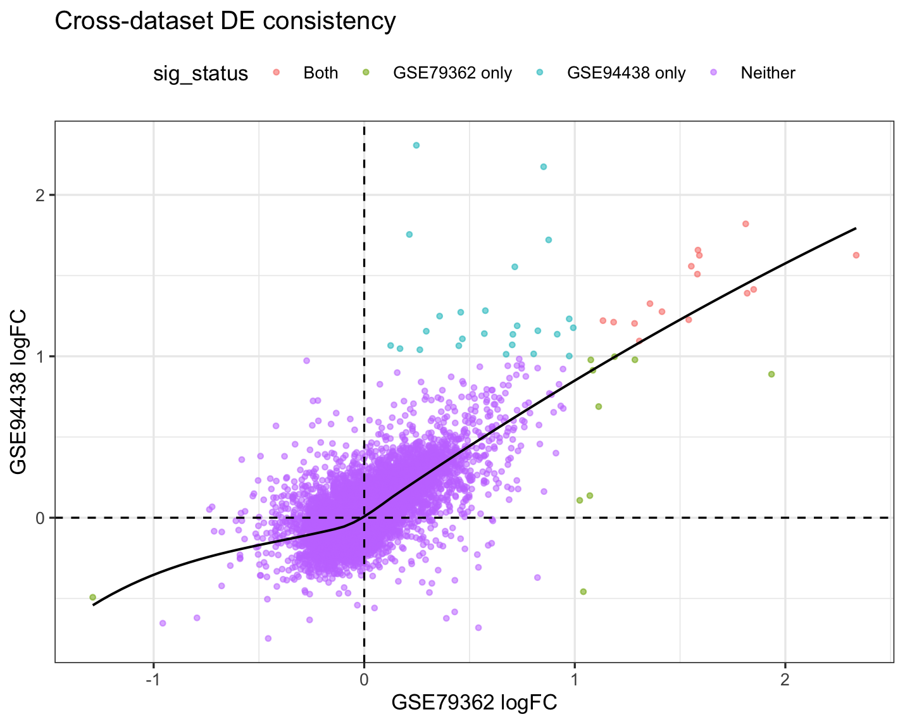
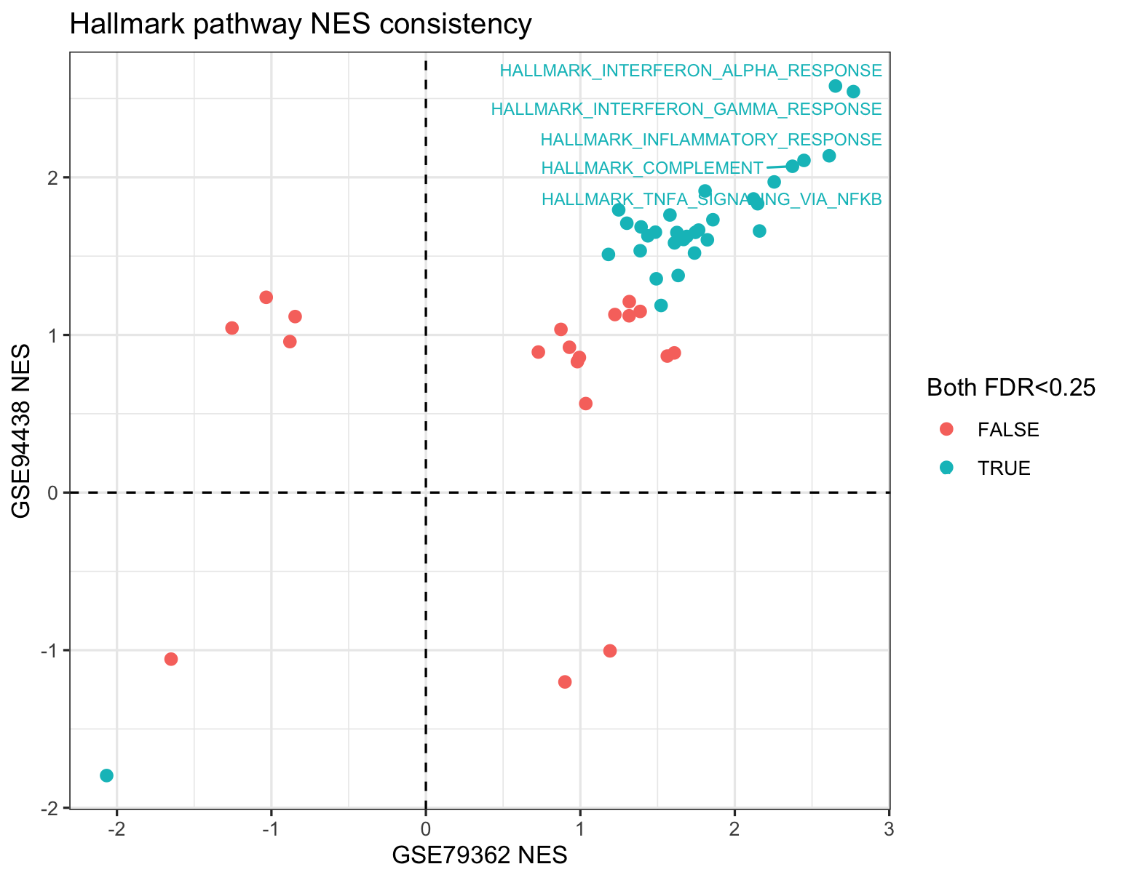
Cross-dataset consistency: pathways agree more strongly than individual genes
Gene level
Strict DEG overlap
Pathway level
Shared tested genes: 14,128; logFC Spearman = 0.64
Shared strict DEGs: 15; top-100 overlap: 40
Hallmark NES Spearman = 0.82
curatedTBData hg38 reprocessed counts; baseline edgeR unless stated otherwise

Slide 9
Biological interpretation: what is shared by infection, disease, and non-progression?
Infected but not diseased / non-progressor
Progression / active TB
Strictly uninfected individuals
LTBI and household-contact Control samples show lower interferon, myeloid, and complement scores on average; they are not transcriptionally inert, but they lack the strong inflammatory disease program.
The shared signal includes interferon-inducible GBP/ISG genes, immune-regulatory genes such as CD274, complement C1 genes, and myeloid activation.
This category is not directly resolved here. GSE94438 controls are exposed household contacts; TST/QFT metadata would be required to define uninfected subgroups.
Commonality 1: active or progressive TB shows strong interferon and innate immune activation in both cohorts.
Commonality 2: complement and myeloid/neutrophil pathway enrichment suggests that whole-blood signals are likely influenced by leukocyte composition.
Commonality 3: signature scores behave as a continuous risk gradient rather than a perfect binary classifier, consistent with the biological continuum from exposure to infection, subclinical disease, and active TB.
Whole-blood DEGs should not be interpreted as cell-intrinsic regulation without deconvolution or single-cell validation

Slide 10
Limitations and next analyses
curatedTBData subset: GSE79362 retains 355/355 samples; GSE94438 retains 434 hg38 count samples but 6 lack TBStatus, leaving 428 labelled samples.
Label definitions differ: GSE79362 is PTB/LTBI, whereas GSE94438 is household-contact Control/PTB; this affects both AUC and DEG interpretation.
Repeated measures matter: adjustment for timepoint and patient blocking substantially reduced GSE79362 DEGs; a baseline-only sensitivity analysis should also be considered.
Site and population effects are especially important for GSE94438; site adjustment preserved most DEGs but should remain in the final model.
Whole-blood composition is a major caveat; the next step should include cell-type deconvolution or validation in sorted-cell/single-cell data.
Take-home message
Across two prospective TB whole-blood RNA-seq cohorts, active or progressive TB is marked by a reproducible interferon-inflammatory-complement-myeloid program; this signal distinguishes disease risk from LTBI or exposed non-progression, but it likely combines immune activation with leukocyte-composition changes.
curatedTBData hg38 reprocessed counts; baseline edgeR unless stated otherwise

