Slide 1
Evaluation of Document Efficacy for Vocabulary Improvement using Lexical Analysis
Melody Swen – Perl for Bioinformatics 1st Term

Slide 2
Application
Description: given a list of words unique to a certain category of documents
Checks how well the documents match up to the list
Compares them
Outputs a match frequency
Good for vocabulary learning, and can easily be adapted a completely different field
E.g. medical terms, law terms, key words in philosophy, religion, health

Slide 3
Usage
Can be used with any Latin Alphabet language (English, German, French, etc.)
Example: finding a book in a foreign language, matching difficult vocab list to different books to find the most suitable one
Example: filtering out books with inappropriate language
Example: finding books with vocabulary appropriate for a certain school grade or vocabulary level
Example: conducting literature review on a number of files with a list of keywords

Slide 4
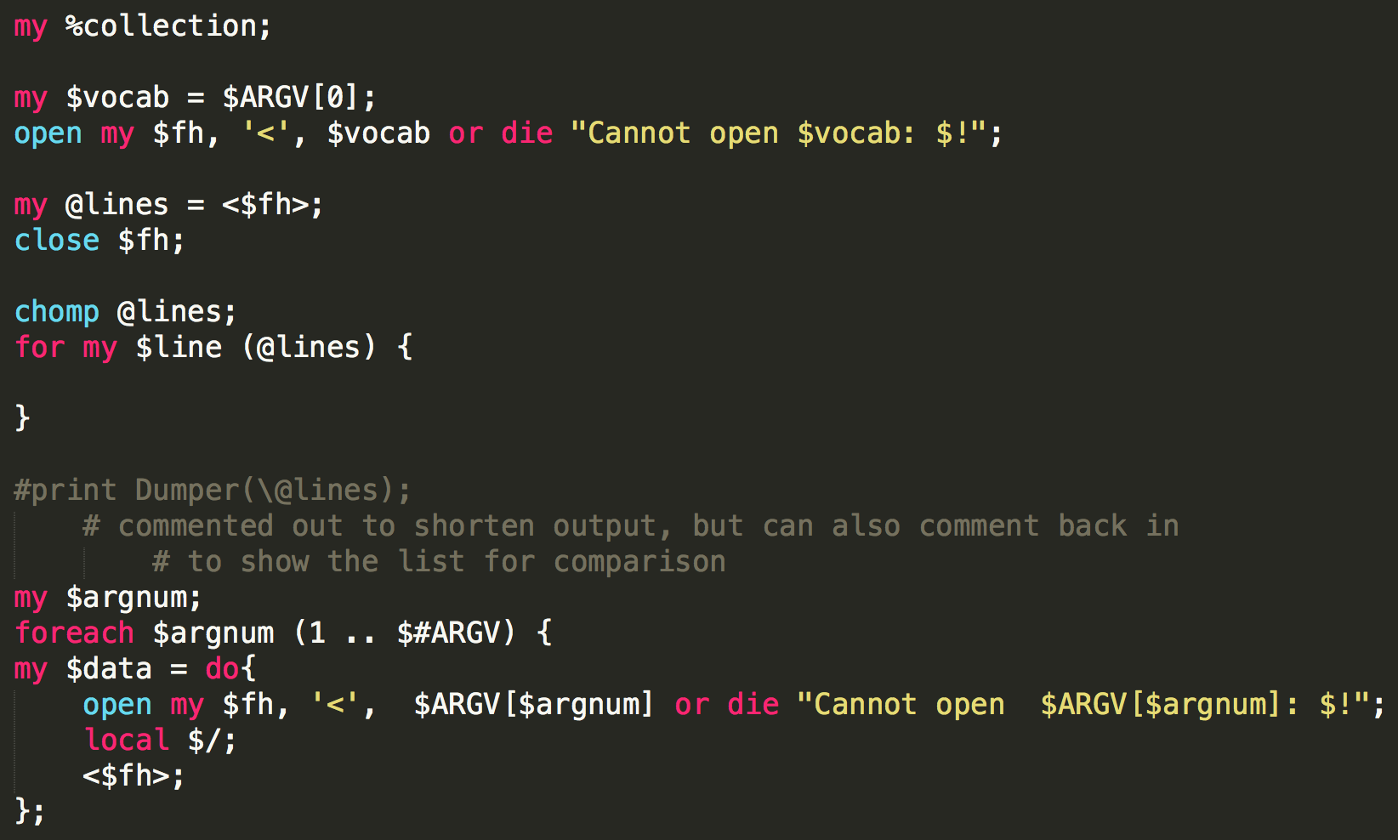
Command Line
$ARGV[0] = document is split into list with one per line in array
(1 .. $#ARGV) = takes as many documents as needed and looks for matches in $ARGV[0] document.

Slide 5
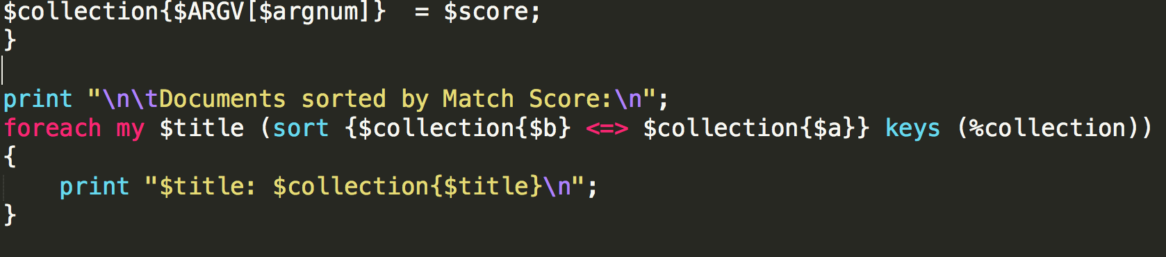
Hash for Match Scores
Key:Value = Document:Match Score are stored in empty hash, %collection
Reverse listed

Slide 6
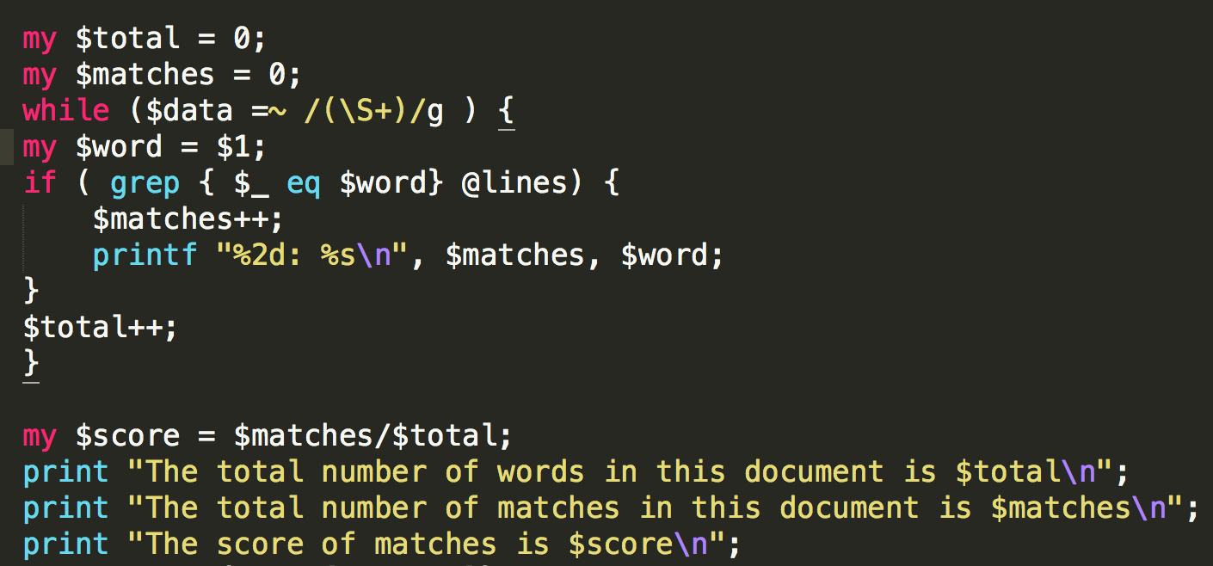
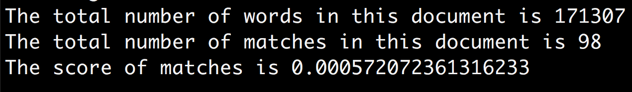
Match Scores

Slide 7
Examples to run
>perl projectms.pl french.txt abbadie.txt
Short French vocab list, Douze Ans dans la Haute Éthiope by Abbadie
>perl projectms.pl words.txt dracula.txt andersen.txt
SAT vocab list, Dracula, Andersen’s Fairy Tales
>perl projectms.pl words.txt dracula.txt pride.txt
SAT vocab list, Dracula, Pride & Prejudice

Slide 8
Future Development
Add a way to read in text from PDF files – more useful for literature reviews
Add functionality for character languages like Chinese, Korean, etc.
Add functionality for n-grams
Right now, the code takes 1-grams (single word = 1 gram)
N-grams would allow for sentences or phrases – search for n-grams of different sizes in the script

