Slide 1
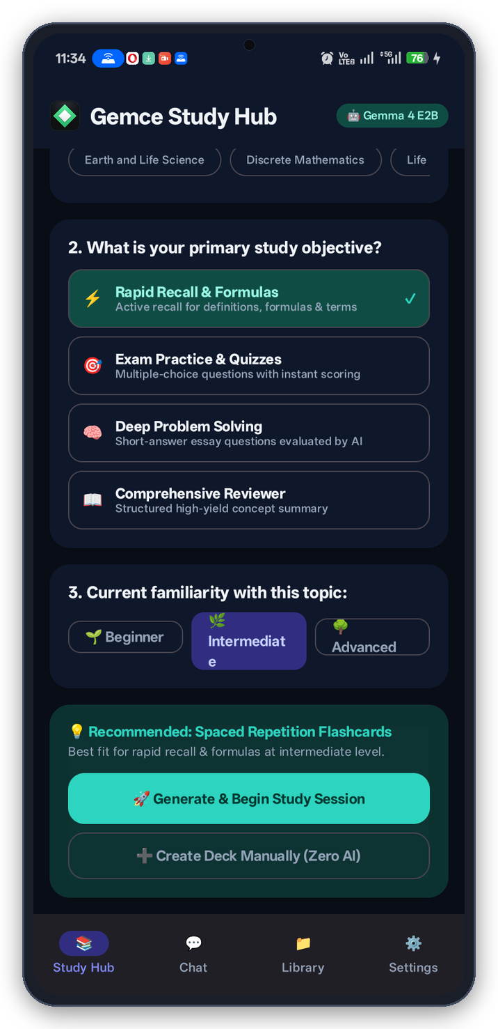
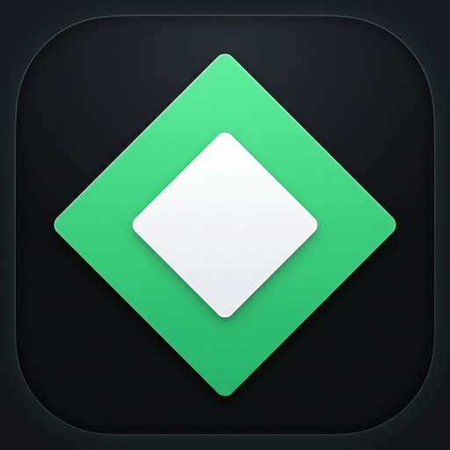
Gemce
AI study buddy that works anywhere you go.
The 100% offline, privacy-first Android study platform powered by on-device Google Gemma 4 E2B via LiteRT-LM. Eliminating the connectivity divide in education.
🔒 100% Offline
⚡ Gemma 4 E2B
📚 Verbatim Citations
🧠 SuperMemo SM-2

Slide 2
01 · PROBLEM & SOLUTION
Why Cloud AI Fails — And How Gemce Solves It
Eliminating connectivity barriers, recurring paywalls, and privacy risks.
❌ The Problem: Cloud AI Limitations
• Fails in Airplane Mode: Cloud AI drops immediately in transit, dorms, or rural areas.
• Cost Barriers: $20/month subscriptions lock out everyday students.
• Privacy Concerns: Uploads private notes and school materials to cloud servers.
✅ The Solution: Gemce On-Device AI
• 100% Local Inference: Runs Google Gemma 4 on-device with zero data connection.
• Free & Sovereign: No subscriptions, no telemetry, and complete data privacy.
• Verifiable Proof: Every card and question cites exact sentences from student notes.
💡 Fundamental Principle: Quality academic assistance should never depend on mobile data or costly subscriptions.

Slide 3
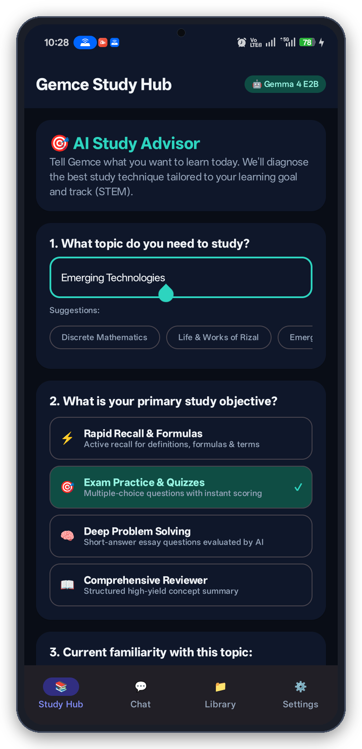
02 · ADAPTIVE STUDY HUB
Personalized Study Paths Tailored to Your Goals
Diagnoses student intent and calibrates academic rigor, grade levels, and language.
🎯 Goal-Oriented Learning Modes
• Diagnoses study intent: Rapid Recall, Exam Practice, Deep Problem Solving, or Reviewers.
• Automatically prescribes optimal study formats based on topic familiarity.
🎓 Academic Level & Major Calibration
• Calibrates technical depth from Junior/Senior High tracks to specialized College majors.
• Tailors difficulty for Accountancy, Nursing, Engineering, CS, and Humanities.
🌐 Multilingual Academic Mentoring
• Speaks English, Filipino (Tagalog), Taglish, and Cebuano (Bisaya).
• Explains tough concepts in the student's natural, conversational tongue.

Slide 4
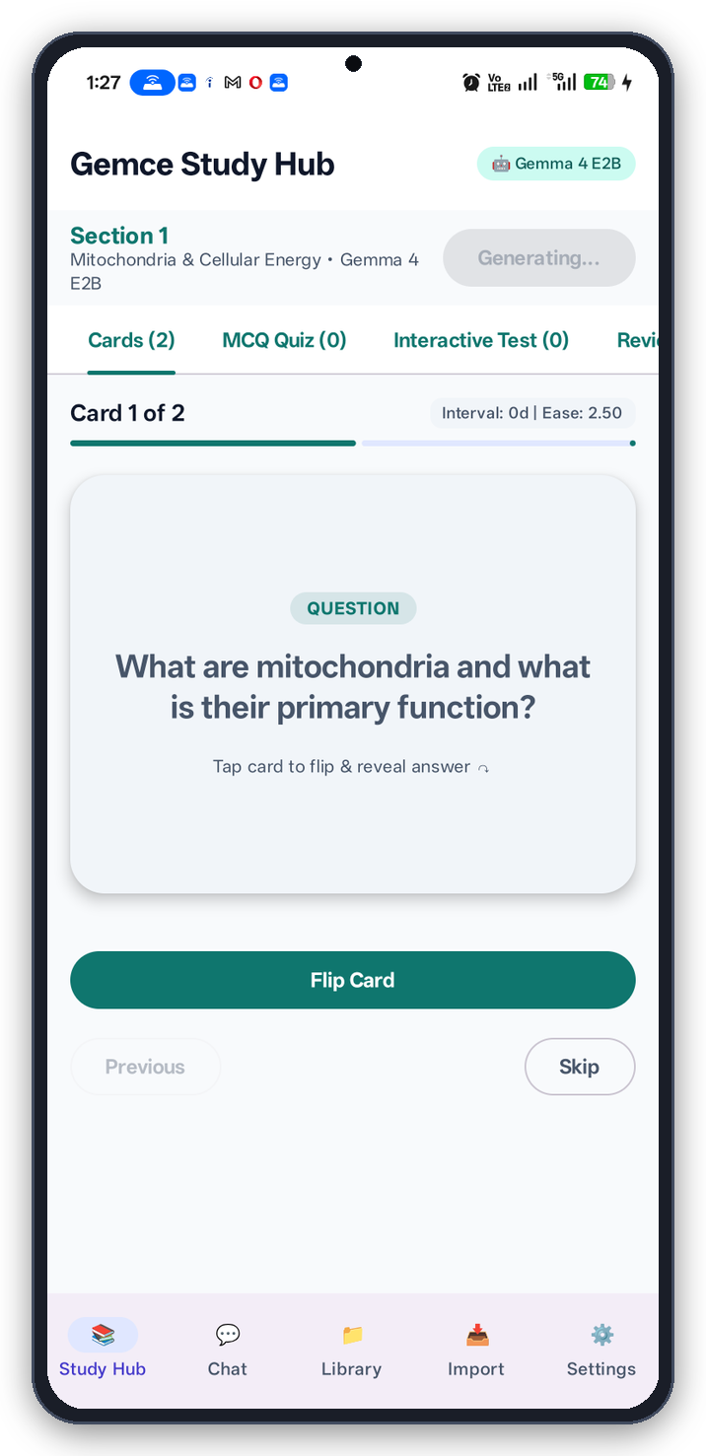
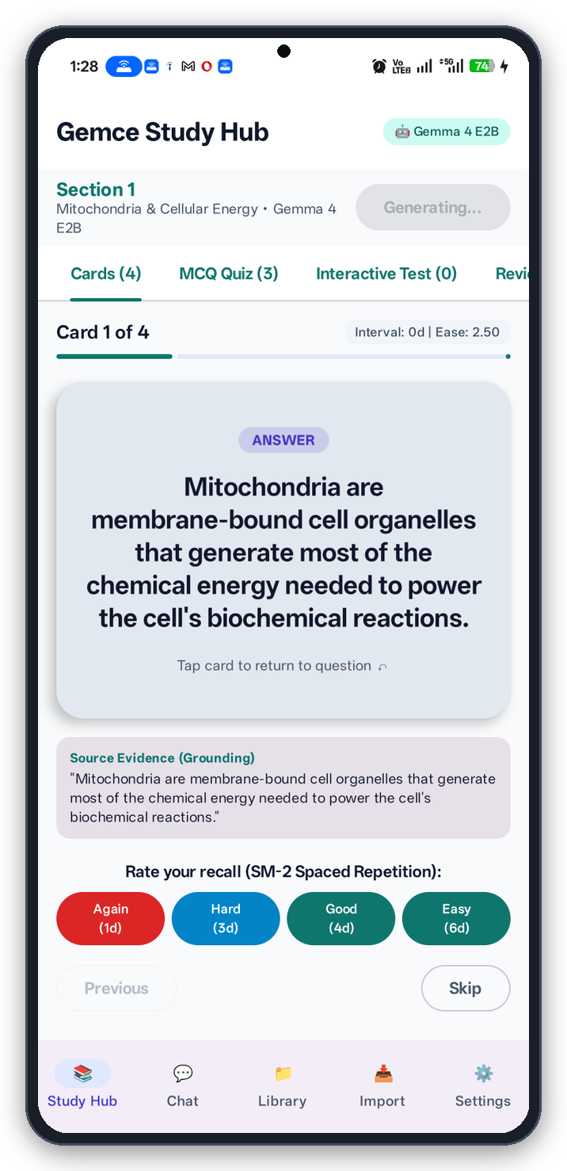
03 · ACTIVE RECALL
Evidence-Grounded Flashcards with SuperMemo SM-2
Spaced repetition paired with zero-hallucination source grounding.
🧠 SuperMemo SM-2 Spaced Repetition
• Dynamically schedules review intervals (Again, Hard, Good, Easy).
• Optimizes long-term memory retention before examinations.
🚫 Strict Anti-Hallucination Prompts
• Forbids generic meta-questions like 'What did the user intend to study?'.
• Tests concrete academic mechanisms: Mitochondria, ATP synthesis, rock types.
📖 Verbatim Source Provenance
• Highlights verbatim source sentences on the card back.
• Guarantees 100% factual accuracy with zero AI hallucinations.

Slide 5
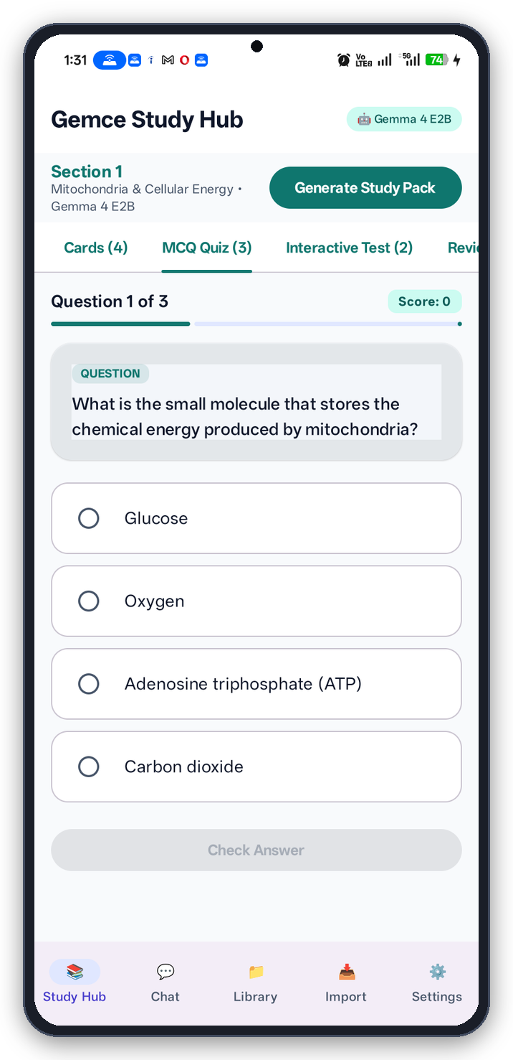
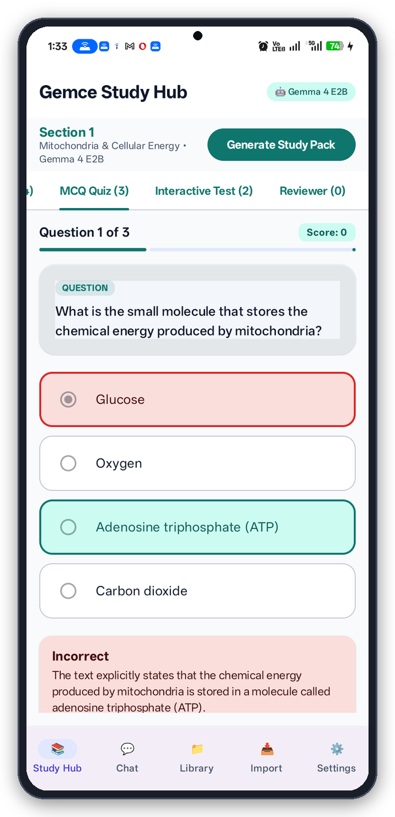
04 · EXAM PREPARATION
Interactive Practice Quizzes & Instant Evaluation
4-option MCQs with instant scoring and explanatory rationales.
🎯 4-Option Multiple Choice Assessments
• Rigorous MCQs testing conceptual mastery and analytical discrimination.
• Challenges students to apply principles rather than passively re-read.
⚡ Instant Grading & Rationale Explanations
• Instantly highlights incorrect selections in red and correct choices in teal.
• Explanatory rationale box details the exact conceptual reason.
📚 100% Material Grounding
• Every question, distractor, and rationale derives directly from student notes.
• Eliminates invalid test keys and erroneous study facts.

Slide 6
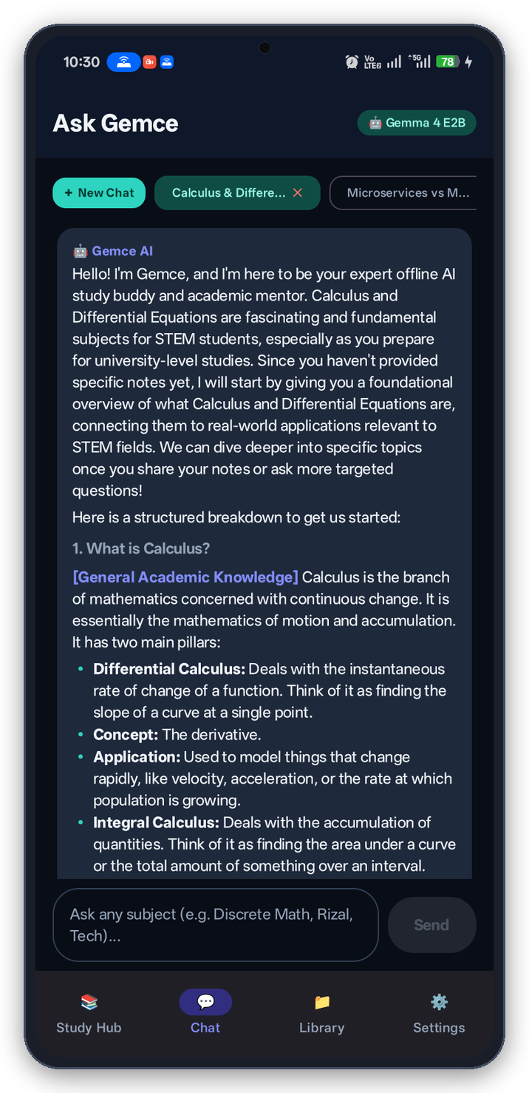
05 · INTERACTIVE TUTORING
Real-Time Academic Mentor in Airplane Mode
On-device conversational AI explaining complex mechanisms on demand.
🌍 Universal Multidisciplinary Grounding
• Mentors across STEM, Calculus, Discrete Math, History, Rizal, Law, and Medicine.
• Unpacks tough mechanisms with step-by-step conceptual walkthroughs.
📑 Rich Markdown & Code Formatting
• Native Jetpack Compose formatting with tables, bulleted lists, and formulas.
• Clean visual hierarchy avoids overwhelming walls of plain text.
💾 Multi-Session Local Memory & Tabs
• Conversation history persisted securely on device with quick topic tabs.
• Complete data privacy: student questions never leave device memory.

Slide 7
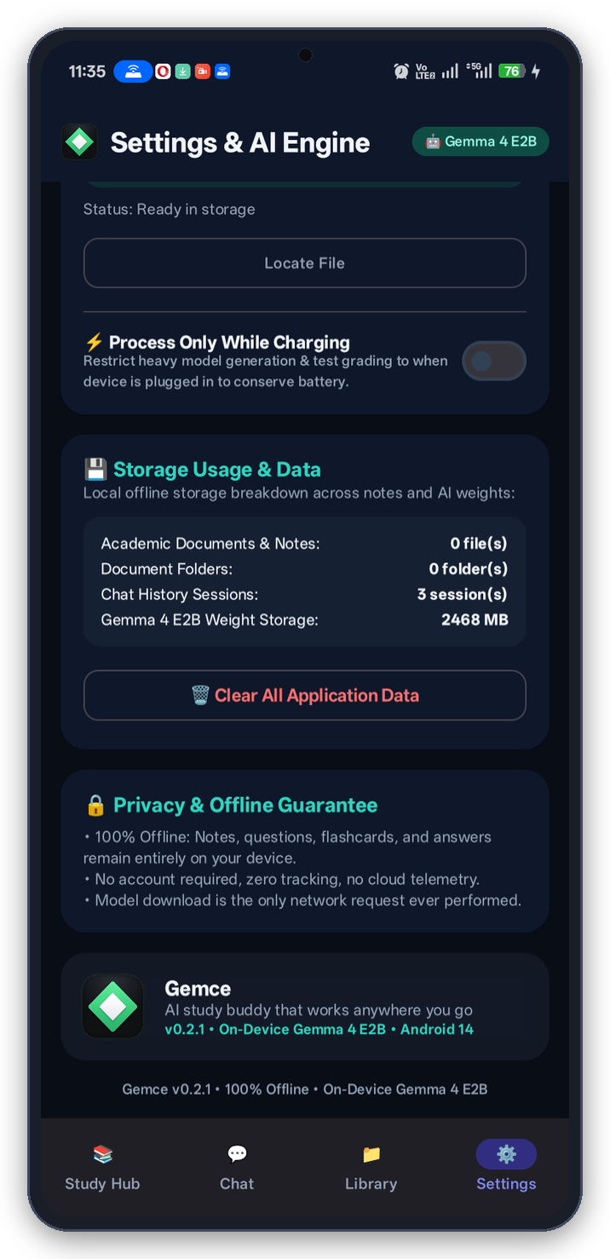
06 · ARCHITECTURE & ROADMAP
Engineered for Performance, Ready to Deploy
Native Android architecture powered by Google LiteRT-LM and open-source delivery.
🤖 Google LiteRT-LM & Gemma 4 E2B
• Quantized 2.4 GB weights executed on-device with OpenCL / Adreno GPU acceleration.
• Sub-second latency with smooth streaming generation entirely offline.
🎨 Native Jetpack Compose & Offline Room DB
• 100% modern Kotlin with Material 3 and packaged typography (Calibri, Serif, Mono).
• Offline OCR via ML Kit v2 and pure local PDF ingestion.
📲 Shipped MVP & Public GitHub Distribution
• Verified on Android 14 hardware (OPPO Reno12 F 5G).
• Public Repository: github.com/meloervy/appbuild.gemce with installable APK.

